Slide 1
AN EMBEDDED SYSTEM FOR AUTOMATIC NUMBER PLATE RECOGNITION(ANPR)AND AUTHENTICATION
Project By
Viswanath M S(31509104116)
Vignesh C(31509104308)
Vignesh G(31509104309)
Project Guide
Mr.Sarath Chandran K R

Slide 2
Abstract
real time embedded system
automatically recognizes the license number of vehicles
adapt to language change

Slide 3
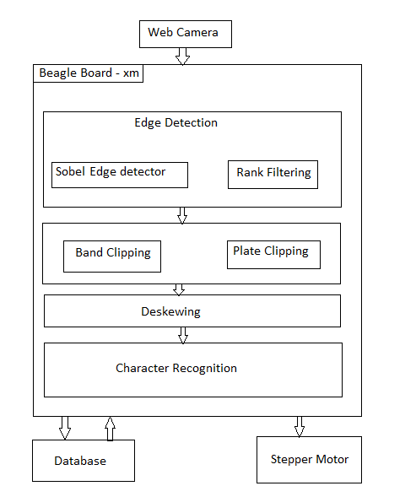
Architecture Diagram

Slide 4
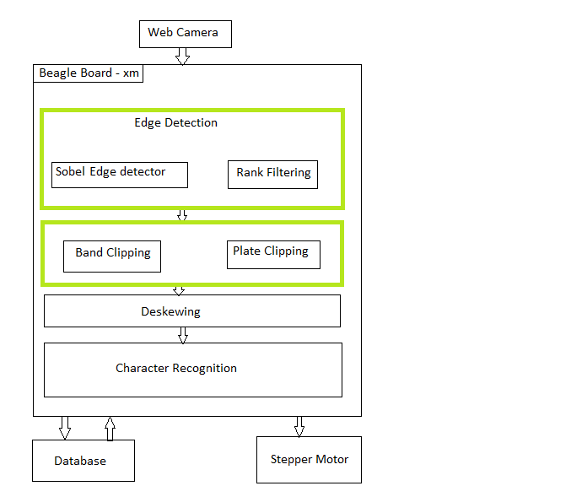
First Review

Slide 5
Comments
What type of Nueral Network is used ?
Implementation must be real time .

Slide 6
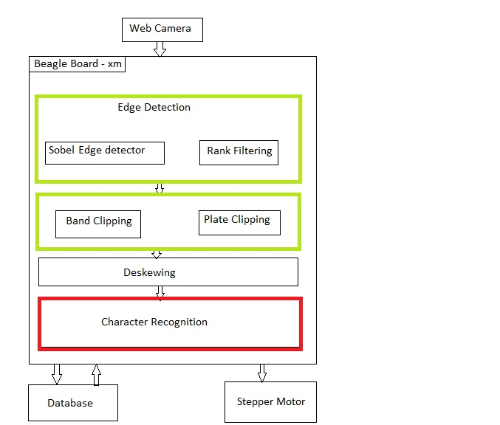
Functionality Added

Slide 7

Number Plate Area Detection
Edge Detection
  Horizontal Edge Detection
    Detection of horizontal edges using convolution
  Vertical Edge Detection
    Detection of vertical edges using convolution
  Sobel Edge Detection
    Improved Performance

Slide 8
Number Plate Area Detection
Rank Filtering
  Higher edge density within number plate
  Horizontal Rank Filtering
    Width greater than height
  Vertical Rank Filtering
    Height greater than width

Slide 9
Number Plate Area Detection
Projection
  Horizontal Projection
    sum of pixels in each row
  Vertical Projection
    sum of pixels in each column

Slide 10

Number Plate Area Detection
Double Phase Statistical Image Analysis
  Band Clipping
    detect and to clip vertical areas of the number plate
  Plate Clipping
    detect and clip the plate from the band

Slide 11
Number Plate Area Detection
Deskewing Mechanism
  Detection of Skew
    Hough Transform
  Correction of Skew
    Shear

Slide 12

Principles of Plate Segmentation
Segmentation of plate using horizontal projection
    Peak at the boundary of every letter

Slide 13
Extraction of characters from horizontal segments
Piece Extraction
  [0,0] upper left top corner
  [w-1,h-1] bottom right corner
  1 – Black Pixels
  2 – White Pixels
  Testing Neighbours

