Slide 1
Visualizing Firewall Configurations Using Created Voids
Shaun P. Morrissey
Georges Grinstein

Slide 2
Proof of Concept: Visualize a Firewall Configuration
Firewall rulesets are large, order-dependent, legacies
  Current tools are text-editors
Goal: Apply visualization to management & comprehension
  Problem: no known work
Solution: Proof of Concept
  Build Interactive Ruleset Editor
  Create Graphics Pipeline for Firewall Configuration
  Try lossless visualization to start
  Find usable dataset

Slide 3
Rules & Ruleset Semantics
Firewall rule as sextuple in two parts
  Predicate – range or interval (upper and lower limit) in five dimensions
    Dimensions: Source Address, Source Port, Protocol Number, Destination Port, Destination Address
  Action: Accept or Deny
Packets processed one at a time by
  Testing against predicates in rule order
  First match determines action (“rule firing”)
Predicate overlap and order-dependence can create problems

Slide 4
Calculate Acceptance Volume
Clear List
Index = last
Guttman algorithm
Constructive Solid Geometry
  Integer lattice
  5 dimensions - Penteracts
  Axis-aligned – intervals only
Modifications
  Add Provenance (rules)
  Add Created Voids
  Convex solid decomposition
Deny or Accept?
Accept
Deny
Union
Subtract
Index-1
Done
Notes:
Define acceptance space and acceptance volume, and provenance

Slide 5
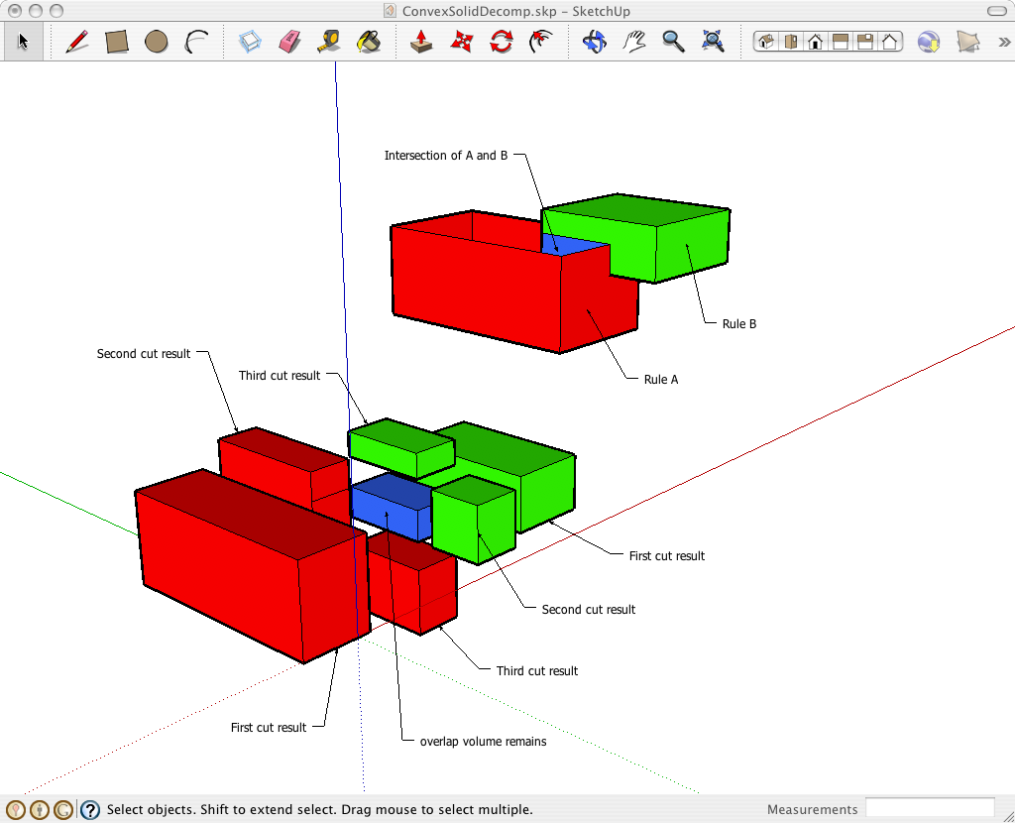
Penteract Constructive Solid Geometry (3D analogue)
Add Provenance of rules
  List of rules
  Connected to editor
Modify Guttman: B - A
  Normal: discard B ∩ A
  Created Void: retain & label with joint provenance
  Creates visualizable artifact
Top face of rule A box (red) has been opened to expose A ∩ B
Notes:
Provenance is a list of all the rules that have touched that penteract.
Created void captures the change of state from accepted to rejected once again.

Slide 6
Use Convex Solid Decomposition
Simple Data Structure
  Only penteracts required
Calculation Complexity
  371,293 types of overlap
  CSD allows one dimension at a time, five cuts, 13 cases
  Cost: longer list
Convex penteract can be visualized easily
  Parallel Set Enclosure
Rule A: red volumes
Rule B: green volumes
B ∩ A : blue volume
1-D cuts

Slide 7
Set operations as disposition rules for convex solid decomposition lists
Operation | A – B | A ∩ B | B – A
Union | Keep | Keep | Keep
Intersection | Discard | Keep | Discard
Set Difference | Keep | Discard | Discard
Void Difference | Keep | Re-label & Keep | Discard
Notes:
Two points, only one slicing/dicing method required.

Slide 8
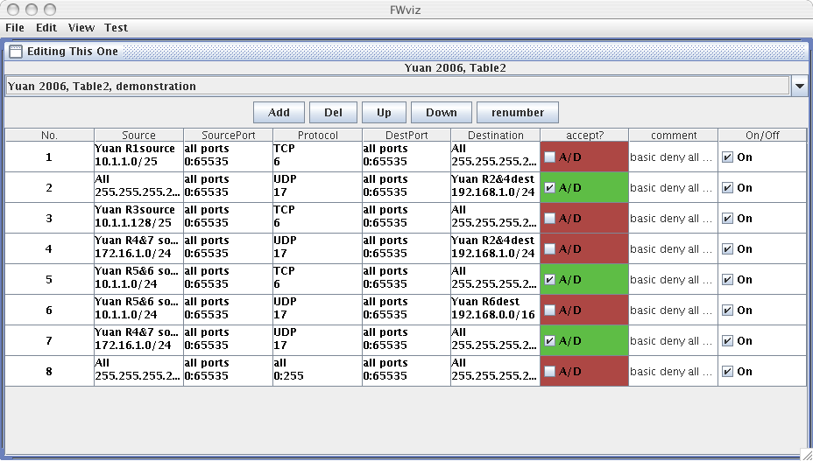
The Editor
Notes:
Note the interaction support for provenance when visual penteract shape is selected (mouse click).

Slide 9
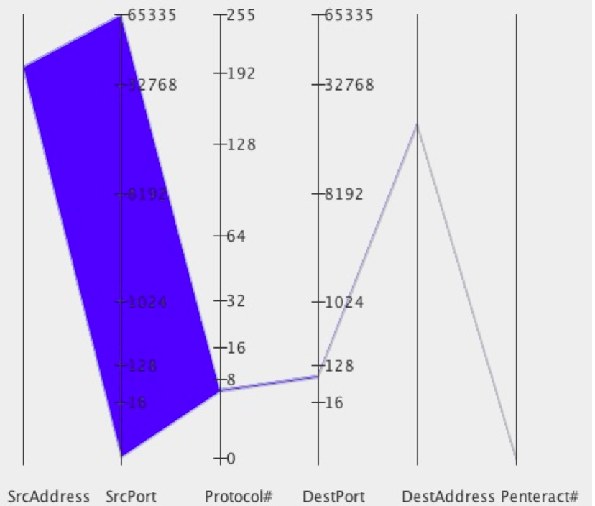
Lossless Parallel Coordinate View
Rule allowing a Class A address access to an
HTTP server
Notes:
Non-linear scale used for ports and protocol to emphasize lower values. All values scaled from 0 to 1.0. Square root for protocol and fourth root for port values.

Slide 10
Finding Firewall Data for Analysis, Comparison, & Publication
Requests for firewall configuration examples
  Occasional examples provided for internal use
  Uniform Absolute Denial of Permission to Expose
  One use case released
Text Firewall Correctness tools appear in the literature
  Al-Shaer and Hamed 2003, Firewall Policy Analyzer
  Yuan, et al. 2006, FIREMAN (modeling and analysis)
Firewall Anomalies – predicate overlaps
  Al-Shaer & Hamed – defined all possible anomalies

Slide 11
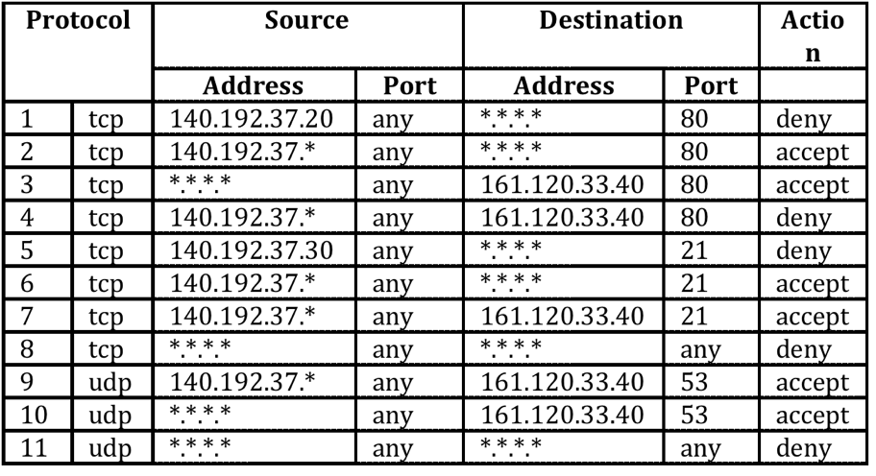
Compact Created Example Includes All Anomalies: Al-Shaer & Hamed
Ruleset created to exercise Firewall Policy Analyzer
Notes:
Al-Shaer & Hamed developed a taxonomy of all possible overlaps, and a set of anomalies.
They produced a compact dataset having at least one of each.

Slide 12
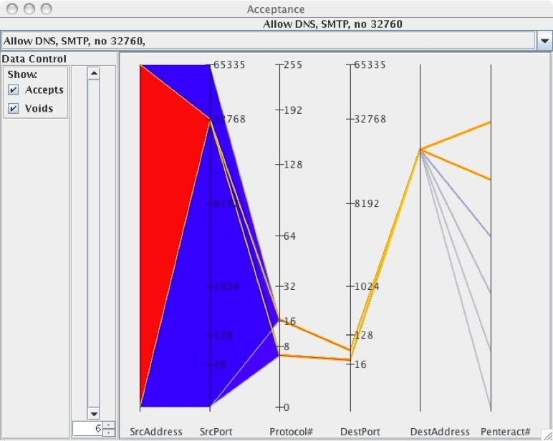
Use Case: Email server collision with legacy service protection rule
DNS and SMTP Created Voids. Six total
penteracts with two voids created by the interaction of the
32760 deny rule’s cleaving. The two voids are contained
within the remainder of the DNS and SMTP accept rules
Notes:
External access firewall disallowed use of 32760 as either a source or a destination port. Server taken down, employee retires, rule still in place.
Over-configured mail server hard-wired to use 32760 as a source port. Email to a remote office dies for days.

Slide 13
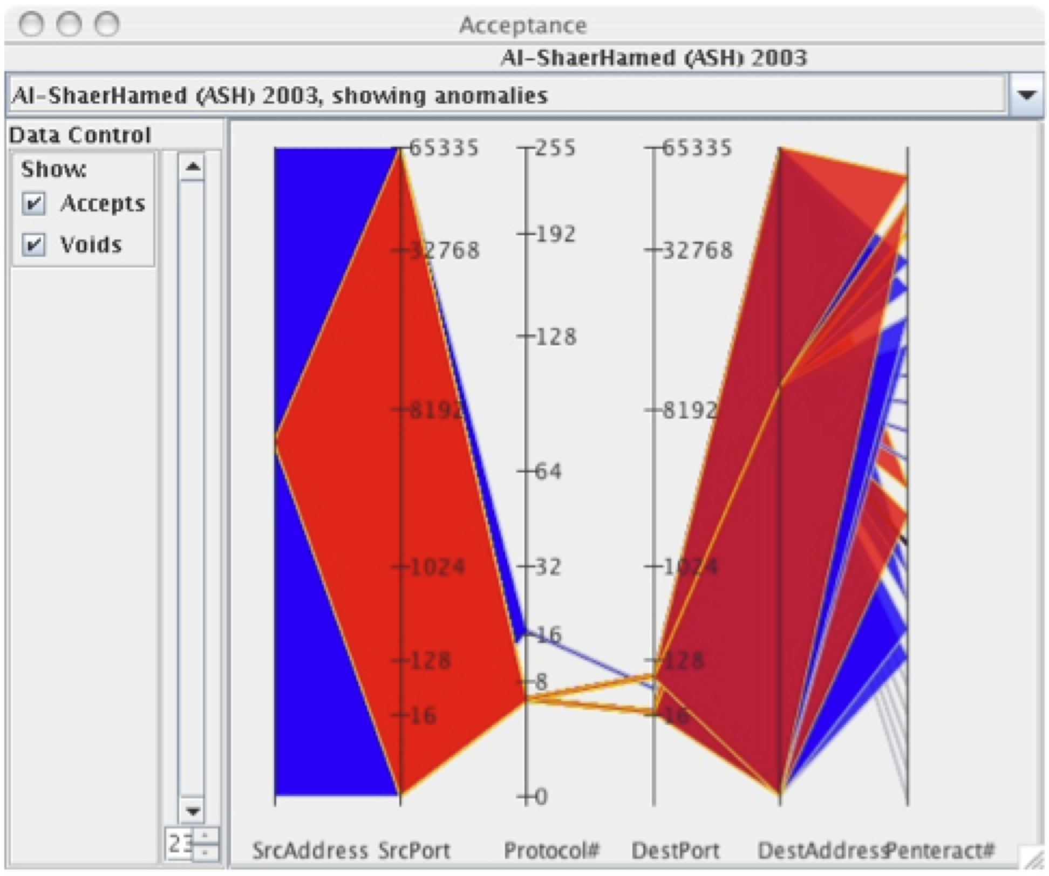
All Anomalies Combined: PC Visual of Al-Shaer & Hamed 2003
23 penteracts are presented clearly highlighting the need for
interactive data zooming and multiple views

Slide 14
Contributions & Directions
Configuration visualization is feasible
Created Voids useful for interaction and visualization
Occlusion quickly becomes issue
PC view does not capture containment of one volume or void within another, the set-subset relationship
Development Directions
  Data windowing controls
    Specialized two-dimensional controls
  Alternate Visualization

Slide 15
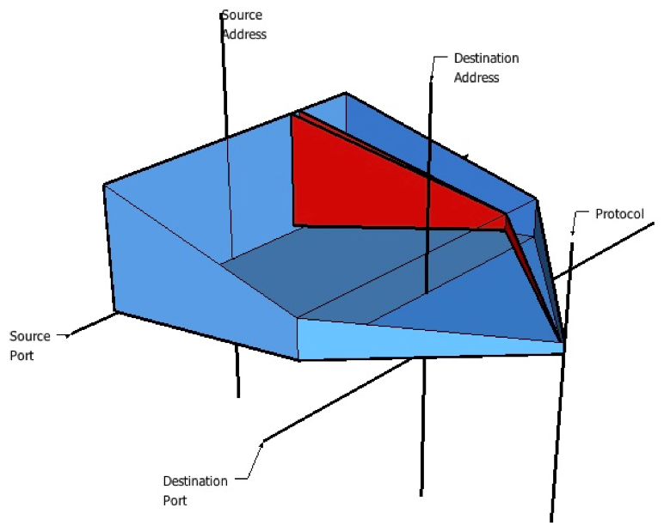
Flow Picture Mockup: Pipe-Through-the-Wall Metaphor
FP Representation. The plane in the left of the object
represents the source address and source port axes. The
destination address and destination port are similarly set up as a
two-dimensional plane. The remaining value, the protocol
number, is treated as a single axis.
Notes:
A deny rule partially overlaps the accept
rule penteract. Its smaller range in both the source plane and
the destination plane carve out an interior volume with respect
to the accept penteract that corresponds to packets that will be
denied by the firewall configuration (rendered in red).

Slide 16

Backups

Slide 17
Anomaly Examples in 2-D
Shadowing
Generalization
Redundancy
Correlation

Slide 18
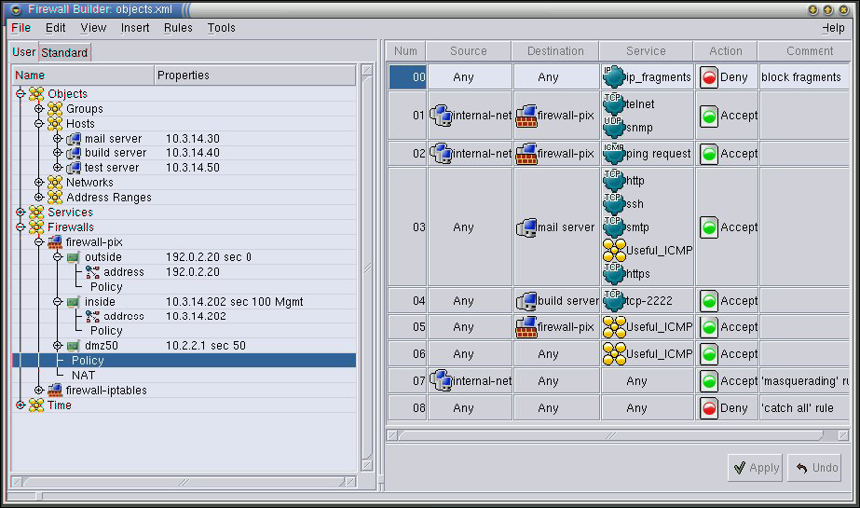
What’s out there?
And the research literature on firewall visualization was simply “None” until 2007.
Notes:
Not much. This is the essential view of every firewall product out there, the tabular representation of rules. And once the ruleset gets large, most firewall admins step back to using text editors for large configuration files.
The example is drawn from fwbuilder.org, an open-source effort on a firewall configuration tool. It is regarded as fairly advanced. This is the current state of the art.
Despite its potential range of impact, no one has taken this problem on. There are no articles we have been able to find that even describe an attempt.

Slide 19
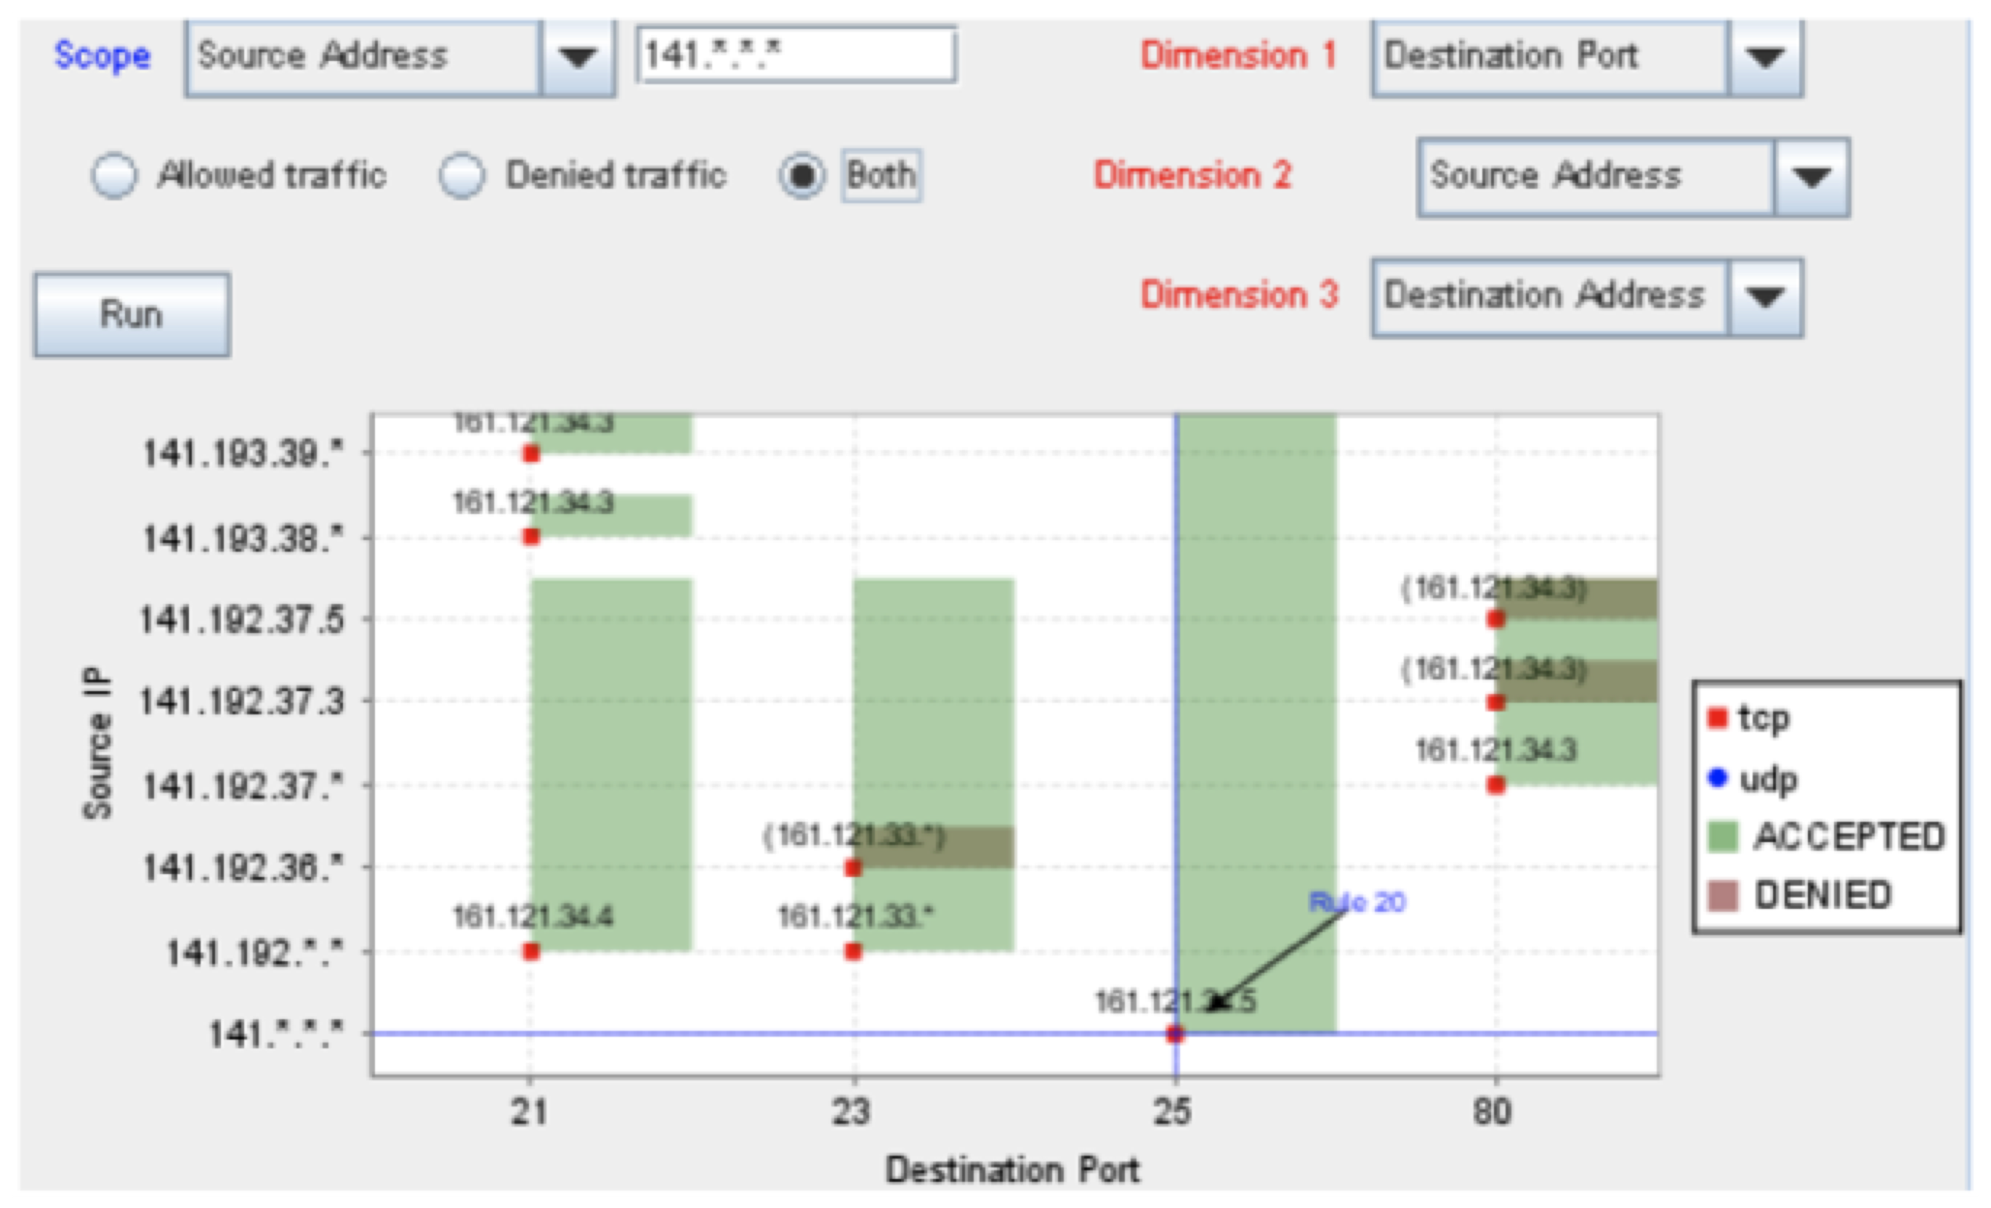
PolicyVis – Tran et al., 2007
Notes:
Displays two-dimensional projections of the predicates of the rules, not the actual configuration.
As a design decision, Tran reports that the tool only uses 2D representations. This means that choices must be made as to what information will be displayed.
Once the user has entered a cue as to what is of interest, PolicyVis makes a set of automated decisions to decide what information axis will not be displayed. The cues are used to select the subset of the indexed rules that will be displayed. The cue is typically the selection of an axis of interest and a value that is relevant. Every rule that is displayed must match the cue condition. This immediately removes one dimension from
further investigation.
shows an example drawn from Tran 2007 showing the fixed use of color to encode both action (accept/deny) and the protocol dimension (tcp/udp). The dimension popup-menu and the text field next to the word “Scope” in blue in the upper left corner are used to enter the cue. Note that this choice has resulted in Source IP as the vertical (Y) axis. The remaining display choices are entered via the popup menus labeled by dimension in the upper right. The third dimension, selected here as Destination Address, results in text cues being placed in the boxes on the 2D display to carry the IP number for the destination.
The heuristics embedded in the program support the visual representation of the anomalies that were developed in prior work by Al-Shaer. At that point, the selected dimensions of the predicates of the relevant rules, along with color-coding of their action are displayed in two dimensions. Detection of potential anomalies is visual by the user, by looking for overlaps in the display. If the user clicks a 2D overlap region, the display switches to a new 2D display presenting the additional dimensions not previously displayed. The user then visually examines this projection to determine if an overlap is present in the additional dimensions. If so, then one of the anomalies that can cause a change in the acceptance volume is detected by the user.

