Slide 1


Visualization is Better!
A Comparative Evaluation
John Goodall
johng@securedecisions.avi.com
Secure Decisions division of Applied Visions, Inc.

Slide 2
Context
This work was part of larger research study
Field study, interviews with security analysts, and survey to understand intrusion detection work practice
Development of vis tool for analysis
  Iterative heuristic reviews and usability testing
Summative comparative evaluation

Slide 3
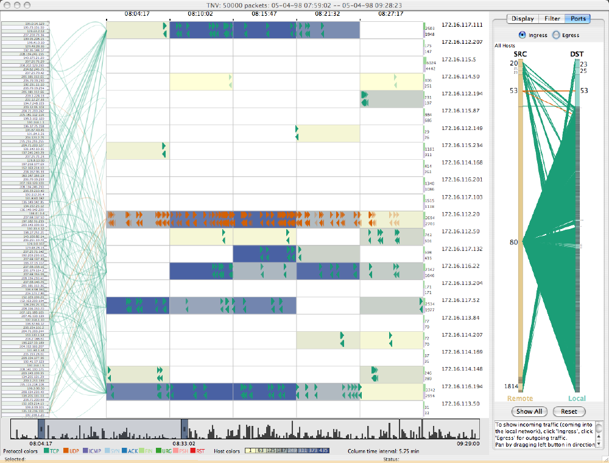
tnv
http://tnv.sourceforge.net/

Slide 4
User Testing
Controlled experiments comparing design elements: a comparison of specific widgets
Usability evaluation of a tool: an evaluation of problems users encounter when using a tool as part of the design process
Controlled experiments comparing two or more tools: a comparison of multiple visualizations or the state of the art with a novel visualization
Case studies of tools in realistic settings: an evaluation of a visualization tool in a natural setting with users using the tool to accomplish real tasks

Slide 5
User Testing
Controlled experiments comparing design elements: a comparison of specific widgets
Usability evaluation of a tool: an evaluation of problems users encounter when using a tool as part of the design process
Controlled experiments comparing two or more tools: a comparison of multiple visualizations or the state of the art with a novel visualization
Case studies of tools in realistic settings: an evaluation of a visualization tool in a natural setting with users using the tool to accomplish real tasks

Slide 6
Study Design
Goal: Compare tnv and the standard tool for network packet analysis
Design: Repeated measure within subject
Participants: 8 IS undergrad/grad students
Tools: tnv & Ethereal
Data: small (200 packets) & large (750 packets)
Tasks: well-defined & exploratory

Slide 7
Why Novice Users?
Learning: research showed that novices ‘play’ with tools to learn; tnv was designed to facilitate learning
Background: domain experts would have lots of experience with Ethereal, which could skew the results
Accessibility: domain experts are hard to come by

Slide 8
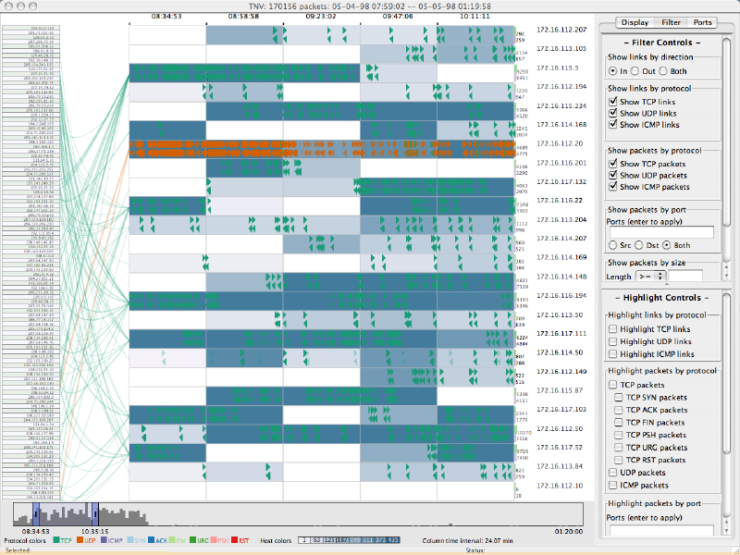
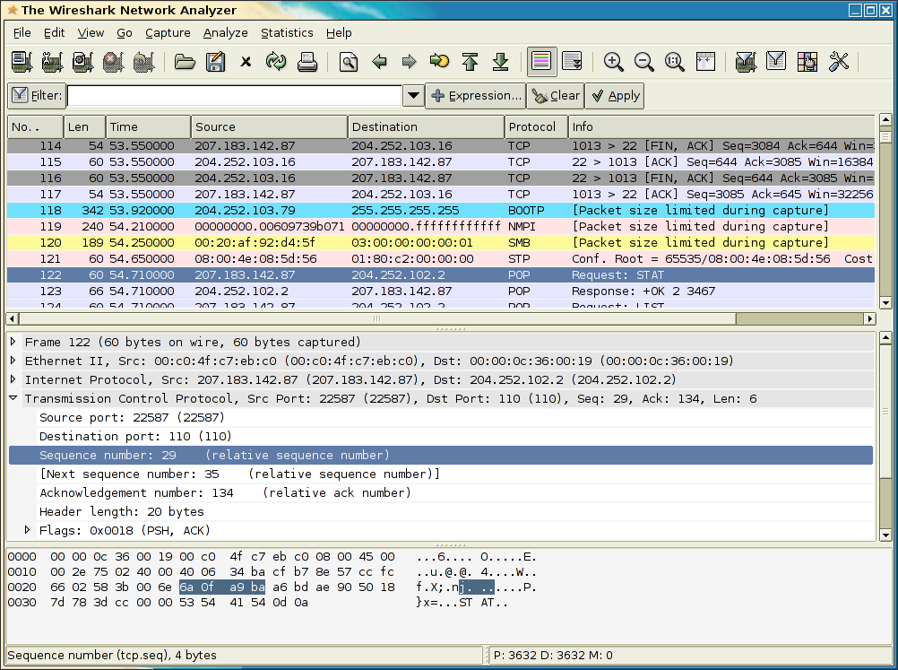
Tools
tnv
Wireshark
Designed to facilitate high-level and detailed understanding of network traffic
De facto standard for packet analysis: 88% of survey respondents used Ethereal at least occasionally (62% frequently)

Slide 9
Tasks
Well-defined
  Representative of ‘typical’ tasks; 1 correct answer
  Task categories: comparison & identification
  16 tasks for each tool
Exploratory
  Asked participants to draw open ended conclusions from the data; no correct answer
  Predefined time limit
  1 exploratory task for each tool

Slide 10
Tasks
Well-defined
  Representative of ‘typical’ tasks; 1 correct answer
  Task categories: comparison & identification
  16 tasks for each tool
Exploratory
  Asked participants to draw open ended conclusions from the data; no correct answer
  Predefined time limit
  1 exploratory task for each tool

Slide 11
Procedure
Introduction to the study and each of the tools
Training using either tnv or Ethereal
Timed tasks using that tool
Exploratory task using that tool
Training using the second tool
Timed tasks using the second tool
Exploratory task using the second tool
A satisfaction questionnaire on both tools

Slide 12
Variables
Independent Variables
  Tool: tnv, Ethereal
  Task Type: Comparison, Identification
Dependent Variables
  Accuracy
  Completion Time
  User Perceptions

Slide 13
Expected Results
Expect users to perform better with tnv…
…Especially for comparison tasks, since tnv shows much more data at once
…But identification tasks will be closer, since Ethereal has easy to use search capability

Slide 14
Analysis
A repeated measures analysis of variance (RMANOVA) with repeated measures for tool (tnv, Ethereal) and task type (Comparison, Identification)
To ensure that counterbalancing the tool order usage had no effect on performance, order was treated as a between subject variable
The between subject variable of tool order was not significant in any of the tests

Slide 15
Accuracy
Interaction effect of tool:
F(1,6) = 14.72, p = 0.009
Participants had significantly fewer errors using tnv than using Ethereal
Mean and 95% confidence interval of accurate responses by tool. (maximum = 10)

Slide 16
Accuracy
Interaction effect between tool and task type:
F(1,6) = 2.139, p = 0.194
But, looking at comparison tasks for each tool, there is an effect
t = 5.612, p = 0.001
Mean and 95% confidence interval of accurate responses by tool and task type. (max. = 5)

Slide 17
Time
Time to completion for successful tasks
  Not partially successful tasks or timed out tasks
  Incorrect responses could have been guesses
Standardized time
  Tasks were of varying levels of difficulty
  Average time for each task varied greatly
  Negative number means faster than average
  StandardizedTime = (ParticipantTime – TaskMeanTime) / TaskStandardDeviation

Slide 18
Time
Interaction effect of tool:
F(1,6) = 5.581, p = 0.056
Trend suggests faster performance, but not significant
Mean and 95% confidence interval of standardized time to successful tasks by tool

Slide 19
Time
Interaction effect between tool and task type
F(1,6) = 2.558, p = 0.161
But, looking at comparison tasks for each tool, there is an effect
t = –4.615, p = 0.002
Mean and 95% confidence interval of standardized time to successful tasks by tool and task type

Slide 20
Discussion: Task Type
Larger difference in comparison tasks
  Ethereal: Statistics were underused; comparisons were done by sorting and mental addition
  tnv: Comparisons could be seen at a glance
Less of a difference in identification tasks
  Ethereal: Search on small data sets removed all but the relevant information
  tnv: Search highlighted relevant information, but kept all data on the screen, so participants didn’t always see where it was

Slide 21
Discussion: Tasks

Slide 22
Port Related Tasks
Tasks 2, 3: compare port activity
tnv port visualization is hidden by default
Participants couldn’t answer by looking at main display
Participants learned in task 2, so task 3 was much faster (81 s -> 22 s)

Slide 23
Exploratory Tasks
Measured number of ‘insights’ that were not mentioned in timed tasks and not incorrect
Results: participants often started out talking about the tools, not the data
Several simply gave up (especially for Ethereal)

Slide 24
Results: Exploration
tnv: higher-level
  Gap in activity
Ethereal: packet-level details
  Unencrypted passwords
Mean and 95% confidence interval of the number of insights discovered

Slide 25
User Perceptions

Slide 26
Ease of Seeing Patterns

Slide 27
Lessons
Domain experts are difficult to recruit
  Include them in the design process
Training can take a lot of test time
  Self-directed training matches how analysts learn
Data sets are problematic and unlabeled
  http://vizsec.org/datasets/
‘Realistic’ tasks that can be answered quickly with both tools are hard to define
  ???

Slide 28
Questions?
John Goodall
johng@securedecisions.avi.com
Secure Decisions division of Applied Visions, Inc.

