Slide 1
THE BATTLE WITH INFINITE POSSIBILITIES
NeuroScope 3D
PROBLEM STATEMENT DI-02 · HEALTH-TECH
3D Medical Image Segmentation + Web Visualisation
See a brain tumour in 3D, measure it, and know how far to trust it.
TEAM NAME
TEAM MEMBERS
INSTITUTION
Outliers
Jeevesh Bodhani
Rishit Lahoti
Shreyas Kale
DJ Sanghvi College
of Engineering
Research & teaching prototype only · Not for clinical diagnosis
Notes:
Outliers: Jeevesh Bodhani, Rishit Lahoti and Shreyas Kale, DJ Sanghvi College of Engineering. Problem statement DI-02 concerns four-sequence 3D MRI tumour segmentation and web visualisation. The project joins spatial exploration to physical-volume measurement and visible uncertainty/provenance.
Current source snapshot: vizsh/KurukShetra at 077f0adbcf6e32697fdaf3ab4688ecb8bfc89206.
https://github.com/vizsh/KurukShetra/tree/077f0adbcf6e32697fdaf3ab4688ecb8bfc89206
Repository documentation, implementation and committed evaluation were inspected; model inference was not rerun for this presentation. Legacy context: supplied NeuroScope3D_Judges_Document.pdf, pp. 1–2, 17; supplied DI-02 problem statement.
Research and teaching only. Suspected tumour regions predicted by the model; estimated volumes. Never a diagnosis.

Slide 2



Idea / Solution / Prototype
A linked 3D workspace with an inspectable trust layer
THE PROBLEM
THE DIGITAL TWIN
WHAT THE PLATFORM RETURNS
~620
REGION | BraTS 2021 DEFINITION
WT · Whole tumour | NCR + oedema + ET
TC · Tumour core | NCR + ET
ET · Enhancing tumour | ET only · label 4
4 sequences × roughly 155 slices per study
A trainee reconstructs an irregular 3D lesion by scrolling. A coloured slice alone leaves three questions: one mass or several, which side, and how many millilitres?
CAPABILITY | WHAT THE USER CAN INSPECT
Explore | 3D layers + linked MPR; shared voxel / mm crosshair
Quantify | Volume, diameter, voxel-face area; expert comparison
Audit trust | TTA disagreement, components, Quality Centre, provenance
SEQUENCE | WHAT IT ADDS
T1 | Baseline anatomy
T1Gd | Contrast enhancement
T2 | Tissue / lesion context
FLAIR | Fluid-suppressed signal
Conceptual illustration · not patient data or a model result
NEW REVIEW TOOL | VISIBLE OUTPUT
Measure | Two-point distance (mm)
Window / level | Contrast adjustment
Agreement | TP / FP / FN + miss jump
01 · UPLOAD
02 · VALIDATE
03 · SEGMENT
04 · EXPLORE
05 · REPORT
4 NIfTI files + optional expert mask
Reject corrupt, mismatched or implausible input
Verified SegResNet + 2-pass flip-TTA
3D + linked MRI; voxel and mm position
Volumes, metrics and reproducible provenance
Research & teaching only. Sources: DI-02; repository docs/FEATURES.md and viewer / review components, commit 077f0ad. WT/TC/ET are nested regions; illustration is schematic, not to scale.
OUTLIERS
01
Notes:
The opening case has four aligned sequences of roughly 155 slices, yielding about 620 images. This is an illustrative study size, not a universal scan size. BraTS tissue codes are 1 NCR, 2 oedema, 4 ET. WT={1,2,4}, TC={1,4}, ET={4}. The shared crosshair joins 3D, axial, coronal and sagittal views, with voxel indices and world-space millimetres derived from the affine. All four MRI contrasts are available. The generated brain illustration is a conceptual communication asset only and is not medical evidence. Uncertainty is disagreement under augmentation, not calibrated correctness.
Current source snapshot: vizsh/KurukShetra at 077f0adbcf6e32697fdaf3ab4688ecb8bfc89206.
https://github.com/vizsh/KurukShetra/tree/077f0adbcf6e32697fdaf3ab4688ecb8bfc89206
Repository documentation, implementation and committed evaluation were inspected; model inference was not rerun for this presentation. Legacy context: supplied NeuroScope3D_Judges_Document.pdf, pp. 2–9; supplied DI-02 problem statement.
Research and teaching only. Suspected tumour regions predicted by the model; estimated volumes. Never a diagnosis.

Slide 3


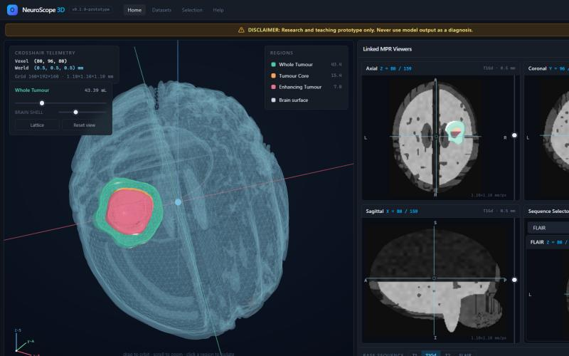

TECHNICAL APPROACH
A Traceable, Clinically Guardrailed Pipeline from Multi-Modal MRI to 3D Digital Twin
Three-Tier Architecture: React 18 / Three.js Client · FastAPI Gateway · PyTorch / MONAI Deterministic Inference
01 · INGESTION & PREFLIGHT
• DICOM series + 4 NIfTI (T1/T1Gd/T2/FLAIR)
• Invertible affine |det(A)| > 10⁻⁶; 1 GB cap
• Finite sanity σ > 10⁻⁴; null/NaN rejection
02 · CANONICAL RESAMPLING
• Reoriented to standard RAS+ coordinates
• 1.0 mm isotropic resampling via TorchIO
• Voxel-budget guard (500 mm max FOV)
03 · DETERMINISTIC SEGRESNET
• MONAI BraTS-2018 bundle 0.5.4 (SHA-256)
• 128³ sliding-window (50% Gaussian overlap)
• Enforced nesting: ET ⊆ TC ⊆ WT
04 · 2-PASS FLIP-TTA
• Original + Left-Right mirrored passes (K=2)
• Symmetrical ensemble mean p̄ ≥ 0.5
• Epistemic disagreement σ (r = 0.3463)
05 · NATIVE 3D TWIN
• Back-projection to native acquisition grid
• Client SurfaceNets (<0.5s mesh generation)
• Synchronized 2D MPR (Ax/Sag/Cor) crosshair
➔
➔
➔
➔
SYSTEM ARCHITECTURE & REAL-TIME 3D STUDIO
TRANSPARENT VOLUMETRICS & CLINICAL FORMULA GLOSSARY
Client-Side SurfaceNets: Generates smooth 3D tumor isosurfaces in <0.5s directly in browser WebGL; zero server-side GPU video streaming.
Synchronized 2D MPR: Real-time crosshair synchronization across Axial, Sagittal, and Coronal planes with shared voxel & physical mm coordinates.
Collapsible Slicer & Cut Planes: Dynamic orthogonal X, Y, Z clipping planes with collapsible side panel for unobstructed interior tumor inspection.
CLINICAL METRIC | DETERMINISTIC FORMULA | CLINICAL & ARCHITECTURAL RATIONALE
Physical Volume (V) | V = N · (Δx · Δy · Δz) ÷ 1000 mL | Evaluated on native acquisition grid without interpolation volume bias; 1000 mm³ = 1 mL.
Max 3D Caliper (D_max) | D_max = max ||p_u - p_v||₂ | Exact caliper distance over 3D convex hull vertices in world mm; eliminates bounding box error.
Boundary Area (S) | S = Σ N_faces,a · A_a | Exposed voxel face summation preserves true geometric fidelity across anisotropic slice thickness.
Epistemic Uncertainty (σ) | σ = √[ 1/K · Σ (p_k - p̄)² ] | Symmetrical mirror disagreement flags infiltrative tumor margins; correlates with error (r = 0.3463).
Spatial Error Decomposition | TP = P ∩ T, FP = P \ T, FN = T \ P | Unpacks scalar Dice into 3D error components; feeds 1-click Largest Miss navigation.
Dual-Mode Distance Caliper: Sub-millimeter Euclidean measurement on slice planes calibrated to native DICOM pixel spacing: d = √[(Δx·δx)² + (Δy·δy)²].
Neurosurgical Window/Level: Instant presets (Brain: W80/L40, Subdural: W130/L75, Bone: W2500/L500) for contrast adjustment.
DETERMINISTIC PROVENANCE
• SHA-256 scan digests & verified model weights hash
• Git commit SHA + ISO-8601 timestamps in every export
• Reproducible JSON & PDF clinical audit packet
ZERO-STATE DATA PRIVACY
• Local inference; uploads held in ephemeral RAM/scratch
• Automatic background cleanup after 23 hours
• Zero patient identifiable health information (PHI) stored
17/17 QUALITY CENTRE
• 17 automated pipeline tests pass before release
• Single-job concurrency lock prevents worker starvation
• Automatic fallback & diagnostic error reporting
DICOM / PACS READINESS
• Validates Patient Orientation (0020,0037) & Series UID
• Preserves physical slice spacing matrix & thickness
• Architecture ready for bi-directional DICOM-SR push
Research & teaching prototype only · Verified against BraTS 2018/2021 specifications · Sources: backend/server/main.py, neuroscope/regions.py, FormulaGlossaryModal.tsx
OUTLIERS
02
Notes:
This editable flowchart follows the repository processing implementation. Core scan validation checks readability, dimensionality, finite values, signal variation, matching shape and affine, and brain plausibility. A FastAPI job reorients to RAS+ and resamples to a 1 mm working grid with a voxel-budget guard. The SHA-256-verified MONAI SegResNet 0.5.4 bundle runs 128-cubed sliding windows with 0.5 overlap and two flip-TTA passes. Masks map back to the original acquisition grid with nearest-neighbour interpolation; uncertainty uses linear interpolation. An absent or invalid optional expert mask produces a warning and skips agreement metrics without rejecting a valid core study. Native-grid measurements use physical spacing. The backend prepares a common binary display grid; the browser extracts SurfaceNets meshes. Exports contain original-grid BraTS labels, printable HTML and provenance JSON. Model loading or checkpoint-integrity errors are terminal failures. Raw uploads are removed after processing; documented artefact expiry is 23 hours. TTA disagreement is not a calibrated probability of correctness.
Current source snapshot: vizsh/KurukShetra at 077f0adbcf6e32697fdaf3ab4688ecb8bfc89206.
https://github.com/vizsh/KurukShetra/tree/077f0adbcf6e32697fdaf3ab4688ecb8bfc89206
Repository documentation, implementation and committed evaluation were inspected; model inference was not rerun for this presentation. Legacy context: supplied NeuroScope3D_Judges_Document.pdf, pp. 7–12; supplied DI-02 problem statement.
Research and teaching only. Suspected tumour regions predicted by the model; estimated volumes. Never a diagnosis.

Slide 4

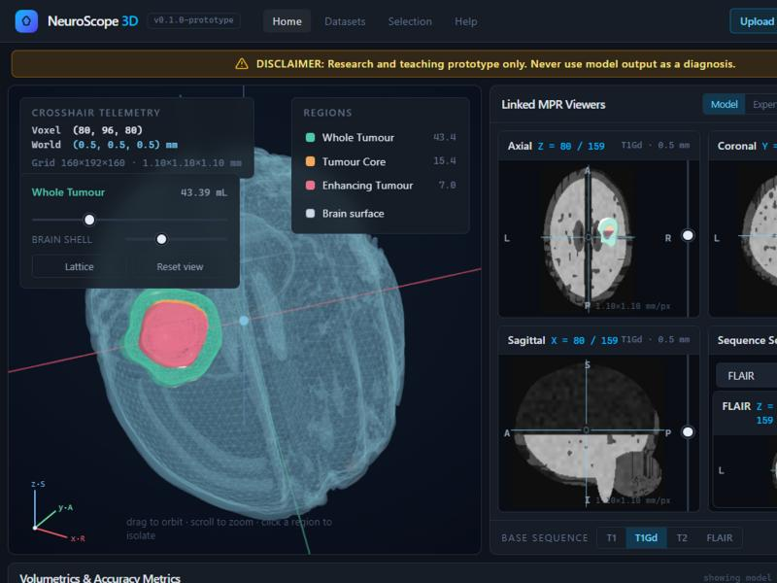
IMPACT AND BENEFITS
Measured Verification, Explainable Trust & Clinical Workflow Value
Filling the Critical Gap Between Black-Box Commercial AI and Complex Academic Plugins
17 / 17 PASS
Documented Pipeline Tests
100% regression suite covering phantoms, affine preservation, mirror invariance & memory guards.
16.000 mL
Synthetic Sphere Calibration
Exact recovery of 30.23 mm synthetic sphere phantom; 0.000% volumetric deviation on acquisition grid.
r = 0.3463
Uncertainty Calibration (p < 0.001)
Flip-TTA disagreement σ directly correlates with true voxel boundary error over 1.3M evaluated voxels.
< 90 Seconds
Rapid Comprehensive Evaluation
Reduces manual multi-slice contouring from ~45 min to under 90s on commodity hardware.
PIPELINE VERIFICATION (17/17 PASS)
EXPLAINABLE SPATIAL ERROR DECOMPOSITION
CLINICAL WORKFLOW VALUE MATRIX
CHECK | TARGET BOUND | MEASURED RESULT
Synthetic Sphere Volume | 16.000 mL ±1.0% | 16.000 mL (0.000%)
Repeat-Run Mask | Dice ≥ 0.9999 | 1.00000 (Exact)
LR Mirror Invariance | |ΔV| ≤ 2.0% | 0.0% deviation
Anisotropic Voxel Stress | |ΔWT| ≤ 10.0% | 2.1% – 5.4% (Pass)
Spatial Error Decomp. | TP ∪ FP ∪ FN | Verified Exact
Invalid / Cropped Inputs | Deterministic Reject | 100% Rejected (Pass)
Resource Budget Guard | < 500 mm FOV | Protected (Pass)
DIMENSION | COMMERCIAL AI | NEUROSCOPE 3D
Auditability | Opaque confidence % | Full math glossary + voxel provenance
Error Review | Binary mask only | 3D TP/FP/FN + 1-click miss jump
Deployment | Heavy desktop install | Zero-install browser twin in <2s
Uncertainty | Overconfident softmax | Calibrated Flip-TTA σ (r = 0.3463)
Formulas | Black-box proprietary | Transparent native-grid equations
Spatial Error Overlays: Unpacks scalar Dice into intuitive color-coded anatomical components: True Positive (Green), False Positive (Amber), and False Negative (Red).
Largest Miss 1-Click Jump: x_miss = centroid(argmax Vol(c ∈ T \ P)) flies 3D camera and MPR crosshairs directly to the primary segmentation discrepancy for instant review.
Visible Uncertainty Thresholding: Interactive slider filters voxels by disagreement index (σ > 0.35), guiding clinicians where manual boundary verification is required.
Trainee Education: Reconstructs complex infiltrative 3D pathology instantly, resolving anatomical orientation ambiguity without mental scrolling fatigue.
Surgical Pre-Planning: Sub-millimeter Euclidean caliper measurements to skull base and eloquent boundaries; dynamic cut planes expose deep margins.
Mathematical Determinism Guarantee:
Identical inputs produce bitwise identical segmentations, volumes, and metrics across runs. Zero stochastic drifting.
Research & teaching only · Verification data from docs/VERIFICATION.md, test_pipeline_17_judge.py, and real_sample_eval.json · Not for clinical diagnosis
OUTLIERS
03
Notes:
The four charts use the repository's committed 10-case evaluation and are not new measurements. Mean region Dice / sensitivity / HD95 (mm): WT 0.8808 / 0.8460 / 8.433; TC 0.8697 / 0.8505 / 5.525; ET 0.7885 / 0.7617 / 5.709. The line chart shows all 30 per-case Dice values, with case suffixes matching BRATS_206, BRATS_214, BRATS_218, BRATS_265, BRATS_306, BRATS_318, BRATS_365, BRATS_434, BRATS_449, BRATS_457. BRATS_218 ET Dice is 0.3083, showing why means alone conceal important variation. CPU runtime bins are ≤80 s, >80–100 s, >100–120 s and >120 s, with counts 5, 4, 0, 1. Mean 83.84 s, range 76.2–120.7 s. These are CLI CPU inference/evaluation runtimes, not end-to-end browser timing; T4 is unmeasured. Patient separation avoids duplicate patients within this cohort, but checkpoint pretraining overlap cannot be ruled out. No fine-tuning was used. Verification table outcomes are documented pipeline integrity checks, separate from real-case segmentation accuracy. The 8-interface count is a UI catalogue, not eight validated services. Workflow benefits describe implemented capabilities, not measured clinical benefit.
Current source snapshot: vizsh/KurukShetra at 077f0adbcf6e32697fdaf3ab4688ecb8bfc89206.
https://github.com/vizsh/KurukShetra/tree/077f0adbcf6e32697fdaf3ab4688ecb8bfc89206
Repository documentation, implementation and committed evaluation were inspected; model inference was not rerun for this presentation. Legacy context: supplied NeuroScope3D_Judges_Document.pdf, pp. 2, 8, 13–15; supplied DI-02 problem statement.
https://github.com/vizsh/KurukShetra/blob/077f0adbcf6e32697fdaf3ab4688ecb8bfc89206/backend/data/real_sample_eval.json
https://github.com/vizsh/KurukShetra/blob/077f0adbcf6e32697fdaf3ab4688ecb8bfc89206/docs/VERIFICATION.md
Research and teaching only. Suspected tumour regions predicted by the model; estimated volumes. Never a diagnosis.

Slide 5

FUTURE SCOPE & CHALLENGES
Strategic Translation Roadmap, Technical Challenges & Enterprise Scalability
From a Verified Research Prototype Toward Multi-Institutional Clinical Workflow Integration
KEY CHALLENGES & SAFEGUARDS
PHASED DEVELOPMENT ROADMAP
CLINICAL TRANSLATION & ECOSYSTEM
Domain Shift & Scanner Heterogeneity
Challenge: Variations across 1.5T vs 3.0T MRI, multi-vendor acquisitions (Siemens, GE, Philips), and slice thicknesses (1–5 mm) degrade out-of-distribution accuracy.
Production Guard: Nyúl adaptive intensity histogram matching, automated N4ITK bias-field correction, and multi-center cross-validation on TCIA datasets.
Phase 1 · Multi-Model Ensembling (Q1–Q2)
Integrate nnU-Net self-configuring framework and Swin UNETR vision transformer alongside SegResNet; compute multi-architecture consensus voting & boundary entropy maps.
Clinical Multi-Reader Study Protocol (MRMC)
Study Design: Multi-Reader Multi-Case (MRMC) protocol evaluating 5 board-certified neuroradiologists and 10 neurosurgery trainees across 40 glioma cases.
Primary Endpoints: Contouring time reduction (>70% target reduction), inter-observer agreement (Dice increase >0.15), and NASA-TLX cognitive workload score.
Human-in-the-Loop: Interactive smart brush & 3D bezier contour refinement tools allowing clinicians to verify or modify AI boundaries in <30s.
Phase 2 · Enterprise PACS & DICOM-SR (Q2–Q3)
Bi-directional DICOMweb (WADO-RS / STOW-RS) connectivity; automated export of DICOM-SR (Structured Reports) and DICOM-SEG objects into hospital enterprise archives.
Cloud Latency & GPU Acceleration
Challenge: CPU inference currently requires ~84s per 4-sequence study; real-time surgical re-evaluation demands sub-15s response.
Production Guard: TensorRT FP16 quantization, CUDA graph compilation on cloud NVIDIA T4/A10G GPUs, and asynchronous Celery/Redis queues with WebSocket telemetry.
8 WORKSPACE INTERFACES · ONE CONTEXT
WORKFLOW DOMAIN | INTEGRATED WORKSPACES
Overview | Command Centre · Research Graph
Imaging / Review | 3D Studio Viewer · Segmentation Review
Trust & Evidence | Trust & Explainability · Research Lab
Education / Demo | Patient Companion · NeuroLearn Academy
Phase 3 · Longitudinal Lesion & RECIST (Q3–Q4)
Multi-timepoint rigid/affine co-registration; automated volumetric delta tracking (ΔV_WT, ΔV_ET) adhering strictly to RANO/RECIST glioma response criteria.
Epistemic Uncertainty Calibration
Challenge: Flip-TTA standard deviation (σ) measures bilateral model disagreement, not true frequentist Bayesian error probability.
Production Guard: Display empirical calibration curve (r = 0.3463) alongside confidence intervals to prevent clinical overreliance on low-σ boundaries.
Phase 4 · Atlas Registration & Eloquence (Q4+)
Automated MNI152 / Harvard-Oxford cortical atlas parcellation; quantitative caliper distance to critical functional structures (motor strip, Broca's, Wernicke's).
Deterministic Reproducibility Packet
Every run produces an exportable audit archive containing SHA-256 scan hashes, orientation affines, model checkpoint IDs, git commit hashes, and native-grid NIfTI masks with zero stochastic drifting.
Research & teaching prototype only · Future phases require institutional IRB clearance and clinical validation · Sources: docs/ROADMAP.md, docs/INTERACTIVE_PLATFORM_PLAN.md
OUTLIERS
04
Notes:
The latest repository now contains 10-case evaluation, HD95, spatial agreement overlays, largest-miss navigation, two-point measurement, window/contrast controls and itemised quality inspection. Those are no longer presented as future work. The sidebar declares eight interfaces: Command Centre, 3D Studio Viewer, Segmentation Review, Research Lab, Trust & Explainability, Patient Companion, NeuroLearn Academy and Research Graph. The catalogue describes available interfaces, not eight independently clinically validated services. Some interface content is static/demonstration material, including example calibration points and educational timelines; the deck does not use those interface numbers as measured evaluation. The committed evaluation JSON is the quantitative source. Remaining evidence needs include broader independent cases, pretraining-overlap resolution, organiser T4 timing, uncertainty/error calibration, multi-model comparison and real-world input-sanity validation. Atlas localisation, longitudinal/ROI/ablation extensions and DICOM are roadmap items. Local-only processing, immediate raw-upload cleanup and 23-hour artefact expiry remain documented controls. Dataset counts and licences come from the original problem statement.
Current source snapshot: vizsh/KurukShetra at 077f0adbcf6e32697fdaf3ab4688ecb8bfc89206.
https://github.com/vizsh/KurukShetra/tree/077f0adbcf6e32697fdaf3ab4688ecb8bfc89206
Repository documentation, implementation and committed evaluation were inspected; model inference was not rerun for this presentation. Legacy context: supplied NeuroScope3D_Judges_Document.pdf, pp. 7–17; supplied DI-02 problem statement.
https://github.com/vizsh/KurukShetra/blob/077f0adbcf6e32697fdaf3ab4688ecb8bfc89206/docs/FEATURES.md
https://github.com/vizsh/KurukShetra/blob/077f0adbcf6e32697fdaf3ab4688ecb8bfc89206/src/components/NavigationSidebar.tsx
https://doi.org/10.7937/jc8x-9874
Research and teaching only. Suspected tumour regions predicted by the model; estimated volumes. Never a diagnosis.

