Slide 1
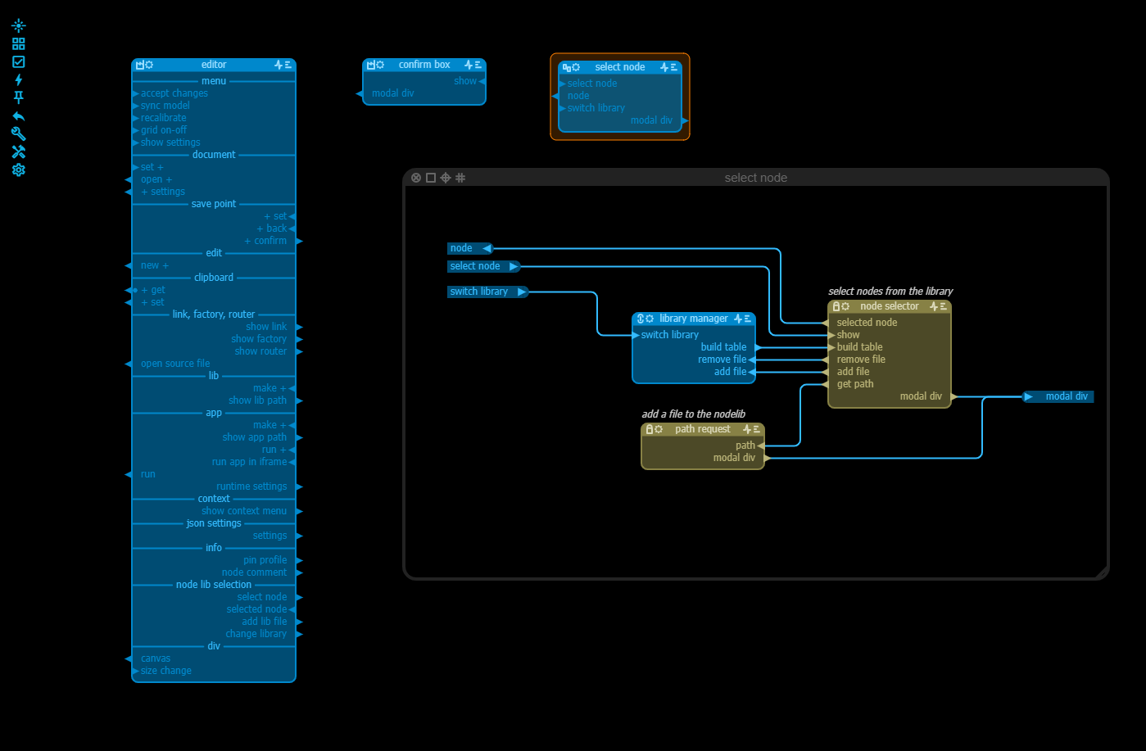
name of the node
group node…
…expanded
Input pin
Output pin
Inputs and outputs can be grouped in interfaces
Nodes can be small or large

