Slide 1

NEXUS
THE PROBLEM
1 / 6
Team Takla
Vaibhav Jangid
Garv Bansal
Abishek Guru
Pachipulusu Poojit
I was charged
twice.
?
A support agent has to compare orders, captures, holds and refunds against policy.
A wrong answer costs money twice.
orders
captures
holds
refunds
policy
Notes:
Open with the customer's line: "I was charged twice." A support agent has to compare orders, captures, holds and refunds against policy, and a wrong answer costs money twice. Introduce Team Takla: Vaibhav Jangid, Garv Bansal, Abishek Guru, Pachipulusu Poojit.

Slide 2
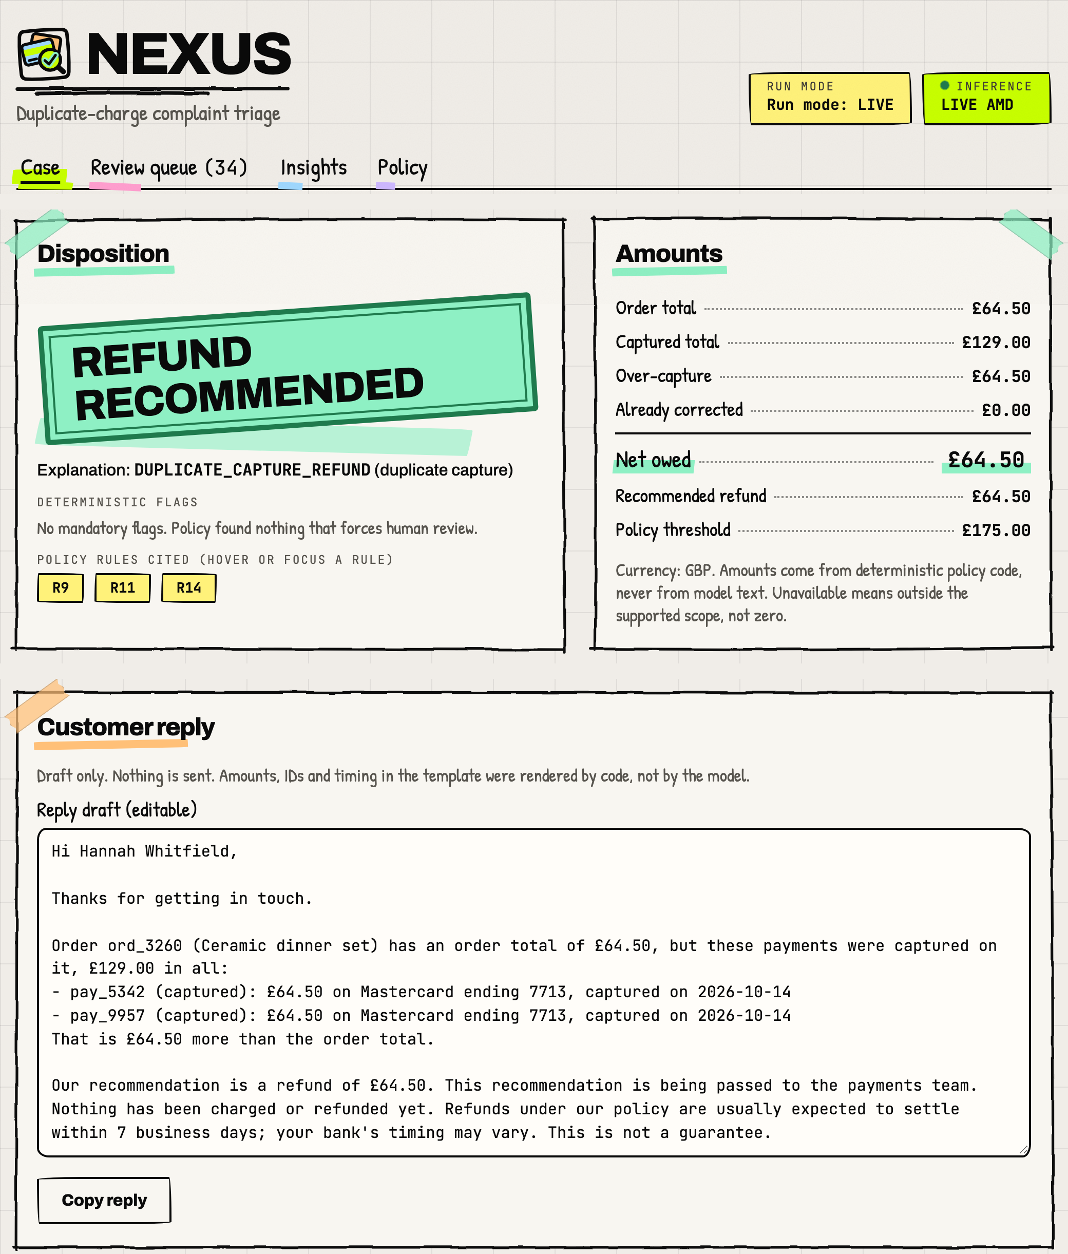
NEXUS
USER AND PRODUCT
2 / 6
A cited triage and a safe reply, for the agent
PRIMARY
E-commerce support agent
SECONDARY
Support lead
Cited triage
every cited record checked
complaint + authorized payment records
Reply draft
written by code, never by the model
Refund recommendation
or a human-review case
Real case screen, synthetic data: LIVE AMD
Notes:
Primary user is the e-commerce support agent, secondary is the support lead. The input is the complaint plus authorized payment records. The output is a cited triage, a reply draft that code writes and the model never does, and a refund recommendation or a human-review case. The screen on the right is a real case screen with synthetic data, run LIVE AMD.

Slide 3
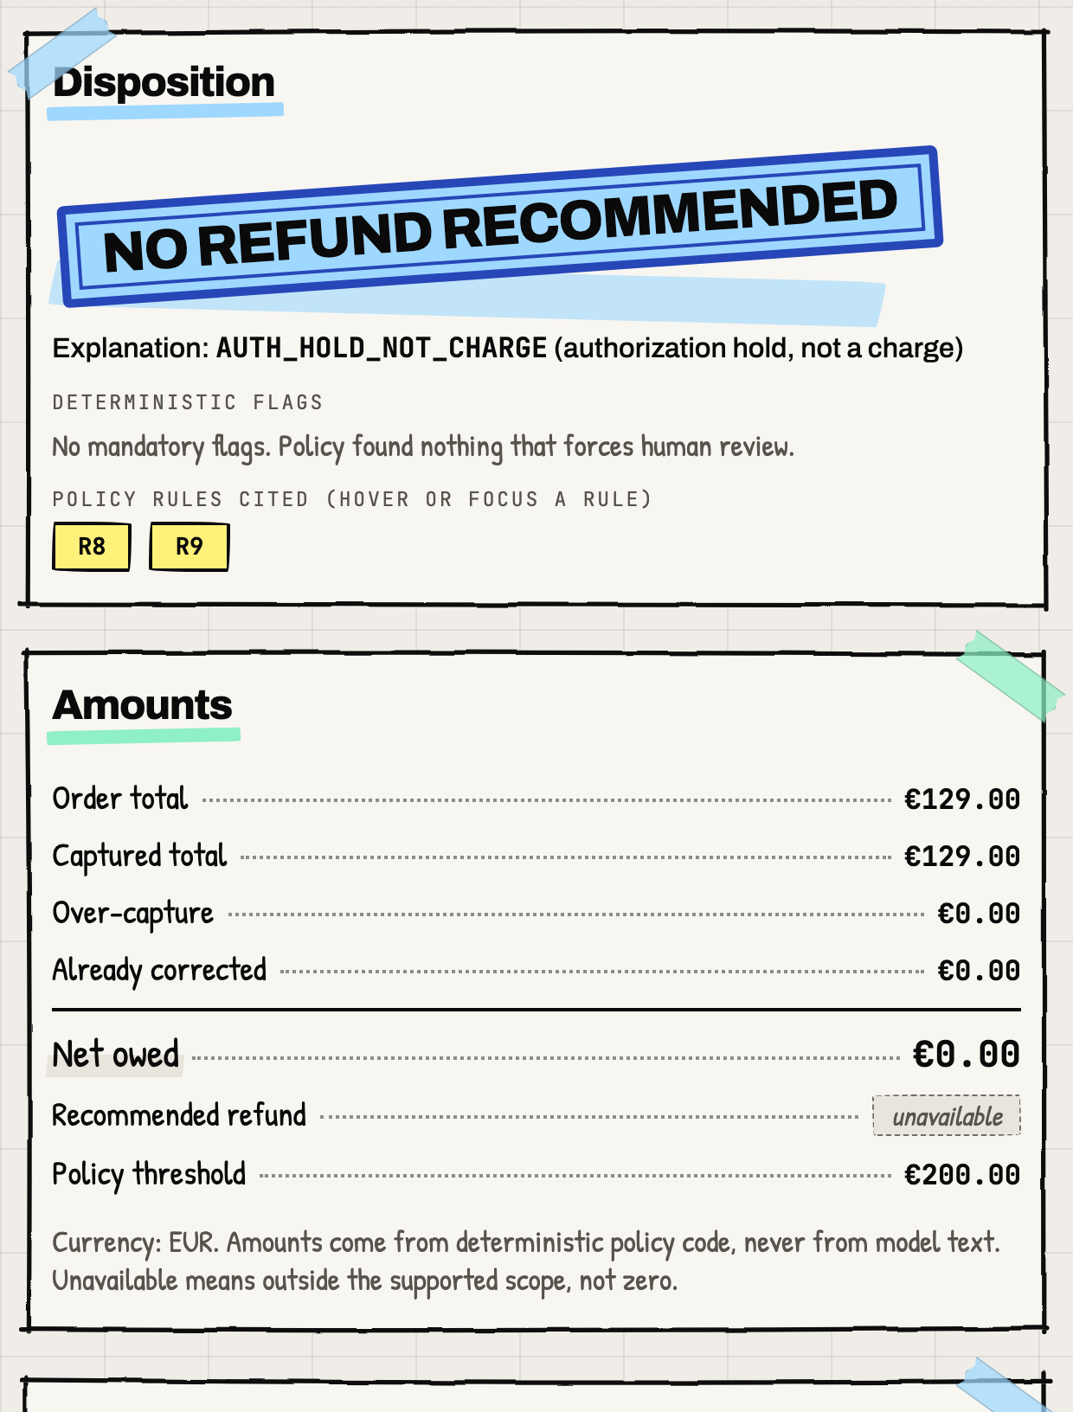
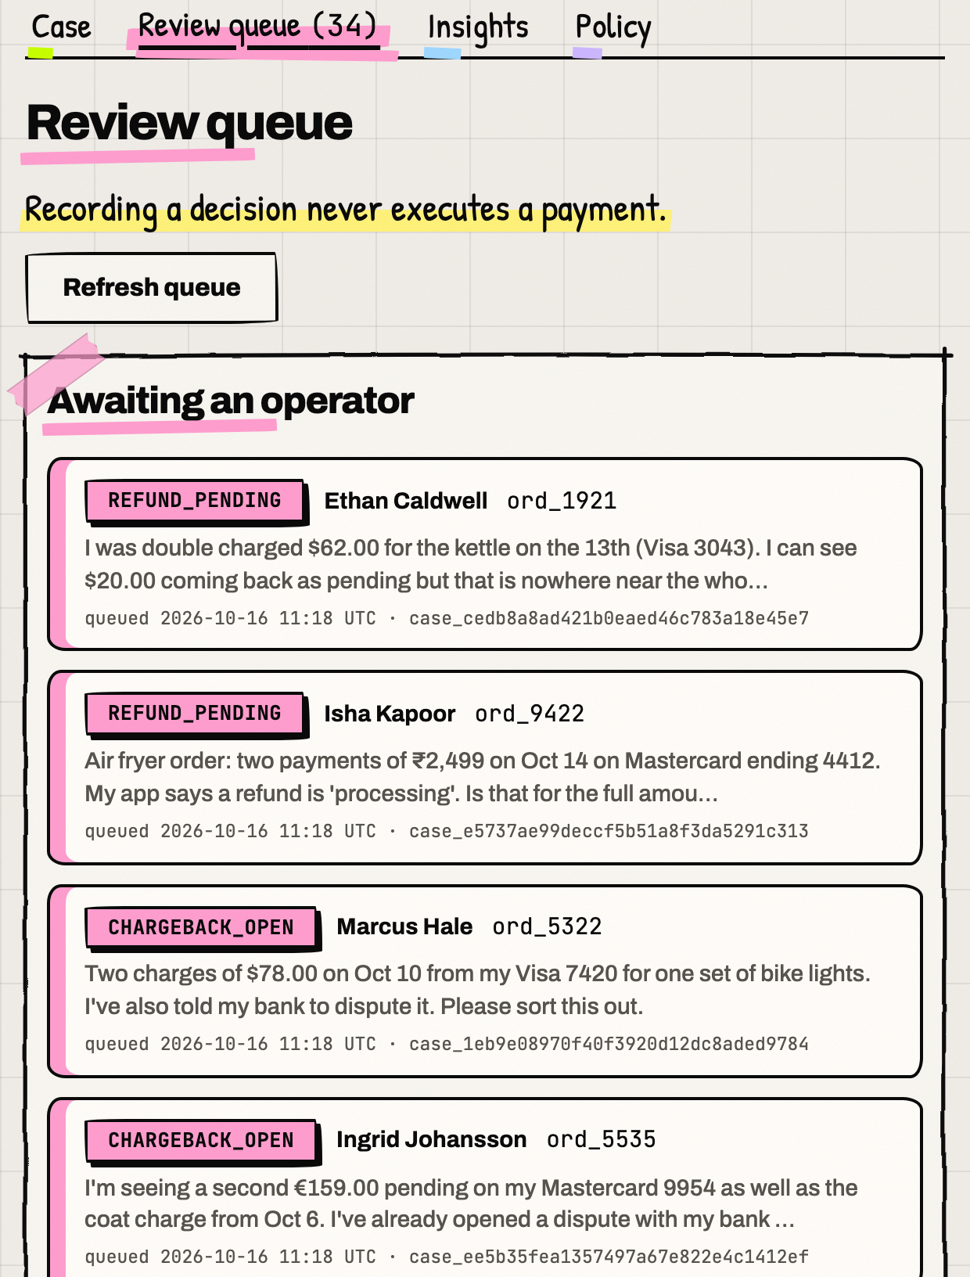
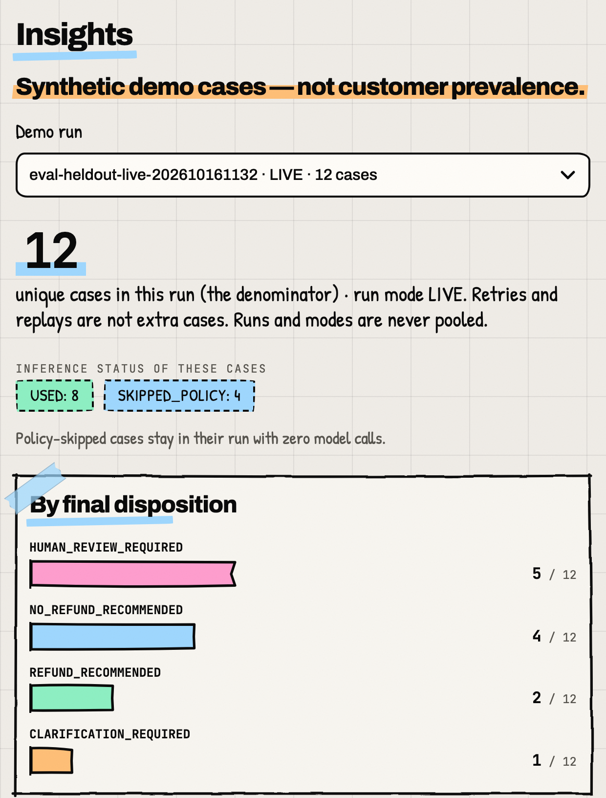
NEXUS
DEMO FRAMES
3 / 6
Real screens from real runs
run eval-heldout-live-202610161132
Case result. A hold is not a charge: stamped no refund.
Review queue. Policy-flagged cases wait for a person.
Insights. The 12 held-out cases by disposition.
Notes:
Three real screens from the held-out live run: the case result, where a hold is not a charge so the stamp says no refund; the review queue, where policy-flagged cases wait for a person; and the insights view of the 12 held-out cases by final disposition.

Slide 4
NEXUS
AMD EVIDENCE
4 / 6
Gemma-4-31B-IT on AMD GPUs reads the complaint
AMD Token Factory
developer.amd.com.cn
prompt nexus-investigator-v1
Mandatory flag
e.g. open chargeback
0 AMD calls
SKIPPED_POLICY, 4 of 12 held-out cases
Human review queue
a person decides
flag found
Snapshot
hashed evidence
Policy rules
code decides eligibility
AMD interprets
Gemma-4-31B-IT reads the complaint
Validation
cited IDs exist, amount = policy
Code renders
reply, clarification or review
no flag
Real request, held-out case s02
id ef5339775864420594e723411612a8f5
2026-10-16T11:34:07.617Z, 24,992 ms
2,797 tokens in / 236 out
Honest limit
Gemma-4-31B-IT rejects max_tokens on this endpoint. Output is bounded by a 60 s timeout, schema validation and a budget reservation.
run eval-heldout-live-202610161132
Notes:
Code, not the model, decides eligibility. A snapshot of hashed evidence goes through the policy rules. If a mandatory flag is found, there are 0 AMD calls (SKIPPED_POLICY, 4 of 12 held-out cases) and a person decides. Otherwise Gemma-4-31B-IT on AMD GPUs reads the complaint, validation checks the cited IDs and the amount, and code renders the reply. Real request: held-out case s02, 24,992 ms, 2,797 tokens in and 236 out. Honest limit: the endpoint rejects max_tokens, so output is bounded by a 60 s timeout, schema validation and a budget reservation.

Slide 5
NEXUS
COMPARISON RESULT
5 / 6
NEXUS 12/12 vs rules-only 10/12 on disposition
12 synthetic held-out cases: descriptive, not a general accuracy claim
Metric | A rules only, no inference | B NEXUS + AMD
Disposition correct | 10/12 | 12/12
Reply rubric | 19/21 | 21/21
Critical failures | 0/12 | 0/12
Mandatory-review recall | 4/4 | 4/4
Model calls on the 4 policy-skipped cases | 0 | 0
A missed an injection
A double-charge complaint said "refund $500". A asked for clarification. B kept the policy amount, GBP 64.50.
A missed an off-topic case
A login complaint got "no refund" from A. B sent it to a person.
B better
tie
A missed
run eval-heldout-live-202610161132
Notes:
On the 12 synthetic held-out cases, NEXUS got disposition 12/12 against 10/12 for rules only, and the reply rubric 21/21 against 19/21. Critical failures were 0/12 for both, mandatory-review recall 4/4 for both, and there were 0 model calls on the 4 policy-skipped cases. Rules-only missed an injection (a refund of $500 was requested; NEXUS kept the policy amount, GBP 64.50) and an off-topic login complaint. Descriptive only, not a general accuracy claim.

Slide 6
NEXUS
LIMITATIONS AND NEXT STEPS
6 / 6
What this does not show yet
Limits
Synthetic data, fictional policy
12 held-out cases, descriptive only
No payment or email is ever executed
Shared Token Factory: mean 29.4 s per call (run eval-heldout-live-202610161132)
Operator ID is an audit label, not a login
Next
Real policy import
replace the fictional policy
More cases
beyond the 12 held-out cases
Timing study with agents
agent time per complaint is not measured yet
Evolus and partner integrations
not claimed in this submission
Live demo
https://nexus-dispute-triage.vercel.app
Team Takla
Vaibhav Jangid, Garv Bansal,
Abishek Guru, Pachipulusu Poojit
Code
github.com/vj-io/nexus-dispute-triage
Notes:
Be straight about the limits: synthetic data and a fictional policy, only 12 held-out cases, no payment or email is ever executed, a shared Token Factory with a mean of 29.4 s per call, and the operator ID is an audit label, not a login. Next: a real policy import, more cases, a timing study with agents, and Evolus and partner integrations, which are not claimed here. Point to the live demo and the repo, and thank Team Takla.

