Slide 1

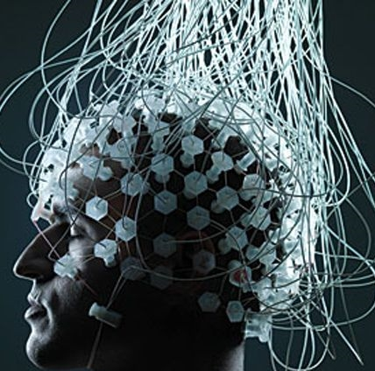
BRAIN COMPUTER INTERFACE
EMOTION RECOGNITION
Project under the guidance of : Ms. Akansha Gupta
Submitted by: Vanshika Jain

Slide 2
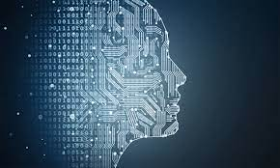
INTRODUCTION
Brain Computer Interface is a computer based system that acquires brain signals, analyzes them and translates them into command that are relayed to an output device that carry out a favored action.

Slide 3
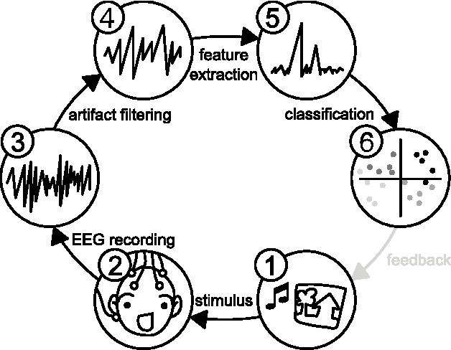
O B J E C T I V E
The main objective of this project is to capture user’s emotional state to avoid stress related diseases. By identifying user emotions, we can avoid suicides. Help people from mental stress by giving them advice
To build a training model including physiological signals (EEG signals from the dataset) useful for detecting emotions with the help of machine and deep learning.
To compare both the algorithms : Recurrent Neural Network and Random Forest classifier
for this purpose.

Slide 4
STEPS TO MAKE BCI
FEEDBACK DEVICE
CLASSIFICATION
SIGNAL ACQUISITION
PRE-PROCESSING
6
4
2
FEATURE EXTRACTION
TRANSLATION
5
1
3

Slide 5
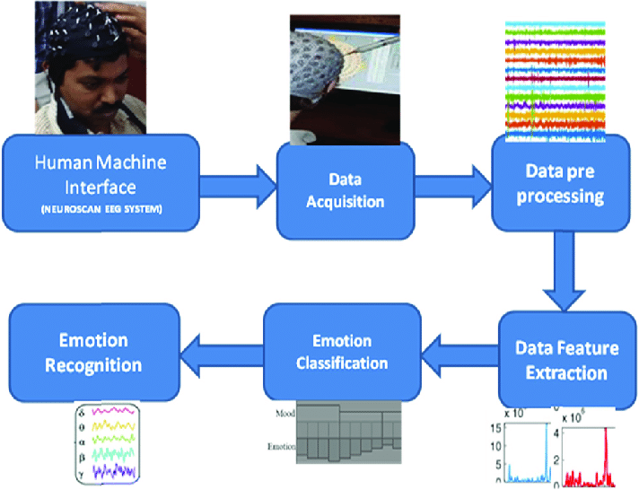
FLOW DIAGRAM

Slide 6
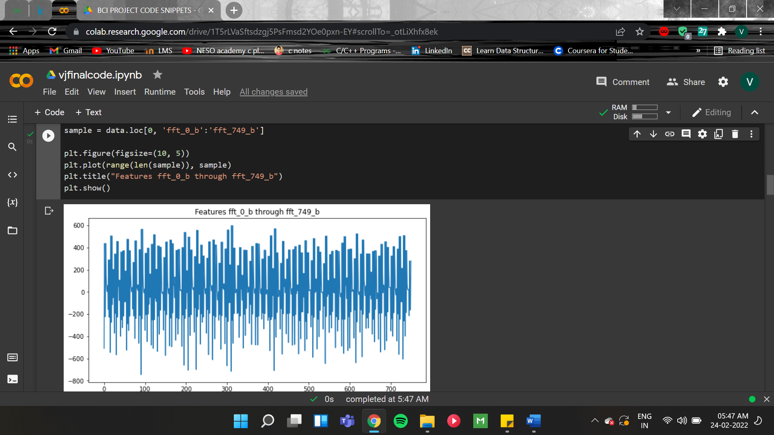
DATA ACQUISITION AND ANALYSIS
The EEG Dataset is acquired from Kaggle.
Details of Dataset: The data was collected from two people (1 male, 1 female) for 3 minutes per state - positive, neutral, negative. We used a Muse EEG headband which recorded the TP9, AF7, AF8 and TP10 EEG placements via dry electrodes.
Six minutes of resting neutral data is also recorded, the stimuli used to evoke the emotions are four different movies with distinct scenes that evoke a particular emotion: positive and negative.
DATASET VISUALIZATION PLOTTED VIA
MATPLOTLIB.

Slide 7






LIBRARIES USED
03
PANDAS
Used for data reading and analysing.
04
06
01
SKLEARN
TENSORFLOW
NUMPY
Includes classifiers for ML
Open source library that mainly helps with training the models.
A Python library offering mathematical functions ,random number generators
02
05
MATPLOTLIB
KERAS
Mostly used for plotting and visualization in Python
Neural network library providing high level API’s

Slide 8
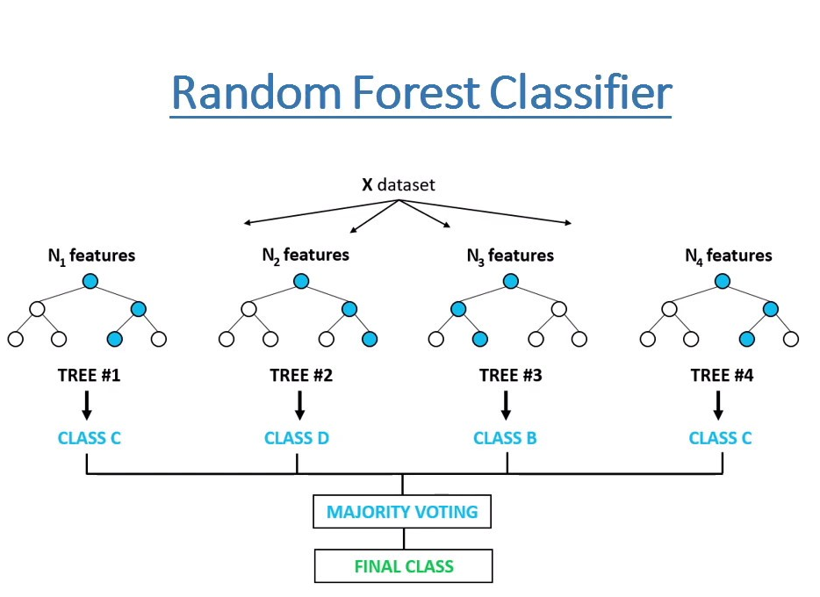
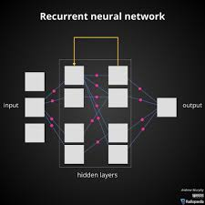
ALGORITHMS
1. Random forest Classifier: Random Forest is a classifier that contains several decision trees on various subsets of the given dataset and takes the average to improve the predictive accuracy.
2. Recurrent Neural Network: RNN is a class of neural network which uses sequential data or time series data.
RNNs can process inputs of varied lengths. The more the computation, the more will be the possibility of information to be gathered and in addition the model size does not increase with the input size.

Slide 9
RESULTS
RANDOM FOREST CLASSIFIER
RECURRENT NEURAL NETWORK
98%
96%
RNN Model architecture gave an accuracy of 96%.
Random Forest gave the accuracy of 98%

Slide 10
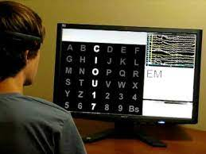
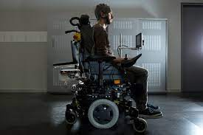
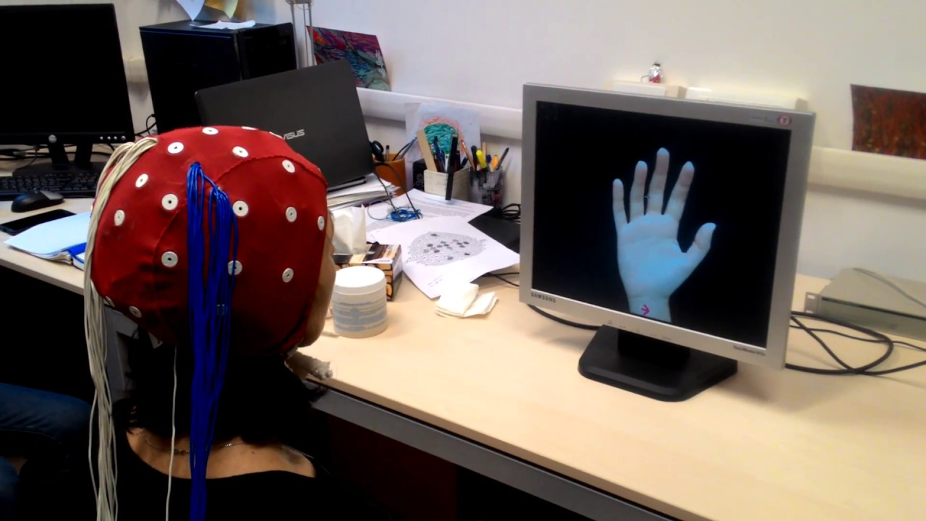
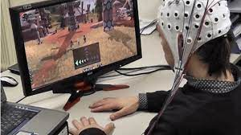
BCI APPLICATIONS
SPELLERS
WHEELCHAIR
MOTOR
IMAGERY
GAMING

Slide 11
LIMITATIONS OF BCI
01
02
DIFFICULT TO DECODE THE SIGNALS ACCURATELY
SIGNAL ACQUISITION HARDWARE.
03
LEGAL IMPLICATIONS
04
POSES RISK TO PATIENT HEALTH.

Slide 12
FUTURE WORK
Once deployed the emotion detection system can be used to bridge the gap between human emotions and computational technology. It can be used to prevent depression before there are any clear outward signs of it. It can also help in inventing ways to help people with special needs who face communication, motivation, and emotion regulation challenges.

Slide 13

T H A N K YOU!

