Slide 1

MUMBAI PYTHON DEVELOPERS GROUP
From Algorithms to
Autonomous Capital
How AI agents are rewriting finance. Multi agent, human in the loop, live in Python.
Vivaan Jain Student, DJSCE
27 June 2026 2:00 PM IDfy

Slide 2
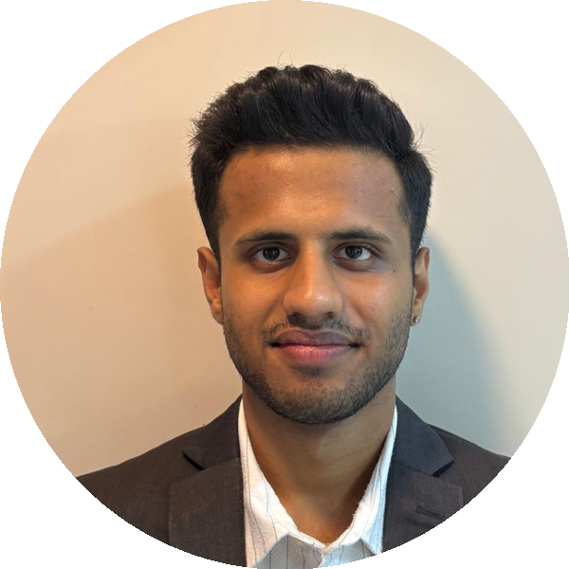









ABOUT ME
Dwarkadas J. Sanghvi College of Engineering
B.Tech, Computer Engineering
Tech Intern
Zeex AI and Internovo Ventures
Synapse
Machine Learning committee, DJSCE
Vivaan Jain
Computer Engineering, DJSCE
ACM Research
Researching credit scoring models
Mumbai, India
github.com/vj0246
Scan, Portfolio
vivaan-jain-portfolio.vercel.app
linkedin.com/in/vivaan-jain
vivaan.jain246@gmail.com

Slide 3




AI IN FINANCE
AI is reshaping finance
From spotting patterns to supporting real decisions.
Where AI works today
How it is evolving
Credit scoring and risk
Predict forecast and classify
Fraud and anomaly detection
Generate read, write, explain
Research and document analysis
Act plan and take steps, with a human gate
Forecasting and decision support
Tonight sits at the frontier: agents that act, responsibly.

Slide 4















WHAT IS AN AI AGENT
Anatomy of an AI agent
An agent is an LLM that can plan, use tools, and act in a loop, not just reply.
THE AGENT
TOOLS
functions the agent can call
calls
Market data
APIs and services
LLM
Memory
Planner
Run code
Web search
reasons
remembers
picks next step
results
HOW IT WORKS, THE LOOP
Goal
Think
Act
Observe
Answer
Observe feeds back to Think. The loop repeats until the agent is done, then it answers.

