Slide 1

Health Prediction System
By:
Priya Kunwar(16egics082)
Megha Vyas(16egics066)
Vinod Joshi(16egics119)
Mihir Maheshwari(16egics067)

Slide 2
The Problem
Outline
Solution Proposal
Objectives
Scope of the project Overall Description Snapshots Conclusion

Slide 3

Problem statement
The health problem is the gap
between an acceptable or desirable
health status and the current status.
Use health status indicators to using this system. Health status indicators are data on outcomes or their causes .
Health status indicator data is made
available by numerous organizations.

Slide 4
Solution
I always knew this was an area in which technology could help improve my workflow and hoped it would also improve patient care. Since then, advancements in electronical medical records have been remarkable, but information they provide is not much better . If technology is to improve care in the future, then the electronic information provided to doctors needs to be enhanced by the power of analytics and machine learning.

Slide 5

Objective
Build a consumer-focused integrated primary health care system.
Improve access and reduce inequity.
Increase the focus on health promotion and prevention, screening and early intervention.
Improve quality, safety, performance and accountability.

Slide 6
Scope of the Project
Firstly, this method provided an efficient approach for the extraction of significant patterns from the disease data warehouses for the efficient guess of heart disease, cancer and arthritis.
The goals are defined based on business intelligence and exploration of data. The goals need to be calculated against the trained models.

Slide 7
Overall Description

Slide 8
ML PERSPECTIVE
Machine Learning methods facilitate development of the intelligence into a machine, so that it can perform better in the future using the learned experience. Machine learning methods application on electronic health record dataset could provide valuable information and predication of health risks.

Slide 9
Snapshots

Slide 10
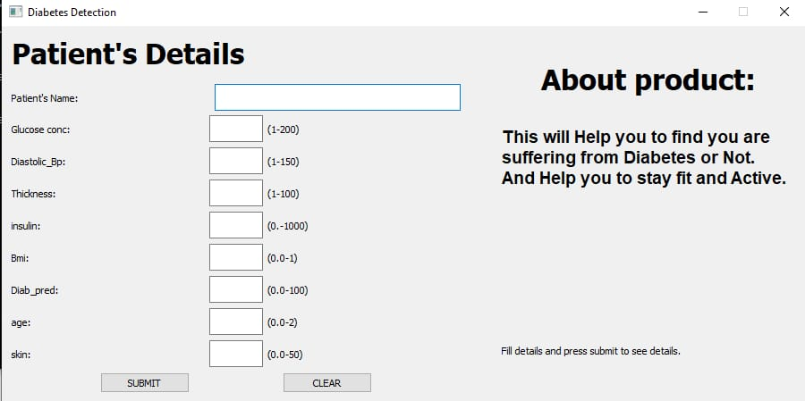
Searching app:
When we search the app and if app is not present in the database it will show that app is not found.

Slide 11
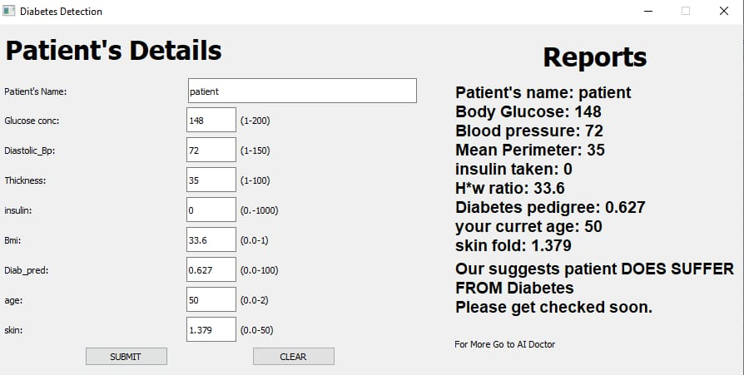
Searching app:
When we search the app and if app is present in the database and is not genuine i.e, sentiment polarity is below some threshold it will show that app is Fraud.
Despite of this if user want to download it then a URL is also given which will redirect to playstore.

Slide 12
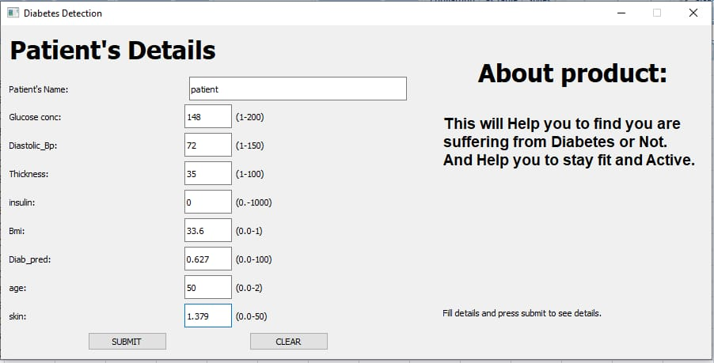
Searching app:
When we search the app and if app is present in the database and is genuine i.e, sentiment polarity is above some threshold it will show that app is Genuine. And if user want to download it then a URL is also given which will redirect to playstore.

Slide 13
Conclusion

Slide 14
The proposed system is GUI-based, user-friendly, scalable, reliable and an expandable system. The proposed working model can also help in reducing treatment costs be providing initial diagnosis in time. The model can also serve the purpose of training tool for medical students and will be a soft diagnosis tool available for physician and cardiologist. General physicians can utilize this tool for initial diagnosis of patients. There are many possible improvements that could be explored to improve the scalability and accuracy of this prediction system. As we have developed a generalized system, in future we can use this system for analysis of different data sets. The performance of the health’s diagnosis can be improved significantly by handling numerous class labels in the prediction process, and it can be another positive direction of research. In DM warehouse, generally, the dimensions of the database is high, so identification and selection of significantattribute for better diagnosis of heart disease are very challenging tasks for future research.

Slide 15
Thank you

