Slide 1
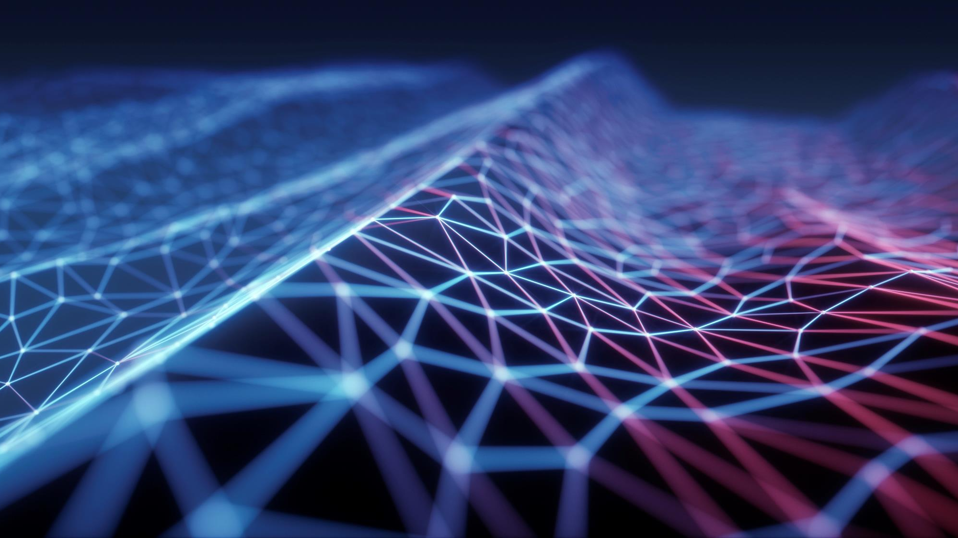
Smart guard: real-time imposter detection
DivyeshKumar Parmar
Ram vishnu surya jannu

Slide 2
Contents
INTRODUCTION
WORKING
RESULTS
APPLICATIONS
FUTURE WORK

Slide 3
INTRODUCTION
This project utilizes a variety of machine learning frameworks and Python to create a robust real-time face detection and identification system. The program can be used to automatically register attendance in settings like meetings, events, and classrooms because it can recognize and identify faces in a live webcam broadcast.
Face Recognition and Detection:
Makes use of the FaceNet model for facial recognition and the OpenCV library for face detection.
Unknown faces are stored for additional examination, while recognized faces are recognized by the system and given their proper names.
Data Augmentation:
Enhances and automatically arranges the student image collection, improving the model's capacity to identify faces in a range of lighting and angle situations.

Slide 4
INTRODUCTION
Real-Time Processing:
Real-time processing of video frames by the system guarantees prompt and precise face detection and recognition.
Attendance Management:
Time stamps and recognized faces are logged, making it simple to monitor attendance over time.
The attendance records are kept in an Excel file, which makes data administration and retrieval simple.
User-Friendly Interface:
Developed with Streamlit, the web browser-based program provides an easy-to-use and interactive interface.

Slide 5
WORKING
Data pre-processing
Data augmentation
Face detection and Face encoding using FaceNet
Face recognition from Live web cam (Real-time processing)
Attendance logging of authorized people
Detecting unauthorized persons and archiving their images

Slide 6
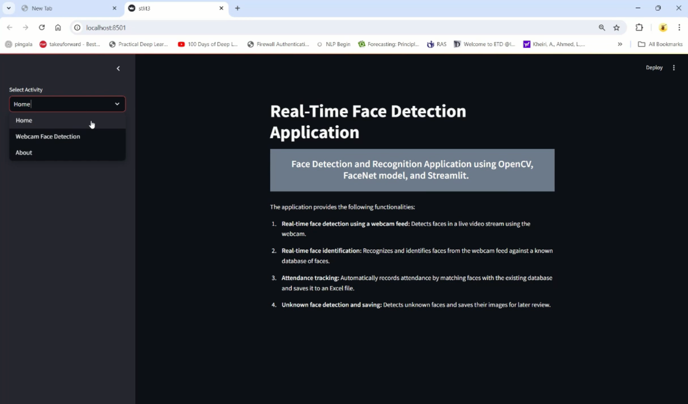
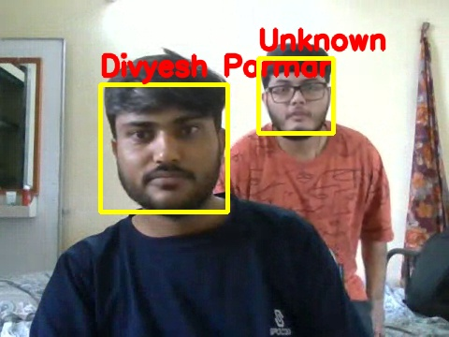
RESULTS
WORKING OF MODEL
IMPOSTER DETECTION

Slide 7
Applications
Automatic attendance monitoring in educational institutions
Meeting room access in corporate environments
Attendance verification at events
Intruder detection
Patient identification at health facilities
Smart homes and IOT
Access to vip lounges, passenger identification in public transport

Slide 8
Future work
Improvement in recognition accuracy by enhancing model training and incorporating Deep learning models
Integration with larger systems
Real-time notification and alerts

Slide 9
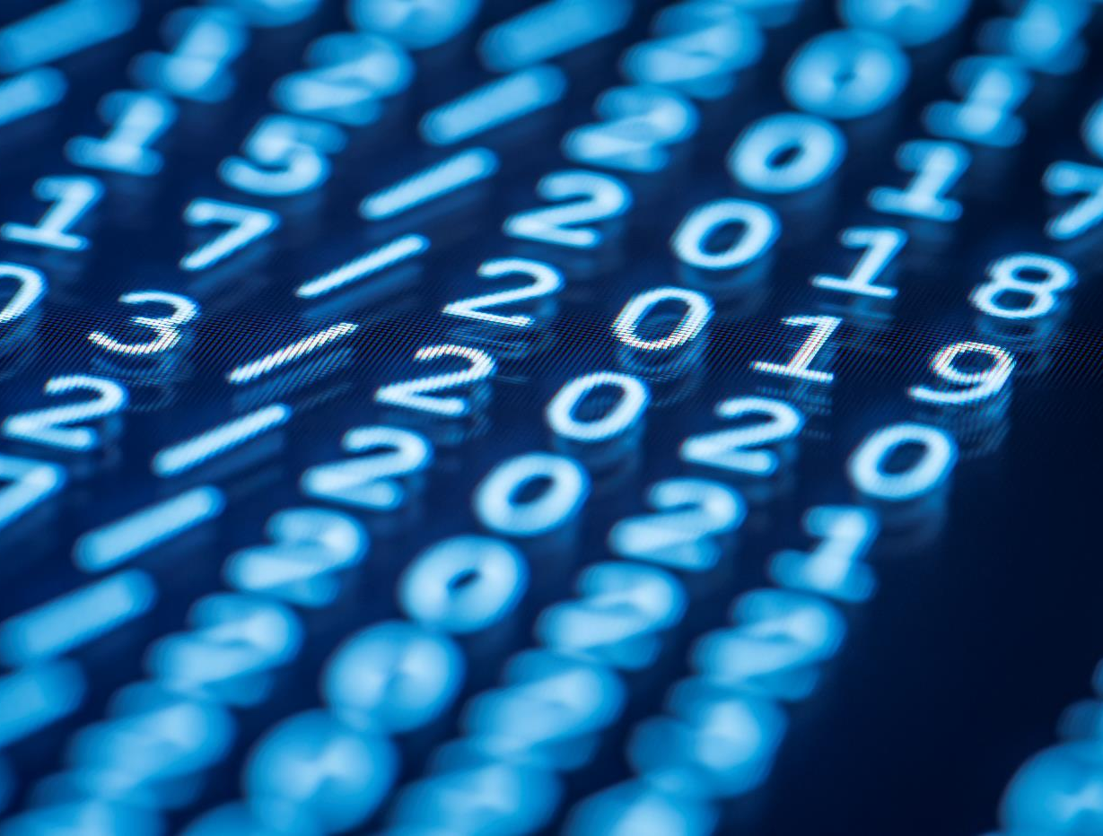
Thank You

