Slide 1
Embedded System Lab
Group: Vijay Mohite
Franki

Slide 2
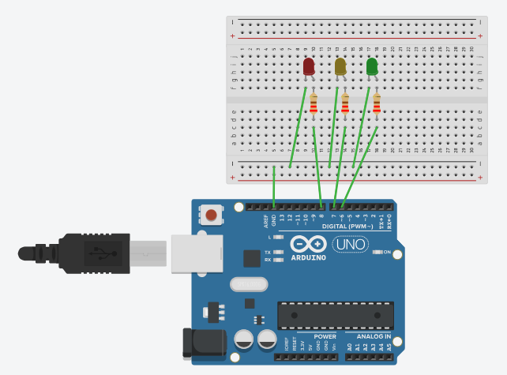
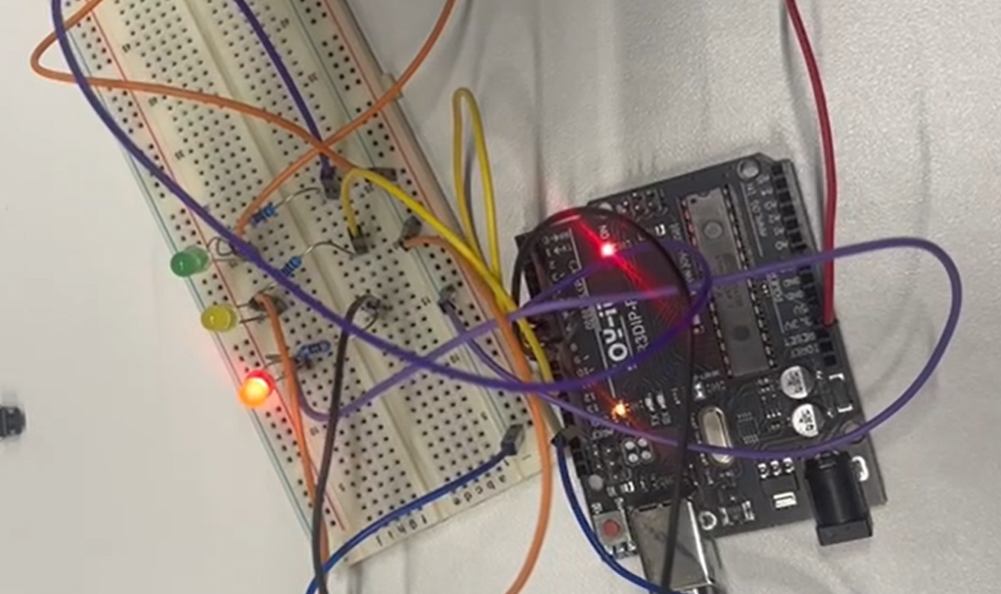
Traffic light system
Tinkercad Circuit
Arduino Board

Slide 3
//Red and Yellow led on
digitalWrite(led_yellow, HIGH);
delay(2000); // Wait for 2000 millisecond(s)
//Led red and yellow off
digitalWrite(led_red, LOW);
digitalWrite(led_yellow,LOW);
//Only Green led on
digitalWrite(led_green, HIGH);
delay(10000); // Wait for 10000 millisecond(s)
//green Off and Yellow led on
digitalWrite(led_green,LOW);
digitalWrite(led_yellow, HIGH);
delay(2000); // Wait for 2000 millisecond(s)
//Led yellow off
digitalWrite(led_yellow,LOW);
}
// C++ code
//
#define led_red 8
#define led_yellow 7
#define led_green 6
void setup()
{
pinMode(led_red, OUTPUT);
pinMode(led_yellow, OUTPUT);
pinMode(led_green, OUTPUT);
digitalWrite(led_red, LOW);
digitalWrite(led_green,LOW);
digitalWrite(led_yellow,LOW);
}
void loop()
{
//Red led on
digitalWrite(led_red, HIGH);
delay(10000); // Wait for 10000 millisecond(s)

Slide 4
Using Switch case
void loop()
{
switch (state) {
case 0: // vehicle Red ON
digitalWrite(led_red, HIGH);
delay(10000);
state = 1;
break;
case 1: // vehicle Red + Yellow ON
digitalWrite(led_red, HIGH);
digitalWrite(led_yellow, HIGH);
delay(2000);
state = 2;
break;
case 2: // vehicle Green ON
digitalWrite(led_green, HIGH);
digitalWrite(led_red, LOW);
digitalWrite(led_yellow,LOW);
delay(10000);
state = 3;
break;
case 3: //vehicle Yellow ON
digitalWrite(led_green, LOW);
digitalWrite(led_yellow,HIGH);
delay(2000);
digitalWrite(led_yellow, LOW);
state = 0;
break;
}

Slide 5
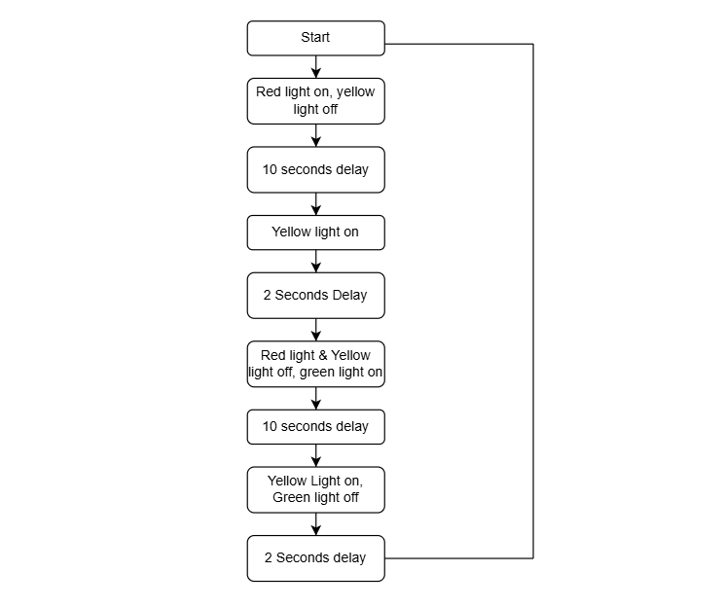

Slide 6
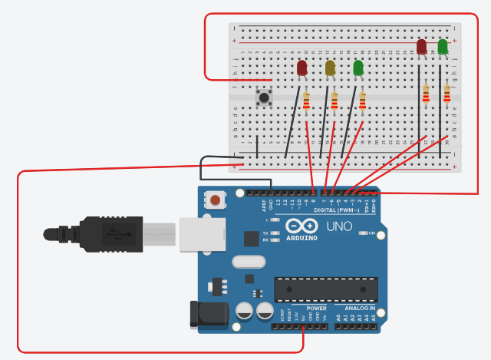
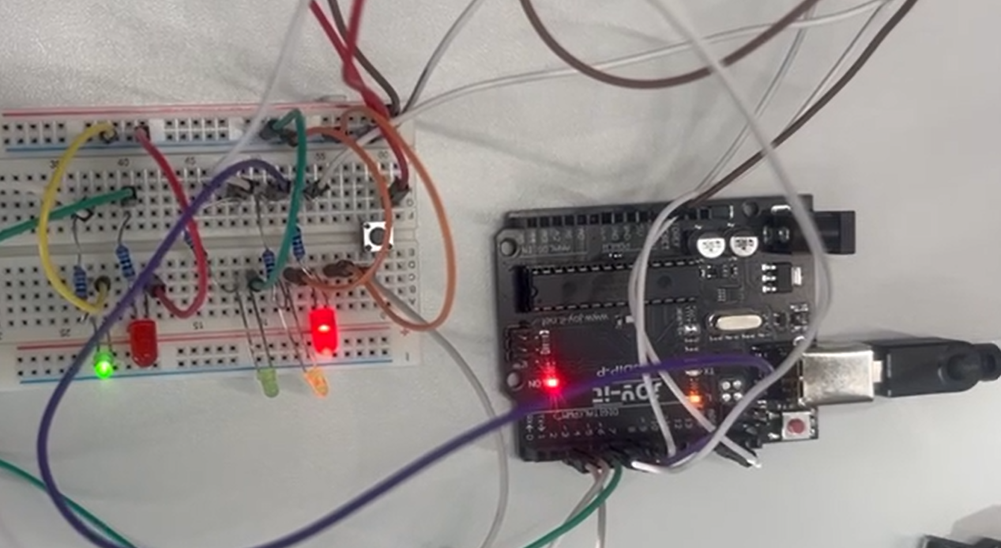
Pedestrian button
Tinkercad Circuit
Arduino Board

Slide 7
// C++ code
//
#define led_red 8
#define led_yellow 7
#define led_green 6
#define led_red_ped 4
#define led_green_ped 3
#define button 2
int state = 0;
bool button_pressed = false;
void setup()
{
pinMode(led_red, OUTPUT);
pinMode(led_yellow, OUTPUT);
pinMode(led_green, OUTPUT);
pinMode(led_red_ped, OUTPUT);
pinMode(led_green_ped, OUTPUT);
pinMode(button, INPUT_PULLUP);
digitalWrite(led_red, LOW);
digitalWrite(led_green,LOW);
digitalWrite(led_yellow,LOW);
digitalWrite(led_red_ped, LOW);
digitalWrite(led_green_ped,LOW);
attachInterrupt(digitalPinToInterrupt(button),buttonISR,FALLING);
}
void loop()
{
switch (state) {
case 0: // vehicle Red ON, Pedestrian green on
digitalWrite(led_red, HIGH);
digitalWrite(led_green_ped, HIGH);
delay(10000);
state = 1;
break;
case 1: // vehicle Red + Yellow ON
digitalWrite(led_red, HIGH);
digitalWrite(led_yellow, HIGH);
digitalWrite(led_green_ped, LOW);
digitalWrite(led_red_ped, HIGH);
delay(5000);
state = 2;
break;
case 2: // vehicle Green ON
digitalWrite(led_green, HIGH);
digitalWrite(led_red, LOW);
digitalWrite(led_yellow,LOW);
delay(10000);
while(!button_pressed); // wait for the pedestrian button press
state = 3;
button_pressed = false;
break;

Slide 8
case 3: //vehicle Yellow ON
digitalWrite(led_green, LOW);
digitalWrite(led_yellow,HIGH);
delay(5000);
digitalWrite(led_yellow, LOW);
digitalWrite(led_red_ped, LOW);
state = 0;
break;
}
}
void buttonISR()
{
button_pressed = true;
}

Slide 9


