Slide 1



Code Trainer (3360707)
ENROLLMENT NO NAME OF STUDENT
1) 176620307029 PRATIK B. KANSARA
2) 176620307016 PRANAV P. CHANPARA
3)176620307028 VANDIT D. JOSHI
4) ) 176620307031 RUTVIK M. KATHROTIYA
DEPARTMENT OF COMPUTER ENGINNERING
DARSHAN INSTITUTE OF ENGINEERING & TECHNOLOGY FOR DIPLOMA STUDIES

Slide 2
1. PROBLEM SUMMARY
1.1 Problem Identification
If a user has to run and execute the source code of the program, he has to install all the necessary software in the system they will consume more required space in the device. And this is time taking process. Use can not do coding of different languages using one software
1.2 Problem Solution
By using our website the space required to install software will be reduced on your device. And user can perform coding of different programming languages like c,c++ and java at the same place..

Slide 3
2. Detail Description
Admin
The Admin can register and add task and its various input and output. Admin can also
See user that register to website.
a_ID: Id of Admin
admin_name: Name of admin
admin_pass: Password of admin

Slide 4
Tasks
The various tasks added by admin are store here.Admin can add , delete , update tasks as per needed.
t_ID: ID of task
t_name: Name of task
t_description: Description of task
t_noOfTestcase:How many testcase to be added
t_noOfInput: How many input in one testcase
t_noOfOutput: How many output in one testcase
ct_language: Language of task

Slide 5
InputOutput-
Various input and output added by admin are stored here. It contain inputs and appropriate output.
io_ID: Id of io
input: For input
output: For output
t_ID: Id of task

Slide 6
Users
The all details of user are stored here like id,username,password,etc.Admin can see user last login , user is active as well as user name.Admin can delete user if needed.
u_ID: Id of user
user_name: Name of user
user_pass: Password of user
user_email: Email of user
user_last_login: User last login
user_joined: user Joined date
is_active: activation of user inform of (0) for deactivate and (1) for activate

Slide 7
Completed Tasks
It stores task completed by user. If user satisfy testcase entered by admin then task is completed and stored. Admin can see Completed tasks done by user.
ID: Id of Completed tasks
u_ID: Id of user
t_ID: Id of task

Slide 8
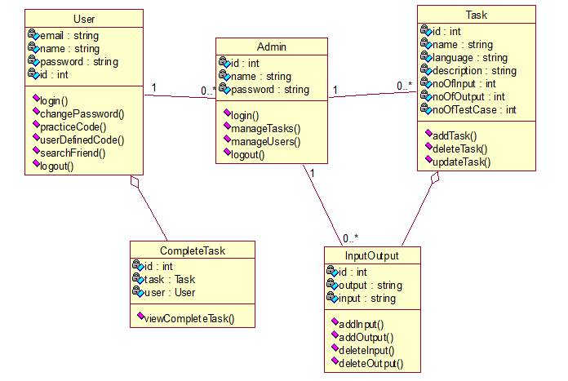
3. DIAGRAMS
3.1 Class Diagram

Slide 9
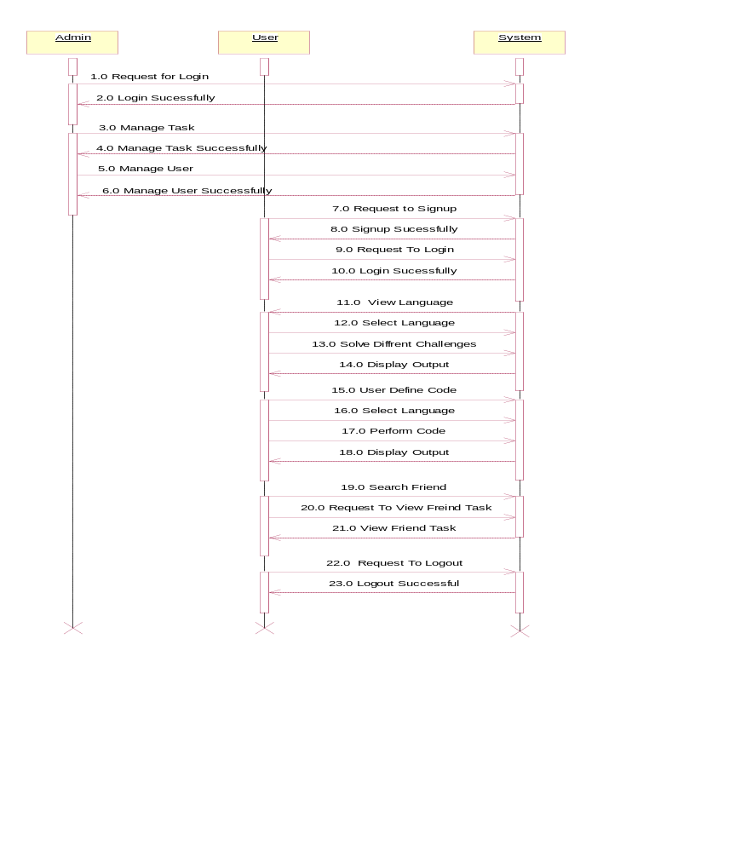
3.2 Sequence Diagram

Slide 10
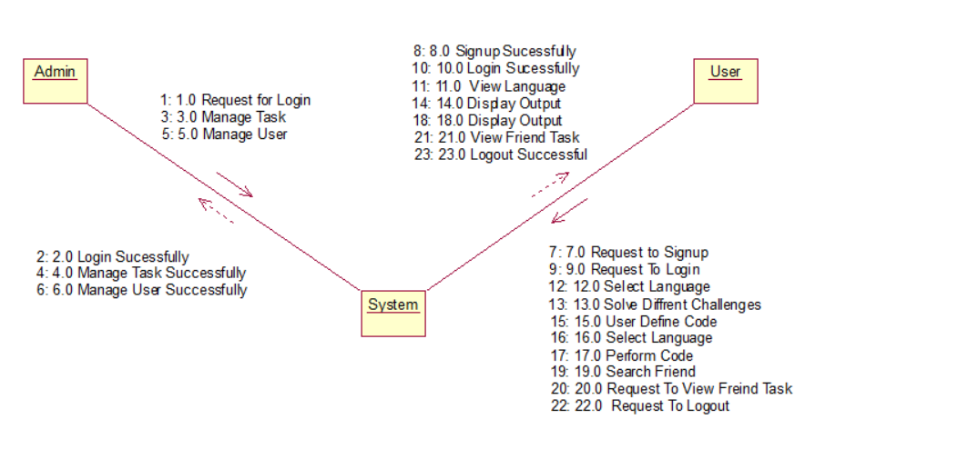
3.3 Collaboration Diagram

Slide 11
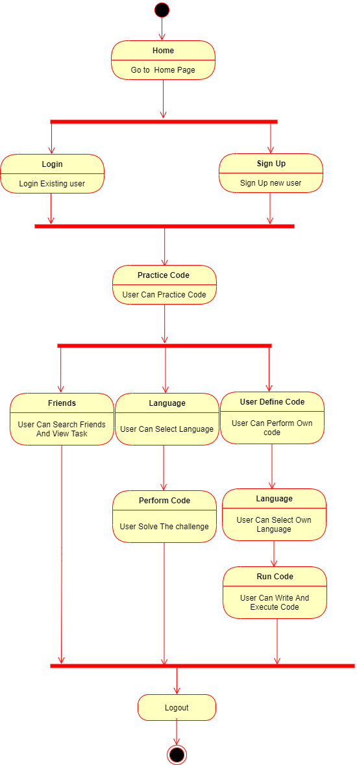
3.4 State Diagram

Slide 12
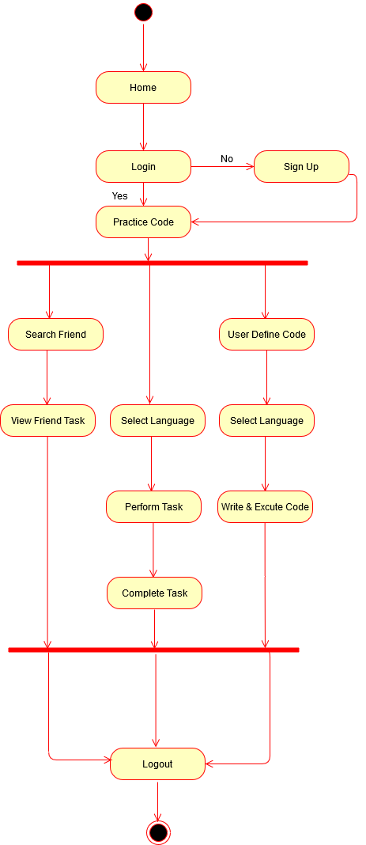
3.5 Activity Diagram

Slide 13
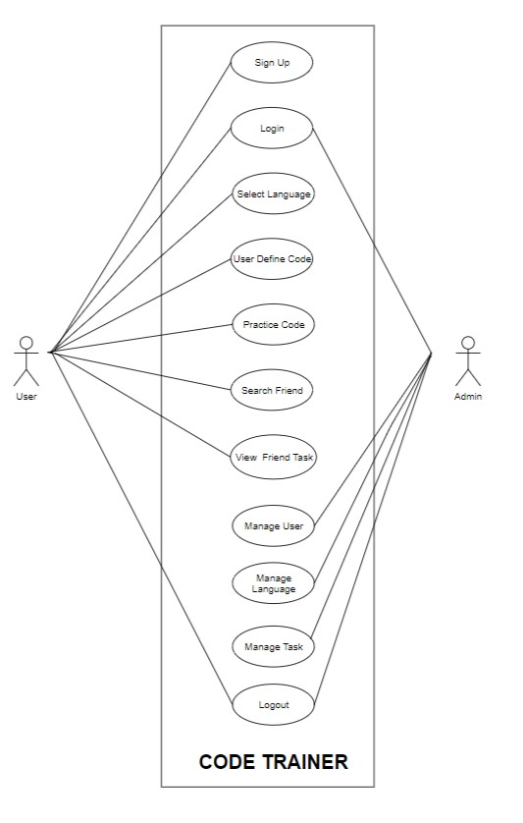
3.6 Use Case Diagram

Slide 14
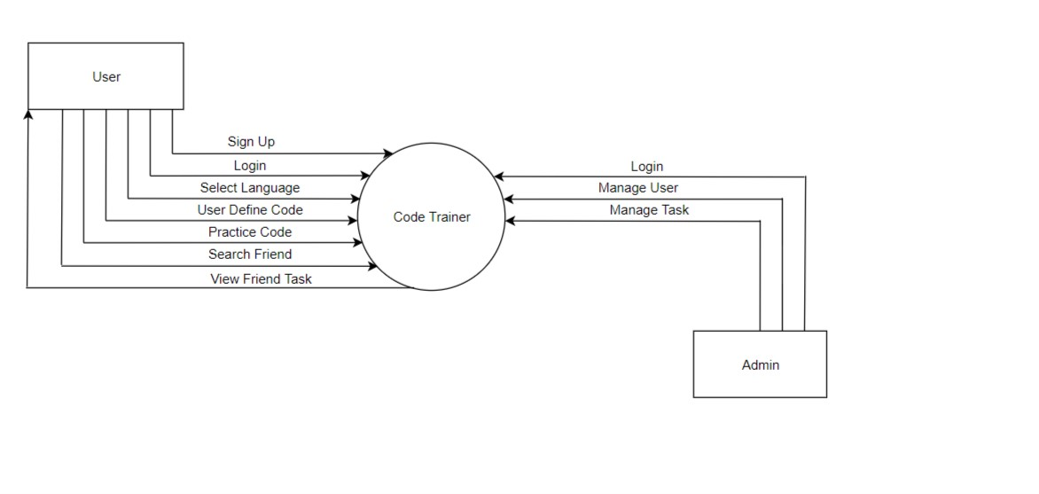
3.7.1 Data Flow Diagram for Admin(Level 1)

Slide 15
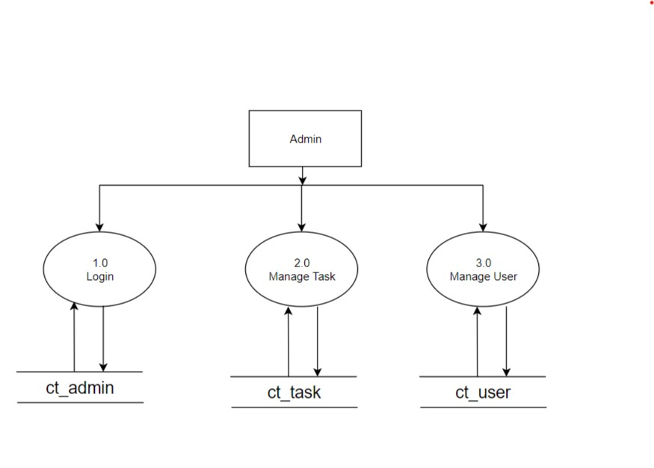
3.7.3 Data Flow Diagram - Admin(Level 1)

Slide 16
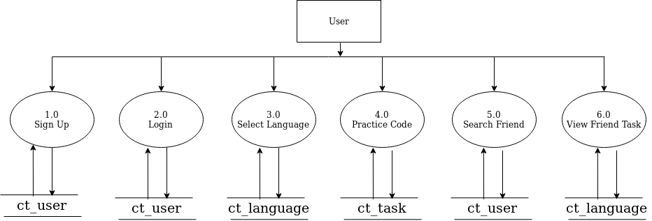
3.7.3 Data Flow Diagram for User(Level 1)

Slide 17
4. DATA DICTIONARY
4.1 Database Tables
ct_user
Field name | Data type | Size | Constraint | Reference | Description
u_ID | int | 20 | Primary Key | - | To get user Id
user_name | varchar | 60 | NOT NULL | - | To get user name
user_pass | varchar | 255 | NOT NULL | - | To get user password
user_email | varchar | 100 | NOT NULL | - | To get user email
user_last_login | datetime | - | NOT NULL | - | Time to get user lastlogin
user_Joined | datetime | - | NOT NULL | - | User joined time
Is_active | boolean | - | NOT NULL | - | For user activation check

Slide 18
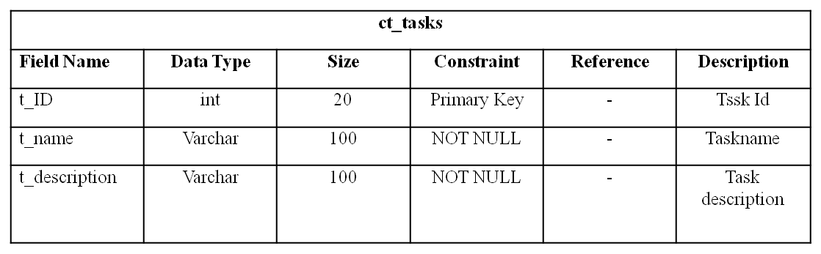
ct_admin
Field Name | Data type | Size | Constraint | Reference | Description
a_ID | int | 20 | Primary key | - | For admin id
admin_name | varchar | 100 | NOT NULL | - | For admin name
Admin_pass | varchar | 100 | NOT NULL | - | For admin password

Slide 19
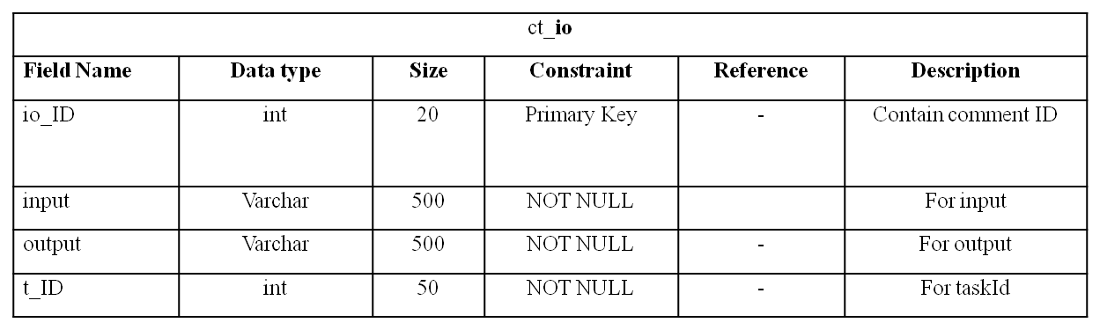
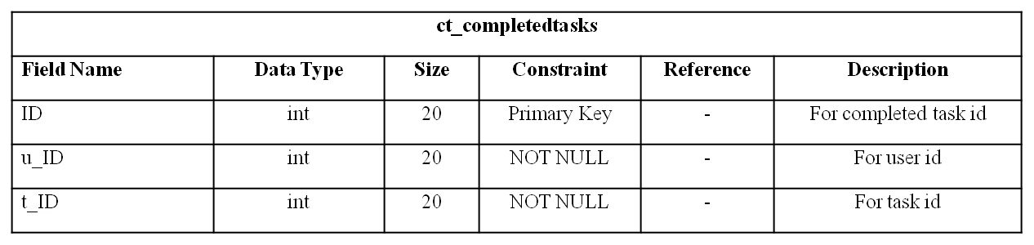

Slide 20
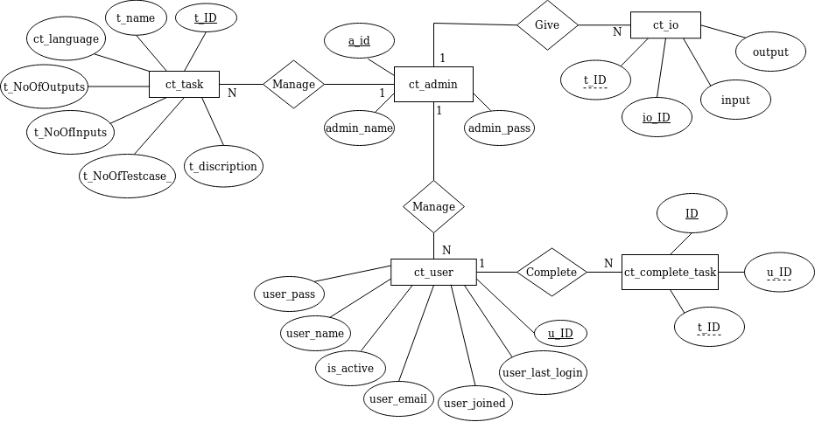
4.2 ER Diagram

Slide 21
5. SCREENSHOTS
5.1 Admin Page
Admin of the system can login through this page.
Admin panel is displayed once admin login through this.
Admin manages the entire site through the admin panel.

Slide 22
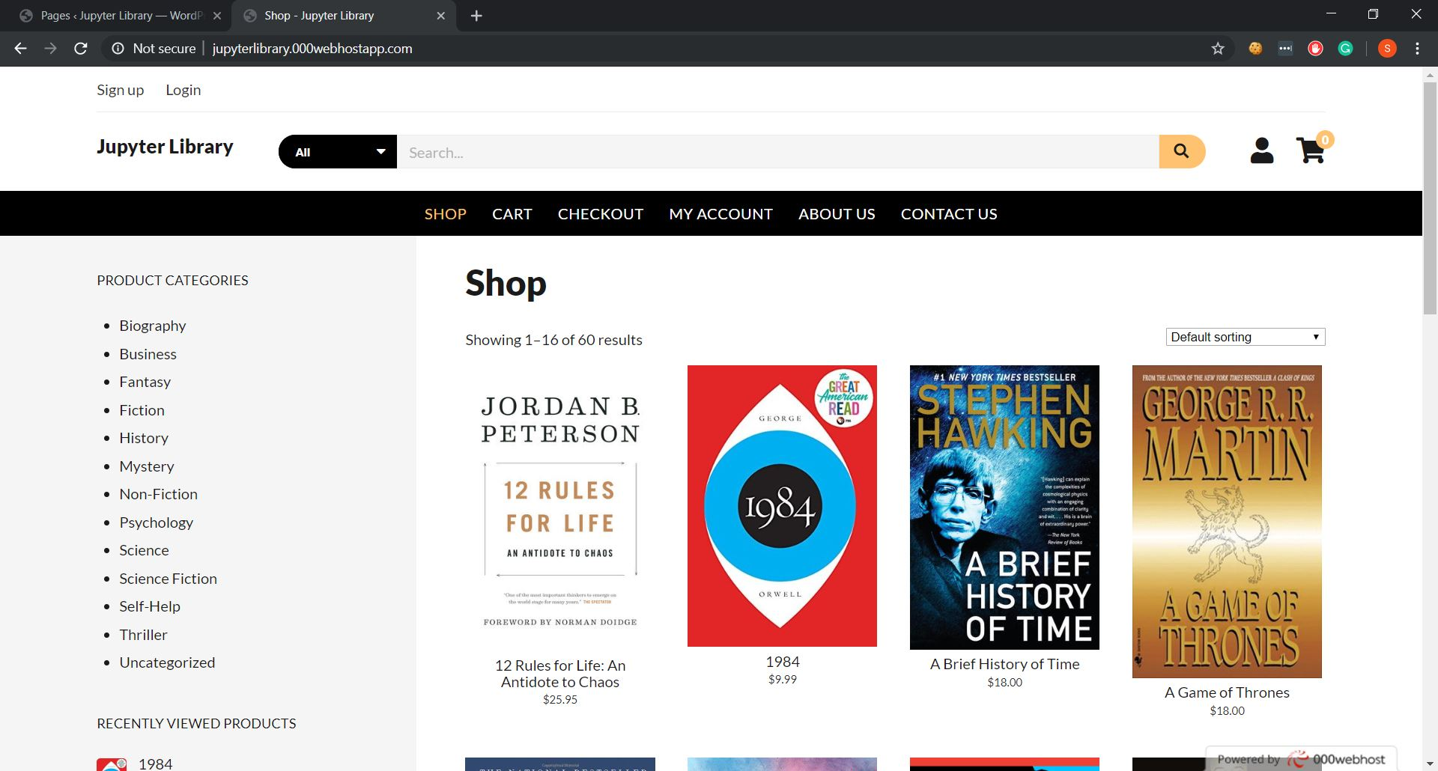
5.2 Store Page
Books available on the store are displayed here.
User can search for books and filter by category.
User can add books to cart and checkout as well.

Slide 23
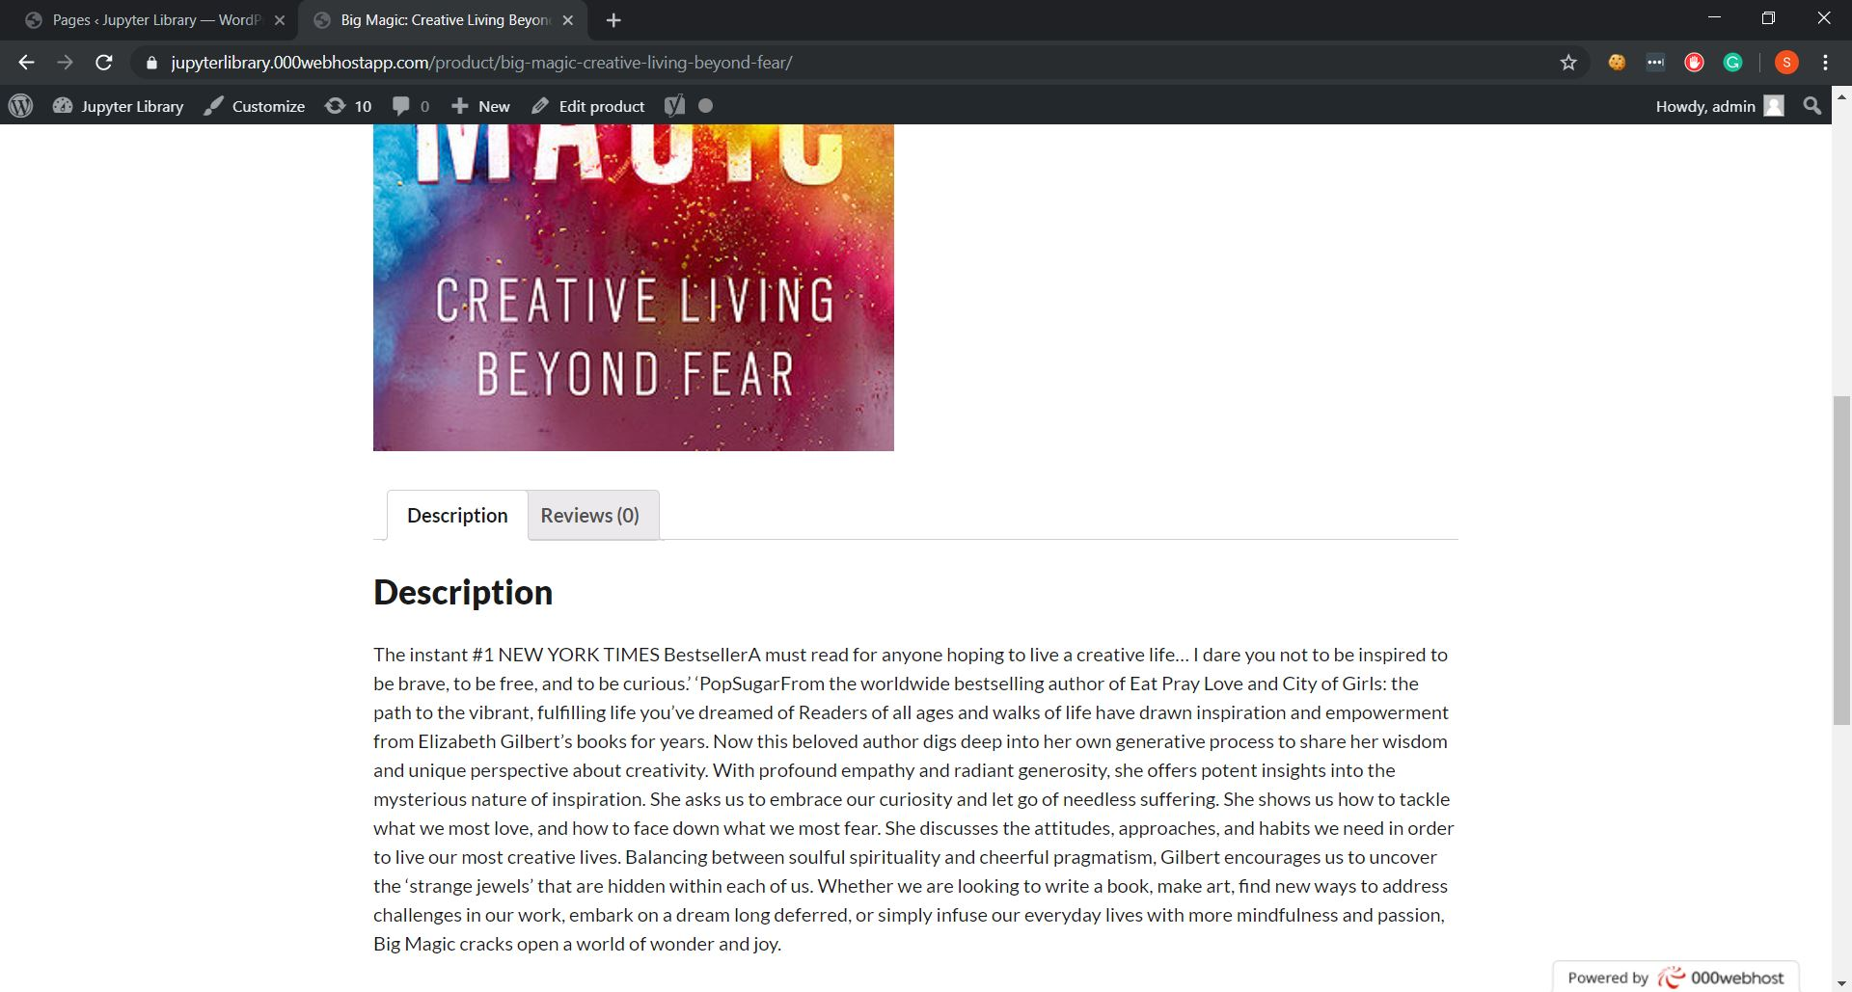
5.3 Book Detail Page
Details of the book can be seen here.
Title, Description, Cover Image and reviews are displayed.
User can comment and write reviews for the products.

Slide 24
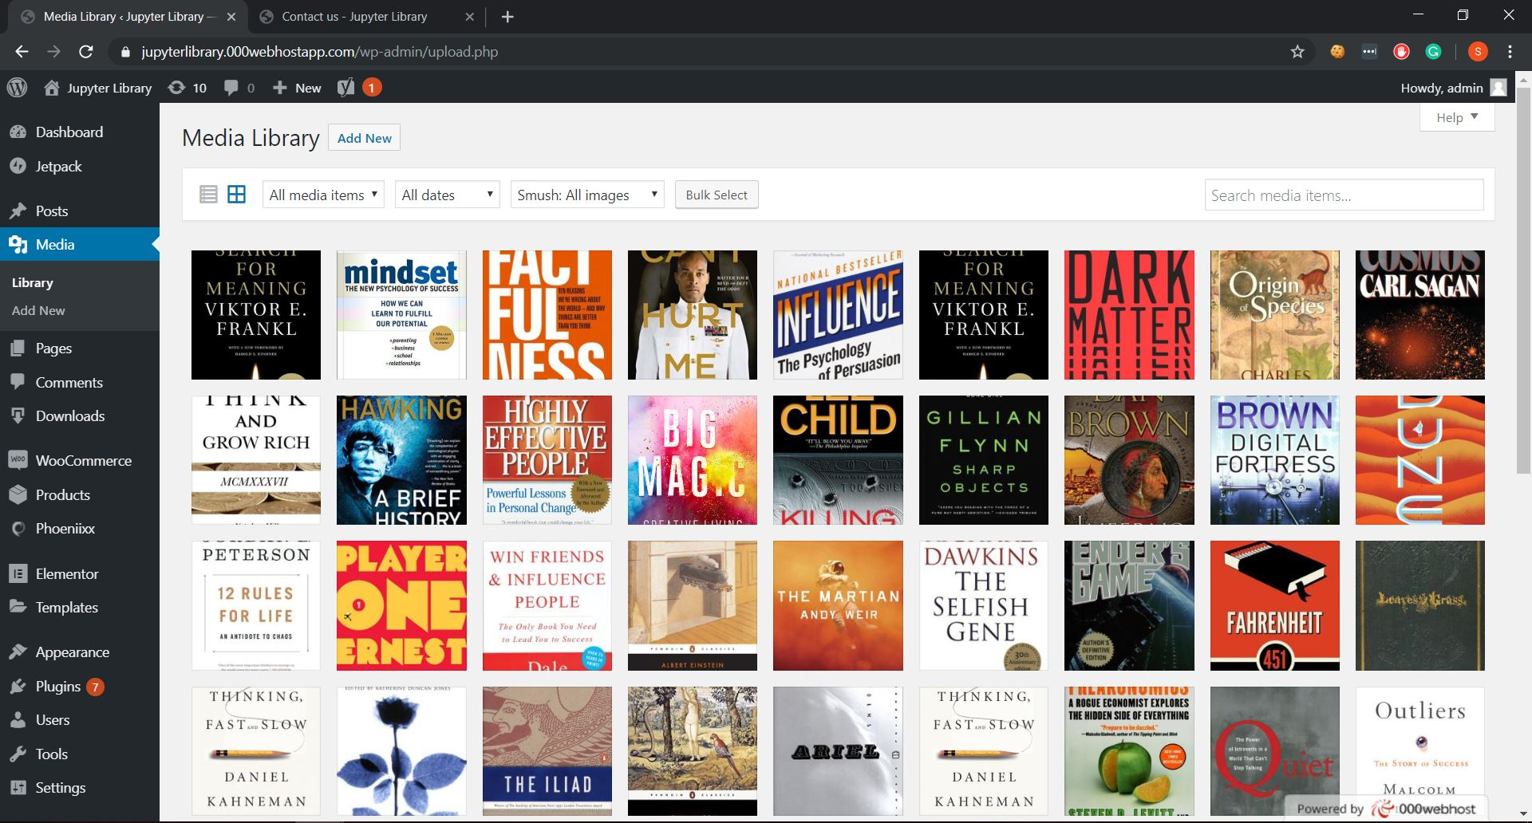
5.4 Media Library
Media of website is seen here.
All book cover images are displayed here.

Slide 25
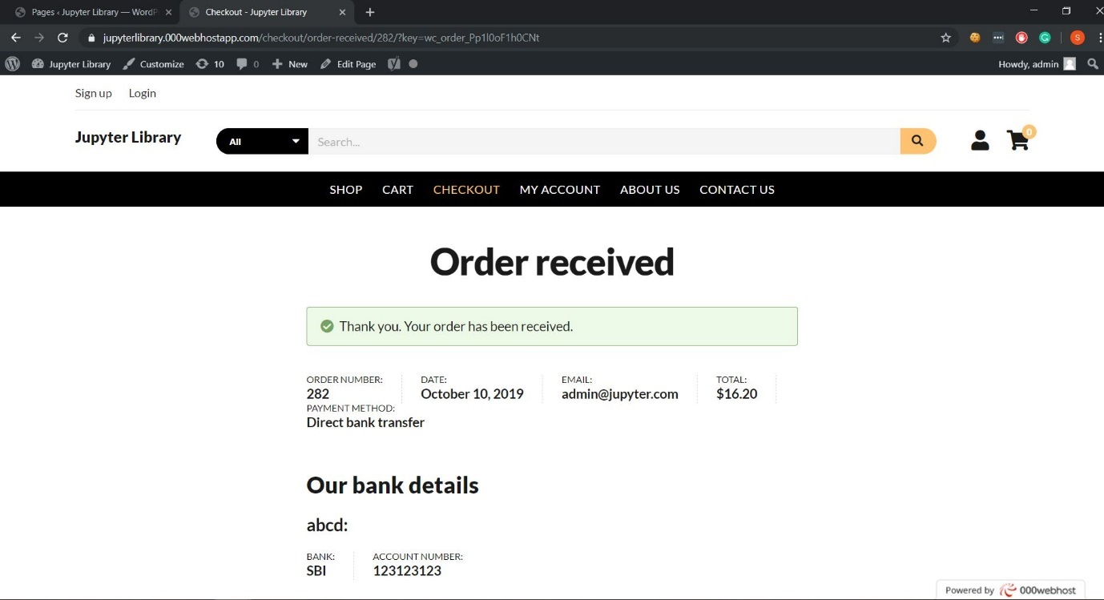
5.5 Order Confirmation
User can place order and checkout.
Order confirmation is displayed.

Slide 26
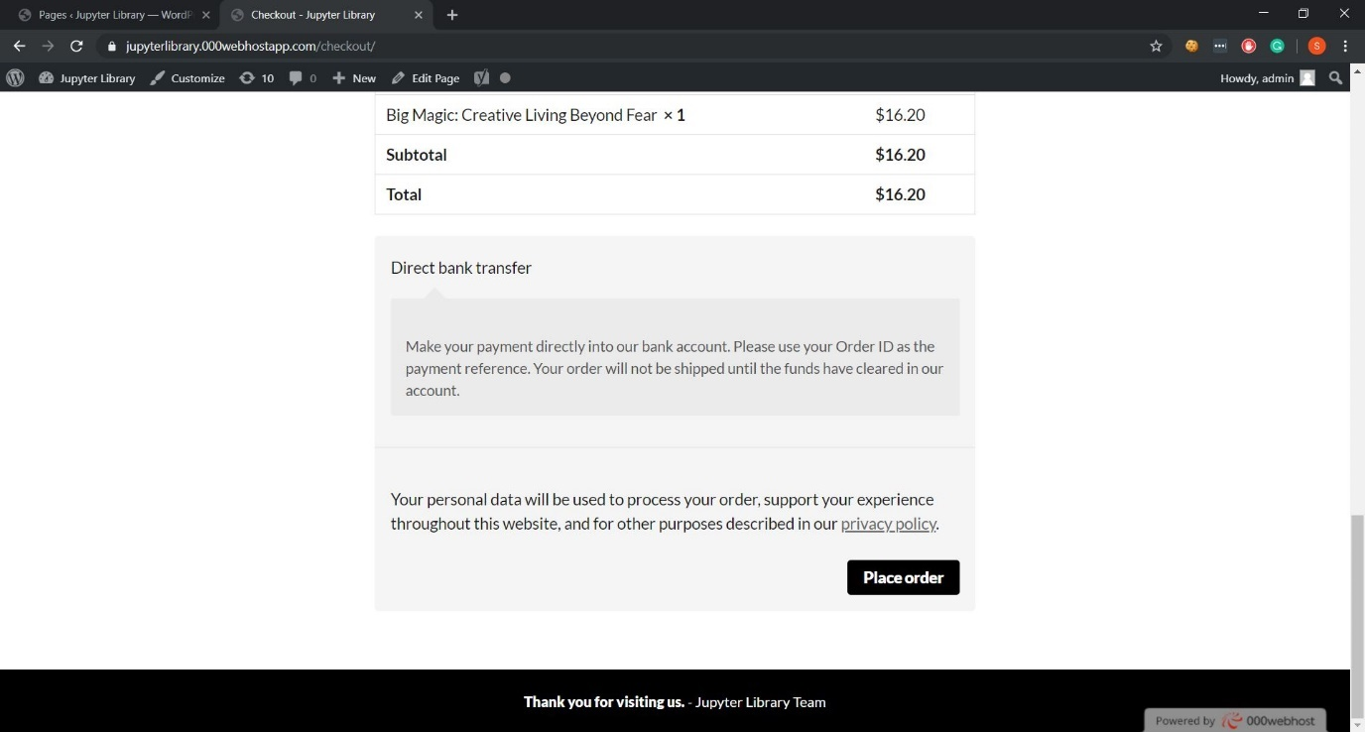
5.6 Order Detail
User can place order and checkout.
Order confirmation is displayed.

Slide 27
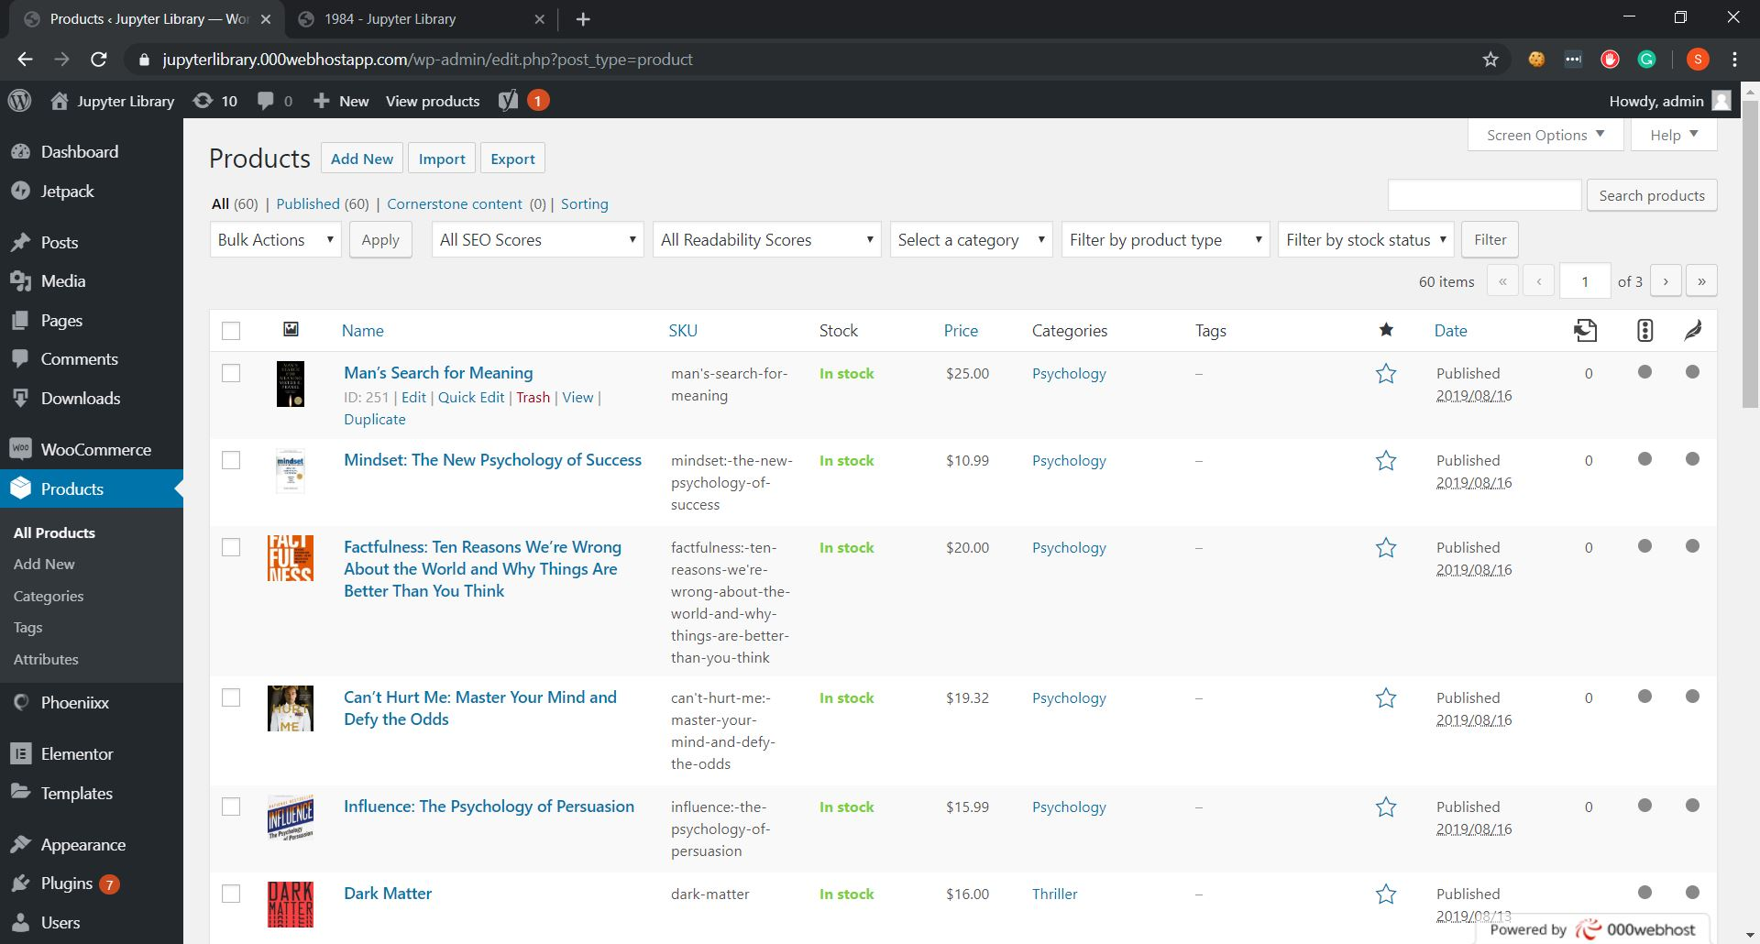
5.7 Products
This is admin page for products.
Admin can manage products from here.
Admin can add, update and delete products from this page.

Slide 28
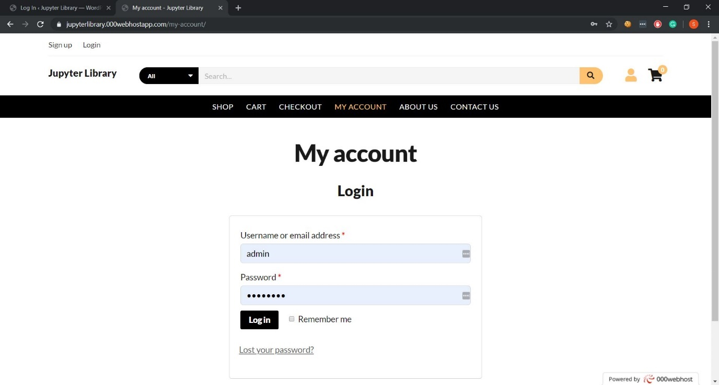
5.8 User Login
User can login from this page.

Slide 29
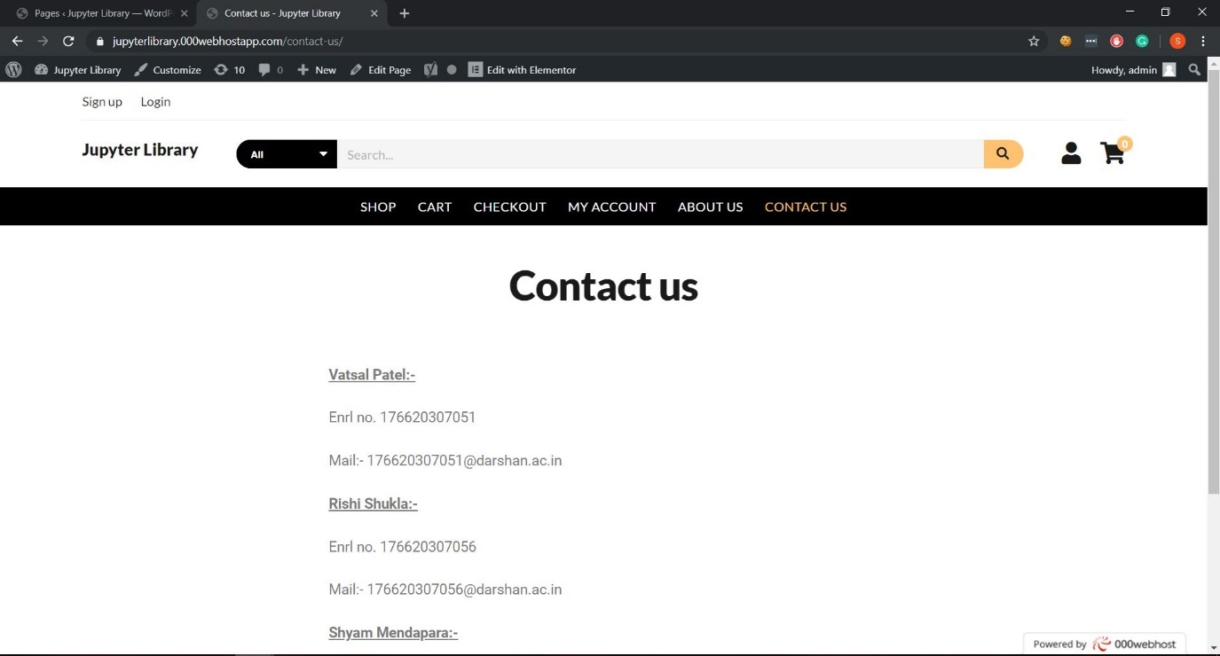
5.9 Contact Page
Comments can be seen here.
Admin can approve or delete comments.

Slide 30
6. Conclusion
After completion of this project, users can order fast food of all types at their home quickly and easily. This will provide you with all the information about ingredients of food with different buying options

Slide 31
THANK YOU
AND
ANY QUESTION?

