Slide 1


Project II (3360707)
Secure Bits
Prepared By:
Vatsal N. Patel(176620307051)
Diploma Computer Engineering
Darshan Institute of Engg. & Tech.
for Diploma Studies, Rajkot.
Guided By:
Prof. Nikita R. Mesvaniya
Computer Engineering Dept.,
Darshan Institute of Engg. & Tech. for Diploma Studies, Rajkot.

Slide 2
1. Abstract
It is a common practice to use the same password on every website. Remembering unique passwords for each website is very tedious. Password manager solves these problems. User has to remember only one master password which unlocks their vaults. These vaults store usernames and passwords securely. Due to strong encryption, no one else can access these besides the user. The encryption key is generated through the hashing of username and password, which is only known by the user. With the help of this password manager, users can use long and complex passwords without having to worry about forgetting them.

Slide 3
2. Problem Summary
Problem Identification
Users find it very difficult to remember lots of long and complex passwords that they use for different websites. The problem with this, however, is that the user may have to reset the password each time they forget it, which is very inconvenient. The alternative to that, using one password for everything is rather risky.
Problem Solution
SecureBits is a security-first password manager. Users can store their login credentials of different websites with us. Usernames and passwords are secured with strong encryption so that no one else may see them. Encryption is done on the user's device with maximum security leaving no risk of attack.

Slide 4
3. Detail Description
Vault :
Vault stores the encrypted login credentials of the user. User can add, update, delete and view their own vaults while the admin can view, add, update and delete everyone’s vaults. Admin can only see these vaults in encrypted form.
id : ID of Vault
name: Name of Vault
username: Encrypted username
password: Encrypted password
folder_id: ID of containing folder
user_id : ID of owner user
Folder :
Folders are for organization and grouping of vaults. User can add, update, delete and view only their own vaults while the admin can perform all actions for all the vaults.
id : ID of Folder
name : Name of Folder
user_id: ID of owner user

Slide 5
Admin :
Admin can login to the system and manage vaults, folders, users and authentication tokens provided to the user.
username : Username of admin
password: Password of admin
email : Email address of admin
first_name : First name of admin
last_name : Last name of admin
date_joined : Date of registration
last_login : Date & Time of last login by admin
Auth Token :
Authentication token is used to verify the identity of the user and authorize them to perform actions which they have permissions for.
id : ID of token
created: Time of token creation
user_id : ID of user the token is assigned to

Slide 6
Permission :
Permission stores and manages the permissions given to users on their vaults and folders.
id : ID of permission
name : Name of permission
content_type_id: ID of content type for permission
codename: codename for permission

Slide 7
4. Data Dictionary
api_folder
Field Name | Data Type | Size | Constraint | Reference | Description
id | integer | 10 | Primary Key | - | ID of folder
name | varchar | 128 | NOT NULL | - | Name of folder
user_id | integer | 10 | Foreign Key | api_vaultuser | ID of owner
api_vault
Field Name | Data Type | Size | Constraint | Reference | Description
id | integer | 10 | Primary Key | - | ID of vault
name | varchar | 128 | NOT NULL | - | Name of vault
username | varchar | 128 | NOT NULL | - | Username to store
password | varchar | 128 | NOT NULL | - | Password to store
folder_id | integer | 10 | Foreign Key | api_folder | ID of containing folder
user_id | integer | 10 | Foreign Key | api_vaultuser | ID of owner

Slide 8
api_vaultuser
Field Name | Data Type | Size | Constraint | Reference | Description
id | integer | 10 | Primary Key | - | ID of user
password | varchar | 128 | NOT NULL | - | password of user
last_login | datetime | - | - | - | last login time
is_superuser | boolean | - | NOT NULL | - | is admin or not
username | varchar | 128 | NOT NULL | - | username of user
first_name | varchar | 128 | - | - | first name of user
last_name | varchar | 128 | - | - | last name of user
is_staff | boolean | - | NOT NULL | - | is staff or not
is_active | boolean | - | NOT NULL | - | is active or not
date_joined | datetime | - | NOT NULL | - | date of registration
email | varchar | 256 | NOT NULL | - | email of user
admin_log
Field Name | Data Type | Size | Constraint | Reference | Description
id | integer | 10 | Primary Key | - | ID of action log
action_time | datetime | - | NOT NULL | - | time of action
object_id | integer | 10 | NOT NULL | - | ID of actioned object
object_repr | varchar | 200 | NOT NULL | - | representation of actioned object
action_flag | smallint | 1 | NOT NULL | - | flag of action
change_message | varchar | 200 | NOT NULL | - | message of change
content_type_id | integer | 10 | Foreign Key | content_type | ID of content type
user_id | integer | 10 | Foreign Key | api_vaultuser | User ID of admin

Slide 9
authtoken_token
Field Name | Data Type | Size | Constraint | Reference | Description
id | integer | 10 | Primary Key | - | ID of auth token
created | datetime | - | NOT NULL | - | time of creation
user_id | integer | 10 | Foreign Key | api_vaultuser | ID of user
content_type
Field Name | Data Type | Size | Constraint | Reference | Description
id | integer | 10 | Primary Key | - | ID of content type
app_label | varchar | 100 | NOT NULL | - | app label of model
model | varchar | 100 | NOT NULL | - | name of model class
auth_permissions
Field Name | Data Type | Size | Constraint | Reference | Description
id | integer | 10 | Primary Key | - | ID of permission
name | varchar | 255 | NOT NULL | - | Name of permission
content_type_id | integer | 10 | Foreign Key | content_type | ID of content type
codename | varchar | 255 | NOT NULL | - | permission codename

Slide 10
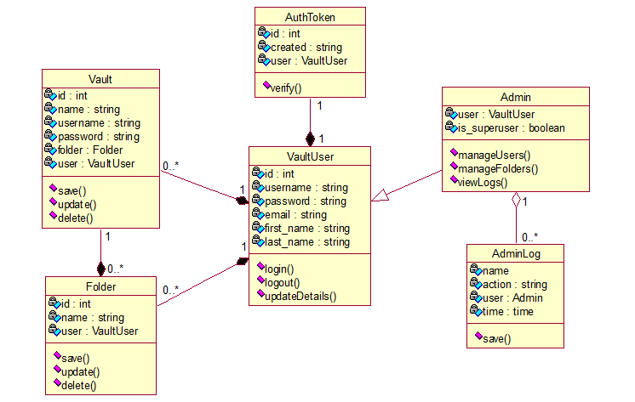
5. Diagrams
5.1 Class Diagram for Secure Bits

Slide 11
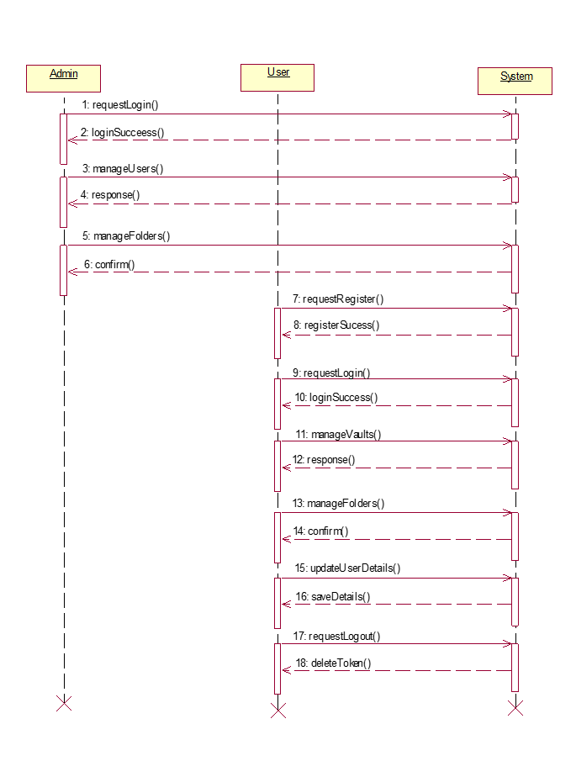
5.2 Sequence Diagram for Secure Bits

Slide 12
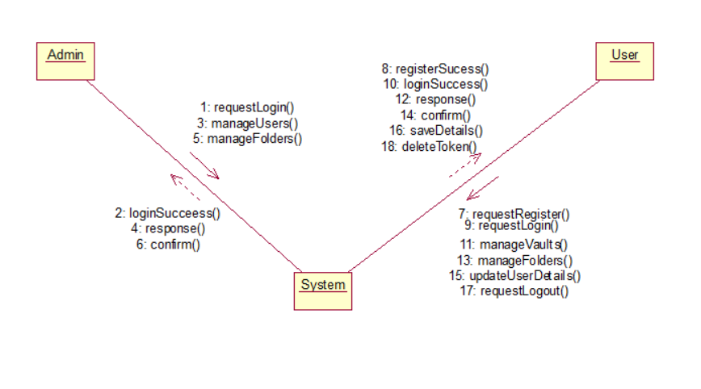
5.3 Collaboration Diagram for Secure Bits

Slide 13
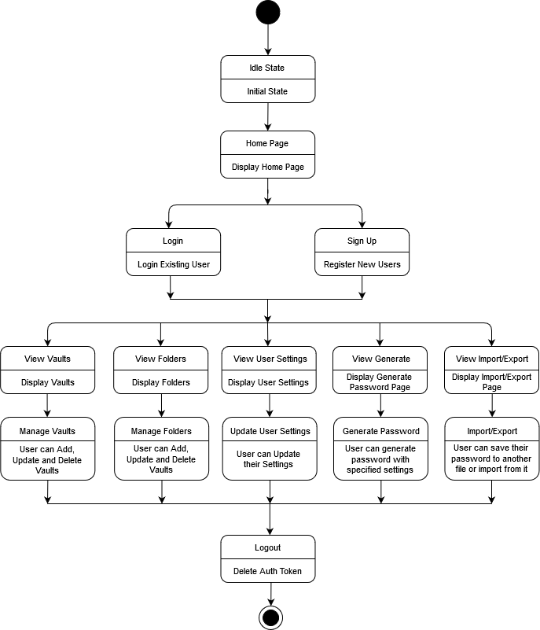
5.4 State Diagram for Secure Bits

Slide 14
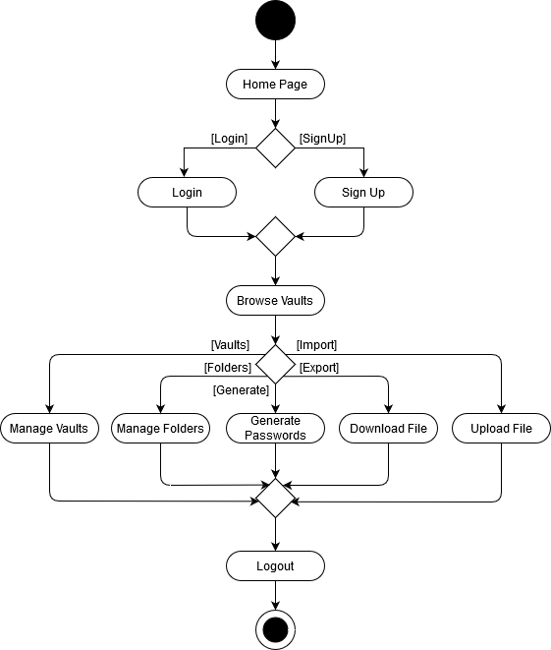
5.5 Activity Diagram for Secure Bits

Slide 15
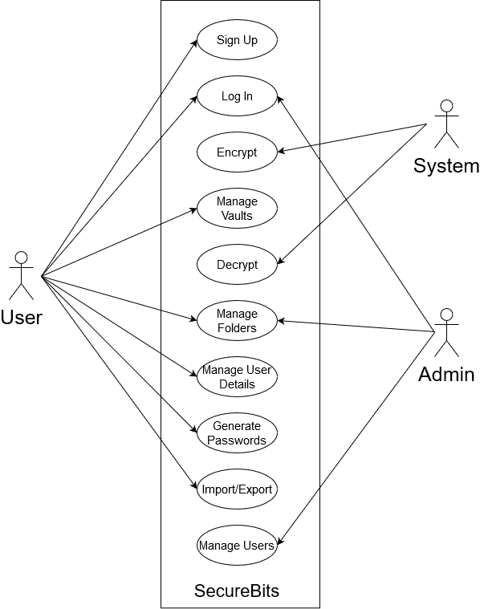
5.6 Use Case Diagram for Secure Bits

Slide 16
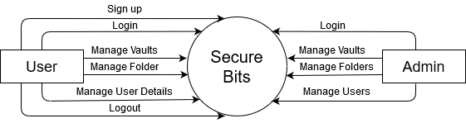
5.7 Data Flow Diagram for Secure Bits
5.7.1 Data Flow Diagram Level 0 :

Slide 17
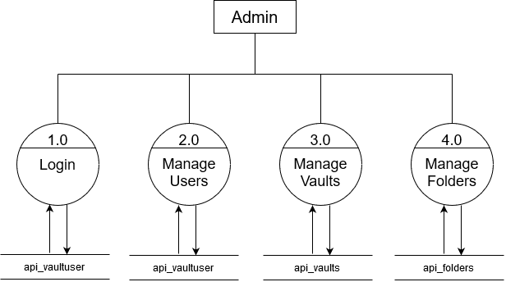
5.7 Data Flow Diagram for Secure Bits
5.7.2 Data Flow Diagram Level 1 for Admin :

Slide 18
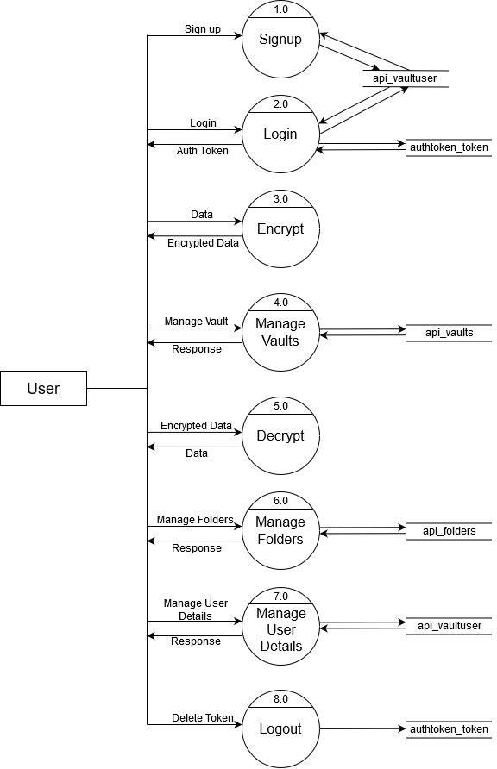
5.7 Data Flow Diagram for Secure Bits
5.7.3 Data Flow Diagram Level 1 for User :

Slide 19
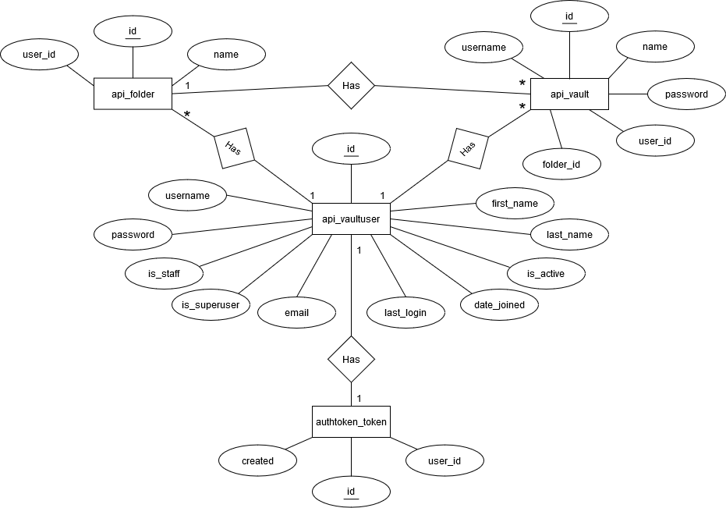
5.8 Entity Relationship Diagram for Secure Bits

Slide 20
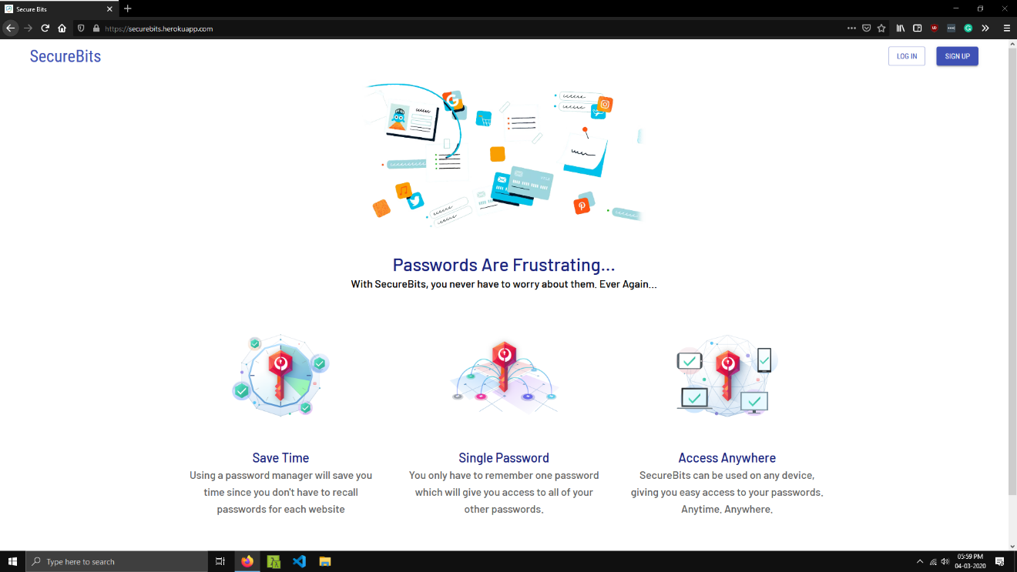
6. Screenshots
Home Page
This is the home page of Secure Bits.
It contains information related to the web app.

Slide 21
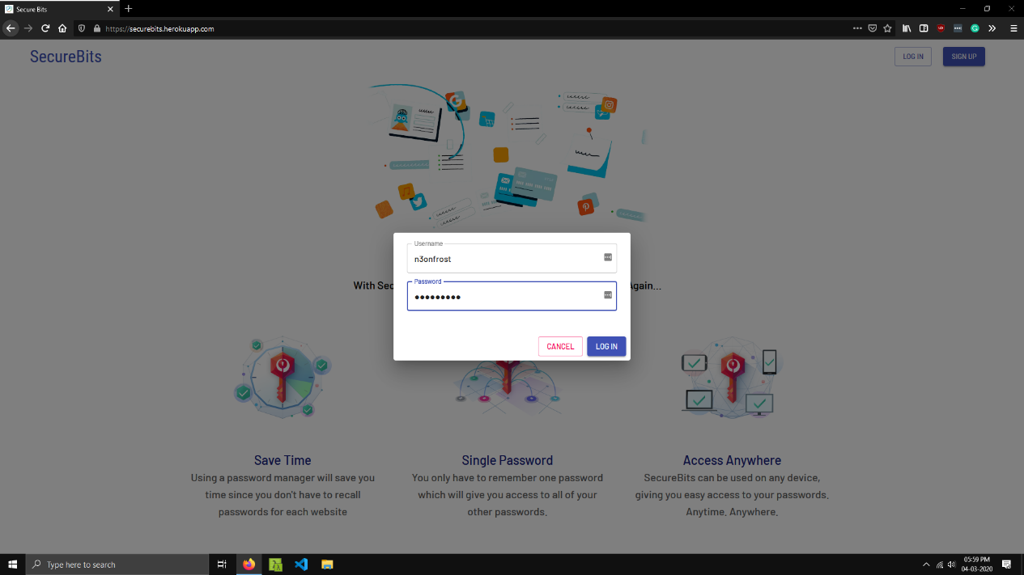
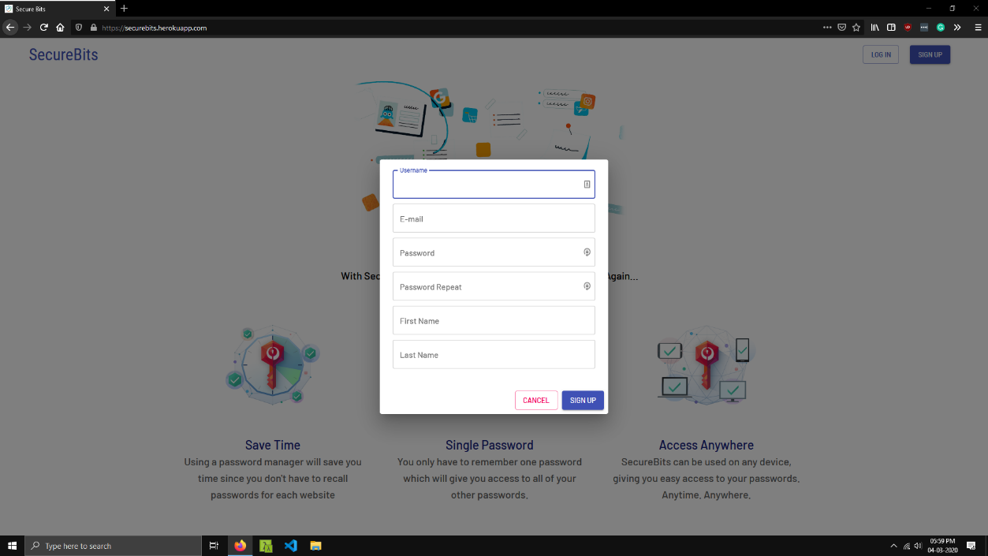
User Login & Sign Up
User can login or signup through these.
Login and Signup are done using AJAX providing a seamless user experience.
User is logged in automatically when sign up is complete.

Slide 22
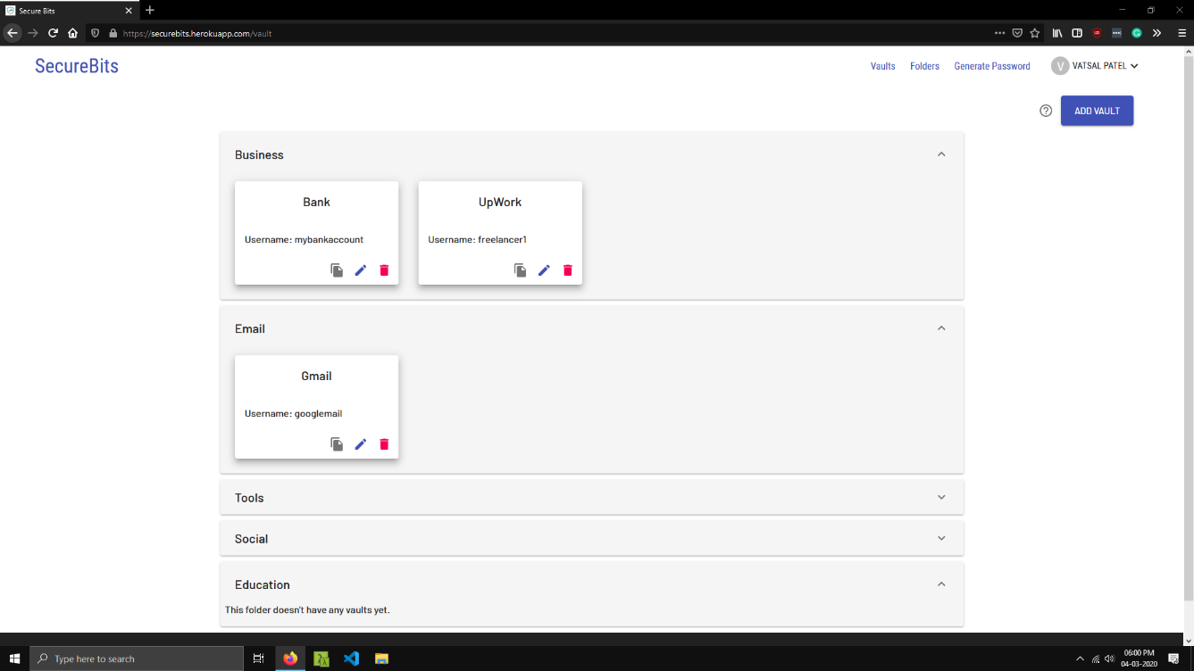
Vault List
All of User’s vaults are displayed on this page.
Each vault contains login credentials of one website/service.
These vaults are organized into folders.
Each vault has three buttons: one to copy password, one to edit its contents and one to delete the vault.
Username and password of vault are encrypted.

Slide 23
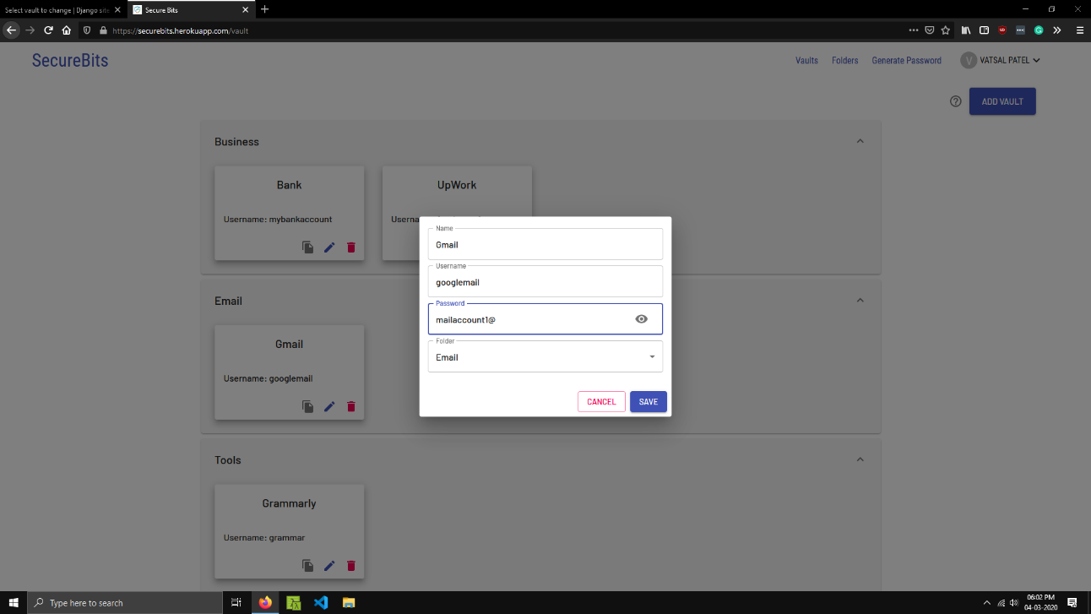
Vault
Vault contains username and password or login credentials for one website.
Each vault has a containing folder.
Username and Password field of each vault are encrypted. The encryption/decryption process is done in the browser to ensure utmost security.

Slide 24
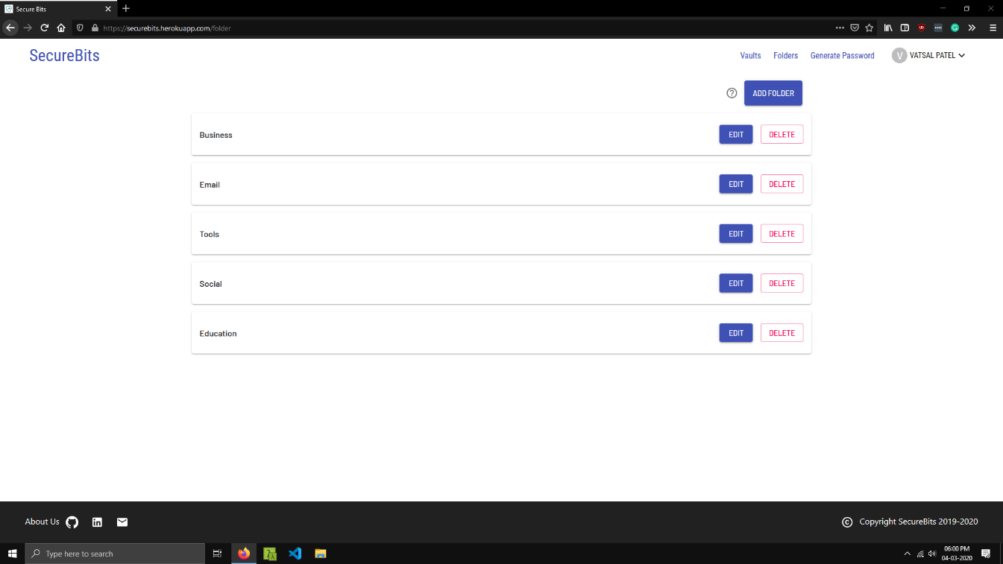
Folders
User can view, edit and delete folders.
Folders are used to organize vaults into categories.
User can add, edit or delete folders from this page.

Slide 25
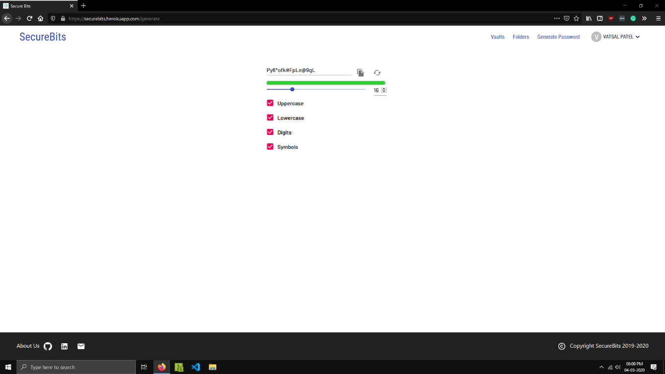
Password Generator
User can generate passwords of certain length and containing certain character sets based on their requirements.
Password strength will be displayed below.
Two buttons are available: one to copy generated password and one to generate a new password.

Slide 26
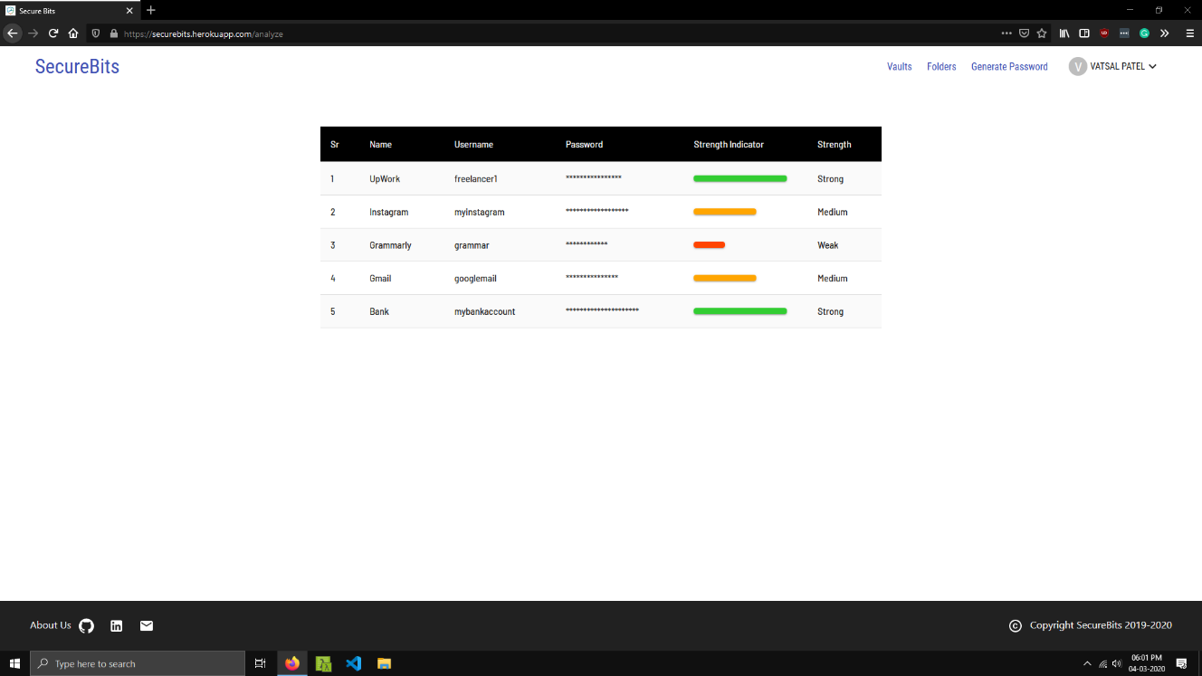
Password Analysis
User can see strength of their stored passwords.
Vault name and user name is displayed along with password strength indicator.

Slide 27
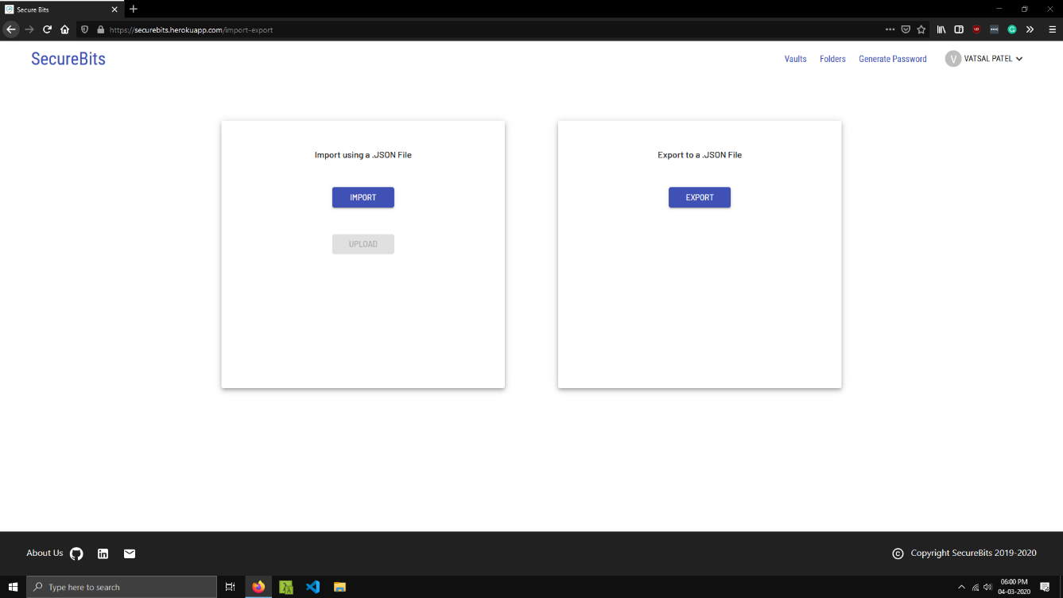
Import/Export
User can import or export all of their passwords.
Exporting will create a .JSON file containing all folder and vault information.
This same .JSON file can be used to import passwords into same or new account.
Folders and Vaults will be re-created as they are specified in the .JSON file.
An error will be shown if file is incompatible or has been tampered with.

Slide 28
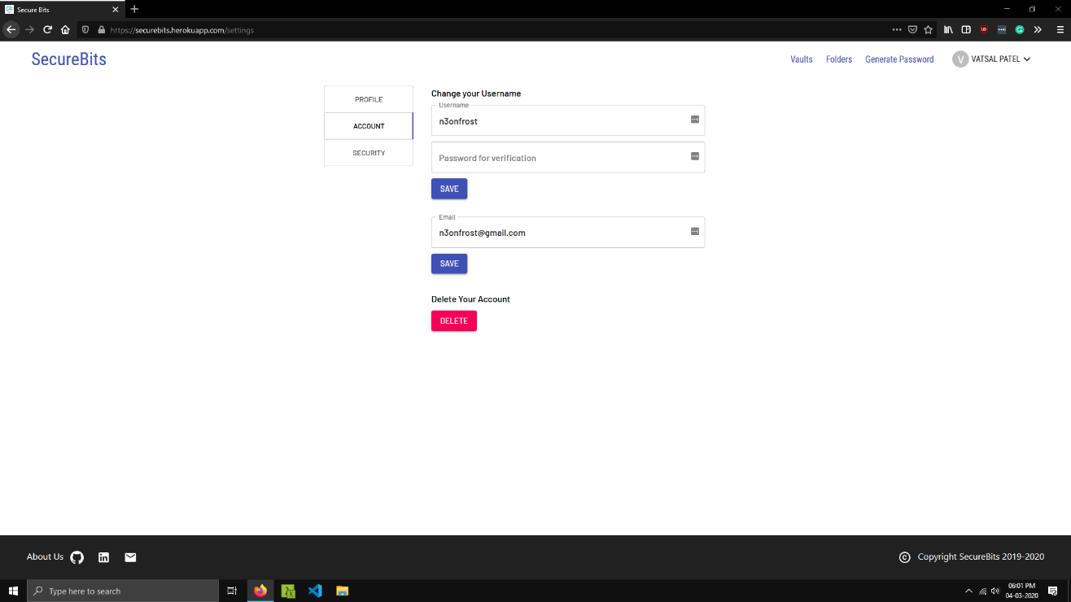
User Settings
User can change their username, password, email address and their displayed name.
User can also delete their account. User will have to enter their credentials to delete their account for security reasons.

Slide 29
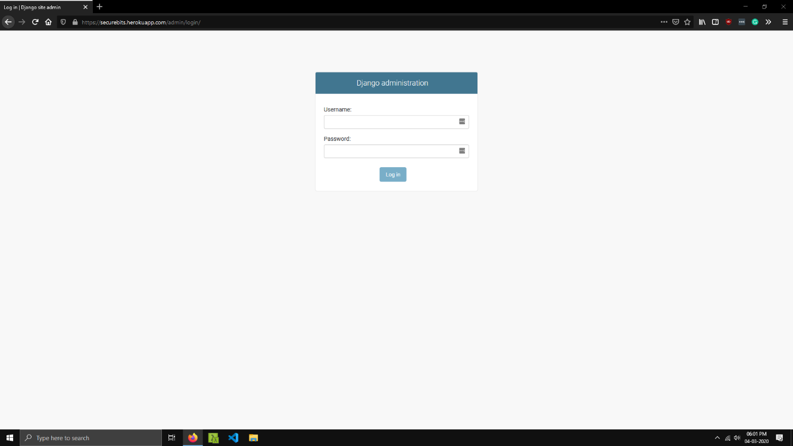
Admin Login
Admin can login into the system from this page.
This will allow the admin to access and manipulate different information.

Slide 30
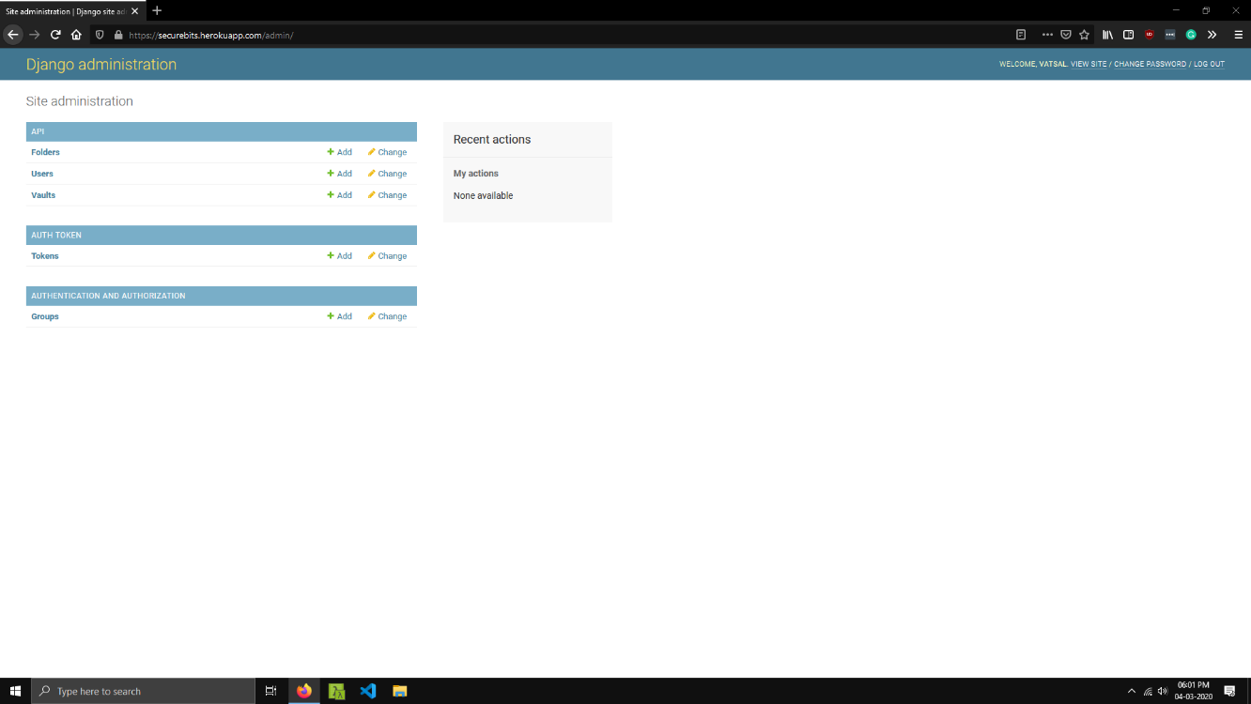
Admin Site
Admin will be shown different database objects grouped by relations.
Admin can view, create, edit and delete these objects.
Admin action logs are also shown on the right side.

Slide 31
7. Conclusion
With the completion of this project, Users will be provided with an option to store their usernames and passwords securely and conveniently. This is a Single Page Application which uses AJAX and consumes an API for better responsiveness and User Experience. Security is the highest priority and provided through a range of encryption and hashing algorithms.

Slide 32
Thank You!
Any Questions?

