Slide 1


Unit-01 Introduction to JAVA
Object Oriented Programming -I (3140705)
Prof. Arjun V. Bala
Computer Engineering Department
arjun.bala@darshan.ac.in
9624822202

Slide 2

Outline
Introduction to Java
Features of Java
Components of Java
JDK
JRE
JVM
Installing JDK
Setting Path Variable
Hello World Program with Java
Compiling Java Code
Running Java Code
Looping

Slide 3



Slide 4
JAVA
Java is a general-purpose computer-programming language that is open source, platform independent, object-oriented and specifically designed to have as few implementation dependencies as possible.
Java was originally developed by James Gosling at Sun Microsystems and released in 1995.
Java was initially named as Oak language and renamed to JAVA in 1995.
Current Version | Java SE 15 (as of feb-2021)
Version we will use | Java SE 11 (LTS)
Setup size | 149 MB (Linux), 152 MB (Windows x64)
Download Link | https://www.oracle.com/in/java/technologies/javase-jdk11-downloads.html
Official Website | https://java.com
Integrated Development Environment (IDE) | Eclipse (going to use this IDE in later chapters) NetBeans IntelliJ IDEA Community Edition BlueJ

Slide 5
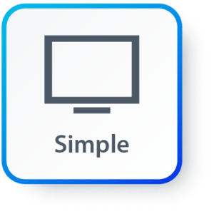
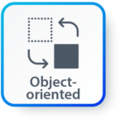
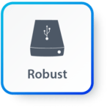

Features of JAVA
Simple: Java inherits C/C++ syntax and many object-oriented features of C++.
Object Oriented: “Everything is an object” paradigm, which possess some state, behavior and all the operations are performed using these objects.
Robust: Java has a strong memory management system. It helps in eliminating error as it checks the code during compile and runtime.
Multithreaded: Java supports multiple threads of execution, including a set of synchronization primitives. This makes programming with threads much easier.

Slide 6



Features of JAVA (Cont.)
Architectural Neutral: Java is platform independent which means that any application written on one platform can be easily ported to another platform.
Interpreted: Java is compiled to bytecodes, which are interpreted by a Java run-time environment.
High Performance: Java achieves high performance through the use of bytecode which can be easily translated into native machine code. With the use of JIT (Just-In-Time) compilers, Java enables high performance.

Slide 7

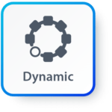
Features of JAVA (Cont.)
Distributed: Java provides a feature which helps to create distributed applications. Using Remote Method Invocation (RMI), a program can invoke a method of another program across a network and get the output. You can access files by calling the methods from any machine on the internet.
Dynamic: Java has ability to adapt to an evolving environment which supports dynamic memory allocation due to which memory wastage is reduced and performance of the application is increased.

Slide 8
Components of Java
Java Virtual Machine (JVM)
Java Runtime Environment (JRE)
Java Development Kit (JDK)
JDK
Compiler (javac.exe)
Java Application
Launcher (java.exe), AppletViewer, etc..)
Java Packages
(math, util, awt etc…)
JVM
Runtime Libraries
Development tools
JRE

Slide 9
Java Development Kit (JDK)
JDK contains tools needed ,
To develop the Java programs and
JRE to run the programs.
The tools include
compiler (javac.exe),
Java application launcher (java.exe),
Appletviewer, etc…
Java application launcher (java.exe) opens a JRE, loads the class, and invokes its main method.

Slide 10
Java Runtime Environment (JRE)
The JRE is required to run java applications.
It combines the Java Virtual Machine (JVM), platform core classes and supporting libraries.
JRE is part of the Java Development Kit (JDK), but can be downloaded separately.
It does not contain any development tools such as compiler, debugger, etc.

Slide 11
Java Virtual Machine (JVM)
JVM is a virtual machine that enables a computer to run Java programs as well as programs written in other languages and compiled to Java Bytecode.
Bytecode is a highly optimized set of instructions designed to be executed by the Java Virtual Machine(JVM).
Byte code is intermediate representation of java source code.
Java compiler provides byte code by compiling Java Source Code.
Extension for java class file or byte code is ‘.class’, which is platform independent.
JVM is virtual because , It provides a machine interface that does not depend on the operating system and machine hardware architecture.
JVM interprets the byte code into the machine code.
JVM itself is platform dependent, but Java is Not.

Slide 12
How Java become Platform Independent?
Source code (Program)
.java file
Compiler
Bytecode
.class file
JVM
(Windows)
JVM
(Linux)
JVM
(Mac)
Machine Code
Machine Code
Machine Code

Slide 13
Installing JDK
Download JDK for Windows platform (.exe) from
https://www.oracle.com/technetwork/java/javase/downloads/index.html
Install the executable of JDK
Set the path variable of System variables by performing following steps
Go to "System Properties" (Right click This PC → Properties → Advanced System Settings)
Click on the "Environment variables" button under the "Advanced" tab
Then, select the "Path" variable in System variables and click on the "Edit" button
Click on the "New" button and add the path where Java is installed, followed by \bin. By default, Java is installed in C:\Program Files\Java\jdk-11.0.1 (If nothing else was specified when you installed it). In that case, You will have to add a new path with: C:\Program Files\Java\jdk-11.0.1\bin
Then, click "OK", and save the settings
At last, open Command Prompt (cmd.exe) and type java -version to see if Java is running on your machine

Slide 14
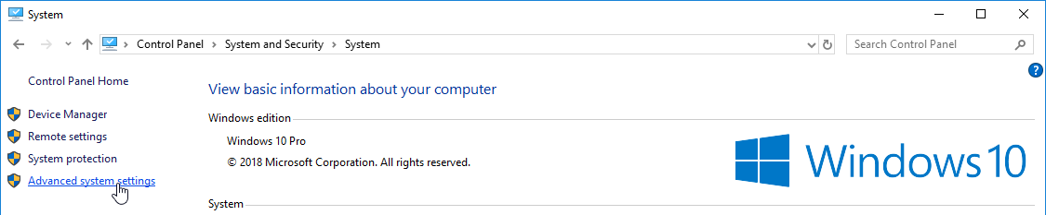
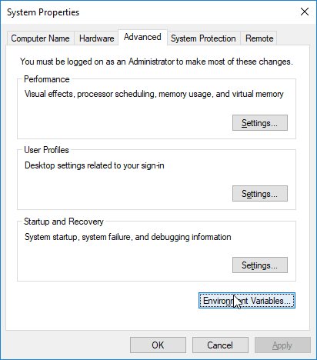
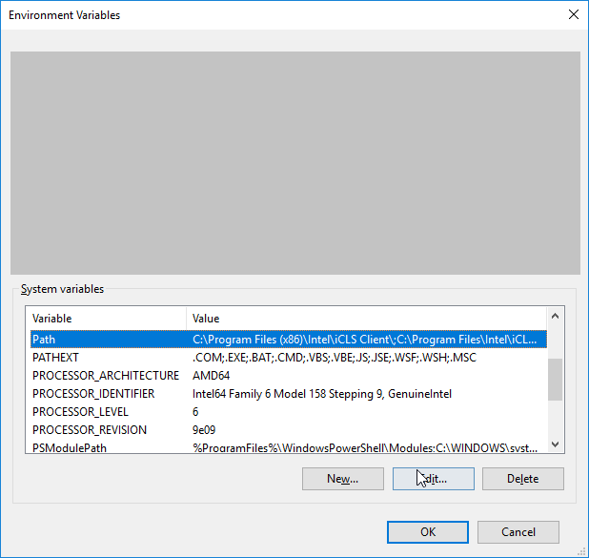
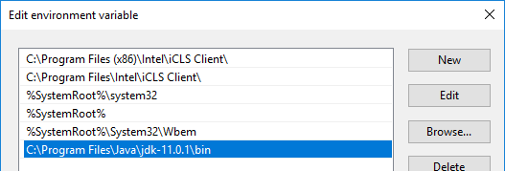
Setting Path Variable
1
2
3
4

Slide 15
Hello World Java Program
File must be saved as HelloWorld.java
public class HelloWorld
{
public static void main(String[] args)
{
System.out.println("Hello World");
}
}
We have to save this in HelloWorld.java file as it has public class named HelloWorld.
String and System are inbuilt Java Classes.
Classes in java are always written in Camel case.
Main method from where execution will start
String must start with capital letter
System must start with capital letter

Slide 16
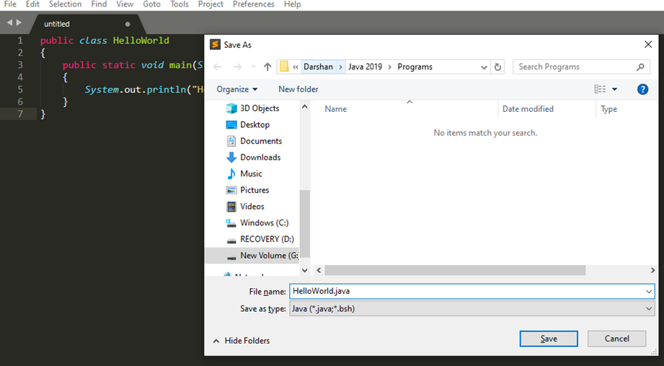
How to execute Java Program?
Save the program with the same name as the public class with .java extension.

Slide 17
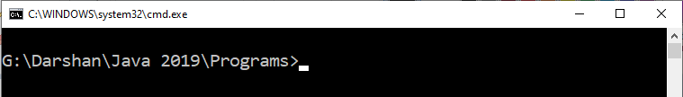
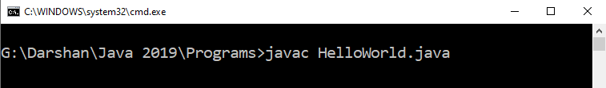
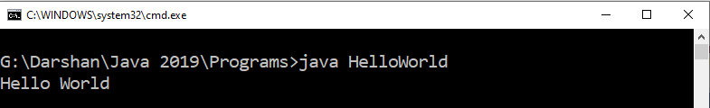
How to execute Java Program?
Open command prompt (cmd) / terminal & navigate to desired directory / folder.
Compile the “.java” file with javac command.
Execute the “.class” file with java command without extension.

Slide 18
Identifiers
They are used for class names, method names and variable names.
An identifier may be any descriptive sequence of
uppercase(A…Z) and lowercase(a..z) letters
Numbers(0..9)
Underscore(_) and dollar-sign($) characters
Examples for valid Identifiers,
AvgTemp
count
a4
$test
this_is_ok
Examples for invalid Identifiers,
2count
High-temp
Ok/NotOK
(Identifiers can not start with digit)
(Identifiers can not contain dash)
(Identifiers can not contains slash)

Slide 19
Data Types
Java Datatypes
Primitive
Non-primitive
Integers
Floating-point numbers
Characters
Boolean
Class

Slide 20
Primitive Data Types
Data Type | Size | Range | Example
byte | 1 Byte | -128 to 127 | byte a = 10;
short | 2 Bytes | -32,768 to 32,767 | short a = 200;
int | 4 Bytes | -2,147,483,648 to 2,147,483,647 | int a = 50000;
long | 8 Bytes | -9,223,372,036,854,775,808 to 9,223,372,036,854,775,807 | long a = 20;
float | 4 Bytes | 1.4e-045 to 3.4e+038 | float a = 10.2f;
double | 8 Bytes | 4.9e-324 to 1.8e+308 | double a = 10.2;
char | 2 Bytes | 0 to 65536 (Stores ASCII of character) | char a = ‘a’;
boolean | Not defined | true or false | boolean a = true;

Slide 21
Escape Sequences
Escape sequences in general are used to signal an alternative interpretation of a series of characters.
For example, if you want to put quotes within quotes you must use the escape sequence, \", on the interior quotes.
System.out.println("Good Morning \"World\"");
Escape Sequence | Description
\’ | Single quote
\” | Double quote
\\ | Backslash
\r | Carriage return
\n | New Line
\t | Tab

Slide 22
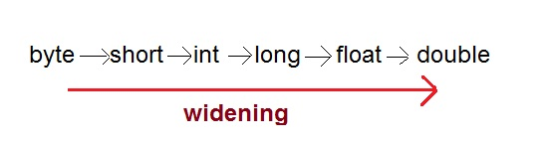
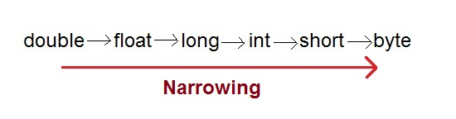
Type Casting
Assigning a value of one type to a variable of another type is known as Type Casting.
In Java, type casting is classified into two types,
Widening/Automatic Type Casting (Implicit)
Narrowing Type Casting(Explicitly done)

Slide 23
Automatic Type Casting
When one type of data is assigned to other type of variable , an automatic type conversion will take place if the following two conditions are satisfied:
The two types are compatible
The destination type is larger than the source type
Such type of casting is called “widening conversion”.
Example:
int can always hold values of byte and short
public static void main(String[] args) {
byte b = 5;
// √ this is correct
int a = b;
}

Slide 24
Casting Incompatible Types
To create a conversion between two incompatible types, you must use a cast
A cast is an explicit type conversion.
Such type is called “narrowing conversion”.
Syntax:
(target-type) value
Example:
public static void main(String[] args) {
int a = 5;
// × this is not correct
byte b = a;
// √ this is correct
byte b = (byte)a ;
}

Slide 25
Operators
Arithmetic Operators
Relational Operators
Bitwise Operators
Logical Operators
Assignment Operators
Conditional / Ternary Operator
Instance of Operator

Slide 26
Arithmetic Operator
Note : A = 10 & B = 20
Operator | Description | Example
+ | Addition | A + B = 30
- | Subtraction | A - B = -10
* | Multiplication | A * B = 200
/ | Division | B / A = 2
% | Modulus | B % A = 0
++ | Increment | B++ = 21
-- | Decrement | B-- = 19

Slide 27
Relational Operators
Note : A = 10 & B = 20
Operator | Description | Example
== | Equals | (A == B) is not true.
!= | Not Equals | (A != B) is true.
> | Greater than | (A > B) is not true.
< | Less than | (A < B) is true.
>= | Greater than equals | (A >= B) is not true.
<= | Less than equals | (A <= B) is true.

Slide 28
Bitwise Operators
Note : A = 60 & B = 13
Operator | Description | Example
& | Binary AND Operator | A & B = 12 which is 0000 1100
| | Binary OR Operator | A | B = 61 which is 0011 1101
^ | Binary XOR Operator | A ^ B = 49 which is 0011 0001
~ | Binary Ones Complement Operator | ~A = -61 which is 1100 0011 in 2's complement form due to a signed binary number.
<< | Binary Left Shift Operator | A << 2 = 240 which is 1111 0000
>> | Binary Right Shift Operator. | A >> 2 = 15 which is 1111
>>> | Shift right zero fill operator. | A >>>2 = 15 which is 0000 1111

Slide 29
Logical Operators
Note : A = true & B = false
Operator | Description | Example
&& | Logical AND operator | (A && B) is false.
|| | Called Logical OR Operator | (A || B) is true.
! | Called Logical NOT Operator | !(A && B) is true.

Slide 30
Assignment Operators
Operator | Description | Example
= | Simple assignment operator | C = A + B will assign value of A + B into C
+= | Add AND assignment operator | C += A is equivalent to C = C + A
-= | Subtract AND assignment operator | C -= A is equivalent to C = C - A
*= | Multiply AND assignment operator | C *= A is equivalent to C = C * A
/= | Divide AND assignment operator | C /= A is equivalent to C = C / A
%= | Modulus AND assignment operator | C %= A is equivalent to C = C % A
<<= | Left shift AND assignment operator | C <<= 2 is same as C = C << 2
>>= | Right shift AND assignment operator | C >>= 2 is same as C = C >> 2
&= | Bitwise AND assignment operator | C &= 2 is same as C = C & 2
^= | bitwise exclusive OR and assignment operator | C ^= 2 is same as C = C ^ 2
|= | bitwise inclusive OR and assignment operator | C |= 2 is same as C = C | 2

Slide 31
Conditional Operator (Ternary)
Conditional Operator ( ? : )
Syntax:
variable x = (expression) ? value if true : value if false
Example:
b = (a == 1) ? 20 : 30;

Slide 32
Operator Precedence & Associativity
How does java evaluate 1 + 10 * 9 ?
(1 + 10 ) * 9 = 99 OR 1 + (10 * 9) = 91
To get the correct answer for the given problem Java came up with Operator precedence. ( multiplication have higher precedence than addition so correct answer will be 91 in this case)
For Operator, associativity means that when the same operator appears in a row, then to which direction the expression will be evaluated.
How does java evaluate 1 * 2 + 3 * 4 / 5 ???
2 + 12 / 5
2 + 2.4
4.4

Slide 33
Precedence of Java Operators
Category | Operator | Associativity
Postfix | () [] . (dot operator) | Left to right
Unary | ++ - - ! ~ | Right to left
Multiplicative | * / % | Left to right
Additive | + - | Left to right
Shift | >> >>> << | Left to right
Relational | > >= < <= | Left to right
Equality | == != | Left to right
Bitwise AND | & | Left to right
Bitwise XOR | ^ | Left to right
Bitwise OR | | | Left to right
Logical AND | && | Left to right
Logical OR | || | Left to right
Conditional | ?: | Right to left
Assignment | = += -= *= /= %= >>= <<= &= ^= |= | Right to left
Comma | , | Left to right

