Slide 1

Exploratory Data Analysis
(AMCAT Dataset)
Submitted By,
Pandey Abhishek Nath Roy
Intern ID: IN9240832

Slide 2
About me
Hi there!! I am Pandey Abhishek Nath Roy (IN9240832), a data enthusiast, currently learning various things to crack an opportunity to go further.
Apart from this, I possess the problem solving ability and I am good at learning new things that makes me an ideal candidate to follow my dreams.
I have previously worked as a data science intern at Innomatics research labs and right now, I am doing the internship to refine my skills at their highest level.
Feel free to reach out! You can do so by following the below links:
https://linkedin.com/in/pandey-abhishek-nath-roy-179879222/
https://github.com/vjabhi000985/

Slide 3
OBJECTIVE OF THE PROBLEM
This exploratory data analysis of “AMCAT DATASET” focuses on understanding various factors that might influence the level of salaries indicated in the dataset. We consider education and experience, gender, specialization, and job roles and observe how they are related in order to understand a factor that influences higher or lower levels of salaries. The critical steps which indicate the analysis involved creating a mental image of the data, establishing trends and patterns, testing many hypotheses post observations to finally build insightful results which could be used as guidelines for any decision making process that could further calibrate salary prediction models.

Slide 4
SUMMARY OF THE DATASET
There are 38 columns in total that are used to find the individual impacts on salary.
Out of 38 columns, there are 29 numerical columns and 9 categorical columns.
With 3998 Datapoints that make our analysis to the optimal insights with all the necessary information.

Slide 5
DATA CHECKS TO PERFORM
Check missing values, duplicated values and various different columns.
Check the datatypes and also look at the unique number of columns.
Check statistics of data set
Check various categories present in the different categorical column.
Drop unnecessary columns

Slide 6
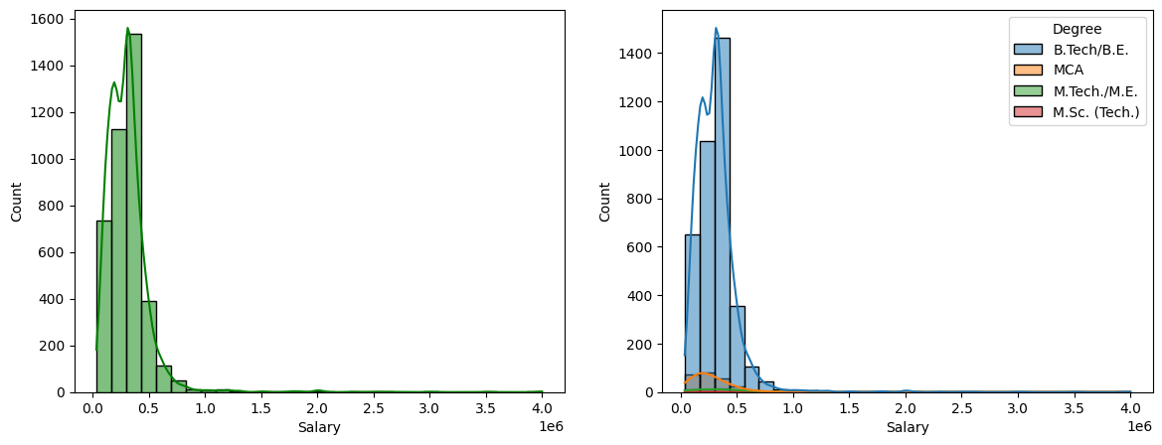
What target variable ‘Salary vs Gender’ shows us?
hhahh
B.Tech students has a higher salary other Degree persons.

Slide 7
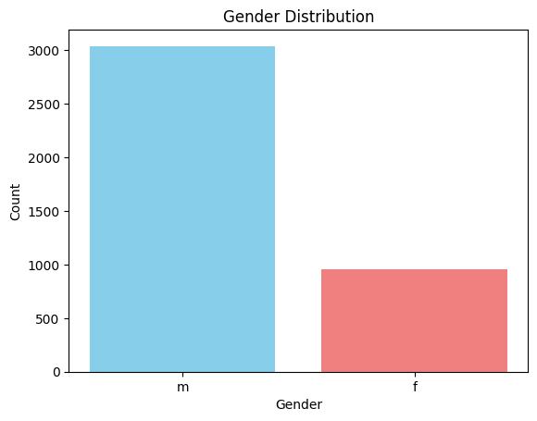
What target variable ‘Gender’ tells us?
The ratio of m/f is 3.19 indicates there are 3 times more men than women employed.

Slide 8
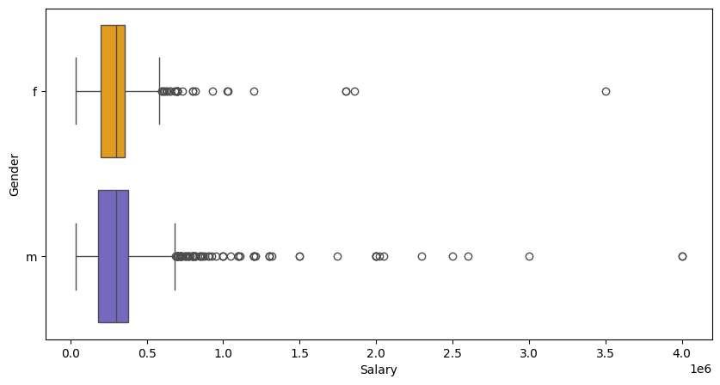
Is Gender have an effect on salary?
Men are earning more than the women.
There is not much difference in between median salary of both genders.

Slide 9
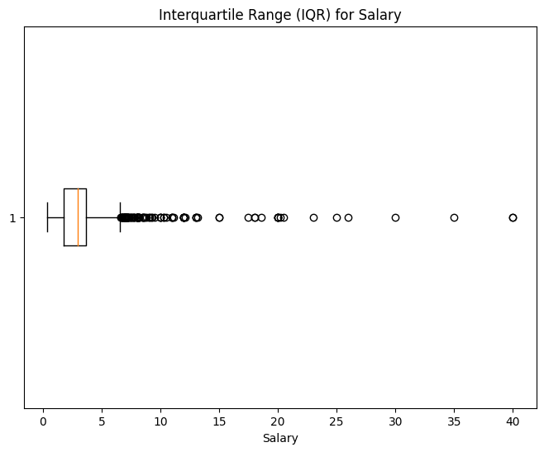
How the ‘Salary Distribution Looks’?
Salary Ranges from – 35000 to 400000.
Median Salary is 300000.

Slide 10
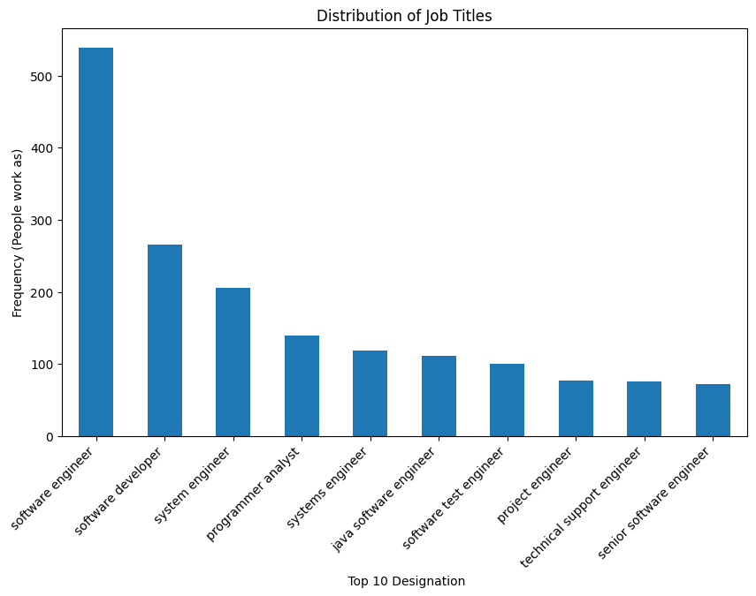
TOP 15 Profession based on AMCAT Dataset

Slide 11
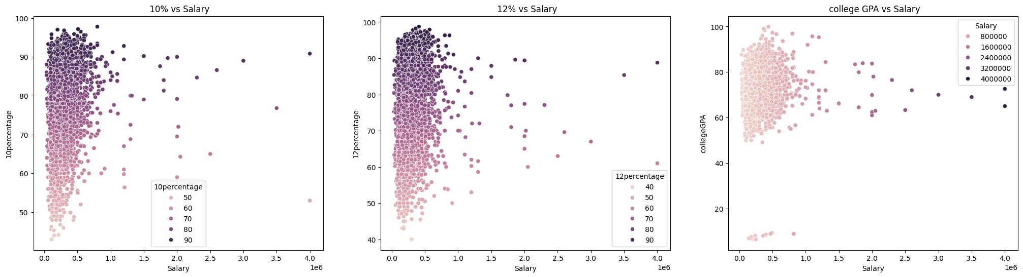
What does “Salary vs Education (Bivariate Analysis)” says?
It clearly shows that Higher education people are earning a good minimum salary that is more than 50k.

Slide 12
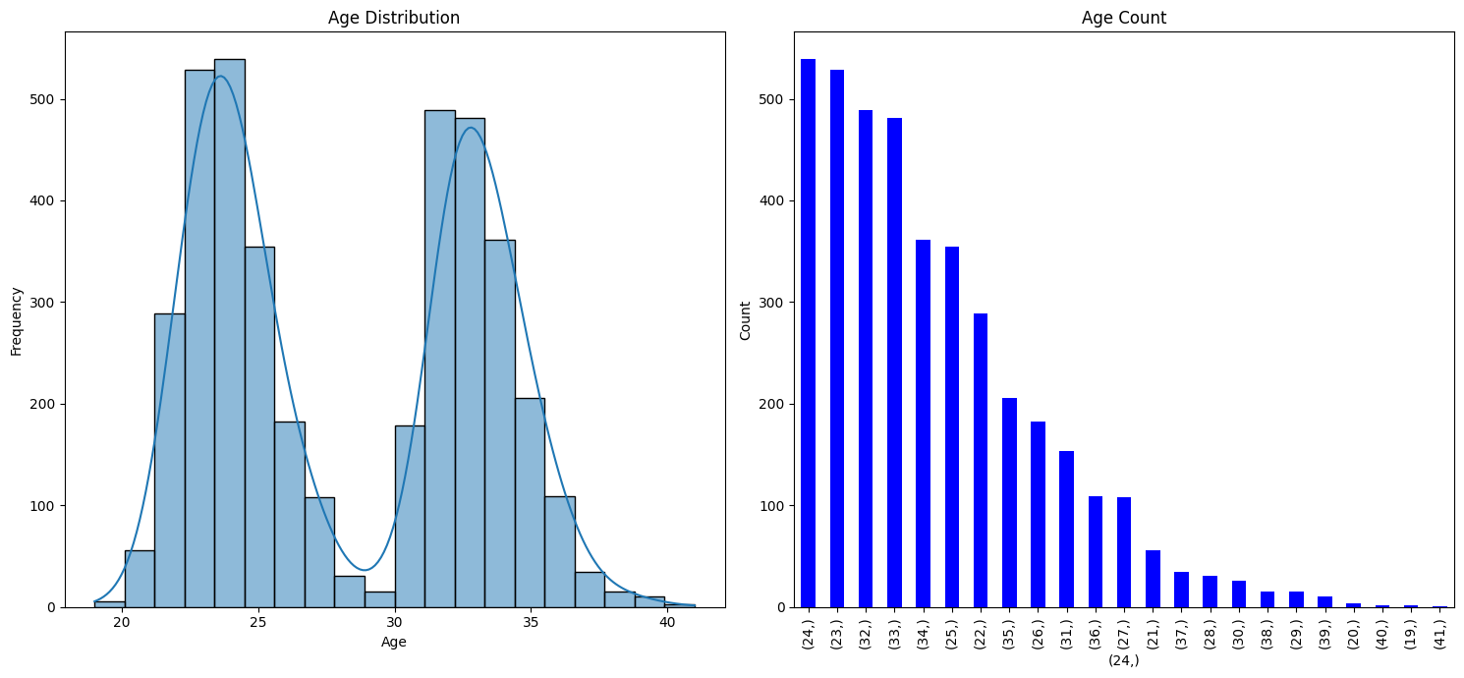
What does “Age Analysis ” says?
The majority of individuals are in the younger age groups, suggesting that the data might represent a population with a relatively young demographic.

Slide 13
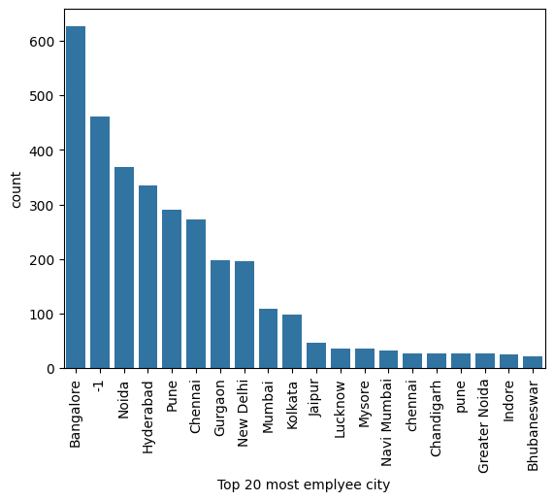
Where job location is more employee of less employee work?
The top 5 cities are Bangalore, Noida, Hyderabad, Pune, and Chennai with “Bangalore” having the most number of employees.
“-1” shows that there exist some null values that needs to be refined and cleaned for further processing.

Slide 14
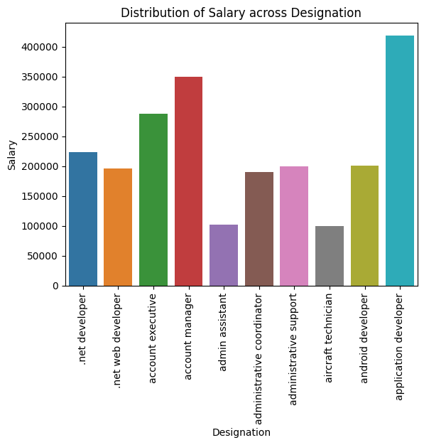
Does Designation affect Salary?
The average salary of “Application Developer” is more compared to other designations.
There are less salaries for admin assistant and aircraft technician.

Slide 15
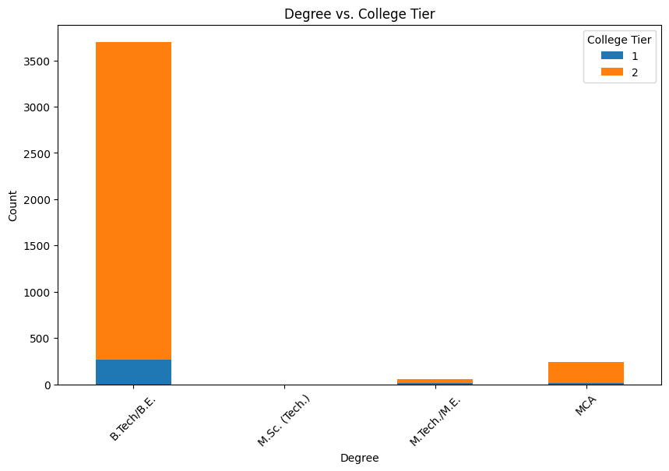
Analyze the relationship between the degree obtained and the tier of the college attended using cross-tabulation or stacked bar plots.
The majority of students are pursuing B.Tech/B.E. degrees.
The number of students pursuing M.SC.(Tech.) is very low followed by MTech./M.E. and MCA degrees

Slide 16
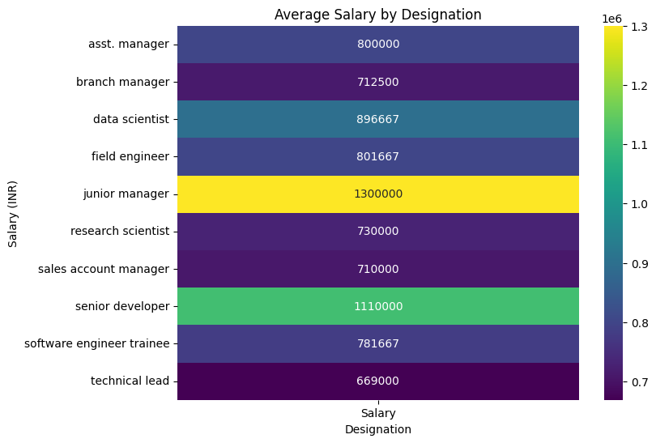
Research Question 1: Determine whether fresh graduates earn 2.5-3 lakhs annually as stated in the article.
The average salary for fresh graduates in the top 10 designations is approximately ₹798,696, with a median of ₹545,000, far exceeding the claimed ₹2.5-3 lakhs.
Statistical analysis strongly rejects the null hypothesis, indicating that the average salary is not within the reported range.
There is no significant relationship between gender and specialization preferences, with a p-value of 0.423, suggesting that gender does not influence specialization choices among graduates.

Slide 17
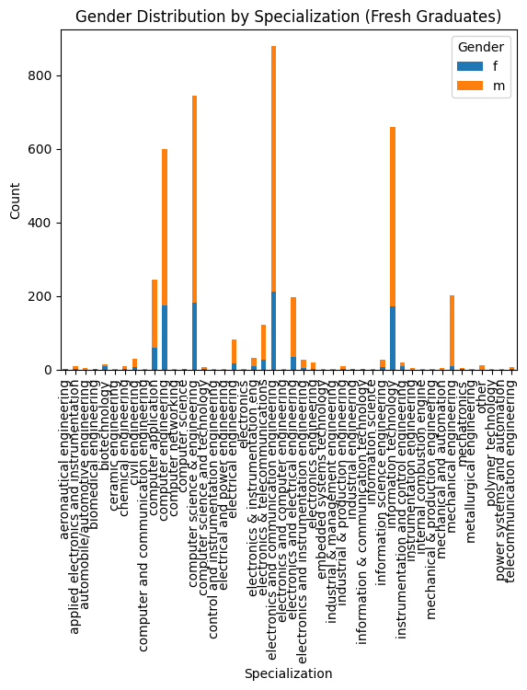
Research Question 2: Determine if gender influences the choice of specialization.
The graph shows that most specializations have a higher number of male graduates than female graduates.
There are a few specializations with a higher number of female graduates, but they are outnumbered by those with more male graduates.
The highest number of graduates is in Computer Science and Engineering, followed by Electronics and Communication Engineering.

Slide 18
Conclusion
The analysis of the AMCAT dataset provides insightful conclusions regarding salary trends, specialization, and skill sets of fresh graduates in different roles. Here are some key takeaway:
The average salaries for roles like Programming Analyst, Software Engineer, Hardware Engineer, and Associate Engineer align with industry standards as reported in the Times of India.
Graduates with Computer Science and IT-related specializations tend to command higher salaries, reflecting the strong demand for these skills in the tech industry.
There is an uneven distribution of male and female graduates across different job roles, indicating potential gender biases or disparities in certain specializations and job roles.
Technical skills like programming, computer science, and other related fields are strongly correlated with higher salaries, emphasizing their significance in securing well-paying jobs.

Slide 19

THANK YOU

