Slide 1

Experiment Tracking and Model Management
(Sentiment Analysis Project)
Submitted by:
Pandey Abhishek Nath Roy
Intern ID : 1240134

Slide 2
About me
Hi there! I am Pandey Abhishek Nath Roy (IN1240134), a fresher data enthusiast, currently learning various things to crack an opportunity to go further.
Apart from this, I possess the problem solving ability and I am good at learning new things that makes me an ideal candidate to follow my dreams.
I have previously worked as a data science intern at “Innomatics Research Labs” and right now, I am doing the internship to refine my skills at their highest level.
Feel free to reach out! You can do so by following the below links:
Github @vjabhi000985
Linkedin

Slide 3
OBJECTIVE OF THE PROJECT
The objective of this task is to introduce you to MLflow for experiment tracking, model management, and reproducibility in machine learning projects for the “Sentiment Analysis Project”.

Slide 4
MLFLOW
“MLflow” is an open source platform for managing the machine learning lifecycle.
What it does :-
Tracks experiments: Logs parameters, metrics, and artifacts (models, code) during training runs.
Enables reproducibility: Compares experiments and facilitates replicating successful runs.
Model registry: Stores, versions, manages, and deploys trained models.
Benefits :-
Improves Collaboration.
Streamline deployments and Automates workflows.

Slide 5
Integration of MLflow into Projects
$ pip3 install mlflow dagshub --quiet
import mlflow
mlflow.set_experiment("flipkart_review_sentiment_prediction")
# Start the experiment run
with mlflow.start_run() as run:
%time grid_search.fit(X_train, y_train)
# Install the required packages

Slide 6
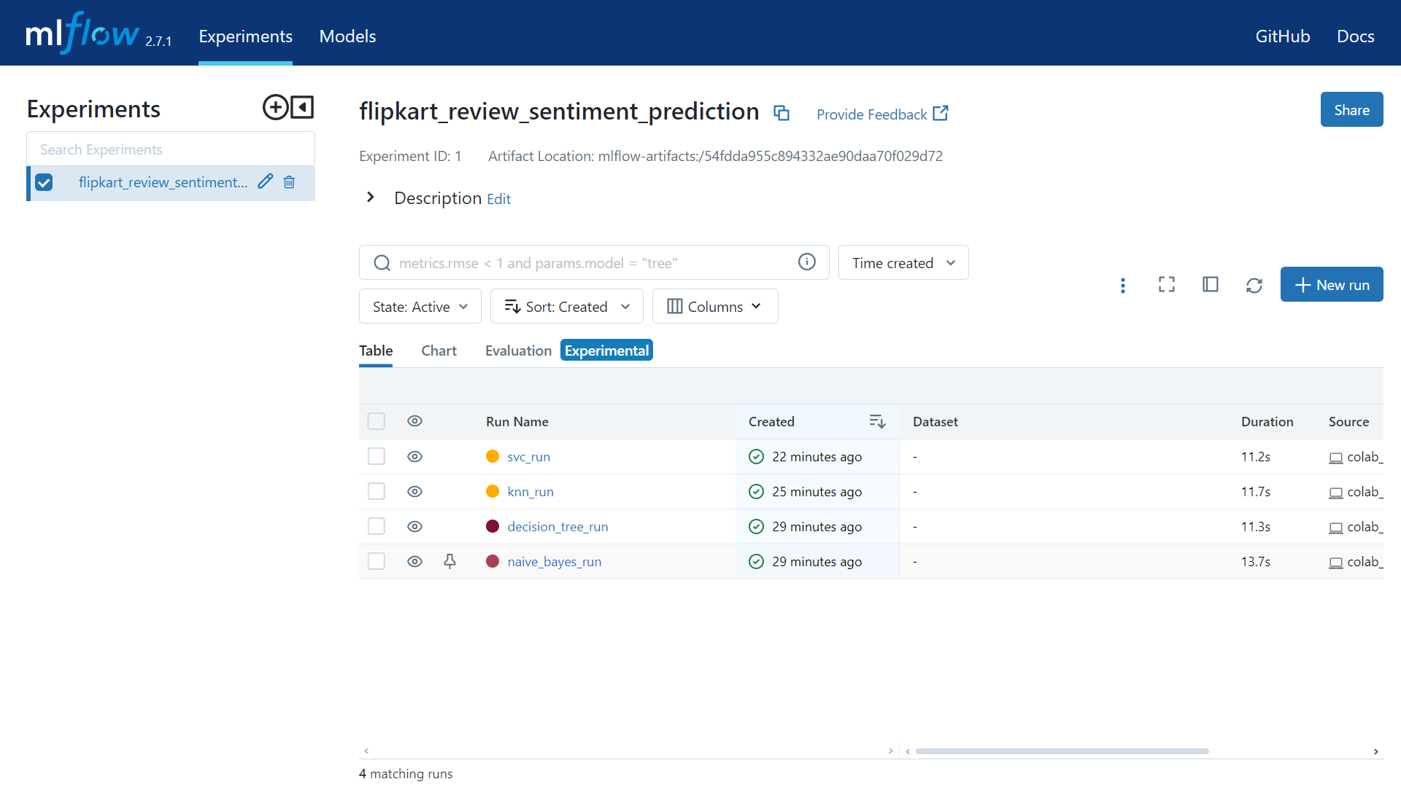
MLflow Dashboard

Slide 7
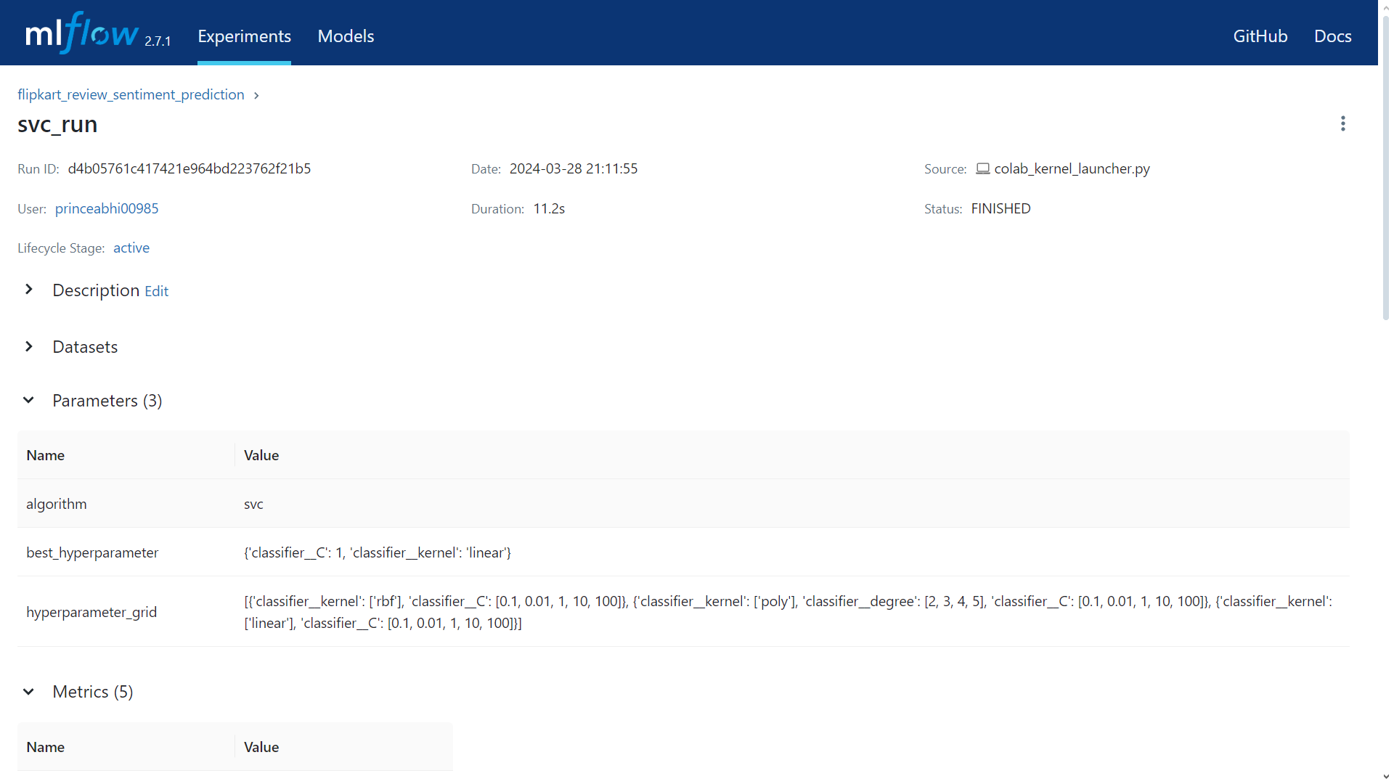
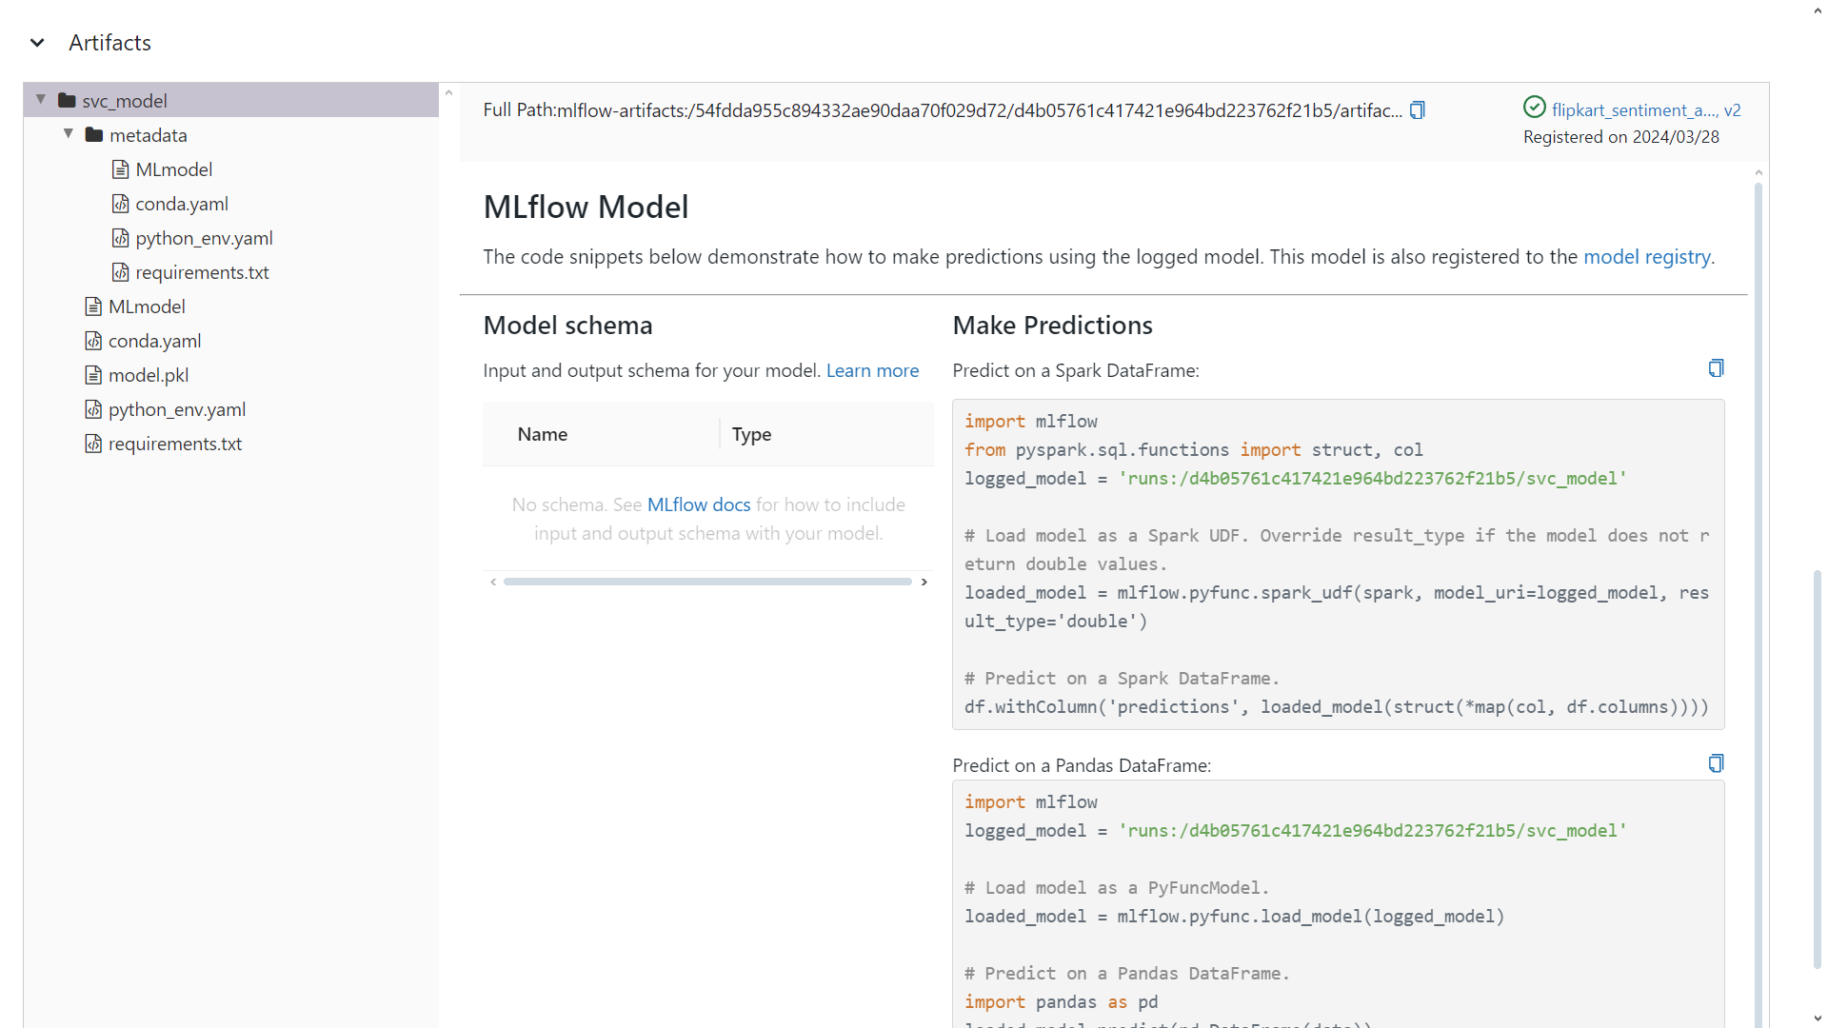
Demonstration of Parameters, Metrics and Artifacts

Slide 8
Demonstration of Parameters, Metrics and Artifacts using MLflow tracking API
Click on “Experiment Name” -> Run Name -> (scroll down for) -> Parameters, Metrics and Artifacts .

Slide 9
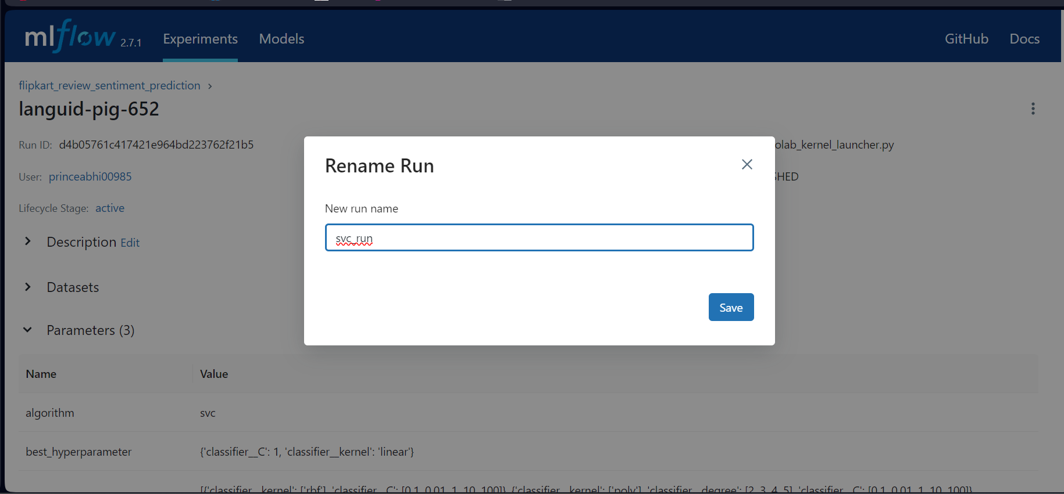
Customizing Mlflow with Run Names
Click on the run name -> Right corner : 3 dots ->
Rename -> Give the name of run -> Save

Slide 10
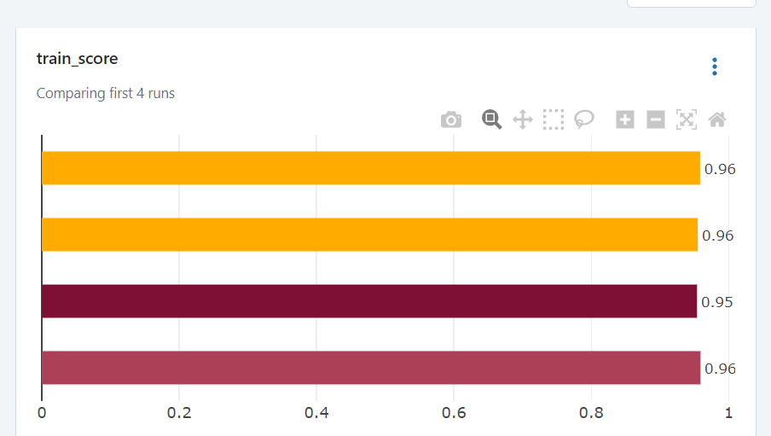
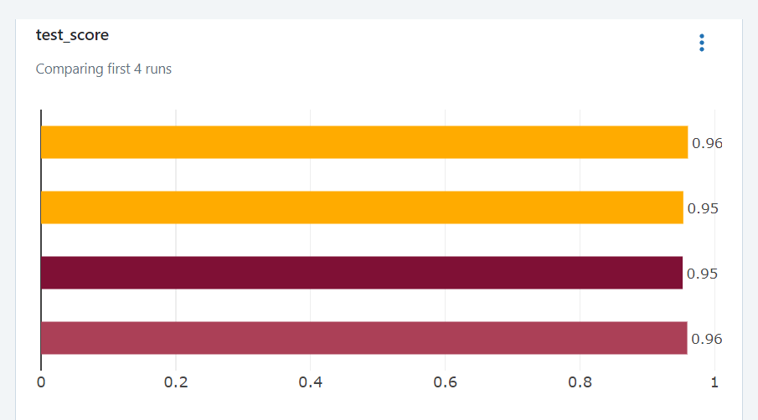
Metric Plots :

Slide 11
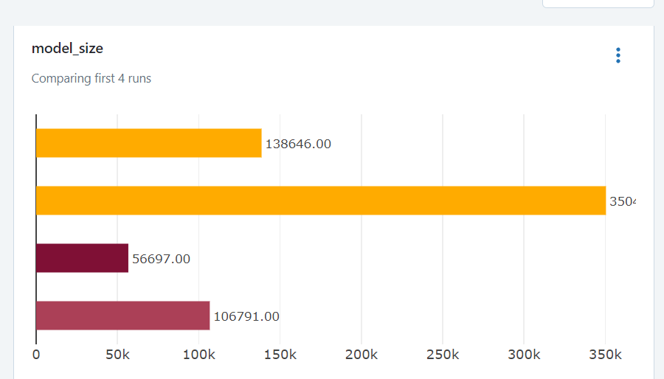
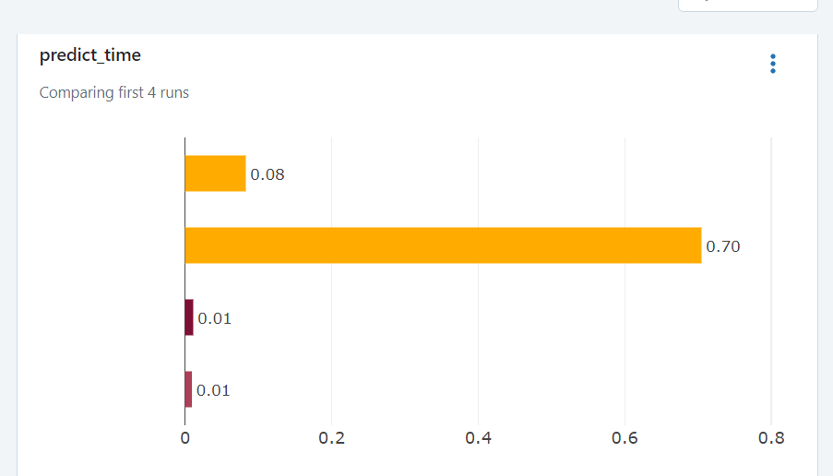
Metric Plots :

Slide 12
Hyperparameter Plots Creation
Click on charts -> Add Section -> Name hyperparameter with model ->
Add Parallel coordinates chart -> give parameters and metrics of particular run ->
Click on the run-name’s “+” : This will pop interactive chart.

Slide 13
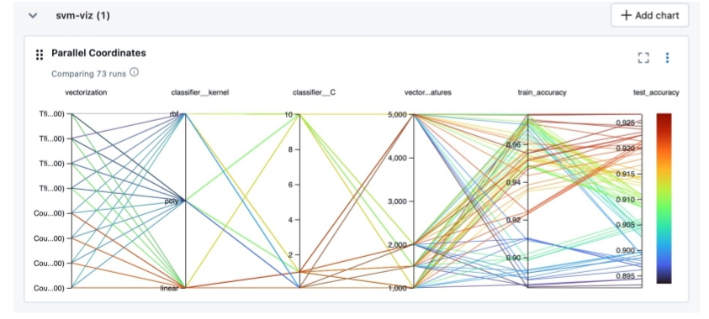
Hyperparameter Plots

Slide 14
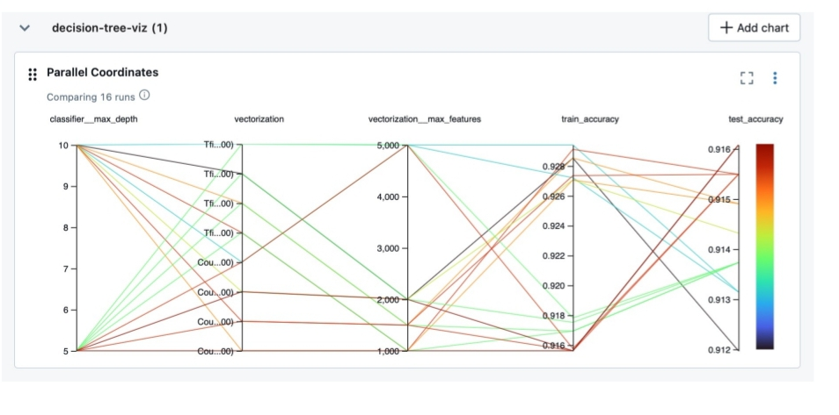
Hyperparameter Plots

Slide 15
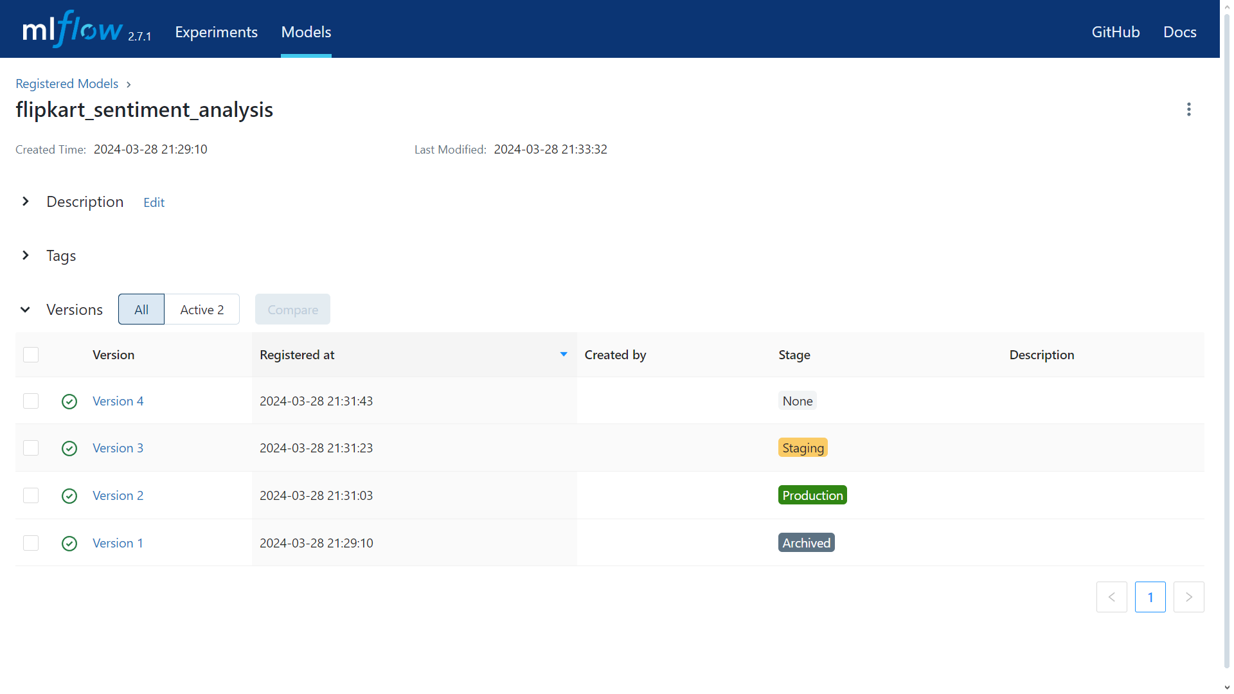
Registering the models

Slide 16
Prefect
Prefect is a Python library that helps you build organized and efficient data pipelines, especially for machine learning. It allows you to:
Break down complex tasks: Prefect lets you divide your data processing or machine learning workflow into smaller, reusable steps called tasks.
Manage task order: It cleverly manages the order in which these tasks run, ensuring everything happens at the right time.
Keep an eye on progress: Prefect monitors your workflows as they run, catching any errors and offering visualizations to help you troubleshoot.

Slide 17
Prefect : Benefits
Less code, more reuse: By using modular tasks, you can write code once and use it in multiple workflows, saving time and effort.
Easier maintenance: Clear organization with tasks makes your workflows easier to understand, modify, and debug later on.
Scales as you grow: Prefect can handle large and complex workflows by allowing tasks to be run on multiple machines.

Slide 18
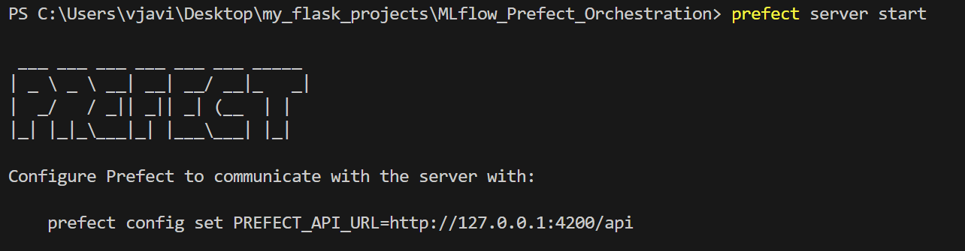
Prefect : Installation and First run
Run the following commands to install the prefect and to run it.
$ pip install prefect
$ prefect server start
This type of prompt will appear.

Slide 19
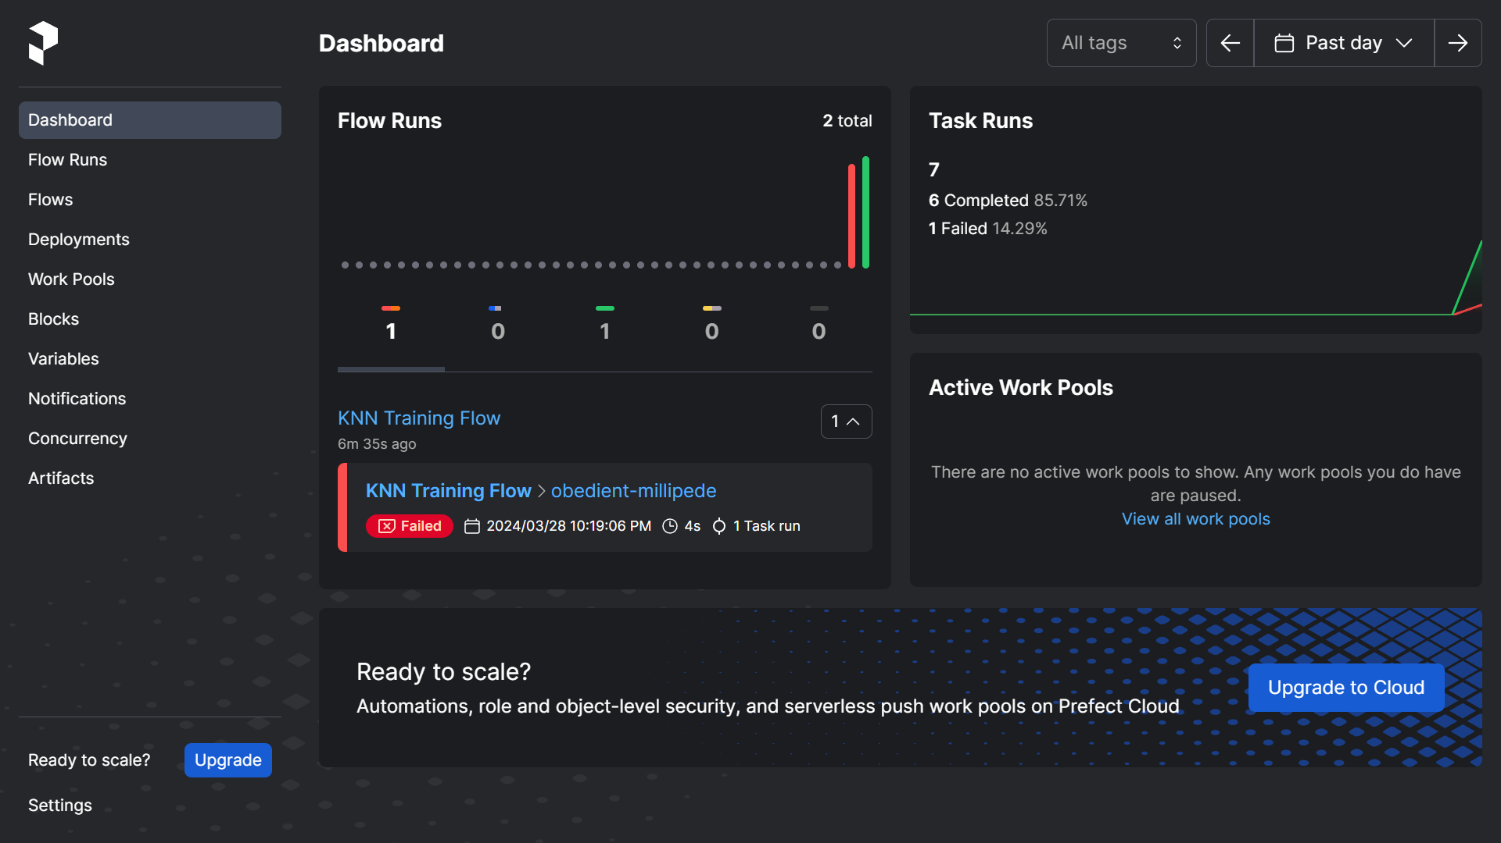
Prefect Dashboard

Slide 20
Building a Prefect workflow
Import Prefect Models (step 1).
Define Prefect Tasks (step 2).
Define Prefect Flow (step 3).
Run Prefect Workflow (step 4).

Slide 21
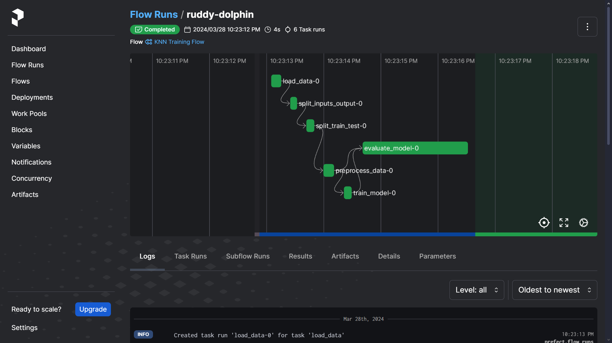
Prefect workflow

Slide 22

THANK YOU

