Slide 1
Analytics Olympiad 2022
Varun Jagannath

Slide 2
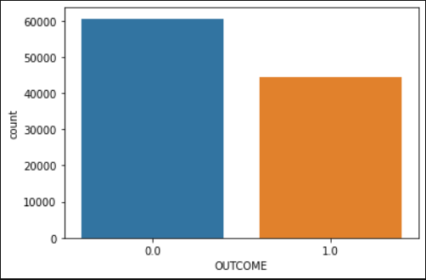
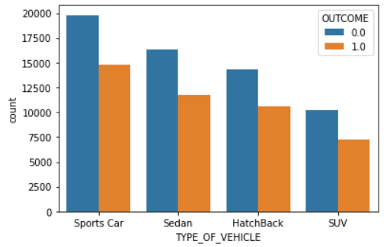
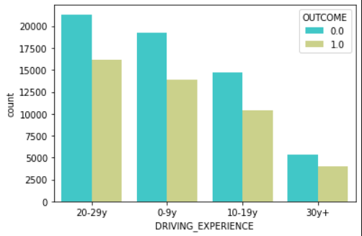
Data Understanding
There are 17 columns in train and test and 16 being categorical columns.
Slightly imbalanced data for the target
32% of vehicles in dataset are sports car’s
More experienced drivers

Slide 3
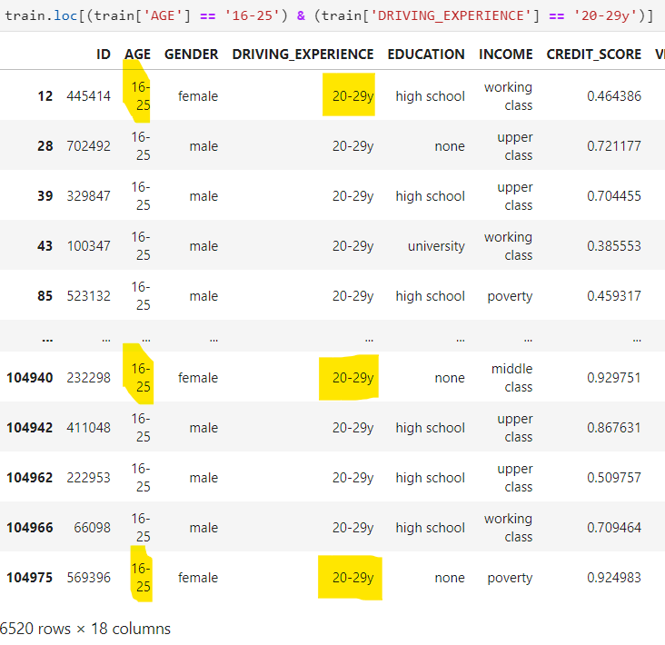
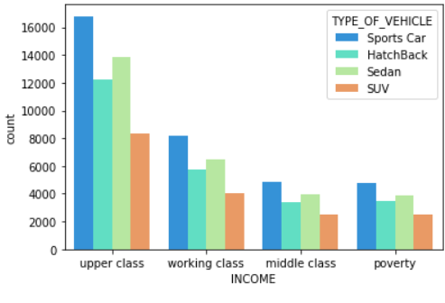
Data Understanding
There looks to be noise or error from data capture as drivers with Age between 16-25 are having 20-29 years of driving experience.
There are more than 4000 sports cars owned by income class poverty which shows error/noise or is the data random shuffled.
Postal Code column is high cardinal categorical column with 10238 postal code sharing more than 70% in the data.

Slide 4
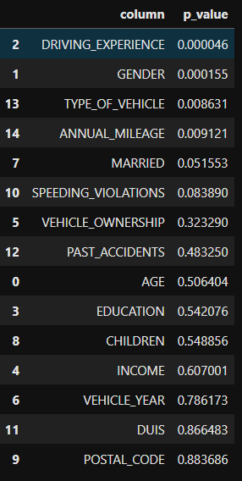
Data Preparation
Label Encoding is done to the following columns;
Gender, Education, Income, Vehicle Year, Type of vehicle
Ordinal Encoding to AGE and Driving Experience.
No outlier treatment is done to credit score as it might lead to some interesting results.
No null values present in the data.
Features driving experience, gender, type of vehicle and annual mileage are having higher pearson chisquare correlation with target column.
Feature correlation based on pearson chisquare for categorical columns

Slide 5
Model Building & Evaluation
Experimented with different models like xgboost, lightgbm and catboost. Also, tried to ensemble or stacked ensemble but catboost gave a better performance in public leader board.
5 fold Stratified cross validation is used across all the models.
Hyperparameters used for catboost were learning rate 0.1, max_depth 7, iterations 3000 and early stopping 100 rounds.
GENDER, DRIVING_EXPERIENCE and TYPE_OF_VEHICLE were explicitly given as cat_features to catboost fit.
Model | CV | Public LB
Xgboost | 0.681158 | 0.68093
LightGBM | 0.681145 | 0.68054
Catboost | 0.681039 | 0.68031
Stacked Ensemble | 0.681109 | 0.68036

Slide 6
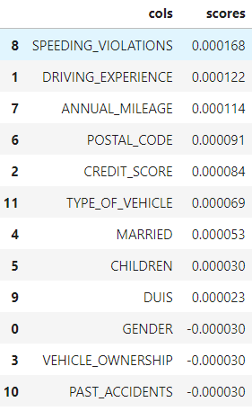
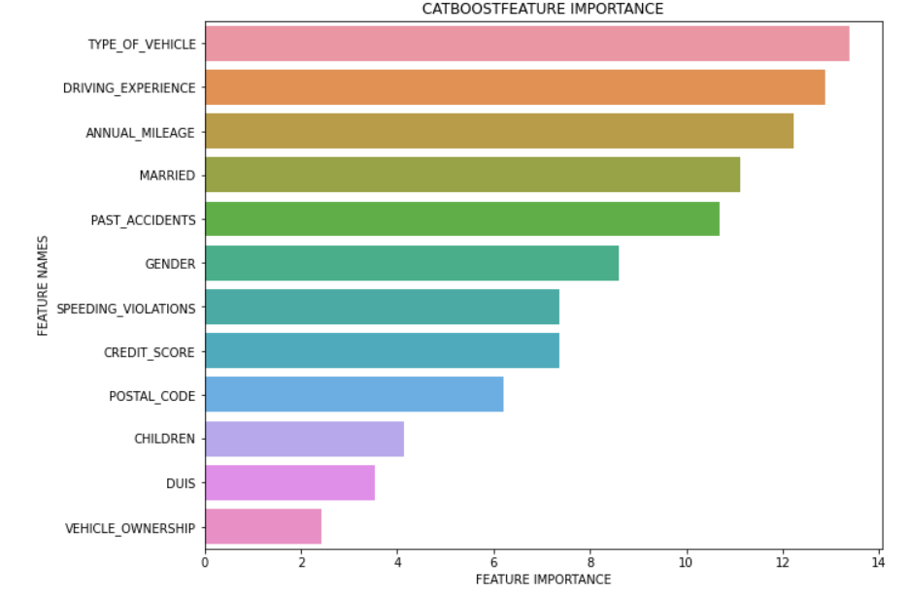
Results and Recommendations
Permutation Importance
Fields which are important according to Permutation Importance and Feature Importance are;
1. Annual Mileage
2. Type of Vehicle
3. Driving Experience

Slide 7
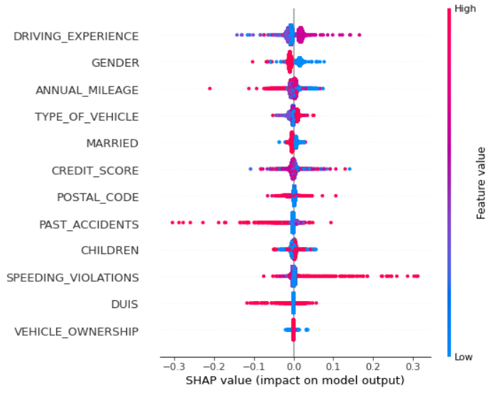
Recommendations
Higher annual mileage is leading to higher rejections in the insurance claims.
Higher accidents are also leading to higher rejections.
Gender of class zero is also giving good model performance.
Higher type of vehicles like Sports car and Sedan are good indicators for model performance.

Slide 8
Recommendations
There seems to be lot of errors/noise with the columns like AGE vs Driving Experience and Type of Vehicle vs Income.
Older Vehicles/Higher Annual Mileage are leading to more Insurance rejections.
Past Accidents is also good indicator to drive business Insight.
We can drive even better results if more columns are captured like number of claims, Average amount claimed etc.
The following features are more important according feature selection/Importance for Insurance rejection or acceptance are;
Type of Vehicle, Annual Mileage, Driving Experience, Past Accidents and Gender

Slide 9
Thank you

