Slide 1

✈
Flight Route
Shortest Path Finder
How does a computer find the best flight path between any two airports in the world?
MSML604 · Project 2 | Individual Work | UID: 122082892

Slide 2
The Problem
Imagine This
What Does "Best" Mean?
You want to fly from Washington D.C. to Tokyo, Japan.
There is no single direct flight. You need to connect through other airports.
With ~7,000 airports and ~67,000 routes worldwide — how do you find the best path?
Fewest layovers
Minimize the number of connecting flights
Shortest distance
Minimize total kilometers flown
This app answers both — and compares them.

Slide 3
How It Works
1
2
3
Real Airport Data
Build a Map (Graph)
Run the Algorithms
67,000 real routes between ~7,000 airports loaded from the OpenFlights dataset — no made-up data.
→
Each airport is a dot on a map. Each route is a one-way arrow connecting two airports. Distance in km = the arrow's weight.
→
Two methods find the best path simultaneously and their results are shown side by side.

Slide 4
Two Algorithms, One Question
BFS — Fewest Stops
Dijkstra — Shortest Distance
Think of BFS like ripples in a pond. It checks all airports reachable in 1 stop, then 2 stops, then 3 — until it reaches your destination.
Result: The path with the fewest layovers.
Think of Dijkstra as a smart GPS. It always explores the cheapest path so far, making sure it never wastes distance on a detour.
Result: The path with the least total kilometers.
✓ Simple ✓ Fast ✗ Ignores distance
✓ Distance-optimal ✓ Real-world useful ✗ More work

Slide 5
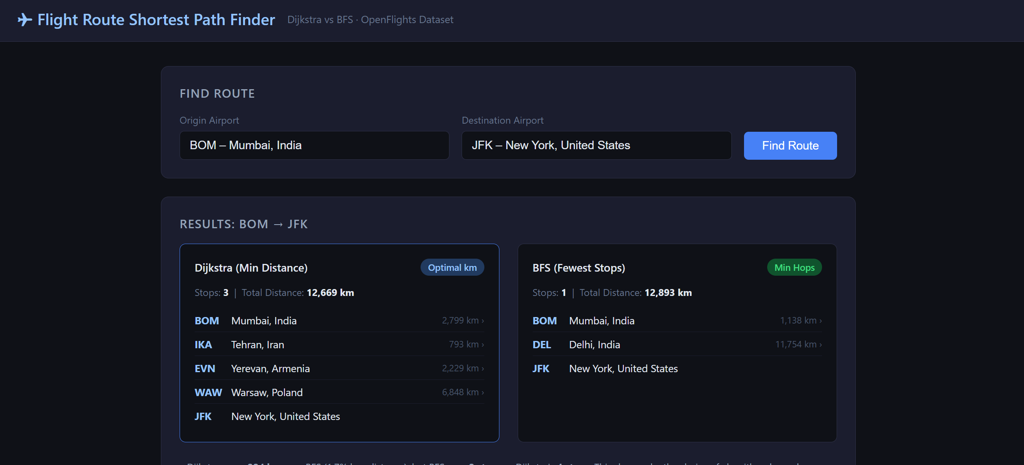
User Interface
Origin: JFK – New York, USA
Destination: NRT – Tokyo, Japan
Search
Dijkstra (Min Distance)
BFS (Fewest Stops)
JFK → ORD → ANC → NRT
JFK → NRT
10,838 km | 2 stops
10,838 km | direct
→ Type any airport name or 3-letter code and compare both routes instantly

Slide 6
Why This Matters
The same algorithm that powers this app is used in:
🗺️
GPS Navigation
📦
Package Delivery
Google Maps uses Dijkstra-like methods to find shortest driving routes in real time.
FedEx & UPS optimize delivery routes across thousands of stops each day.
🌐
Internet Routing
💊
Hospital Networks
Data packets on the internet are routed using shortest-path algorithms across network nodes.
Emergency systems find the fastest path to route patients to available care.

Slide 7
Key Takeaways
1
Real airline data — 7,000 airports, 67,000 routes
2
BFS finds the fewest stops (ignores distance)
3
Dijkstra finds the shortest distance (the smarter choice)
4
Side-by-side comparison shows why algorithm choice matters
5
The same logic powers GPS, logistics, and the internet
Tools: Python · Flask · OpenFlights Dataset · Dijkstra's Algorithm · BFS

