Slide 1
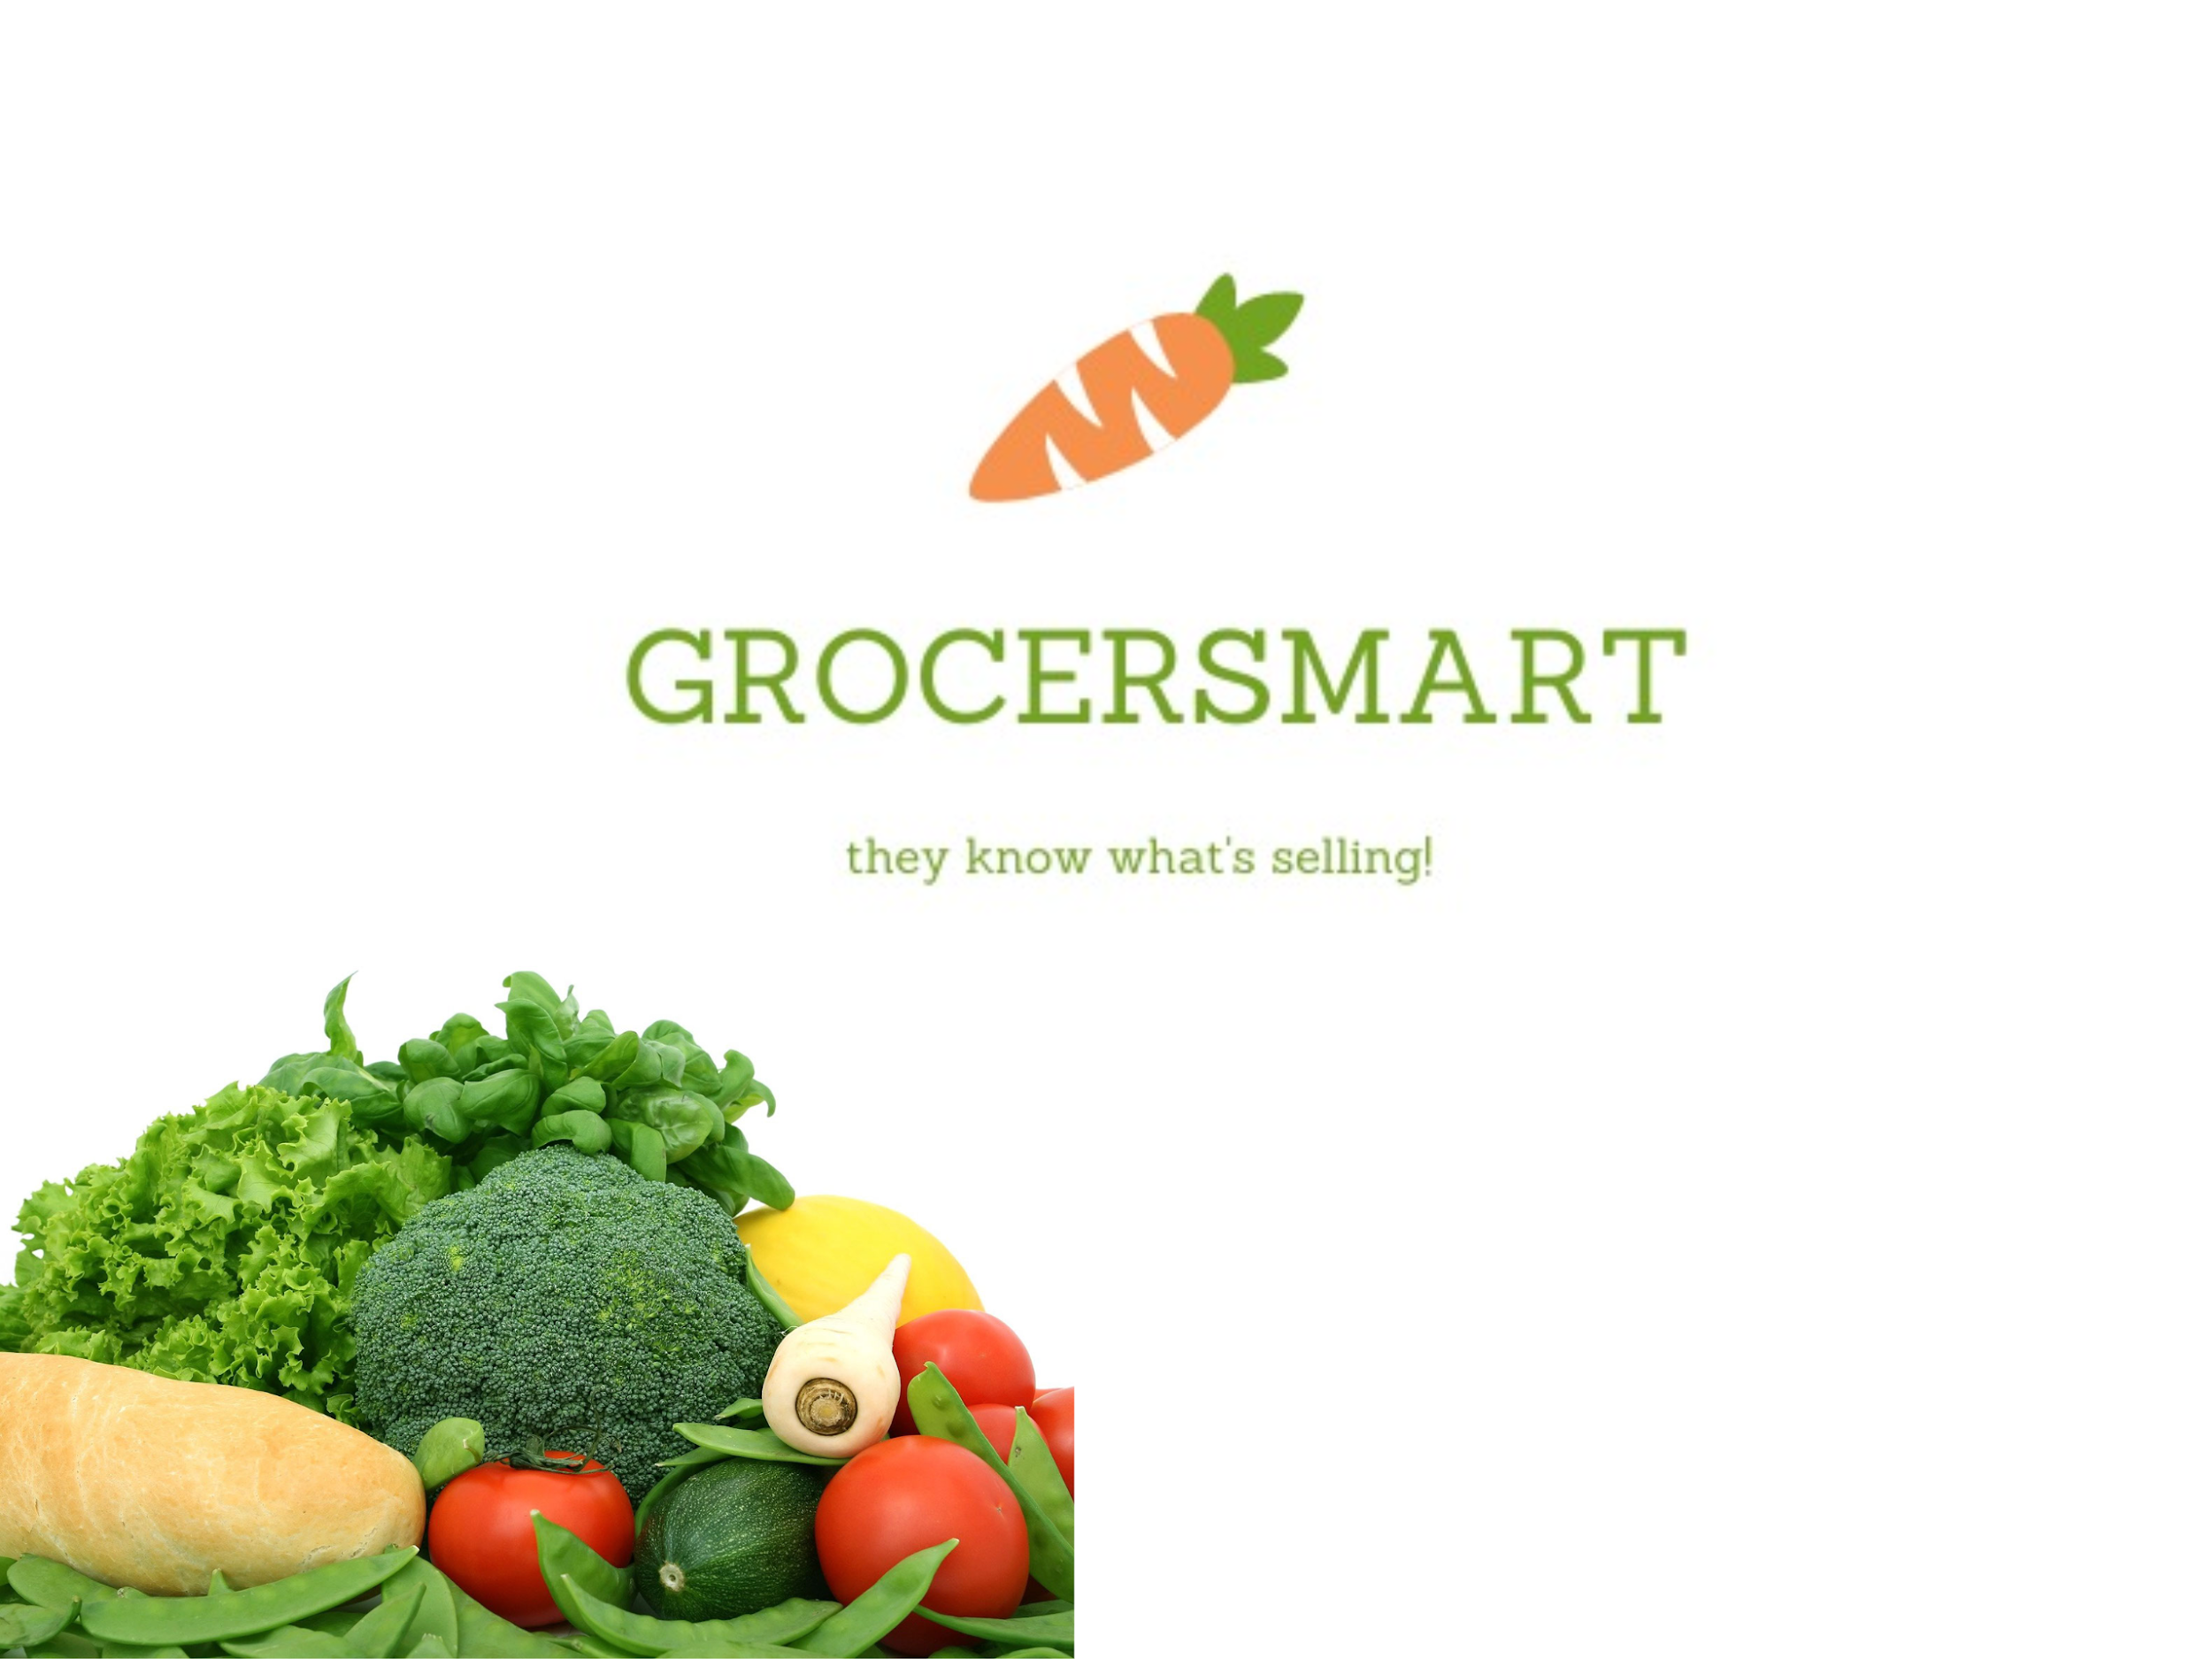
BY
TEAM 22 Chandralekha Vaibhav Sayali Kesiya

Slide 2
ABSTRACT
What is GrocerSmart?
A solution to all sales related problems faced by a grocer.
Compare sales based on Tier, outlets, categories or sale of a specific item across outlets.
Predict item sales based on changes in Item MRP, Item Visibility and Item Weight.
End User
City/Tier level manager of a supermarket like Walmart, Costco, etc.
Outlet level managers of those individual supermarkets.

Slide 3
INTRODUCTION
Need of GrocerSMART
Manual Predictions can go wrong.
Retailers add new locations with unique needs
Introducing new products
Ever transitioning seasonal tastes
Unpredictable product marketing,etc.

Slide 4
DATA ANALYSIS
GrocerSmart uses data from leading supermarket retail branch chain, BigMart.
The dataset available is in the form of csv files.
Tier(3) → Outlets → Categories → Item Numbers
Store Informations like store type, store location, store size, etc.
Item Informations like MRP, item visibility, item type, item sales,etc.

Slide 5
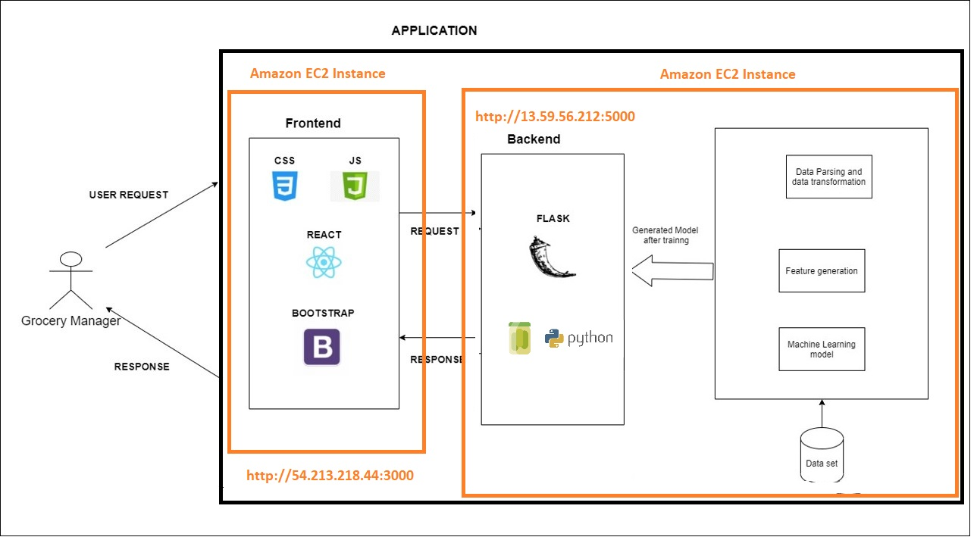
ARCHITECTURE

Slide 6
DATA PRE-PROCESSING
The first pre-processing steps are pretty rudimentary as the data is already structured for this use case.
A list of all columns with empty or null values are fetched, categorical values not considered.
Numerical values such as Item Weight, Outlet Size (derived from Outlet Type) are filled with average/mean of their sub categories.
Labelling is made uniform across all records on other categorical fields like Item Fat Content and derived categorical values, like New Item Type, i.e. Consumable/Non-Consumable.
Finally, a LabelEncoder is used to transform all the categorical values into distinct numerical values. using FIT Transform method.

Slide 7
DATA MODELING
To train our data model, we use multiple approaches and compare the models using Mean Square Error (MSE) and Cross Validation (CV) scores.
Linear Regression serves as a baseline model, and we used multiple strategies like LGB, Ridge, Lasso and eventually end up with best results from Random Forest Regressor model. We observed much lower MSE and slight improvement in CV score
The model was then extracted to a Pickle file(.pkl) to be used by the python Flask backend to query the model in real time.

Slide 8
FRONTEND & BACKEND
Grocersmart is available to its customers as a website which can be developed into an mobile application in future.
FRONTEND
It is written in react JS.
We have also used third party libraries like google charts, bootstrap, etc.
BACKEND
Written in python flask
Uses pkl file to predict target values( Outlet Sales ) from the trained model

Slide 9
DEMO

Slide 10
CONCLUSION
Our key learnings from this project:
Understanding the data view from end user’s perspective
Data pre-processing techniques and advantages
Data modelling algorithms and their strengths/drawbacks
Full stack application development, integration and deployment workflow.
Team effort management and frequent collaboration

Slide 11
FUTURE IMPROVEMENT
Use time stamped data ranging over multiple days to build Time series features to predict over multiple date ranges ( i.e. period of two weeks )
Adding more features like real time inventory management based on expected outlet sales for each item
Expanding the product to include data at higher and lower granularity (from city, state level to sub-product category or aisle level.
Building more graphical interfaces for the user to compare outlet sales with more ease in the “Predict” section to compare values against baseline and trend over period of 15 days.

