Slide 1
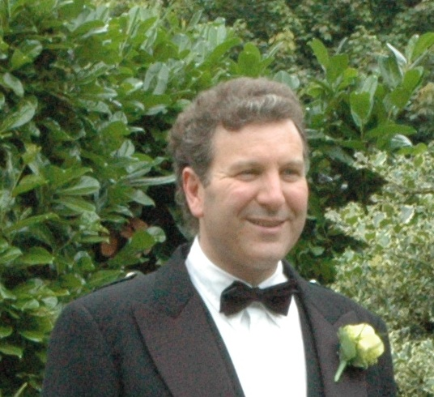
European
Commission
Advisory Board
Project
Coordinator
Steering Committee
Project
Administrator
Subproject Team Leader
Workpackage Team Leader
Workpackage
Workpackage
Workpackage

