Slide 1


ONLINE GADGET PORTAL CSCI-6628-Object Oriented Analysis & Design
Guided By: Prof. Thomas Shokite
Team-5 Payal Patel, Manushi Vakharia, Jaya Krishna

Slide 2
Contents
Glance to the Sprint:1 product backlogs
1
Sprint:2 Product Backlogs
2
Future Product Backlogs
3
Screenshots
4

Slide 3
Few highlights of the system,
The goal of this project is to design and develop an online system consists of latest mobile phones and its accessories.
It has a feature that enables customers to get helped incase of any damage/problem from the webpage itself rather than walking in the store.
It has three main characters who make the whole system, namely: Customer, System and an Admin.
In the system customer can view products of the interest.
Technologies used: ASP.net core with MVC, Microsoft SQL Server,HTML5, Bootstrap.

Slide 4
Sprint:1 product backlogs
Story | Estimation | Priority
As an unauthorized user, I want to create a new account | 3 | 1
As a user, I want to login into my personal account prior to browsing for items. | 1 | 2
As an authorized user, I want to be able to update my profile | 3 | 3
As an admin, I want customers to create their own account with unique username | 1 | 4
As a user, I want to be able to recover my account | 1 | 5

Slide 5
Sprint: 2 Product Backlogs
As a user, I want to be able to browse(search) products according to my choice | 2 | 7
As an admin, I want to be able to add/remove items to/from the system | 3 | 6
As a user, I want to be able to select a list of items that I wish to buy | 2 | 8
As a user, I want to be able to add/remove items to/from the cart | 2 | 9
As a user, I want to see every single detail of an item before making any purchase | 1 | 10
As a user, I want to be able to secure my purchase by buying coverage(warrantee) for it | 3 | 12
As an admin, I want to be able to add/remove items according to their category | 2 | 13
As an admin, I want to be able to perform maintenance at a scheduled time | 2 | 14
As a user, I want to use the system anytime | 1 | 15
As a user, I want to be able to select any displayed items for purchase | 1 | 17
As a user, I want to be able to purchase (check out with payment) any selected items | 2 | 18
As a user, I want to logout from the system | 1 | 20
As a trusted user, I want to get assistance under warranty period. | 3

Slide 6
Future Product Backlogs
As a curious user, I want to be able to compare items of my interest. | 2 | 11
As an admin, I want the system to use only safe and trusted payment gateway | 3 | 16
As a user, I want to be able to receive conformation for my purchase | 2 | 19

Slide 7
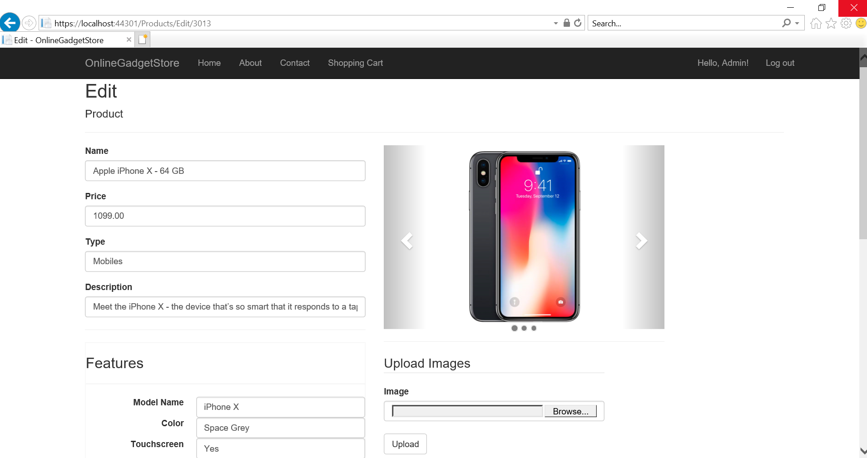
Screenshots:

Slide 8
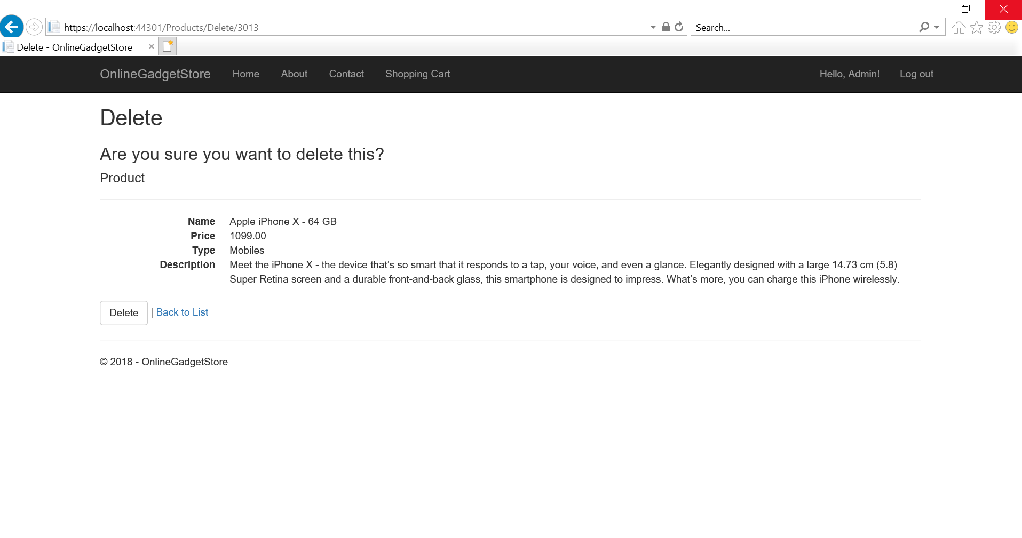

Slide 9
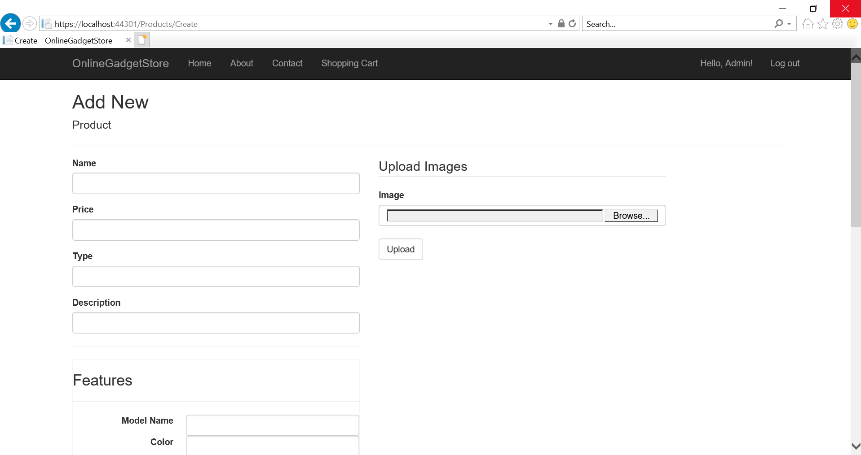

Slide 10
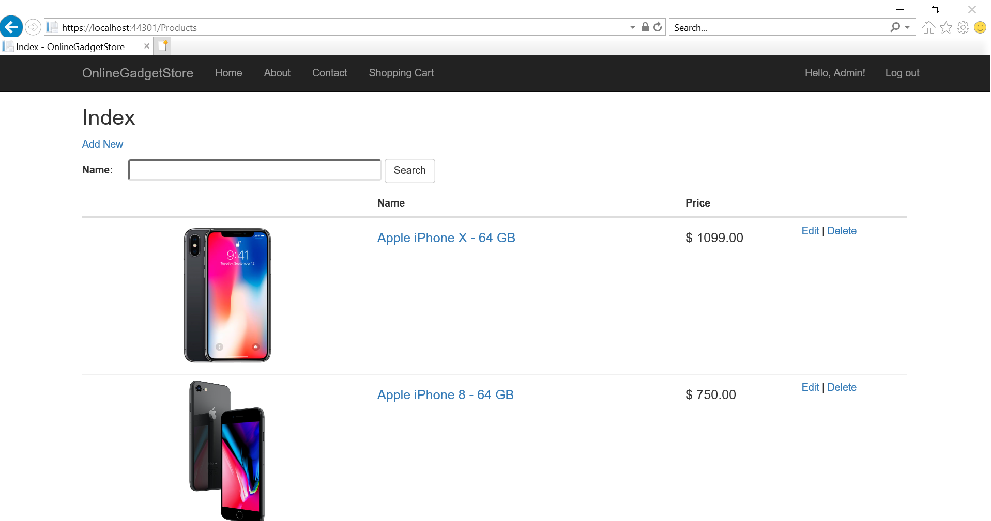

Slide 11
Demo!

