Slide 1

University Course Offering Determination(UCOD)
Interim Presentation
Hiranthi Ranasinghe (149157U)

Slide 2
Outline
Introduction
Course Selection Decision Making-Issues & Challenges
Multi Agent Systems and Machine Learning
Novel Approach To University Course Selection Determination
Design Of University Course Selection Determination System
Implementation of the proposed solution
Evaluation

Slide 3

Introduction
14 Universities
Art
Commerce
Biological Science
Physical Science
About
90
different Courses

Slide 4
Introduction
Aim: The aim of this research is to design and implement a solution for student counselling when selecting a suitable degree program after G.C.E (A/L) with the use of machine learning and multi agent technologies

Slide 5
Introduction (contd.)
Objectives
Study the current issues and challenges of the selection process
Study of technologies that can solve the problem
Study the usage of multi agent and machine learning technique to solve the problem
Design and develop a system for solving the problem
Do predictions using machine learning
Evaluation of the proposed solution

Slide 6
Course Selection Decision Making-Issues & Challenges
The MAS approach has proven an important and effective framework for intelligent educational systems
iHelp [8]
program planning [9]
Time Table Scheduling [10] etc
COD -Course Selection Determination as a MAS system that consists of an
Administrator (AD) agent,
A group of student (SA) agents, and
A student representative (SR) agent.

Slide 7
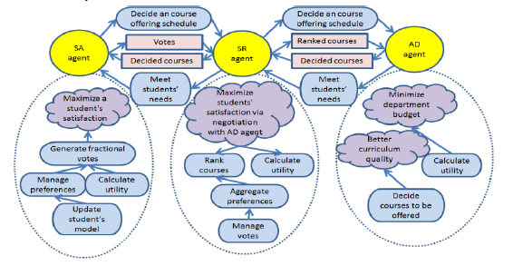
Course Selection Decision Making-Issues & Challenges(Contd.)

Slide 8
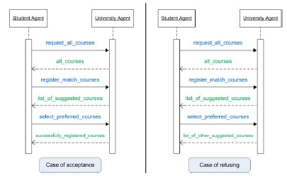
Shi et al. designed an integrated Multi agent systems for computer science education
Java RMI, JavaSpace and JATLite to create a web-based system
personal agents to manage student’s data and their interactions with course material

Slide 9
Course Selection Decision Making-Issues & Challenges(Contd.)
Many researchers have contributed to the field of data mining in higher education.
- Abu Tair and El-Halees :data mining in the educational domain
- M. Sukanya, S. Biruntha, S. Karthik and T. Kalaikumaran : predict the number of upcoming students in the next year based on the number of enrolled students in the previous years

Slide 10
Multi Agent Systems and Machine Learning
Machine Learning
finding patterns and making predictions from data
multivariate statistics, data mining, pattern recognition, and advanced/predictive analytics.
linear regression
Pattern recognition and predictions

Slide 11
Multi Agent Systems and Machine Learning(Contd.)
Multi Agent System
Autonomous : operates without the direct intervention of humans or others
Social : cooperates with humans or other agents in order to achieve its tasks
- Reactive : perceives its environment and responds in a timely fashion
- mobile: ability to travel between different nodes in a computer network

Slide 12
Novel Approach To Course Offering Determination
Agent Technology
Machine Learning
Suitable Course Determination Module
Prediction Module
Student Agent
Suitable Subjects Determination Module
Course Agents

Slide 13
Agent Architecture
Z-Score & District
Aggregate Students Preferences
A/L Schema
Decide Eligibility
Select Proffered Courses
Offer courses effectively
Student Agent
Course Agent
Express Preferences
Provides detail discriptions

Slide 14
Implementation of the proposed solution

Slide 15
References
Vassileva, J., G. McCalla, & J. Greer, “Multi-Agent Multi-User Modeling In I-Help,” User Model. User-Adapt. Interact. 13, (2003). 179–210
Hamdi, M. S. MASACAD: A Multiagent-Based Approach to Information Customization. IEEE Intelligent Systems, 21(1). (2006). 60-67.
Tariq M., Mirza M., Akbar R., Multi-agent Based University Time Table Scheduling System (MUTSS). Inter. J. of Multidisciplinary Sci. and Engg., 1(1). (2010) 33-39
Sampson, D., Karagiannidis, C. and Kinshuk Personalised Learning: Education, Technological and Standardisation Perspective. Interactive Education Multimedia, 42002), 24-39.
Bellifemine, F. L., Caire, G. and Greenwood, D. Developing Multi-Agent Systems with JADE. John Wiley, Chichester,UK, 2007.
Graesser, A., Chipman, P., Haynes, B., & Olney, A. (2005). AutoTutor: an intelligent tutoring system with mixed-initiative dialogue. IEEE Trans. on Education, 48(4), 612–618.
Mitrovic, A., & Ohlsson, S. Evaluation of a constraint-based tutor for a database language. International Journal on Artificial Intelligence. (1999).
Wilson, D. C., et al. SmartChoice: An Online Recommender System to Support Low-Income Families in Public School Choice. AI Magazine, 30(2), (2009). 46-58

Slide 16
Q&A

Slide 17
Thank you

