Slide 1



Software Engineering (303105253)

Slide 2


Software Design
Software Design is the process of transforming user requirements into a suitable form, which helps the programmer in software coding and implementation.
During the software design phase, the design document is produced, based on the customer requirements as documented in the SRS document
This phase aims to transform the SRS document into a design document.
Image source : Google

Slide 3
Objectives of Software Design
Correctness: A good design should be correct i.e., it should correctly implement all the functionalities of the system.
Efficiency: A good software design should address the resources, time, and cost optimization issues.
Flexibility: A good software design should have the ability to adapt and accommodate changes easily.
Understandability: A good design should be easily understandable, it should be modular, and all the modules are arranged in layers.
Completeness: The design should have all the components like data structures, modules, external interfaces, etc.
Maintainability: A good software design aims to create a system that is easy to understand, modify, and maintain over time.
Image source : Google

Slide 4
Software Design Concepts
The software design concept simply means the idea or principle behind the design.
It describes how you plan to solve the problem of designing software, and the logic, or thinking behind how you will design software.
It allows the software engineer to create the model of the system software or product that is to be developed or built.
It allows the software engineer to create the model of the system software or product that is to e developed or built.
Image source : Google

Slide 5
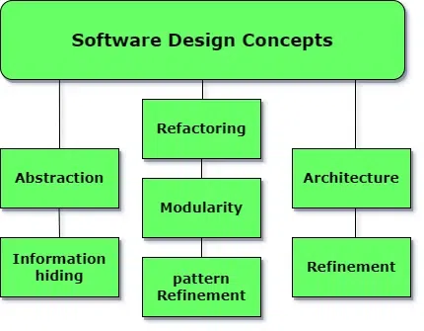
Cont…
There are many concepts of software design and some of them are given below
Image source : Google

Slide 6
Cont…
Points to be Considered While Designing Software
Abstraction: Abstraction simply means to hide the details to reduce complexity and increase efficiency or quality.
Modularity: Modularity simply means dividing the system or project into smaller parts to reduce the complexity of the system or project.
Architecture: Architecture simply means a technique to design a structure of something.
Refinement: Refinement simply means to refine something to remove any impurities if present and increase the quality.
Image source : Google

Slide 7
Cont…
Pattern: The pattern in the design process means the repetition of a solution to a common recurring problem within a certain context.
Information Hiding: Information hiding simply means to hide the information so that it cannot be accessed by an unwanted party.
Refactoring: Refactoring simply means reconstructing something in such a way that it does not affect the behavior of any other features.
Functional Independence: The functional independence is the concept of separation and related to the concept of modularity, abstraction and information hiding.
Image source : Google

Slide 8
Cont…
Abstraction
1. Procedural abstraction
2. Data abstraction
2. Architecture
1. Structural properties
2. Extra functional properties
3. Families of related systems
3. Design pattern
4. Modularity
5. Information hiding
6. Functional Independence
1. coupling -> outside the model
2. Cohesion -> within the model
7. Refinement
8. Refactoring
9. Object Oriented design concept
Image source : Google

Slide 9
levels of Software Design
Architectural Design: The architecture of a system can be viewed as the overall structure of the system and the way in which structure provides conceptual integrity of the system.
Preliminary or high-level design: Here the problem is decomposed into a set of modules, the control relationship among various modules identified, and also the interfaces among various modules are identified. Design representation techniques used in this stage are structure chart and UML.
Detailed design: Once the high-level design is complete, a detailed design is undertaken. In detailed design, each module is examined carefully to design the data structure and algorithms.
Image source : Google

Slide 10
Design Model
Design modeling in software engineering represents the features of the software that helps engineer to develop it effectively, the architecture, the user interface, and the component level detail
Design modeling provides a variety of different views of the system like architecture plan for home or building.
Different methods like data-driven, pattern-driven, or object-oriented methods are used for constructing the design model.
All these methods use set of design principles for designing a model.
Image source : Google

Slide 11
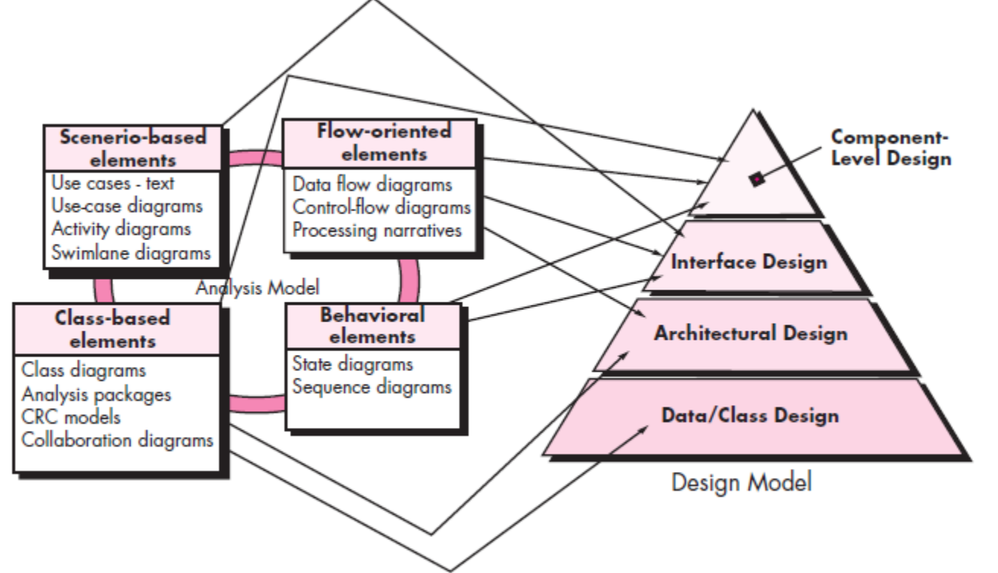
Cont..
Designing a model is an important phase and is a multi-process that represent the data structure, program structure, interface characteristic, and procedural details.
It is mainly classified into four categories:
Data Design Model
User Interface Design Model
Architectural Design Model
Component Level Design Model
Image source : Google

Slide 12
Data Design
It represents the data objects and their interrelationship in an entity-relationship diagram.
Entity-relationship consists of information required for each entity or data objects as well as it shows the relationship between these objects.
It shows the structure of the data in terms of the tables
It shows the structure of the data in terms of the tables
In one to one relation, one entity is connected to another entity. In one many relation, one Entity is connected to more than one entity.
In many to many relations one entity is connected to more than one entity as well as other entity also connected with first entity using more than one entity.
Image source : Google

Slide 13

User Interface Design
User Interface is the front end application view to which user interacts with the software.
It determines how command is given to the computer or the program and how data is displayed in the system screen.
The software becomes more popular if its user interface is:
Attractive
Simple to use
Responsive in short time
Clear to understand
Consistent on all interfacing screen
Image source : Google

Slide 14
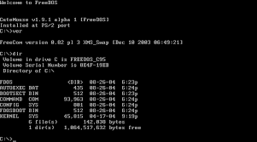
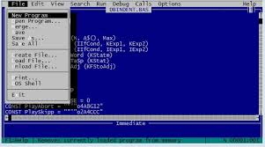
Cont..
Types of user interface
1. Text Based or Command Line Interface:
Text based interface primarily used keyboard handling data.
Command line interface proved command prompt or coding tools where the user types the command towards the system.
User need to remember syntax of command and its uses.
Command line interface used by technical people or programmers.
Image source : Google

Slide 15
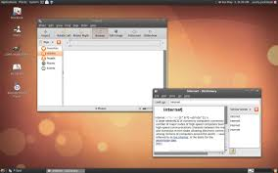
Cont..
2. Graphical User Interface:
Graphical user interface provides the simple interactive interface to interact with the system.
GUI can be combination of both software and hardware.
Graphical user interface is easy to learn as compared to the command line interface.
Graphical user interface provide multiple window to the user simultaneously to interact with the system .
Image source : Google

Slide 16
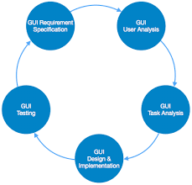
Cont..
User Interface design process.
Image source : Google

Slide 17
Cont..
User Interface design principles:
User familiarity: The user interface should be based on user oriented terms and concepts.
Examples: in windows terms like desktop, document, folder rename etc.
2. Consistency : The system command and menu should have be same formant and parameter.
Example: Group of font size and color.
3. Minimal surprise: User never like to see the system working in an unexpected manner. They get frustrated in such cases. Develop as per user tendency.
Example: Group similar type of features , In MS Word, File-> New, open, save print close restart system.
Image source : Google

Slide 18
Cont..
User Interface design principles:
4. Recoverability: Users most open makes mistakes while working with the system these mistakes can be reduced but can not be completely eliminated.
Example: Undo, Rename
5. User diversity: The interface should provide appropriate interaction facilities for the various type of system user.
Example: Larger font, Privacy setting.
6. User Guidance: The user interface should provide meaningful feedback when errors occur and provide different levels of help and advice.
Example: User manual, forgot password.
Image source : Google

Slide 19
Cont..
User Interface design Golden rules:
1. Place the user in control
The user should be able to easily enter and exit the mode.
Provide flexible interaction using keyboard, mouse or touch screen etc.
User must be able to interrupt the sequence to do so other work.
Display descriptive messages and text.
Allow users to customize user interface like short cut keys.
Hide technical internal details from the users.
Allow user to directly manipulate interface objects.
Image source : Google

Slide 20
Cont..
User Interface design Golden rules:
2. Reduce User’s Memory Load
Reduce demand on short term memory,
New features update in system.
Define shortcuts that are intuitive.
The visual layout of the interface should be based on a real-world metaphor
Disclose the information in the hierarchical and progressive fashion.
3. Make the interface consistent
Meaningful user task performed.
Maintain consistency across a family of applications.
Keep interaction results the same as per user expectation.
Image source : Google

Slide 21
Cont..
User Interface design issues:
1. Response Time: Time between request and response of the system. If he response time is too late then the user will be frustrated.
2. Error Handling: Poor error message may result in rejecting the product.
3. Help Facilities: User requires help when he need some information and he can not find it then the user is in trouble.
4. Application Accessibility: It states whether the application is simple to interact with or not specially guideline are given to user while interacting with software.
Image source : Google

Slide 22
Architectural Design Model
Architectural design model serve as a blueprint of a system.
The architecture focus on early design decisions.
Architectural design styles describes
Set of hardware and software components that will perform a function required by a system. Eg. Database, module frameworks etc.
Set of connectors will help in coordination and communication between the components.
Conditions that how components can be integrated to form the system.
Semantic modules that help the designer to understand the overall properties of the system.
Image source : Google

Slide 23
Importance of Software Architecture
Security: The system is secured against malicious users by encryption or any other security measures due to layered software architecture.
Performance: It handle request and response of the page in minimum time.
Maintainability: Architecture design process uses early modifiable and replaceable components which is easy to change them over time according to new requirements.
Safety: Avoid critical functionalities in small components & improve the communication of the system.
Availability: Architectural design process includes corresponding components functionality for handling the occurrence of any type of errors.
Image source : Google

Slide 24
Decisions of Architectural Design
The architectural design process differs as the system differs upon the type of the system being developed.
There are some common decisions that should be taken care of in any design process.
How can be the system distributed across the network?
which approach can be used to structure the system?
which architectural styles are suitable for the proposed system?
How can be software architecture be documented ?
How can system be decomposed into modules?
What control strategy must be used to control the operation of the components in the system?
How can architectural design be analyzed?
Image source : Google

Slide 25
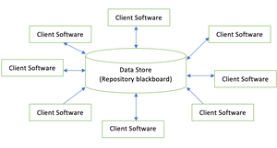
Taxonomy of architectural styles
Architectural styles is establish a complete structure & components of all over the system.
Data centered architecture.
Data Flow architecture.
Object oriented architecture.
Layered architecture.
Data centered architecture
Data stored at center of this architecture and is accessed frequently by everyone.
Update, add, delete the data present within the store.
It is widely used in DBMS, in library management system.
Image source : Google

Slide 26
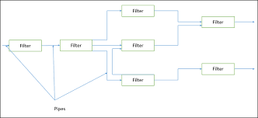
Taxonomy of architectural styles
Data flow architecture
This architecture is used when input data is transferred into output data through a series of computational manipulative components.
Pipe is a connector which passes the data directionally from one filter to next.
Filter is a component reads the data from its input pipes and perform its functions.
this data places the result on all output pipes.
Image source : Google

Slide 27
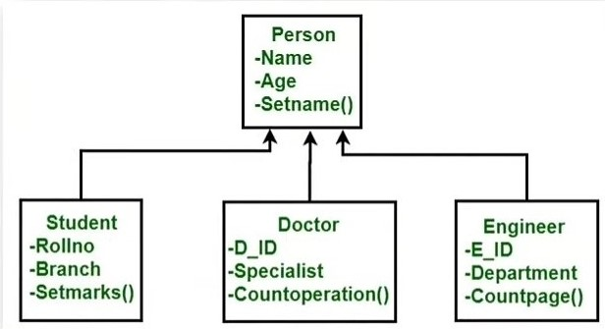
Taxonomy of architectural styles
Object Oriented architecture
Objects are functional building blocks for all kinds of software applications.
Objects: Object is an instance of the class. Eg. Student S, Person
Class: It defines all attributes, methods which represents the functionality of the objects.
Encapsulation: It is the process of binding similar kind of an abstraction.
Abstraction: It is the removal of irrelevant essentials form the users.
Inheritance: It drive new class from existing class. Enhance reusability.
Polymorphism: It has multiple forms. Eg: Draw circle rectangle,
Image source : Google

Slide 28
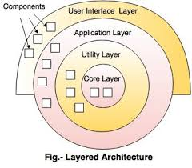
Taxonomy of architectural styles
Layered architecture
Data moves form one level to another level for processing is called as layered architecture.
Number of different layer are defined every layer performing well-define operations.
Outer Layer components manage the user interface operations.
Inner layer components will perform the operating system interfacing.
Intermediate layer provide utility services and software application functions.
Eg: Ecommerce Web application development like Amazon.
Image source : Google

Slide 29
Component Level Design Model
What is component?
A component is a modular , portable, replaceable and reusable set of well defined functionalities.
What is component level design ?
The component based architecture focuses on breaking down the software design into small individual modules.
The component design describes communications, interface, algorithm & functionalities of each component regarding the whole software design.
Component levels designs notations are Activity diagram, Data flow diagram, conditional notations and tabular form.
Image source : Google

Slide 30
Benefits of Component Design
The major benefits of using the components design is that it makes every module reusable.
It also reduce the cost as every module is reusable.
It is more reliable as the client gets its interaction with the system with each module, so it increases the reliability of the entire system.
The component design makes the system easy to maintain as we don’t need to make changes in the entire system.
The component design describes each component’s functionality more easily.
Image source : Google

Slide 31
Steps of Component Level Design
Identify all design classes that corresponds to problem domain.
Identify all design classes that corresponds to infrastructure domain. Eg. GUI class Database management class, OS communication class etc.
Elaborate all design classes that are not acquired as reusable component. Eg. Coupling and cohesion method like message details between classes, data type, data structure & data flow between class.
Describe persistent data source & identify classes required to manage them.
develop behavioral representation for a component and class.
Elaborate development design. Eg Hardware, OS, Server of components.
Factors every component level design representations.
Image source : Google

Slide 32
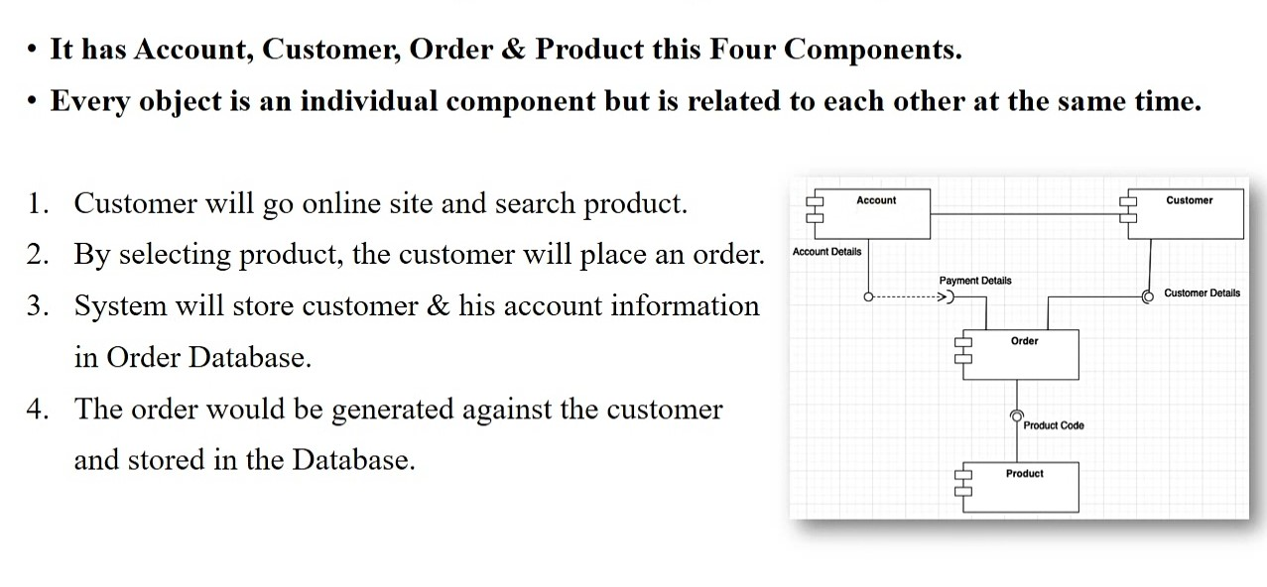
Component Design Example
Image source : Google

Slide 33
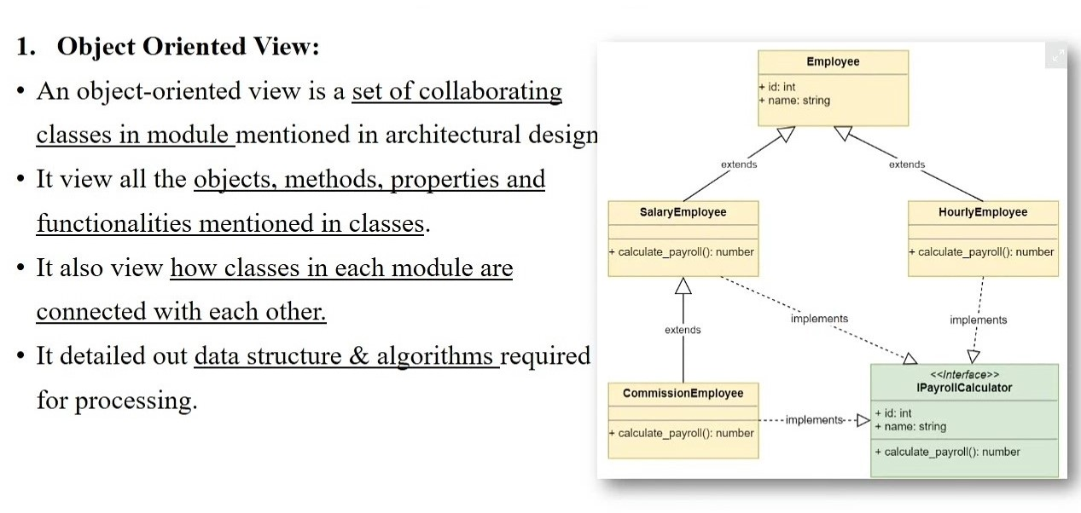
Component Design View
Image source : Google

Slide 34
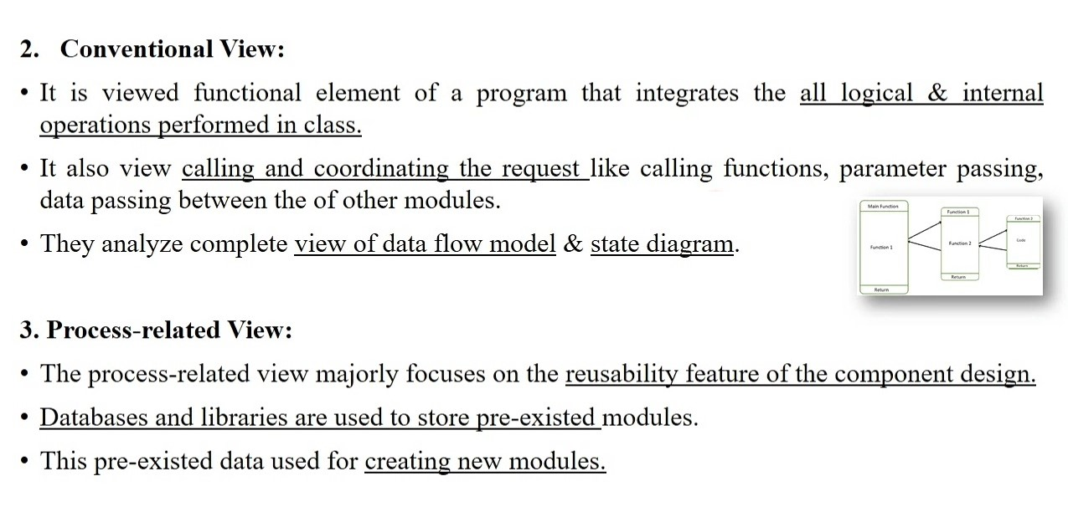
Cont…
Image source : Google

Slide 35
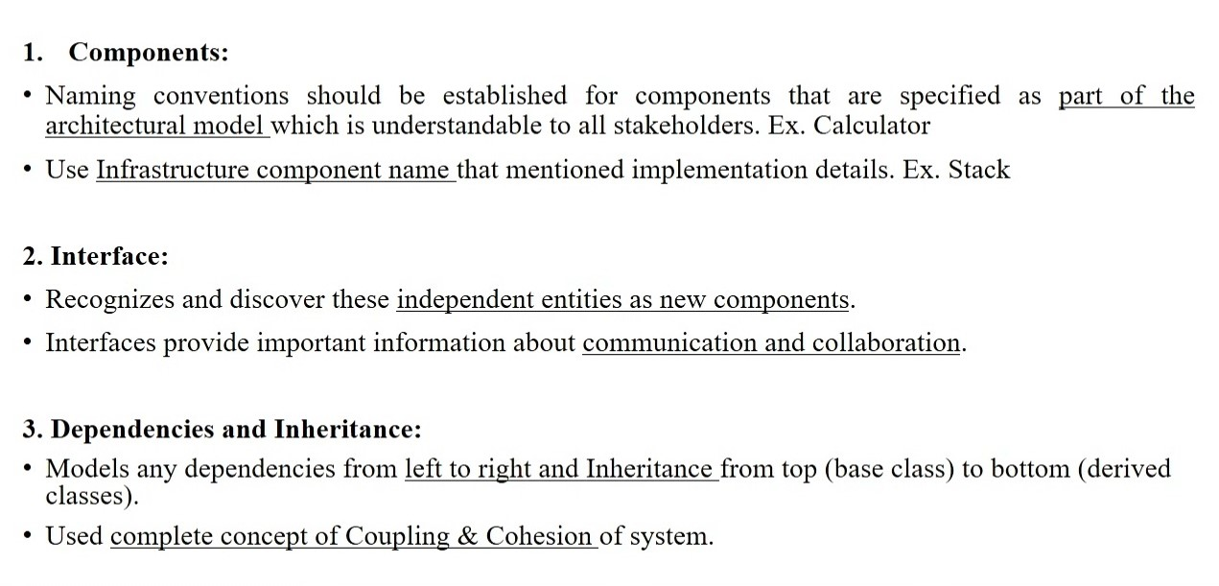
Component Level Design Guidelines
Image source : Google

Slide 36
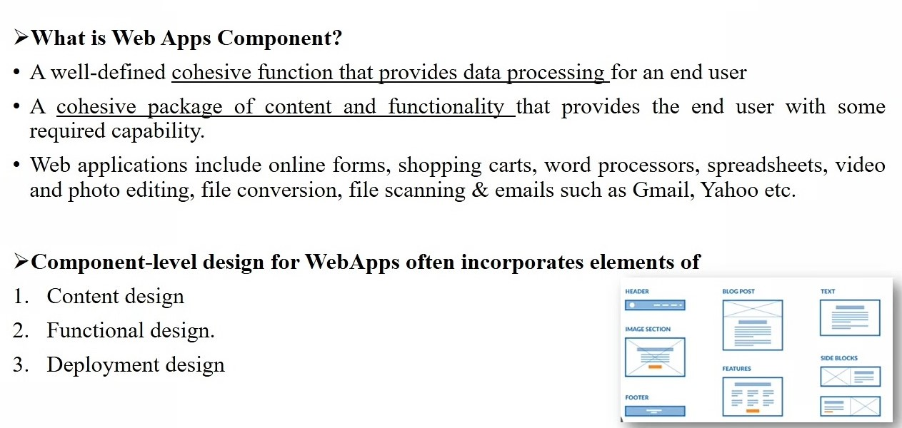
Component Level Design for WebApps
Image source : Google

Slide 37
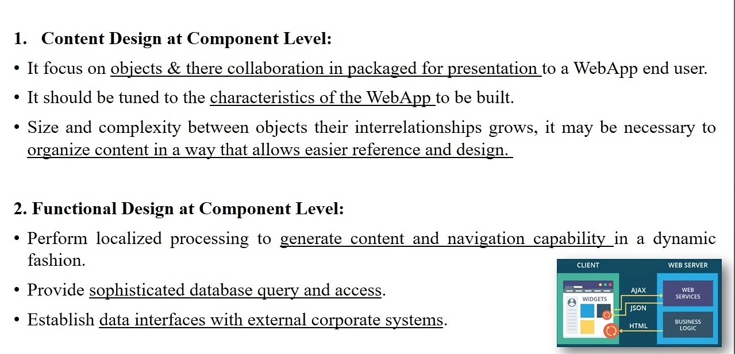
Cont….
Image source : Google

Slide 38
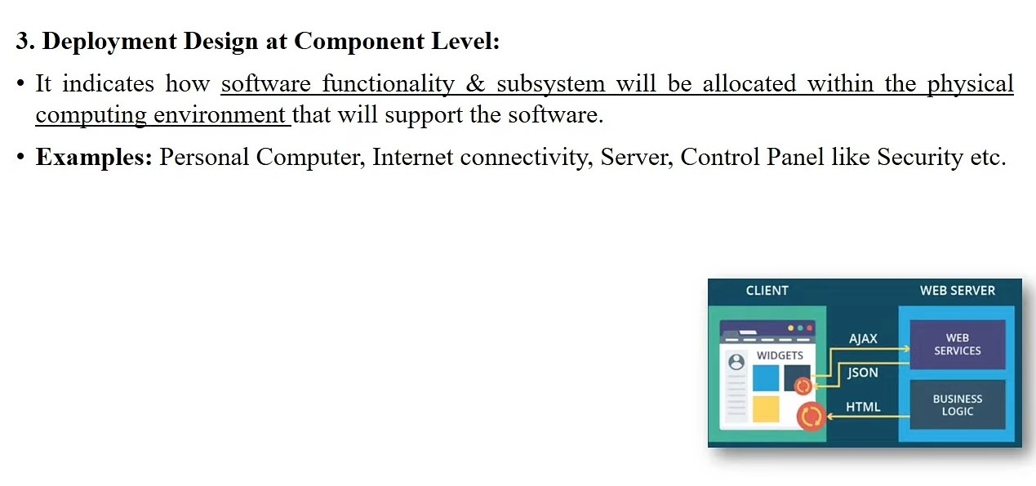
Cont…
Image source : Google

Slide 39
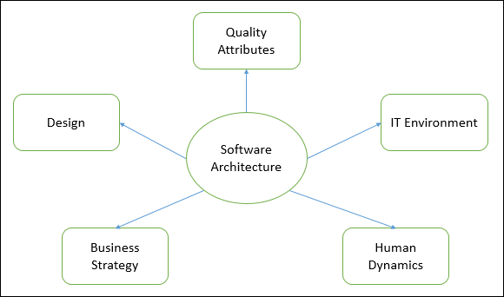
Software Architecture
The architecture of a system describes its major components, their relationships (structures), and how they interact with each other.
Software architecture and design includes several contributory factors such as Business strategy, quality attributes, human dynamics, design, and IT environment.
Image source : Google

Slide 40
Cont…
Architecture serves as a blueprint for a system. It provides an abstraction to manage the system complexity and establish a communication and coordination mechanism among components.
In Software Architecture, nonfunctional decisions are cast and separated by the functional requirements.
It defines a structured solution to meet all the technical and operational requirements, while optimizing the common quality attributes like performance and security.
It involves a set of significant decisions about the organization related to software development and each of these decisions can have a considerable impact on quality, maintainability, performance, and the overall success of the final product.
Image source : Google

Slide 41
Cont…
These decisions comprise of −
Selection of structural elements and their interfaces by which the system is composed.
Behavior as specified in collaborations among those elements.
Composition of these structural and behavioral elements into large subsystem.
Architectural decisions align with business objectives.
Architectural styles guide the organization.
Image source : Google

Slide 42
Characteristics of Software Architecture
Architects separate architecture characteristics into broad categories depending upon operation, rarely appearing requirements, structure etc.
Some important characteristics which are commonly considered are.
Operational Architecture Characteristics
Availability
Performance
Reliability
Low fault tolerance
Scalability
Image source : Google

Slide 43
Cont..
Structural Architecture Characteristics
Configurability
Extensibility
Supportability
Portability
Maintainability
Cross-Cutting Architecture Characteristics
Availability
Performance
Reliability
Low fault tolerance
Scalability
Image source : Google

Slide 44
Cont..
SOLID principles of Software architecture
Each character of the word SOLID defines one principle of software architecture
This SOLID principle is followed to avoid product strategy mistakes
A software architecture must adhere to SOLID principle to avoid any architectural or developmental failure.
1. Single Responsibility
- Each services should have a single objective.
2. Open-Closed Principle
- Software modules should be independent and expandable.
Image source : Google

Slide 45
Cont..
3. Liskov Substitution Principle
- Independent services should be able to communicate and substitute each other.
4. Interface Segregation Principle
- Software should be divided into such micro-services there should not be any redundancies.
5. Dependency Inversion Principle
- Higher-levels modules should not be depending on low-lower-level modules and changes in higher level will not affect to lower level.
Solid Principle - https://www.youtube.com/watch?v=yxf2spbpTSw
Image source : Google

Slide 46
Procedural Design
The objective in procedural design is to transform structural components into a procedural description of the software.
The step occurs after the data and program structures have been established, i.e. after architectural design. Procedural details can be represented in different ways:
1. Graphical Design Notation:
The most widely used notation is the flowchart. Some notation used in flowcharts are: (i) Boxes to indicate processing steps. (ii) Diamond to indicate logical condition. (iii) Arrows to indicate flow of control. (iv) Two boxes connected by a line of control will indicate a Sequence.
Image source : Google

Slide 47
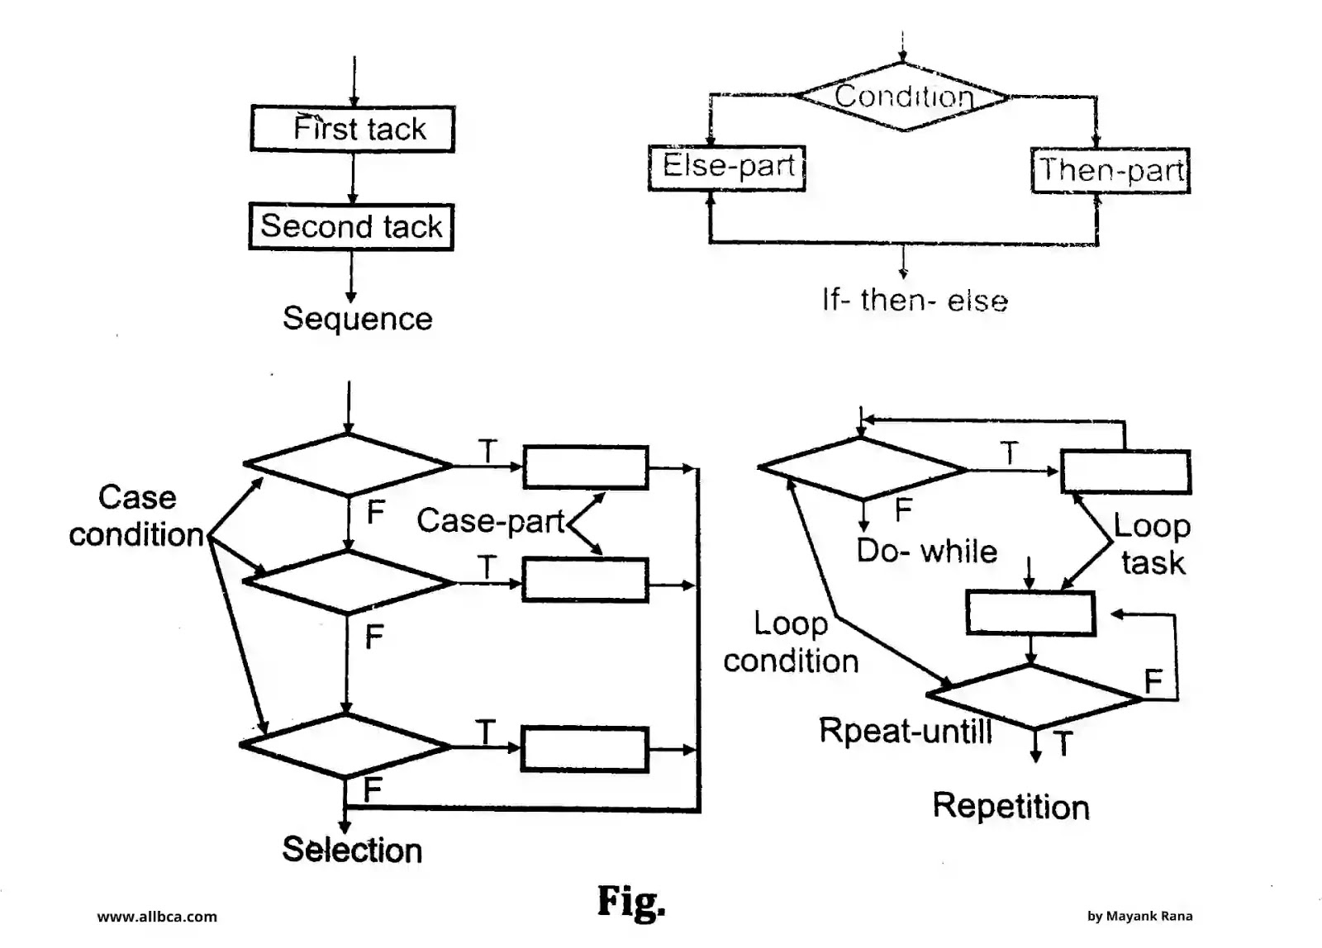
Cont..

Slide 48
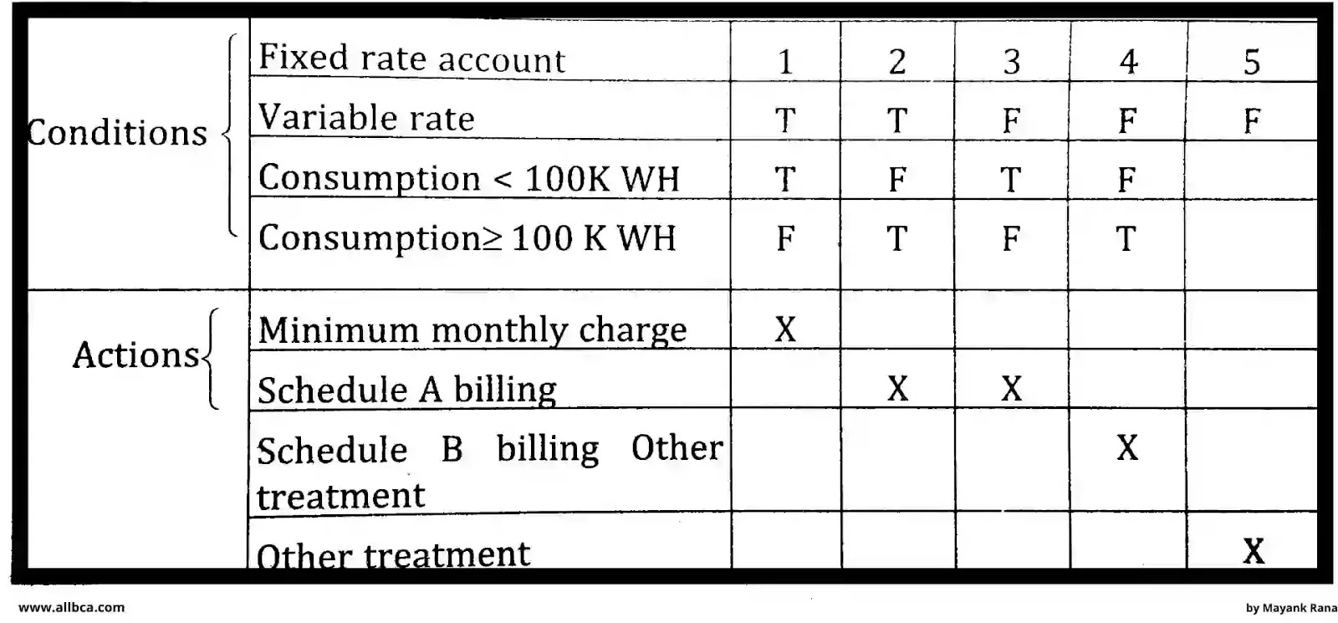
Cont…
2. Tabular Design Notation:
(i) Decision tables provide a notation that translates actions and conditions (described a processing narrative) into a tabular form.
Image source : Google

Slide 49
Cont…
2. Tabular Design Notation:
(ii) The upper left-hand section contains a list of all conditions. The lower left-hand section lists all actions that are possible based on the conditions. The right-hand sections form a matrix that indicates condition combinations and the corresponding actions that will occur for a specific combination.
3. Program Design Language: It is a method designing and documenting methods and procedures in software. It is related to pseudocode, but unlike pseudocode, it is written in plain language without any terms that could suggest the use of any programming language or library.
Image source : Google

Slide 50
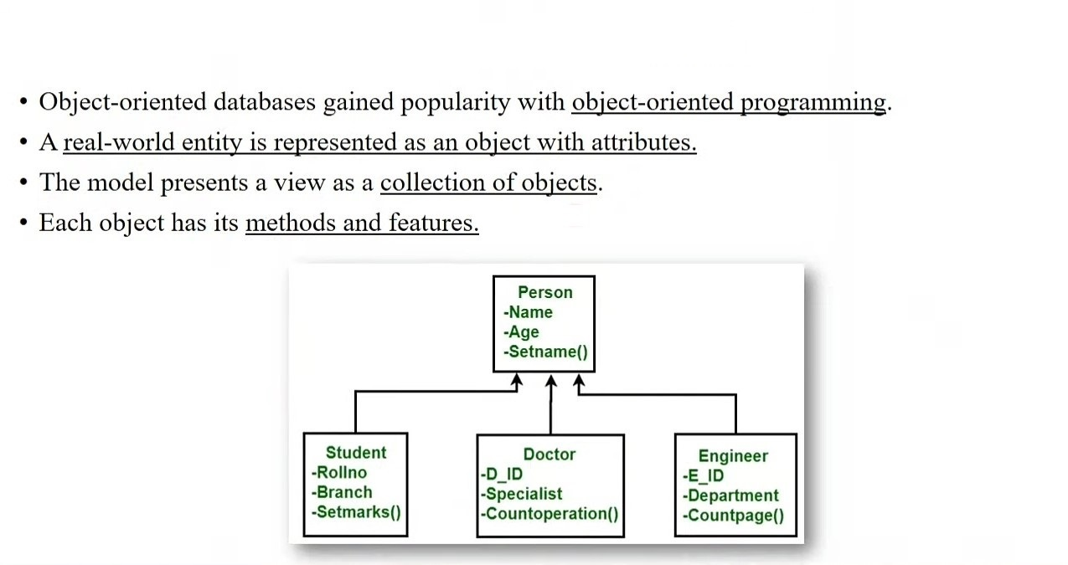
Object Oriented Design
Image source : Google

Slide 51
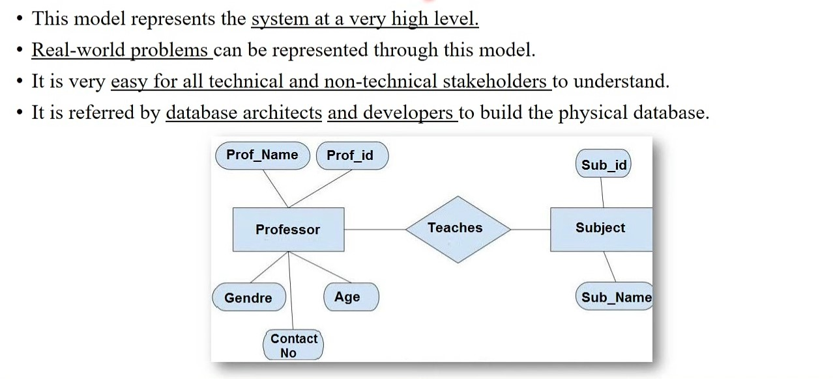
E-R Diagram
Image source : Google

Slide 52
Diff. Between data & Information
Data | Information
1. Data is unorganized and unrefined facts. | 1. Information comprises processed, organized data presented in a meaningful context.
2. Data is an individual unit that contains raw materials which do not carry any specific meaning. | 2. Information is a group of data that collectively carries a logical meaning.
3. Data doesn’t depend on information. | 3. Information depends on data.
4. Raw data alone is insufficient for decision making. | 4. Information is sufficient for decision making.
5. An example of data is a student’s test score. | 5. The average score of a class is the information derived from the given data.
Image source : Google

Slide 53
Data Flow Model
A data flow diagram is a visual representation of the flow of information for a process or a system
The data flow diagram helps the engineers and plant workers to plan the work efficiently by picturizing the entire system.
Creating a data flow diagram is a good practice adopted by almost all manufacturers, industries, software houses, and other institutions.
It can be used as a tool for communication between a system analyst and everyone involved in the order that serves as a beginning point for system change. The goal is to demonstrate the breadth and bounds of a system as a whole.
Image source : Google

Slide 54
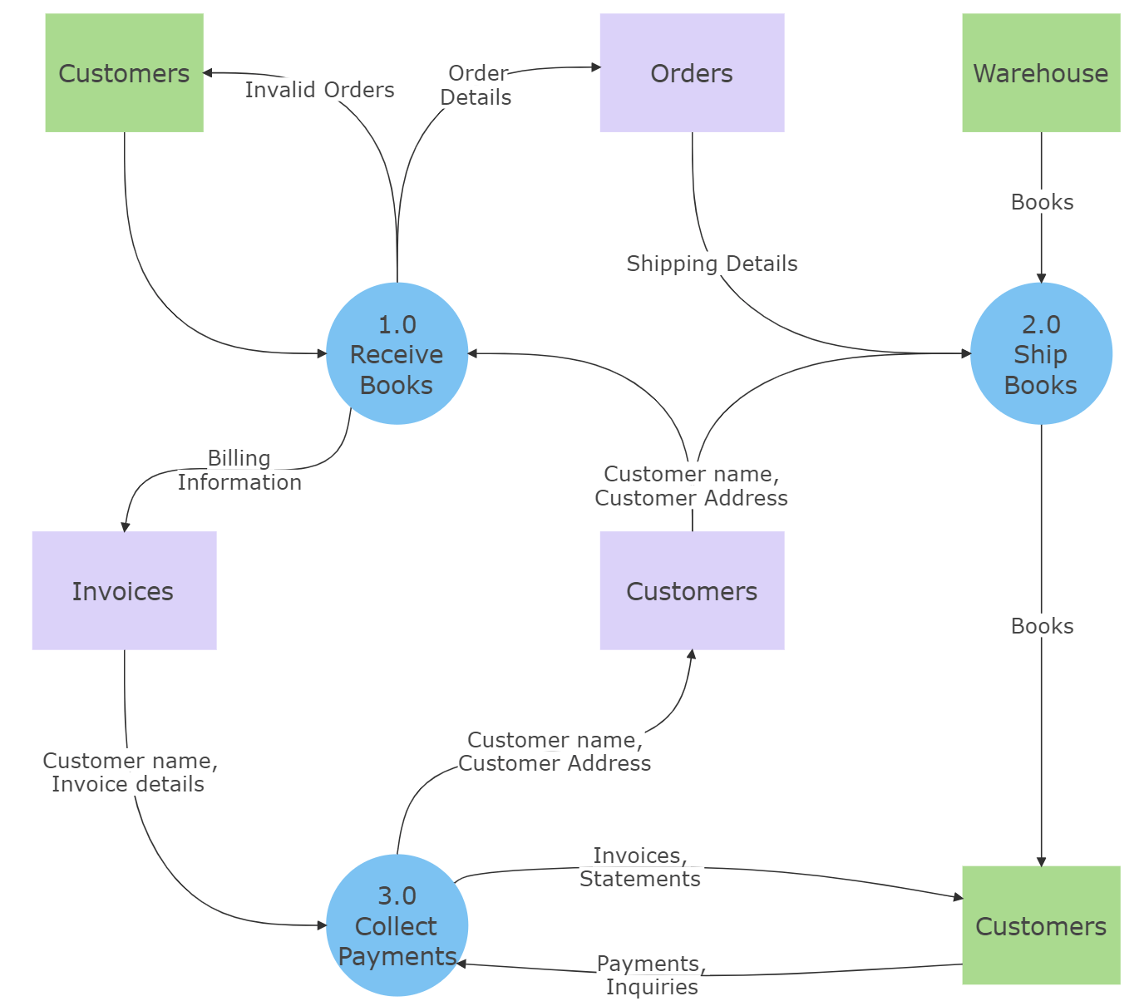
Data Flow Model
Image source : Google

Slide 55
Components of Data Flow Diagrams
The data flow diagram shows data inputs, outputs, storage sites, and paths between each destination using predetermined symbols and shapes like rectangles, circles, and arrows, as well as short text labels.
Data flow diagrams can range from simple, even hand-drawn process overviews to multi-level and in-depth that go deeper into how data is processed.
The main components or symbols in the data flow diagram include:
Process: A circle is a process in data flow diagrams and depicts how the data is handled and processed in the system.
Data Flow: The data flow is the curved line that shows the flow of data in or out of the system.
Image source : Google

Slide 56
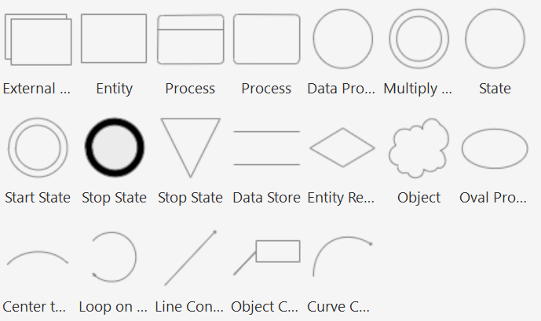
Components of Data Flow Diagrams
3. Data Store: A data store denotes the storage of information that can be retrieved later or by other processes in a different order.
4. Entity: An external entity that serves as a source of system inputs or a sink of system outputs is called a source or sink.
Image source : Google

Slide 57
Level of data flow diagram
Level 0 DFDs
The level 0 data flow diagrams are the most basic, and they do not provide every little detail of the information or the structure; instead, it gives a broad view that can easily be understood. These diagrams are straightforward and show single process nodes and connections of those nodes with externalities.
Level 1 DFDs
The level 1 data flow diagrams provide more information than the Level 0 DFDs. It shows the general overview of the system. The single process node from the level 0 diagram is split into sub-processes in a level 1 data flow diagram. Additional data flows and data stores will be required as these processes are added to the diagram.
Image source : Google

Slide 58
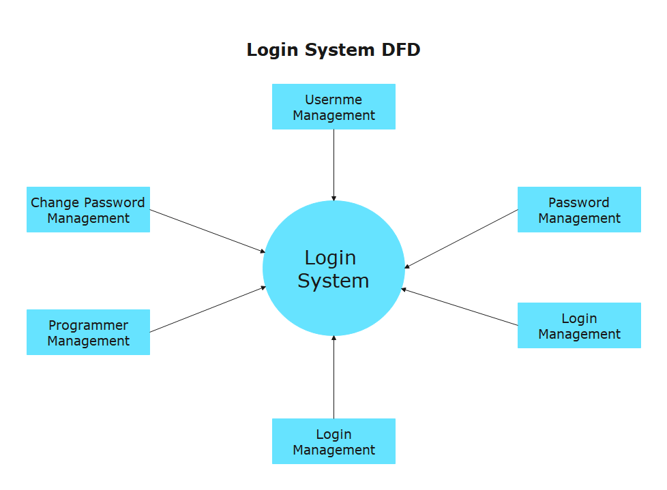
Level of data flow diagram
Level 2 DFDs
The level 2 data flow diagrams are way too detailed, where processes from Level 1 DFDs are further broken down into more chunks. The objective is to create a map of every little detail of the system to help the engineers to understand and work on it.
Image source : Google

Slide 59
Control Flow Model
A Control Flow Model is the graphical representation of control flow or computation during the execution of programs or applications.
Control flow graphs are mostly used in static analysis as well as compiler applications, as they can accurately represent the flow inside a program unit
Characteristics of Control Flow Graph
The control flow model is process-oriented.
The control flow model shows all the paths that can be traversed during a program execution.
A control flow model is a directed graph.
Edges in Control flow model portray control flow paths and the nodes in Control flow model portray basic blocks.
Image source : Google

Slide 60
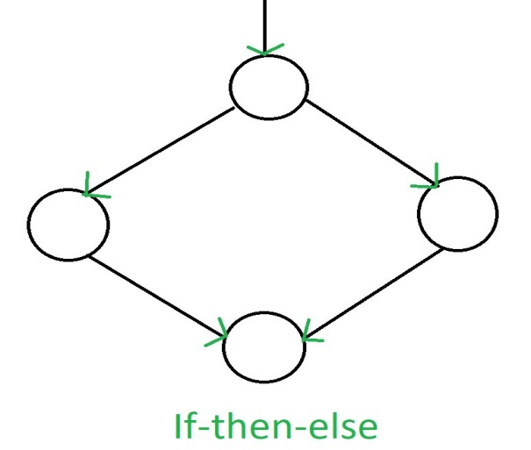
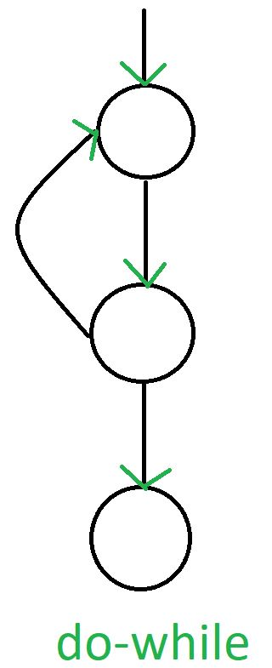
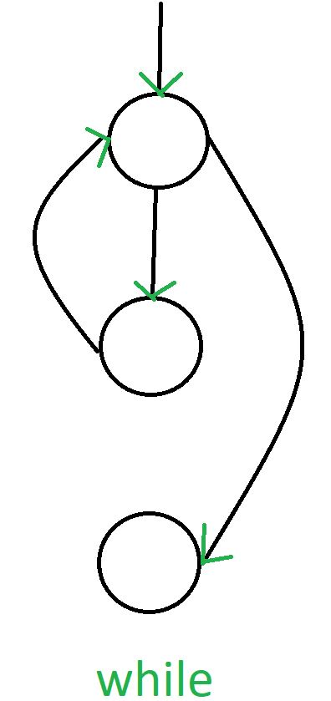
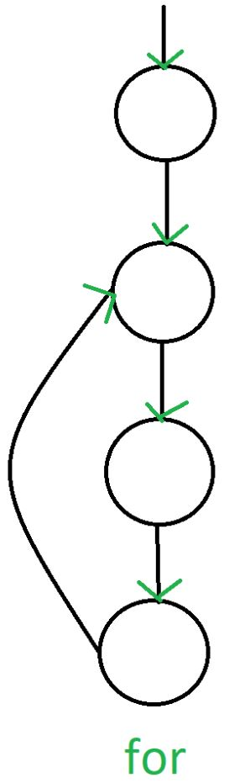
Cont…
There exist 2 designated blocks in the Control Flow Graph:
Entry Block: The entry block allows the control to enter into the control flow graph.
Exit Block: Control flow leaves through the exit block.
Image source : Google

Slide 61
Control and Process Specification
Process Specification
In the process specification, we describe the overall process required for the development of a particular software or system.
It works by giving detailed documentation about how a particular software needs to be made such as the steps and tasks involved in the development of the process and the process on how to maintain the project once it’s completed.
In process specification, the work starts with the testers who test for various types of bugs that can be found in the system or software and then they report these bugs to the manager, once the report has been submitted the manager selects the team and gives them the task to fix these bugs.
Image source : Google

Slide 62
Cont..
Steps to fix bug using the process specification method
Step 1: Identify the Bug: The first step is to identify the details of the bug. The testers go through the process of finding the bug and checking how it works then they move to the next step.
Step 2: Log the Bug: In this step, the testers log the bug which means that they identified that the bug exists and now they want the team to find a proper fix for the bug.
Step 3: Assign Priority for the Bug: When the testers log the bug, they also need to assign priority for the bug which means that the bugs that are critical for the system are fixed on a more priority basis than the less priority bugs.
Image source : Google

Slide 63
Cont..
Step 4: Fixing the Bug: In this step, the developers work the fix the bug by understanding how they can solve the bug and then fix the bug.
Step 5: Verifying the Fix: In this step, the developers verify the fix for the bug so that they know for sure that they have fixed the bug that existed in the first place before moving to the final step.
Step 6: Updating the Status of Bug: After making sure that the bug is fixed, the final step is to update the status of the bug so that the manager and other members of the team can know that the bug has been fixed successfully.
Image source : Google

Slide 64
Control Specification
The control specification is used in software engineering to maintain control of the software.
It helps us to create a clear process and set of rules that can define the control of the system.
By defining the control specification, we can have a better understanding of the system.
It also helps in the performance optimization of the system which is the main reason why we should implement control specifications in software development
Image source : Google

Slide 65
Components of Control Specification
1. Concurrency Control: Concurrency is an important factor in software development. It defines a set of mechanisms that can help us manage the resources that are being shared among one or more tasks so that there is consistency in the data, it also makes sure that we have synchronized data in the system.
2. Authorization and Access Control: Authorization control and access control help us to define a set of rules for the users so that we can help the users log in or visit pages that they are authorized to visit and protect unauthorized access to the functions of the system.
Image source : Google

Slide 66
Components of Control Specification
3. Error Handling: Whenever we create software we have chances that we may get errors in the future, so it is important to have some functions that can handle the errors when it is required. This is where the error handling comes in, we use the error handling of the control specification to define the various steps, the software should take when there is an error in the system.
4. Input Validation: We can understand the input validation with the help of an example, whenever we create passwords or usernames for websites and apps, we are presented with certain rules for entering, what we want, we can not enter special symbols in usernames this is known as input validation and it helps us to validate the data.
Image source : Google

Slide 67
Data Dictionary
The data dictionary is a centralized repository of information about data. It provides a detailed description of the data, including its meaning, relationship to other data, usage, and format.
These are important in database management, data modeling, and software development.
It helps to ensure consistency, clarity, and efficient data management.
It helps to ensure that everyone in the organization understands the data, how it should be used, and how it should be managed.
It is essential for maintaining data quality and facilitating effective data governance.
Image source : Google

Slide 68
Components of Data Dictionary
In Software Engineering, the data dictionary contains the following information:
Data Elements: This includes the attributes of the data element such as Name, Description, Type, Length, Default Value, and Constraints.
Data Structure: This includes Tables, Fields, Keys, and Indexes.
Relationships: This includes information about the Relationships and Dependencies.
Usage and Access Information: This includes Access Permissions, Usage, and Update Frequency.
Data Quality Metrics: This includes information regarding Accuracy, Completeness, Consistency, and Timelines about data.
Data Lineage: Information about the Source, Transformation, and Destination of data is included.
Image source : Google

Slide 69
Cont..
Versioning and History: Version and History of the data element definition are recorded.
Technical Metadata: Storage Information and Storage Format are also recorded.
Business Metadata: Business Rules and the Business Context in which the data is used are included.
Image source : Google

Slide 70
How to Create a Data Dictionary?
Define Scope and Objectives: This involves identifying the objective of the data dictionary and the data elements it will cover.
Gather Metadata: Collect detailed information about each data element.
Organize Information: Structure the collected metadata in a clear and accessible format.
Implement Standard Naming Conventions: Ensure consistency in how data elements are named and described.
Create and Enter Data in Data Dictionary: Use software tools to build the data dictionary and enter the data.
Review and Validate: Ensure the accuracy and completeness of the data dictionary.
Maintain and Update Regularly: Keep the data dictionary up to date with ongoing updates and changes.
Image source : Google

Slide 71
Any
Query?

