Slide 1



Software Engineering (303105254)

Slide 2

UNIT-5
Coding and Unit Testing

Slide 3
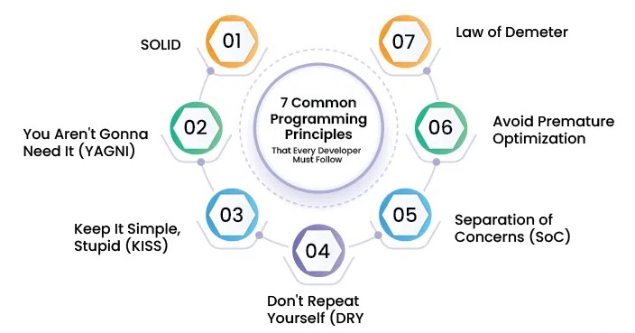

Programming principles and guidelines
Programming principles are guidelines and best practices that help developers write clean, maintainable, and efficient code.
Here are 7 common programming principles.
Image source : Google

Slide 4
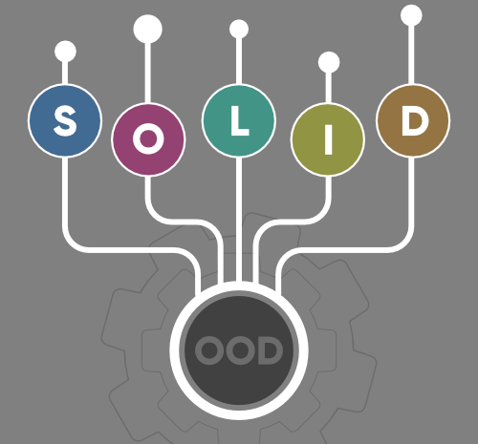
Cont…
SOLID Principles
Single Responsibility Principle (SRP)
Open/Closed Principle
Liskov’s Substitution Principle (LSP)
Interface Segregation Principle (ISP)
Dependency Inversion Principle (DIP)
Image source : Google

Slide 5
Cont…
YAGNI (You Aren’t Gonna Need It )
Your software or program can become larger and complex if you are writing some code which you may need in the future but not at the moment.
“You Aren’t Gonna Need It (YAGNI)” principle states that “don’t implement something until it is necessary” because in most of the cases you are not going to use that piece of code in future.
// If Programmer asked to write a Program to add 7 and 3 function (x,y){ return x+y; } instead of this write what you have to told function ( 7, 3 ){ return 7+3 }
Image source : Google

Slide 6
Cont…
KISS (Keep It Simple, Stupid)
Nobody in programming loves to debug, maintain, or make changes in complex code.
“Keep It Simple, Stupid (KISS)“ states that most systems work best if they are kept simple rather than making it complex, so when you are writing code your solution should not be complicated that takes a lot of time and effort to understand.
If your code is simple then other developers won’t face any problem understanding the code logic and they can easily proceed further with your code.
In KISS principal we neither want less nor more, we only want to have as much as is required.
Image source : Google

Slide 7
Cont…
DRY (Don’t Repeat Yourself )
Duplication of data, logic, or function in code not only makes your code lengthy but also wastes a lot of time when it comes to maintaining, debug or modify the code.
If you need to make a small change in your code then you need to do it at several places.
Don’t Repeat Yourself (DRY)” principal goal is to reduce the repetition of code.
It states that a piece of code should be implemented in just one place in the source code.
Image source : Google

Slide 8
Cont…
DRY (Example)
//Convert Two Temperatures From Fahrenheit to Celsius before applying DRY principal input far1 from user input far2 from user calculate cel1 = (fah1-32) *5/9 calculate cel2= (fah2-32)*5/9 print cel1 print cel2 //Convert Two Temperatures From Fahrenheit to Celsius after applying DRY principal input far1 from user input far2 from user calculate cel1 = cal ( f1) calculate cel2= cal (f2) print cel1 print cel2 function cal ( fah ) { cel= (fah1-32) *5/9 return cel }
Image source : Google

Slide 9
Cont…
Separation of Concerns (SoC)
Separation of Concerns Principle partition a complicated application into different sections or domains.
Each section or domain addresses a separate concern or has a specific job.
Each section is independent of each other and that’s why each section can be tackled independently also it becomes easier to maintain, update, and reuse the code.
Image source : Google

Slide 10
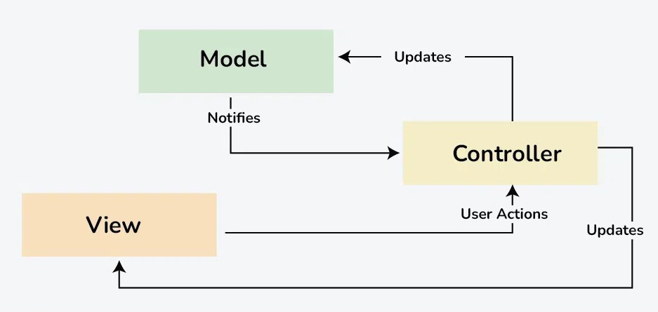
Cont…
Example
business logic (the content of the webpage) in an application is a different concern and user interface is a different concern in a web application program. One of the good examples of SoC is the MVC pattern where data (“model”), the logic (“controller”), and what the end-user sees (“view”) divided into three different sections and each part is handled independently. Saving of data to a database has nothing to do with rendering the data on the web.
Image source : Google

Slide 11
Cont…
Avoid Premature Optimization
Optimization indeed helps in speeding up the program or algorithm but according to this principle you don’t need to optimize your algorithm at an early stage of development.
If you do premature optimization you won’t be able to know where a program’s bottlenecks will be and maintenance will become harder for you.
If you optimize your code in the beginning and case if the requirement may change than your efforts will be wasted and your code will go to the garbage.
So it’s better to optimize the algorithm at the right time to get the right benefit of it.
Image source : Google

Slide 12
Cont…
Law of Demeter
This principle was first introduced by Ian Holland in 1987 at Northeastern University. It is also known as the principle of least knowledge.
This principle divides the responsibility between classes or different units and it can be summarized in three points.
Each unit should have only limited knowledge about other units: only units “closely” related to the current unit.
Each unit should only talk to its friends; don’t talk to strangers.
Only talk to your immediate friends.
Image source : Google

Slide 13
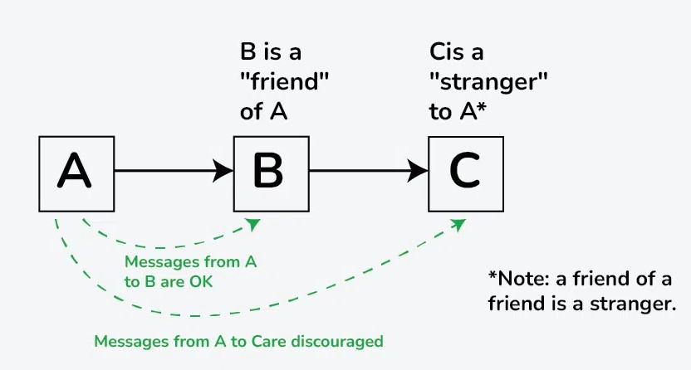
Cont…
The Law of Demeter helps in maintaining independent classes and makes your code less which is very important in software development to make your application flexible, stable, maintainable and understandable.
Image source : Google

Slide 14
Programming practices
Control construct
The single entry and exit constructs need to be used.
Use of goto
The goto statements make the program unstructured. So avoid use of goto statements as possible.
Nesting
Structure inside another structure is called as nesting. If there is too deep nesting then it becomes hard to understand the code as well as complex.
User defined data types
User can define data type to enhance the readability of the code.
Image source : Google

Slide 15
Cont….
Modular size
The size of program may be large or small. There is no rule for size of the program. So as possible generate different module but not of large size.
Side effects
Sometimes if some part of code may change then it may generate some kind of problems called as side effects.
Robustness
If any kind of exception is generated, the program should generate some kind of output. Then it is called as robustness. In this situation the programs do not crash.
Image source : Google

Slide 16
Cont….
Switch case with defaults
Inside the switch case statement if any value which is unpredictable is given as argument then there should be default case to execute it
Image source : Google

Slide 17
Coding Standards
Good software development organizations normally require their programmers to adhere to some well defined and standard style of coding called coding standards.
Image source : Google

Slide 18
Coding Standards (Contd.)
Most software development organizations formulate their own coding standards that suit them most, and need their engineers to follow these standards strictly.
The purpose of requiring all engineers of an organization to adhere to a standard style of coding is the following:
A coding standard gives a uniform appearance to the codes written by different engineers.
It enhances code understanding.
It encourages good programming practices.
Image source : Google

Slide 19
Coding Standards (Contd.)
A coding standard lists several rules to be followed such as, the way variables are to be named, the way the code is to be laid out, error return conventions, etc.
▪ The following are some representative coding standards:
Rules for limiting the use of global
These rules list what types of data can be declared global and what cannot.
Naming conventions for global & local variables & constant identifiers
A possible naming convention can be that global variable names always start with a capital letter, local variable names are made of small letters, and constant names are always capital letters.
Image source : Google

