Slide 1

B.Tech 6th Semester Minor project Presentation
“Rent Rider”
Presented by:
Sachin Kumar(2203051050508)
Vijay Kumar(2203051050620)
Shivam Singh(2203051050534)
Chitranjan Kumar(2203051050140)
Supervisors:
Keya Patel
PARUL INSTITUTE OF TECHNOLOGY, PARUL UNIVERSITY
NAME OF THE INSTITUTE, PARUL UNIVERSITY

Slide 2
Content of Presentation
Abstract
Introduction (front end technology/back end technology
/Aim and Objectives project/application etc.)
Problem Statement
Literature Review (if any)
Proposed Methodology
Project Module
Use case diagram/ER diagram/Flow diagram
Hardware and software Requirement
Excepted Outcome of the Project
Limitation
Conclusion and Future Work
References
PARUL INSTITUTE OF TECHNOLOGY, PARUL UNIVERSITY
NAME OF THE INSTITUTE, PARUL UNIVERSITY

Slide 3
Abstract
•
RentRider is a web-based platform that allows users to rent bikes and cars for short-term use. It is designed
for students, urban commuters, and travellers, providing a secure and flexible rental experience. Key features include real-time GPS tracking, secure payment gateways(Stripe and PayPal), an auto-lock mechanism using geofencing, and ID proof verification for enhanced security.
PARUL INSTITUTE OF TECHNOLOGY, PARUL UNIVERSITY
NAME OF THE INSTITUTE, PARUL UNIVERSITY

Slide 4
Introduction
Front-End Technologies:
HTML5 and CSS3 (with SASS/SCSS) for website structure and design.
JavaScript (ES6+) for interactivity and enhanced user experience.
React.js, Vue.js, or Angular for a modern, responsive user interface.
Bootstrap or Tailwind CSS for responsive design.
Google Maps API for real-time vehicle location tracking.
Back-End Technologies:
Node.js and Express.js for API development and server-side processing.
MongoDB for data storage (users, vehicles, transactions).
JWT Authentication for secure login and user management.
Socket.IO for real-time updates on bookings and vehicle status.
Geofencing API for vehicle tracking and auto-locking.
IoT Hardware Integration (Optional) for Bluetooth/NFC-controlled locks.
PARUL INSTITUTE OF TECHNOLOGY, PARUL UNIVERSITY
NAME OF THE INSTITUTE, PARUL UNIVERSITY

Slide 5
Introduction
Aim and Objectives:
Main Goal:
To create a secure, efficient, and user-friendly platform for short-term vehicle rentals.
Objectives:
Enable a seamless rental process.
Empower vehicle owners to manage their listings.
Provide security features like ID verification, GPS tracking, and geofencing auto-lock.
Ensure secure payments through integrated gateways.
PARUL INSTITUTE OF TECHNOLOGY, PARUL UNIVERSITY
NAME OF THE INSTITUTE, PARUL UNIVERSITY

Slide 6
Problem Statement
Current rental systems face the following challenges:
Lack of security: Existing platforms do not provide adequate safety for renters and owners.
Unavailability of vehicles: High demand causes shortages during peak hours.
Difficult rental management: Owners struggle to efficiently manage their vehicles.
Solution:
RentRider introduces features like real-time GPS tracking, geofencing security, and auto-locking systems to ensure security, convenience, and transparency.
PARUL INSTITUTE OF TECHNOLOGY, PARUL UNIVERSITY
NAME OF THE INSTITUTE, PARUL UNIVERSITY

Slide 7
Literature Review
Bike Sharing Systems (e.g., Lime, Ofo):
Limited to specific locations.
Lack of user verification and security features.
Traditional Car Rental Services (e.g., Enterprise, Zipcar):
Focused on long-term rentals, not individual owner listings.
Lacks modern features like real-time tracking and geofencing.
RentRider's Unique Proposition:
A scalable, secure, and user-friendly short-term vehicle rental platform with advanced features.
PARUL INSTITUTE OF TECHNOLOGY, PARUL UNIVERSITY
NAME OF THE INSTITUTE, PARUL UNIVERSITY

Slide 8
Proposed Methodology
Design & Planning:
Wireframes, UI/UX designs, database structures.
Frontend Development:
Static pages, dashboards, Google Maps API integration.
Backend Development:
Node.js & Express.js for APIs, MongoDB for data storage.
Registration, booking, and vehicle listing functionalities.
GPS & Auto-Lock Integration:
Geofencing API for vehicle tracking and auto-locking.
Testing & Debugging:
Functional testing of ID verification, payments, and geofencing.
Launch & Maintenance:
Deployment, bug fixes, and feature updates.
PARUL INSTITUTE OF TECHNOLOGY, PARUL UNIVERSITY
NAME OF THE INSTITUTE, PARUL UNIVERSITY

Slide 9
Project Modules
User Module:
Registration, browsing, booking, payments, GPS tracking.
Bike Owner Module:
Listing management, availability tracking, earnings management.
Admin Module:
User and vehicle management, transaction monitoring, geofencing enforcement.
PARUL INSTITUTE OF TECHNOLOGY, PARUL UNIVERSITY
NAME OF THE INSTITUTE, PARUL UNIVERSITY

Slide 10
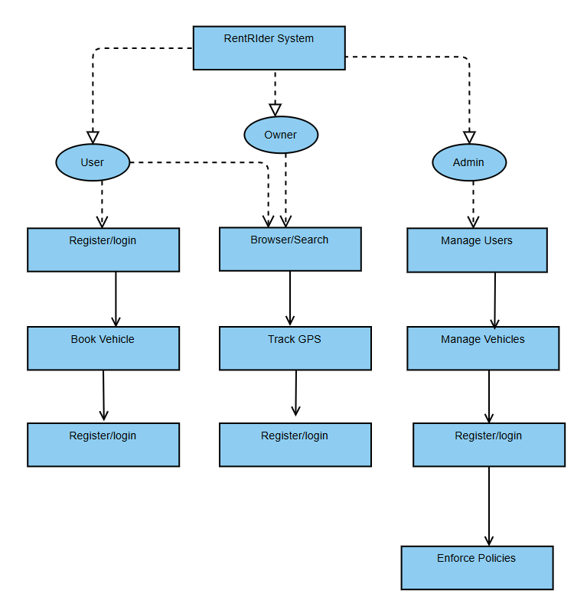
Use-Case Diagram
PARUL INSTITUTE OF TECHNOLOGY, PARUL UNIVERSITY
NAME OF THE INSTITUTE, PARUL UNIVERSITY

Slide 11
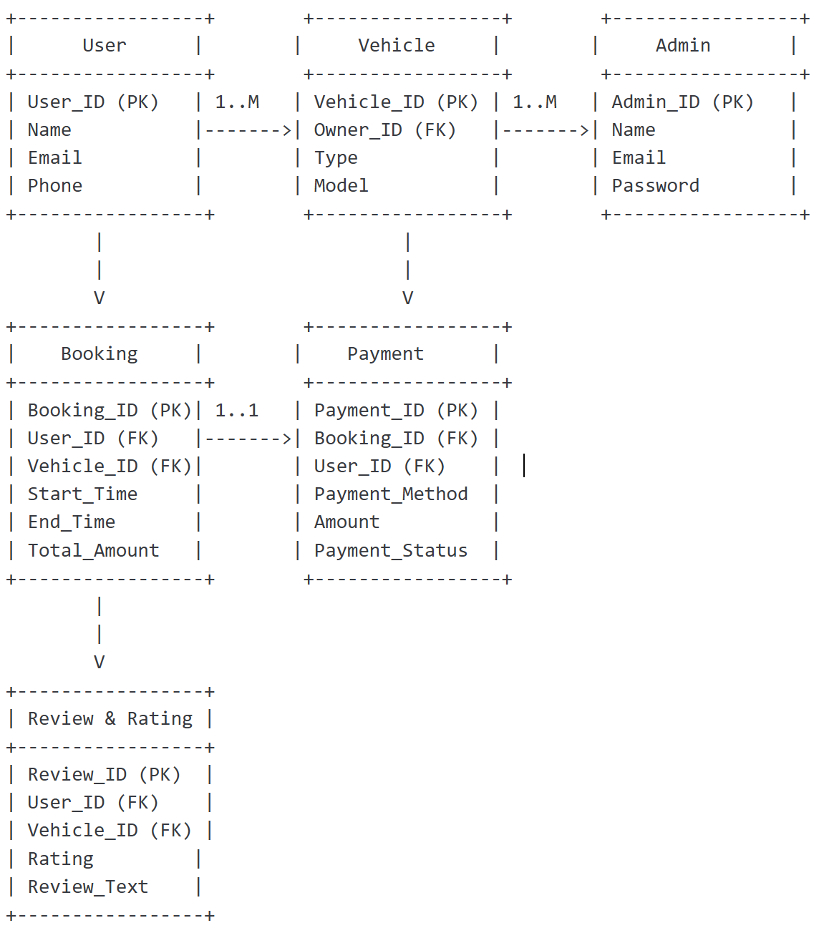
E-R Diagram
PARUL INSTITUTE OF TECHNOLOGY, PARUL UNIVERSITY
NAME OF THE INSTITUTE, PARUL UNIVERSITY

Slide 12
Hardware and Software Requirements
Software Requirements:
Frontend: HTML, CSS, JavaScript (React/Vue/Angular), Bootstrap/Tailwind CSS
Backend: Node.js, Express.js
Database: MongoDB
APIs & Integrations: Google Maps API, Stripe/PayPal for payments, Socket.IO for real-time communication
Hardware Requirements:
Server: Cloud-based hosting (AWS, Google Cloud, or DigitalOcean)
IoT Devices (Optional): Bluetooth/NFC locks for auto-locking mechanisms
PARUL INSTITUTE OF TECHNOLOGY, PARUL UNIVERSITY
NAME OF THE INSTITUTE, PARUL UNIVERSITY

Slide 13
Expected outcome of project
A fully functional web platform for short-term bike and car rentals.
A seamless experience for both renters and owners.
Enhanced security features like GPS tracking, geofencing, and ID verification.
PARUL INSTITUTE OF TECHNOLOGY, PARUL UNIVERSITY
NAME OF THE INSTITUTE, PARUL UNIVERSITY

Slide 14
Limitations
Urban Area Limitation: Initially targeted at urban areas with high demand.
GPS/Internet Dependency: Requires stable internet and GPS connectivity.
IoT Hardware Costs: Implementing Bluetooth/NFC locks adds extra costs.
PARUL INSTITUTE OF TECHNOLOGY, PARUL UNIVERSITY
NAME OF THE INSTITUTE, PARUL UNIVERSITY

Slide 15
Conclusion and Future Work
RentRider aims to revolutionize short-term vehicle rentals with security, ease of use, and transparency.
Future Enhancements:
Expansion to more vehicle types (e.g., scooters, electric bikes).
AI-powered recommendations for personalized suggestions.
Enhanced IoT system for better vehicle monitoring and remote control.
PARUL INSTITUTE OF TECHNOLOGY, PARUL UNIVERSITY
NAME OF THE INSTITUTE, PARUL UNIVERSITY

