Slide 1
Vancomycin exposure predictions for proposed dosing protocols in a prospective pharmacokinetic trial in critically-ill pediatric patients
Vijay Ivaturi

Slide 2
Background
Trial objectives:
To determine the optimal dose of vancomycin in a critically-ill pediatric patient in the PICU to achieve an AUC₂₄/MIC >400 using a population pharmacokinetic model in patients not on ECT
To evaluate vancomycin PK in critically ill children on ECT of multiple forms in order determine the dosing regimen required to generate an AUC₂₄/MIC> 400 h
ECMO
ELS
CRRT [CVVH, CVVHD, CVVHDF]
Standard of care dosing protocols from UMB and TCH will be used
Le et al.’s pharmacokinetic model parameters were used to predict exposures for the standard of care dosing protocols.

Slide 3
Distribution of patient demographics
1070 patients sampled from a large pediatric infectious disease database from University of Utah’s Medical Center
Varying degrees of age, renal function and body weight were chosen to represent the expected population.
Ctroughs – sample before next dose
AUC0-24 – Area under the curve in the first day (4 doses for q6, 3 doses for q8 and 2 doses for q12)
AUC0-48 – Area under the curve in the secondday (4 doses for q6, 3 doses for q8 and 2 doses for q12)

Slide 4
Distribution of serum creatinine by age
SCR_Range | Age_Range | No. Subjects
0.21-0.33 | 1-18 | 266
0.34-0.47 | 1-18 | 262
0.48-0.69 | 1-19 | 272
0.7-4.5 | 1.2-19 | 270

Slide 5
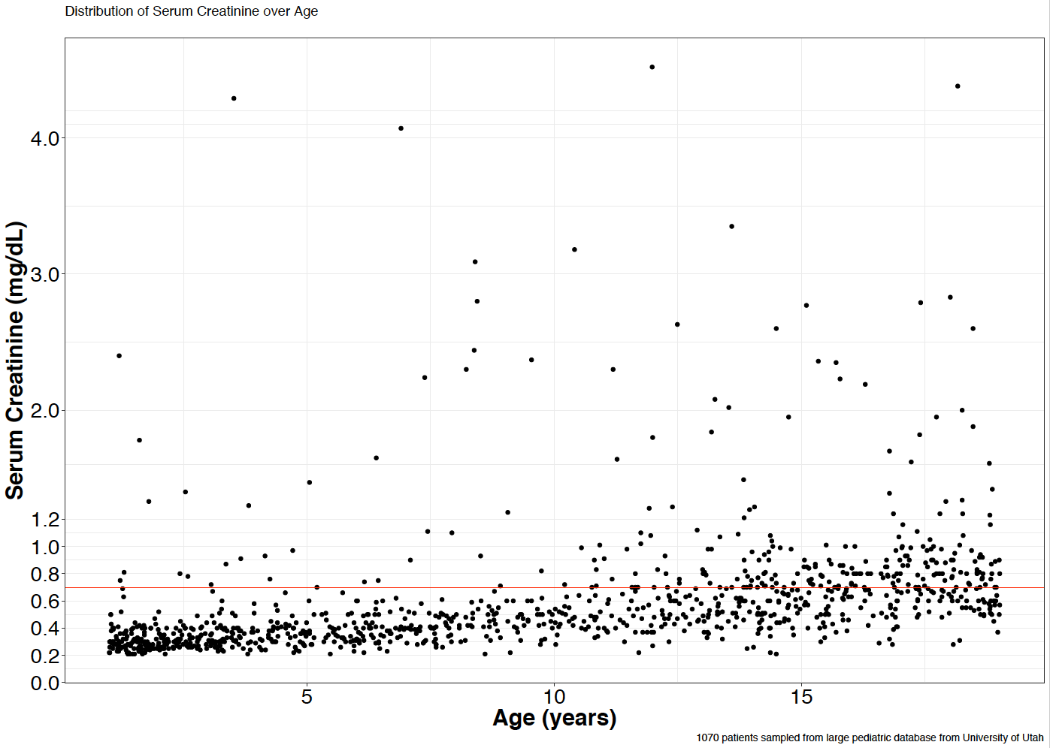

Slide 6
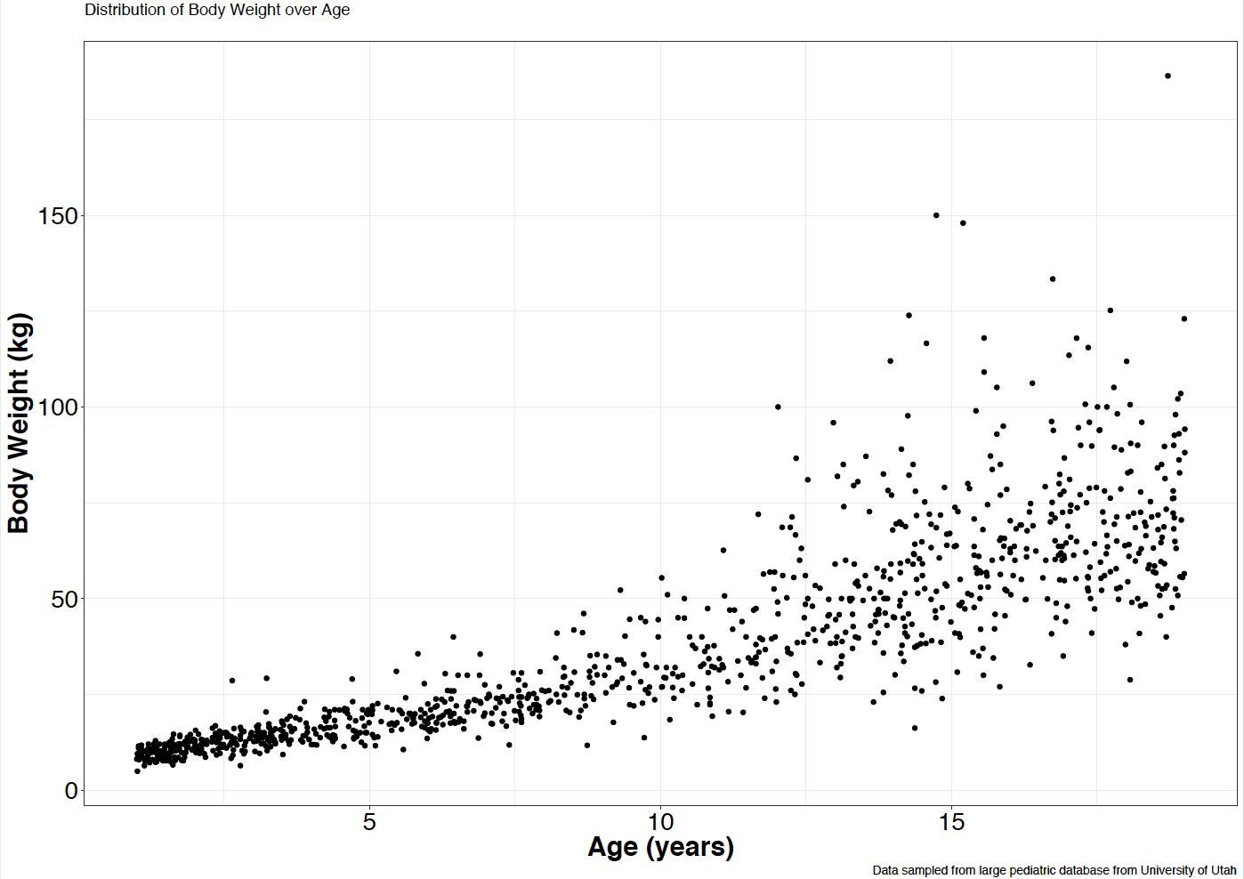

Slide 7
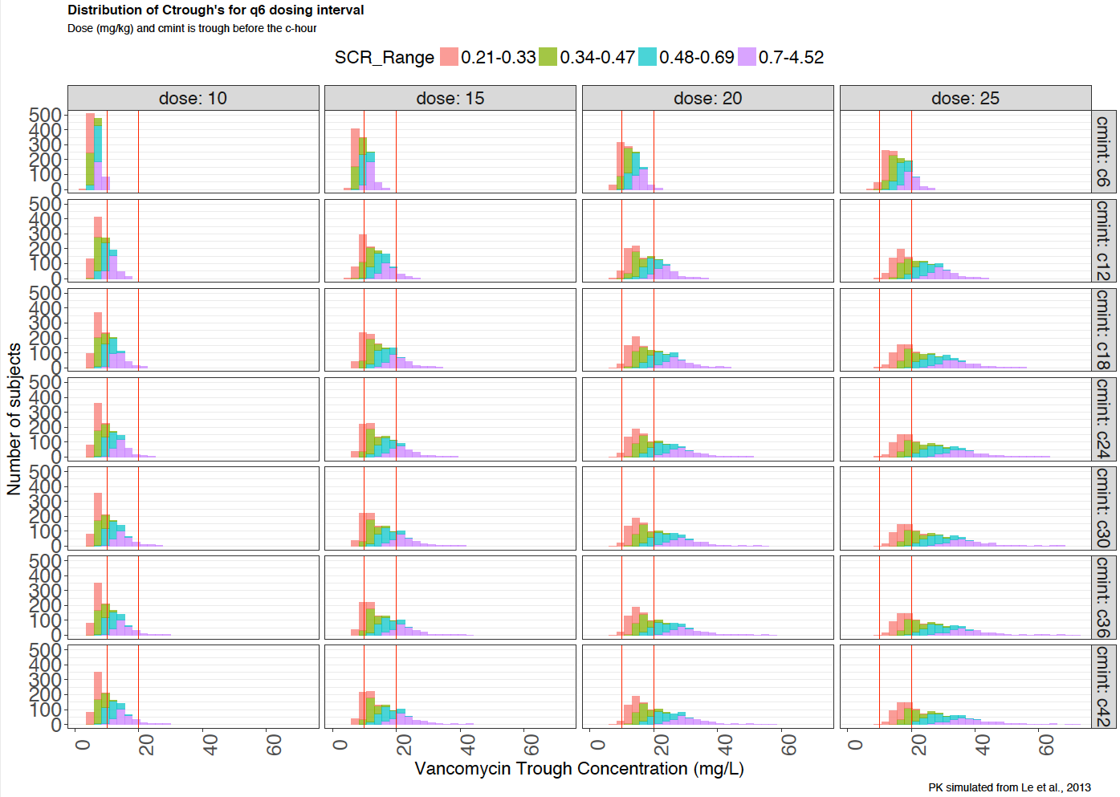
UMB Standard Protocol

Slide 8
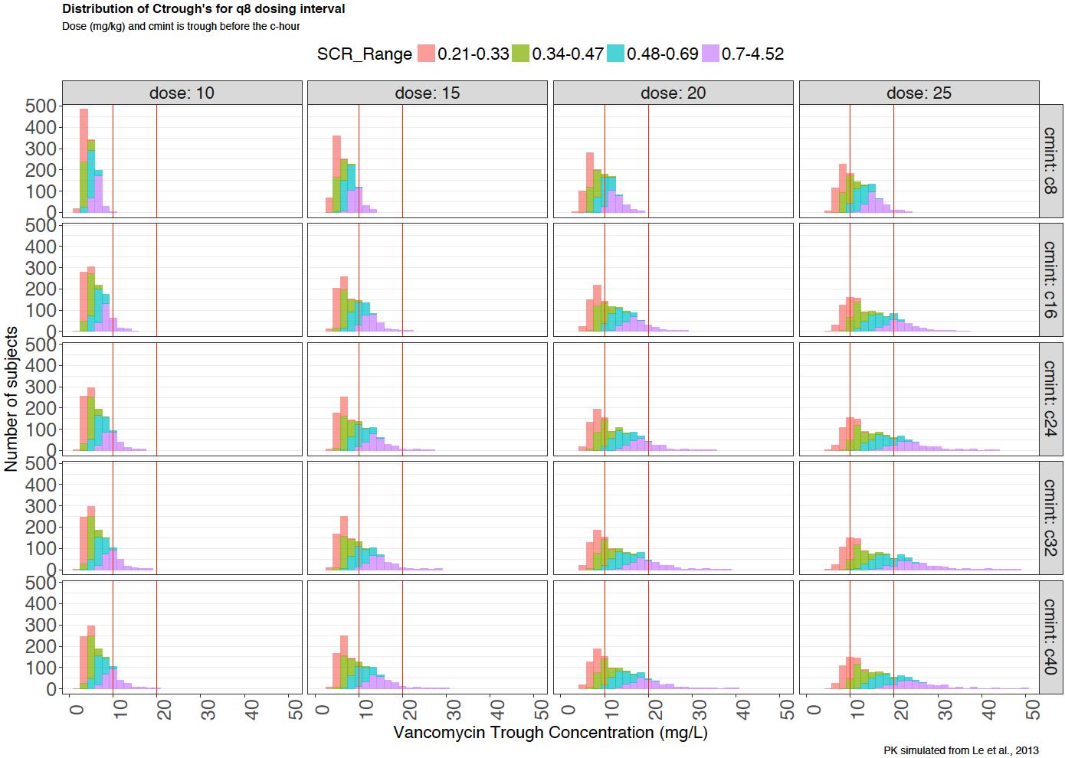
TCH Standard Protocol

Slide 9
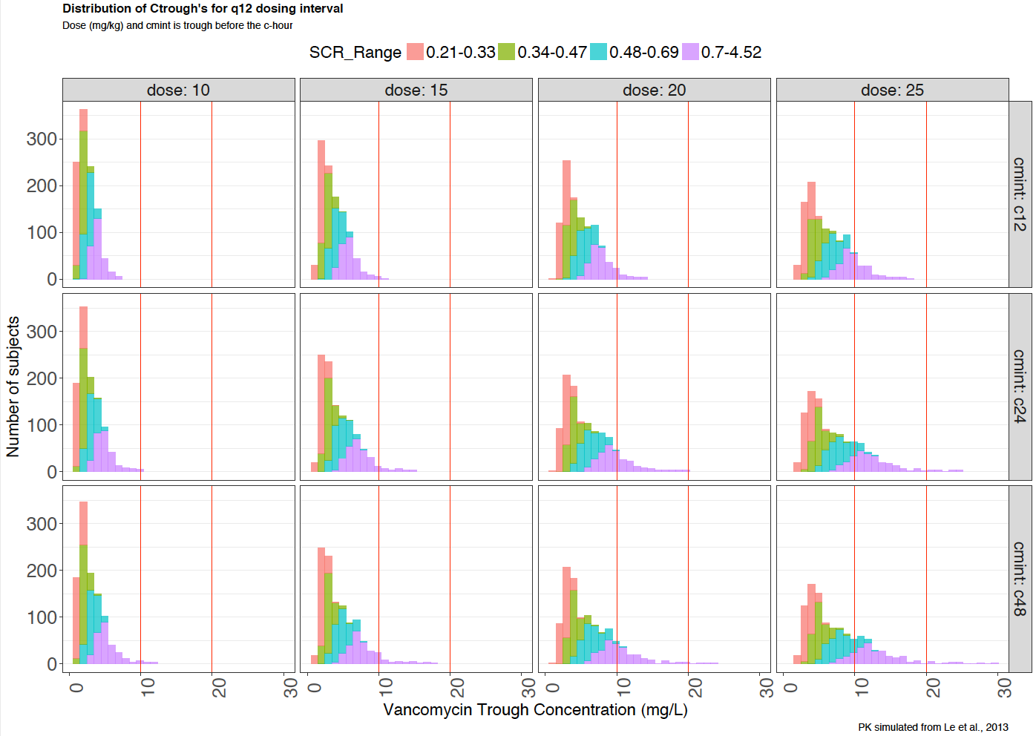

Slide 10
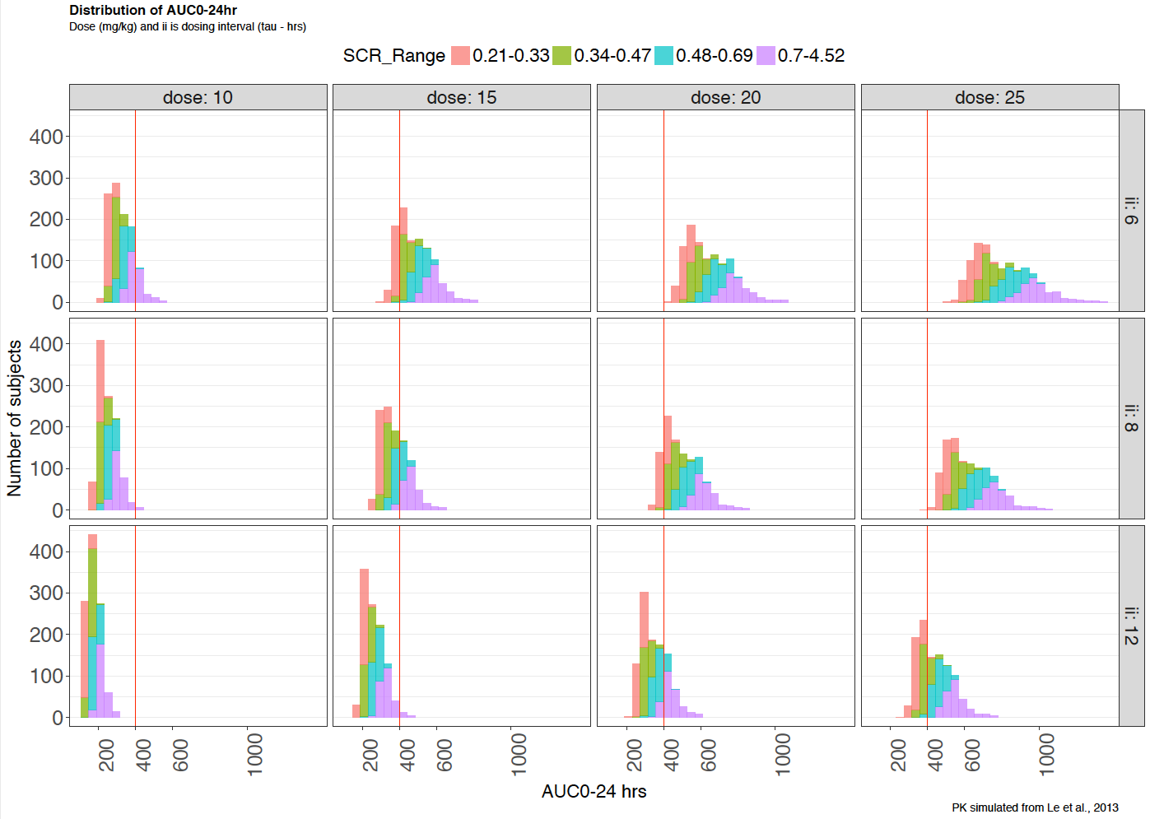
UMB Standard Protocol
TCH Standard Protocol

Slide 11
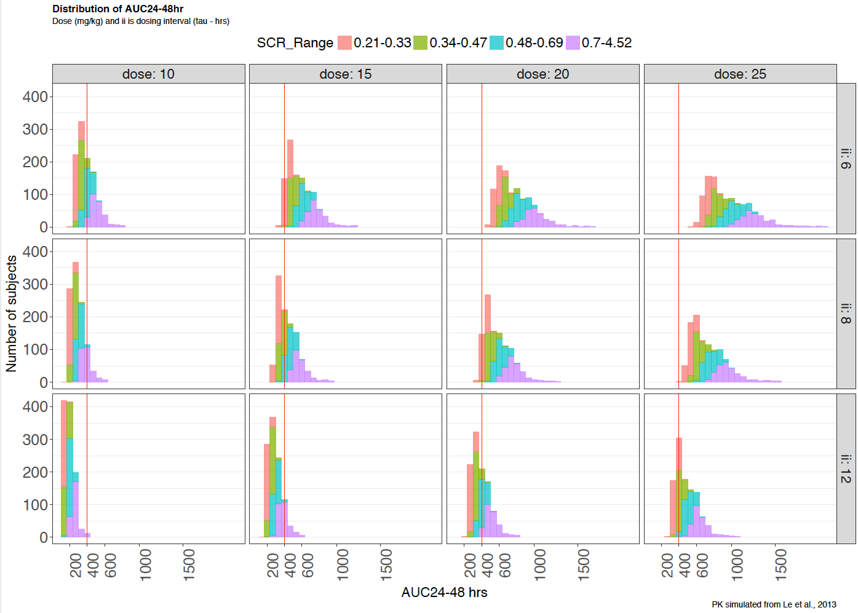
UMB Standard Protocol
TCH Standard Protocol

Slide 12
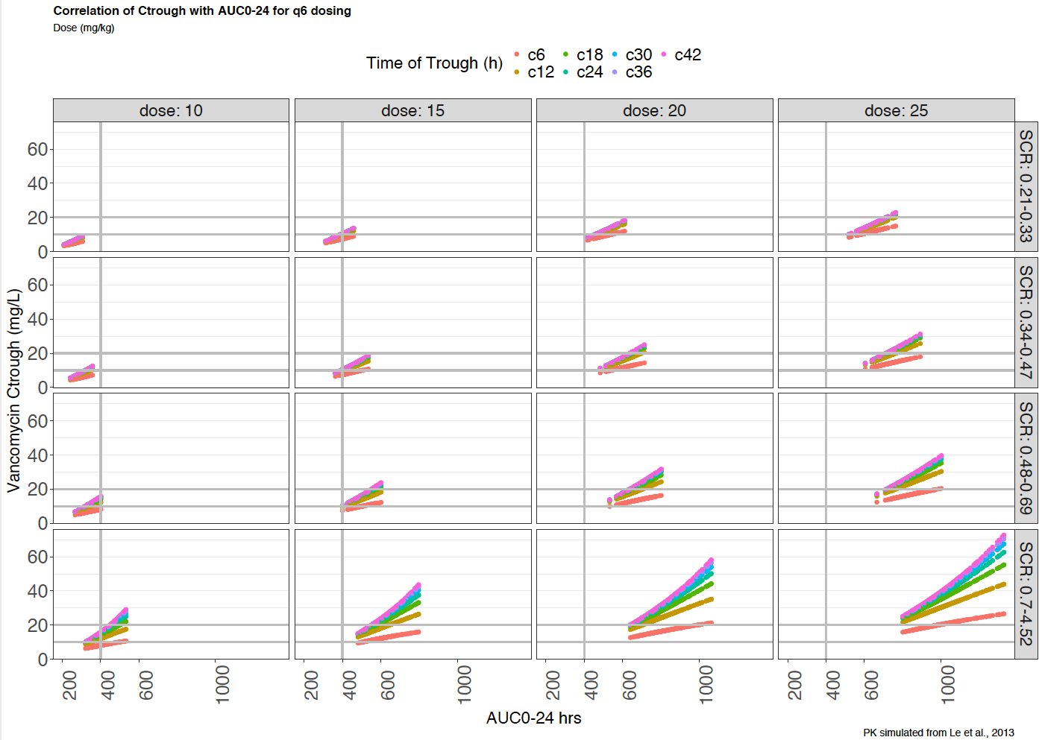
UMB Standard Protocol

Slide 13
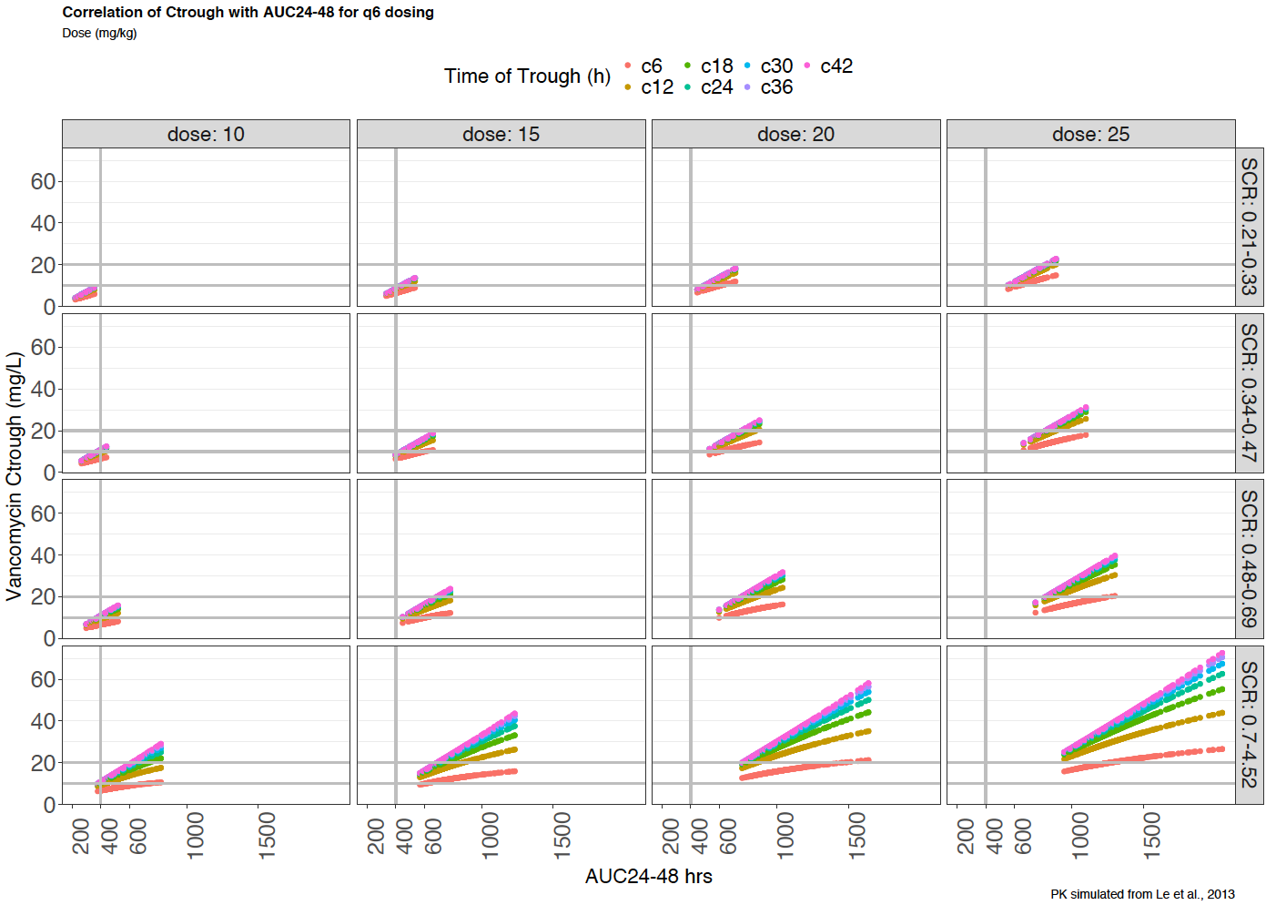
UMB Standard Protocol

Slide 14
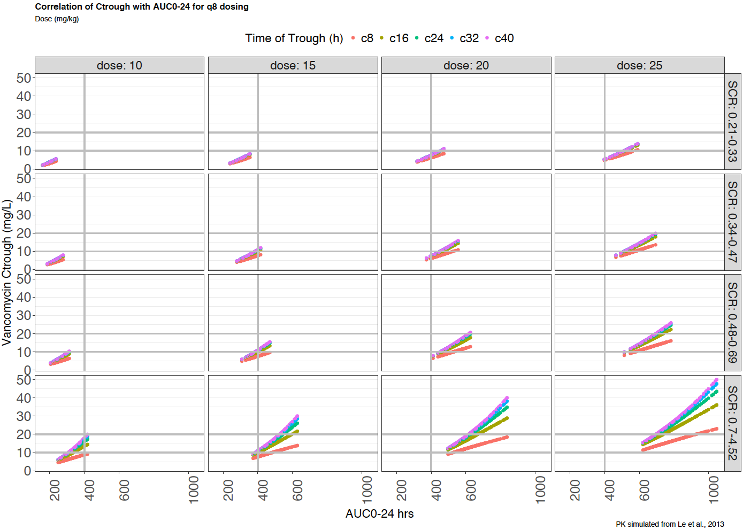
TCH Standard Protocol

Slide 15
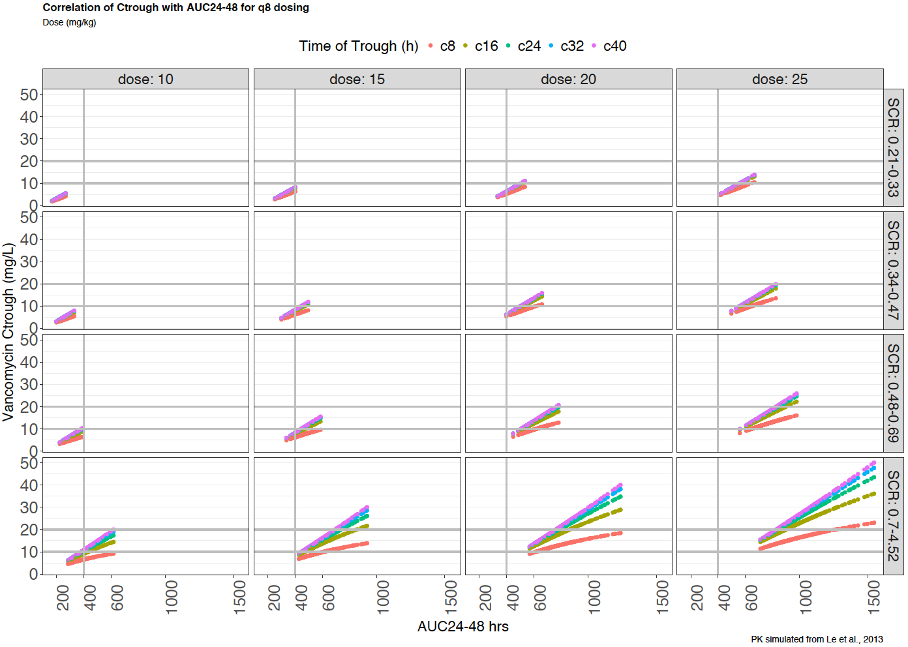
TCH Standard Protocol

Slide 16
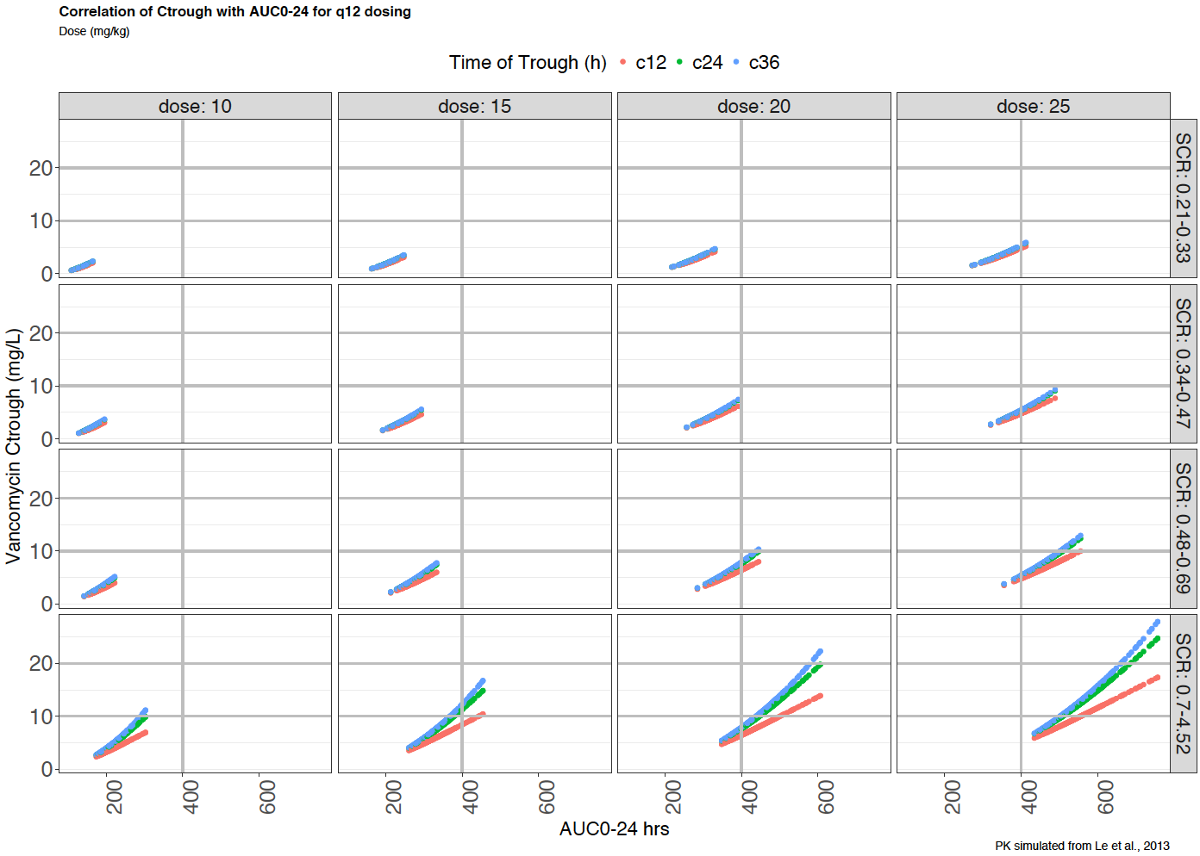

Slide 17
