Slide 1
Lending Club Case Study
Irfan Syed & Jereme Wilsander

Slide 2
Business Understanding
A consumer finance company which specializes in lending various types of loans to urban customers. When the company receives a loan application, the company has to make a decision for loan approval based on the applicant’s profile.
The data given in dataset loan contains information about past loan applicants and whether they ‘defaulted’ or not. The aim is to identify patterns which indicate if a person is likely to default, which may be used for taking actions such as denying the loan, reducing the amount of loan, lending (to risky applicants) at a higher interest rate, etc.

Slide 3
Business Objective
To understand the driving factors (or driver variables) behind loan default, i.e. the variables which are strong indicators of default. The company can utilise this knowledge for its portfolio and risk assessment.

Slide 4
Analysis Approach
Data Understanding
Check the dataset for the nature of Data
Data Cleaning
Remove unwanted data that might influence our analysis
Derived Variables
Derive useful information from existing data
Univariate Analysis
Analyze Individual variables to get insights
Bivariate Analysis
Analyze the relationship between 2 variables

Slide 5
Data Understanding
Load the given ‘loan.csv’ to python data frame and check the data
It has 39717 rows and 111 columns
Observations
We have quite a few columns that has ONLY NULL values
We have some columns that has only unique values
We have some columns calculated on customer behaviour and won’t be useful for our analysis
We have some columns whose data are got after the loan approval process
We have some columns that has free text or links that doesn’t help in our analysis

Slide 6
Data Cleaning
Following steps are performed as part of data cleaning
Drop invalid/unnecessary columns
Fix/Filter rows
Missing Values
Standardize Numbers
Standardize Text
Fix Invalid Values
Filter Data

Slide 7
Derived Variables
Derive month and year from issue_d column

Slide 8
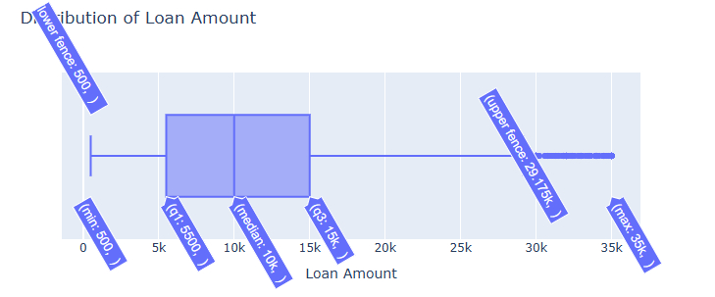
Distribution of Loan Amount
Most of the customers got loan amount sanctioned between 5k-15k

Slide 9
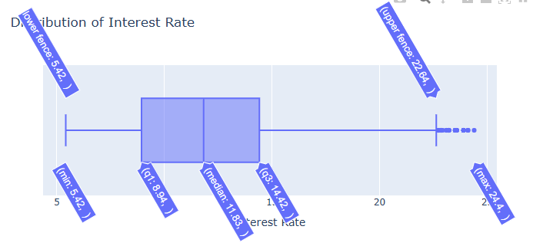
Distribution of Interest Rate
Most of the loans have interest rate between 9%-15%

Slide 10
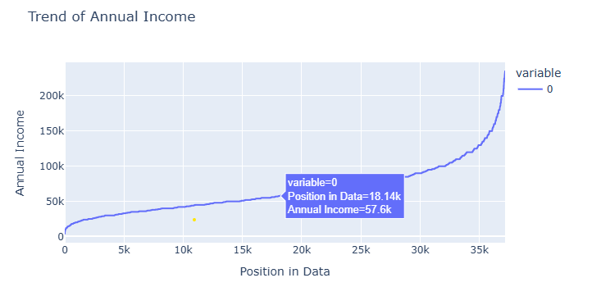
Trend of Annual Income
Approximately 80% of customers who availed loan had income less than 100k

Slide 11
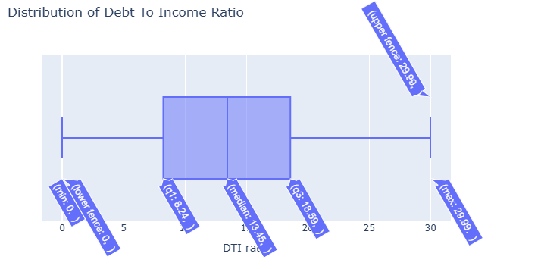
Distribution of Debt To Income Ratio
Most of the customers has debt to income ratio between 8 - 20

Slide 12
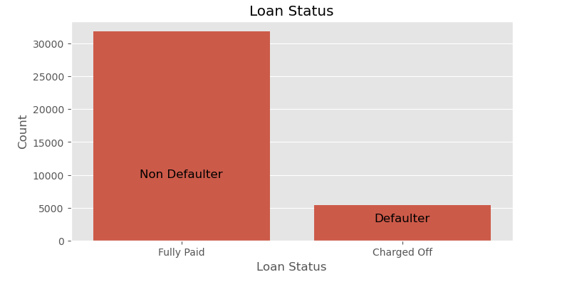
Loan status
Approximately 13% of total customers defaulted their loans

Slide 13
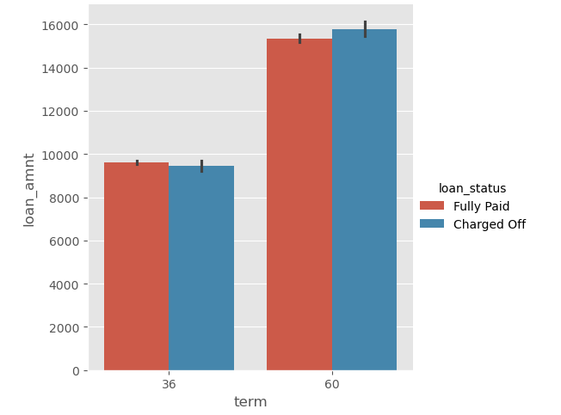
Term of loan
People who took loan for higher term tend to default more

Slide 14
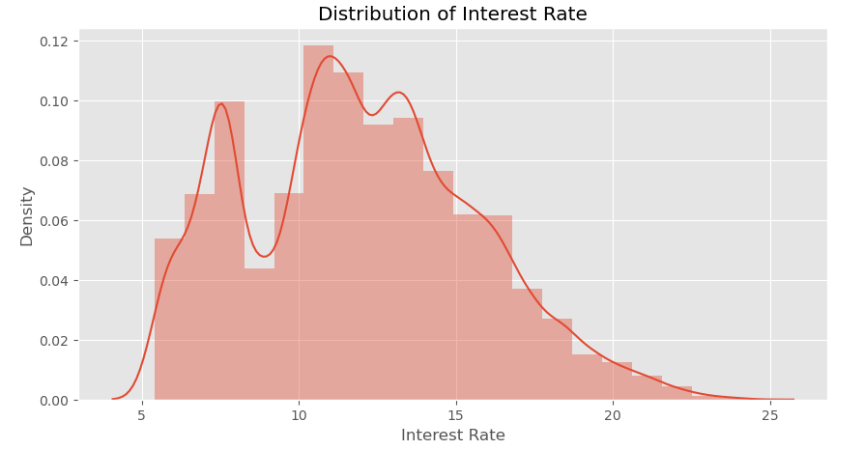
Distribution of interest rate
Most of the customers got interest rate between 10-14% and a considerable amount of customers also got around 8%

Slide 15
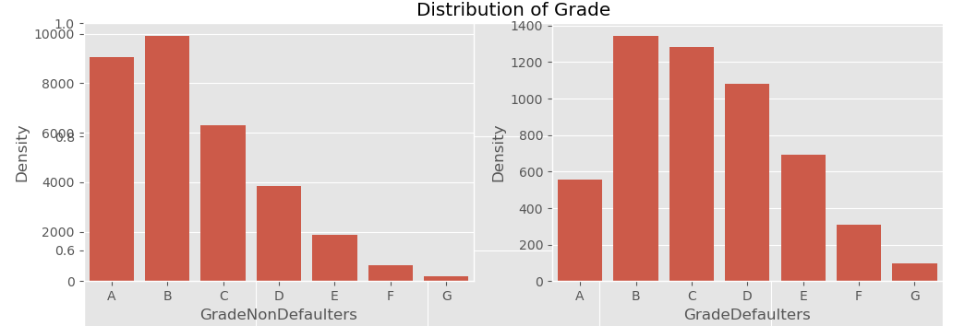
Distribution of Grade
People in Grade ‘A’ default very less compared to other grades

Slide 16
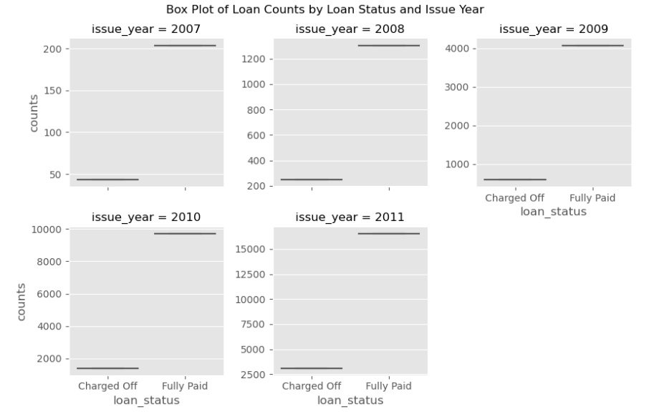
Distribution of Loan Status For Issue Year
Volume of loans has vastly increased with each year, also indicates approvals have increased

Slide 17
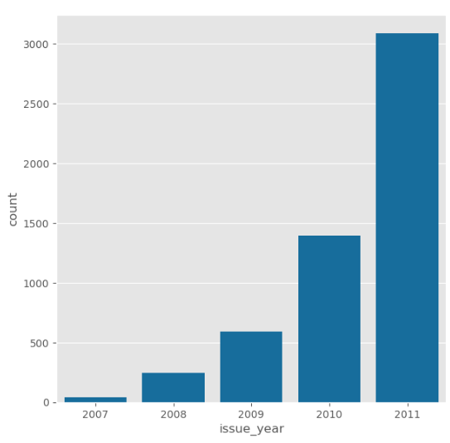
Distribution of defaulted loans across year of lending
Year 2011 had a huge surge of loans resulting in huge amount of defaults

Slide 18
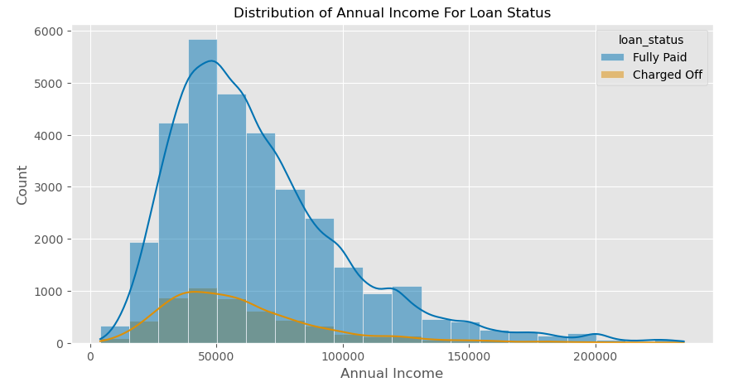
Distribution of Annual Income For Loan Status
Borrowers below 50k have high almost half of the defaulters, this can be a risk factor

Slide 19
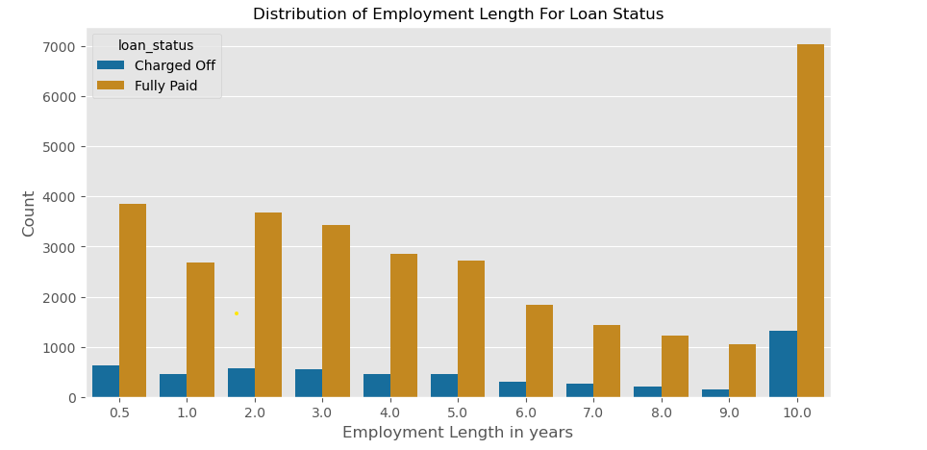
Distribution of Employment Length For Loan Status
Borrowers with 10+ years have taken more loans and high number of fully paid, defaulters are also comparatively more

Slide 20
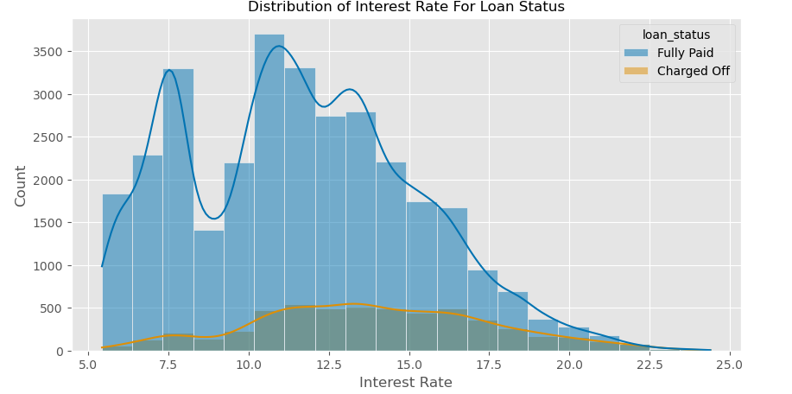
Distribution of Interest Rate For Loan Status
The interest rate has increased till 16% and then dropped from 17% for defaulters. For Fully paid , there is drop near 10%

Slide 21
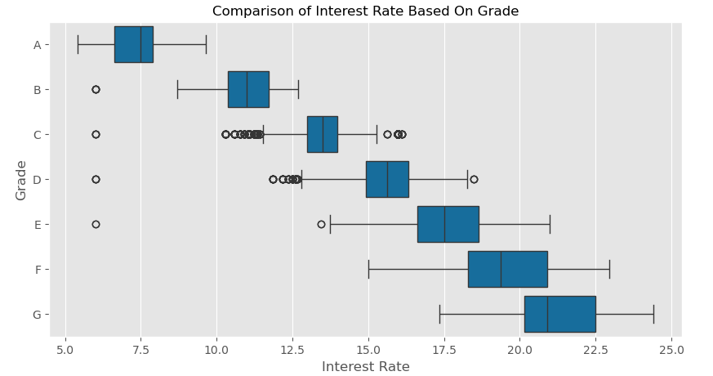
Comparison of Interest Rate Based On Grade
Higher the grade lower the rate of interest. People with good grades get lower interest rates.

Slide 22
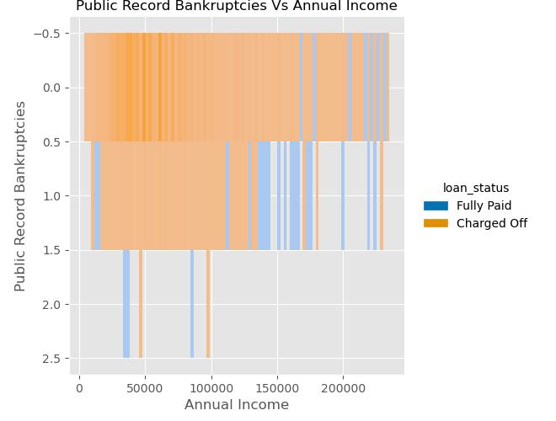
Public Record Bankruptcies Vs Annual Income
Most of the borrowers don't have bankruptcy records and are safe choice for loan approval

Slide 23
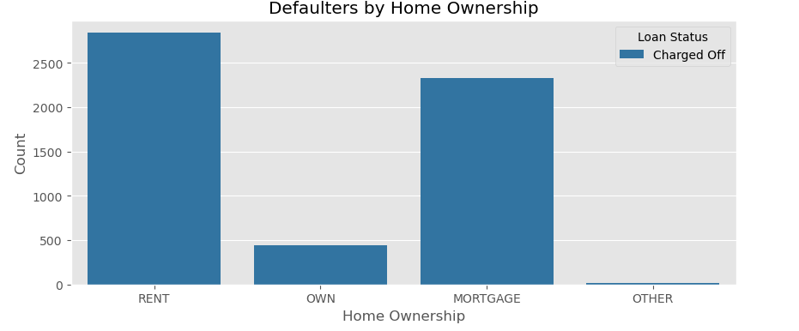
Defaulters by Home Ownership
Defaulters with RENT and MORTGAGE Home Owners are most likely to default than with OWN homes

Slide 24
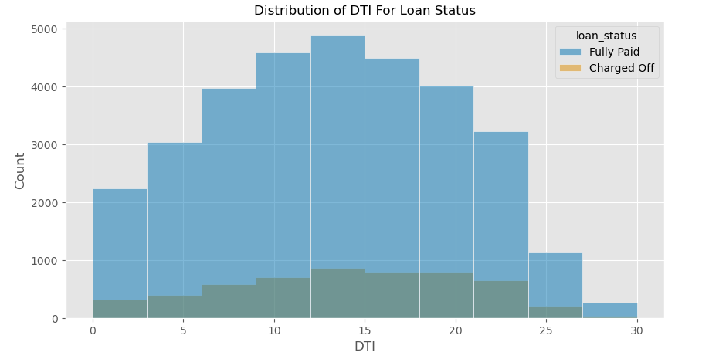
Distribution of DTI For Loan Status
The Loan Status varies with DTI ratio, we can see that the loans in DTI ratio 10-15 have higher number of defaulted loan but higher dti has higher chance of defaulting

Slide 25
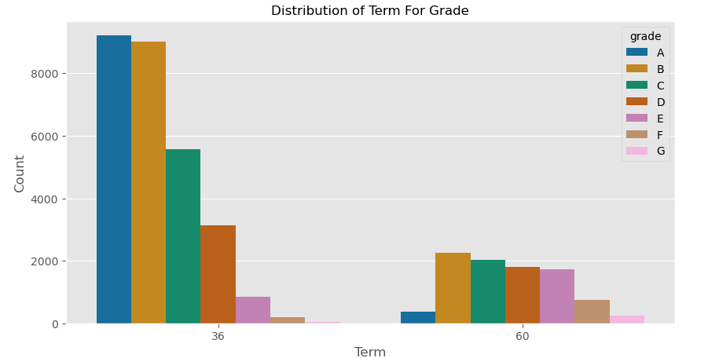
Distribution of Term For Grade
People with grade ‘A’ took loan for short term

Slide 26
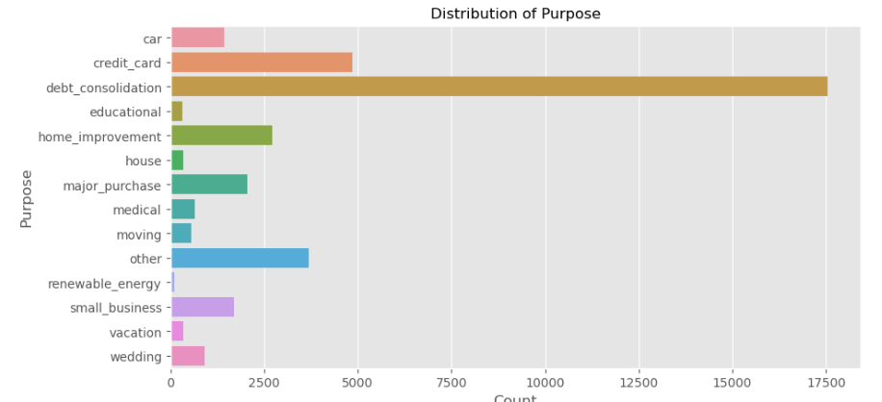
Distribution of Purpose
A high percentage of loans are taken for the purpose of debt consolidation followed by credit card

Slide 27
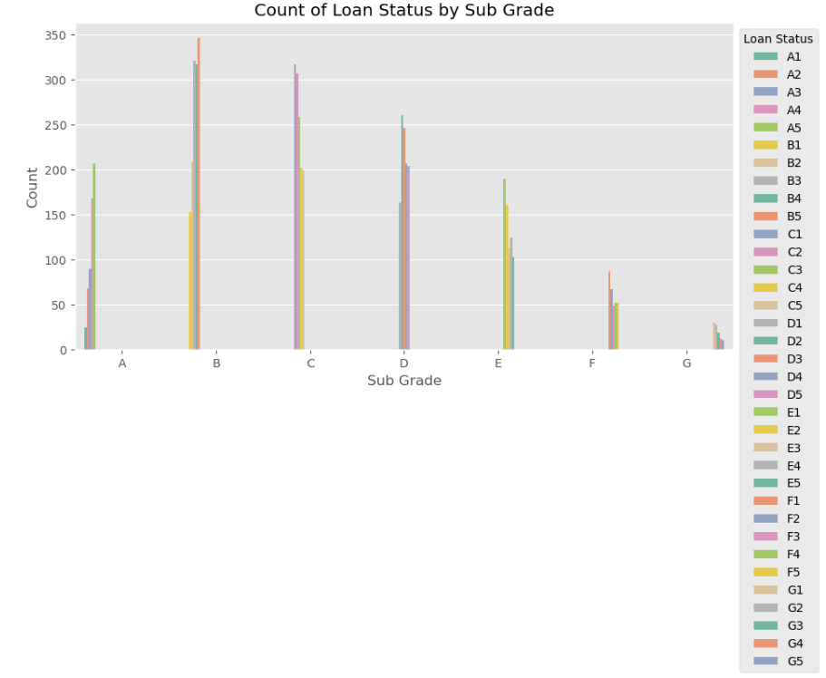
Count of Loan Status by Sub Grade
Compared to Sub grades of A , more numbers of defaulters are in Sub Grades of B & C, this is a risk factor

Slide 28
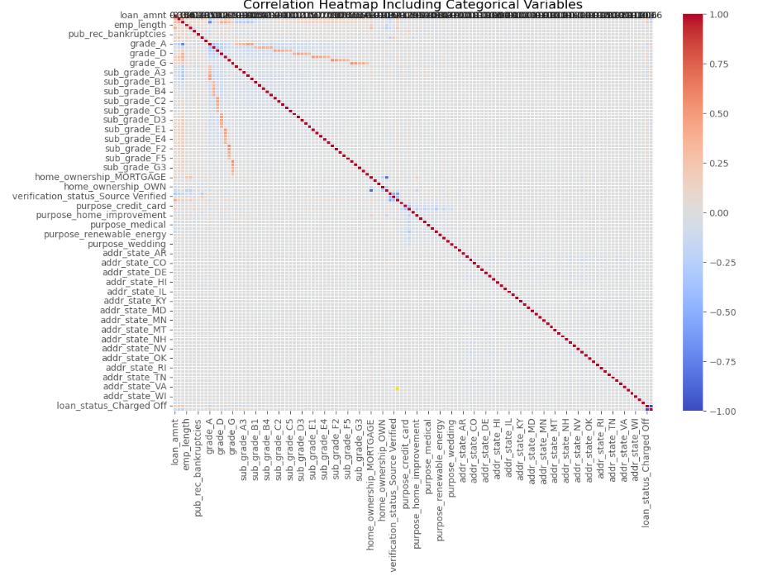
Correlation Heatmap Including Categorical Variables

Slide 29
Observations
Univariate Analysis
Defaulter's loans are lower in numbers compared to Non-Defaulters (Fully Paid)
Loan amount has a range of loans from 500 to 35k with a mean of 9.8k
The loans in 60 months term mostly consist of grade B, C and D loans whereas the loans in 36 months term majorly consist of grade A and B loans
More than half of the loan taken has term of 36 months compared to 60 months
Interest rate is more crowded between 5-10 and 10-15 along with a drop near 10%
Lot of loans are in Grade A and Grade B, meaning loans are approved more for higher grades

Slide 30
Observations
Segmented Univariate Analysis
High number of loans are issued in 12th months and year 2011
Borrowers below 50k have high almost half of the defaulters, this can be a risk factor
Volume of loans has vastly increased with each year, also indicates approvals have increased
Borrowers with 10+ years have taken more loans and high number of fully paid, defaulters are also comparatively more
The interest rate has increased till 16% and then dropped from 17% for defaulters. For Fully paid, there is drop near 10%
Defaulters with RENT and MORTGAGE Home Owners are most likely to default than wit OWN homes
The Loan Status varies with DTI ratio; we can see that the loans in DTI of 10-15% have higher number of defaulted loan, higher the DTI more chance of defaulting.
A high percentage of loans are taken for the purpose of debt consolidation followed by credit card
Compared to Sub grades of A, more numbers of defaulters are in Sub Grade of B & C, this us a risk factor

Slide 31
Observations
Bivariate Analysis
The rate of interest is inversely proportional to Grades meaning higher the grade, lower is the interest rate. Grade is a risk factor.
Most of the borrowers don't have bankruptcy records and are safe choice for loan approvals
The Grade A which is lowest risk also has lowest DTI ratio which we can say that higher grade has lower rate of default
The borrowers are mostly having no record of Public Recorded Bankruptcy and are safe choice for loan issue.

Slide 32
Factors influencing loan defaulters
Loans against Debt Consolidation and Credit Card
Debt to Income factor
Grades
Annual income
Public Record Bankruptcies
Home Ownership
Higher Interest rates
Length of the Employment

Slide 33
Recommendations
Borrowers having loans against debt consolidation and Credit Cards are more likely to get into debt trap with high interest rates complicating loan repayment and are likely to default
Borrowers with very high Debt to Income ratio are likely to default, additional due diligence needs to be carried out
Borrowers with highest grade A are safer compared to lower grades pose high risk
Borrowers having annual income less than ~50000 are likely to default more posing risk of repayment
Borrowers with Public Recorded Bankruptcies pose higher risk for loan repayment
Borrowers with Rented and Mortgaged Home Ownership carry more disk to default loans
Borrowers with high interest rates pose high risk to default
Even though borrowers with working experience of 10+ years are likely to fully pay, they also pose risk to default loans given the fact borrowers with 10+ years experience are high consumers of loans

