Slide 1
Lending Club Case Study
Irfan Syed & Jereme Wilsander

Slide 2
Business Understanding
A consumer finance company which specializes in lending various types of loans to urban customers. When the company receives a loan application, the company has to make a decision for loan approval based on the applicant’s profile.
The data given in dataset loan contains information about past loan applicants and whether they ‘defaulted’ or not. The aim is to identify patterns which indicate if a person is likely to default, which may be used for taking actions such as denying the loan, reducing the amount of loan, lending (to risky applicants) at a higher interest rate, etc.

Slide 3
Business Objective
To understand the driving factors (or driver variables) behind loan default, i.e. the variables which are strong indicators of default. The company can utilise this knowledge for its portfolio and risk assessment.

Slide 4
Analysis Approach
Data Understanding
Check the dataset for the nature of Data
Data Cleaning
Remove unwanted data that might influence our analysis
Derived Variables
Derive useful information from existing data
Univariate Analysis
Analyze Individual variables to get insights
Bivariate Analysis
Analyze the relationship between 2 variables

Slide 5
Data Understanding
Load the given ‘loan.csv’ to python data frame and check the data
It has 39717 rows and 111 columns
Observations
We have quite a few columns that has ONLY NULL values
We have some columns that has only unique values
We have some columns calculated on customer behaviour and won’t be useful for our analysis
We have some columns whose data are got after the loan approval process
We have some columns that has free text or links that doesn’t help in our analysis

Slide 6
Data Cleaning
Following steps are performed as part of data cleaning
Drop invalid/unnecessary columns
Fix/Filter rows
Missing Values
Standardize Numbers
Standardize Text
Fix Invalid Values
Filter Data

Slide 7
Derived Variables
Derive month and year from issue_d column

Slide 8
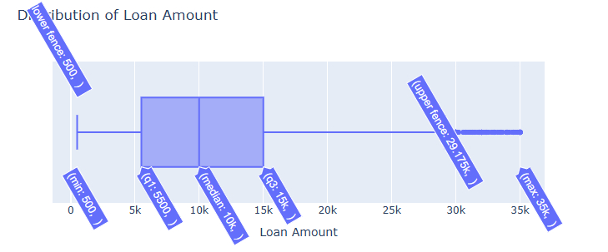
Distribution of Loan Amount
Most of the customers got loan amount sanctioned between 5k-15k

Slide 9
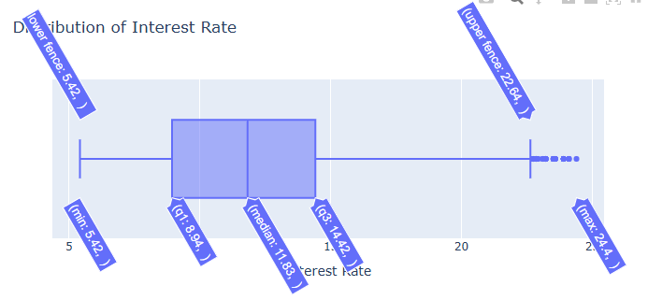
Distribution of Interest Rate
Most of the loans have interest rate between 9%-15%

Slide 10
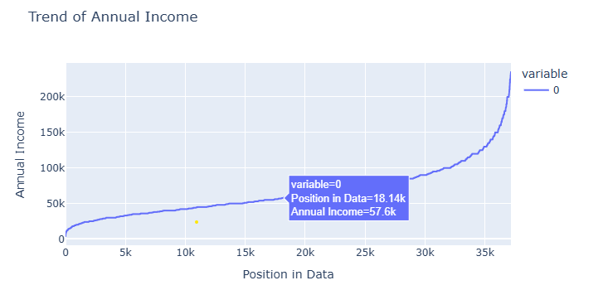
Trend of Annual Income
Approximately 80% of customers who availed loan had income less than 100k

Slide 11
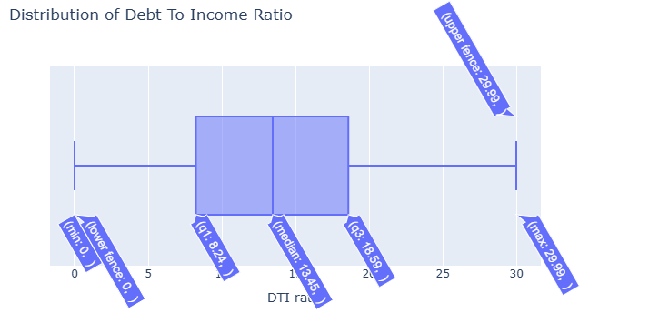
Distribution of Debt To Income Ratio

Slide 12
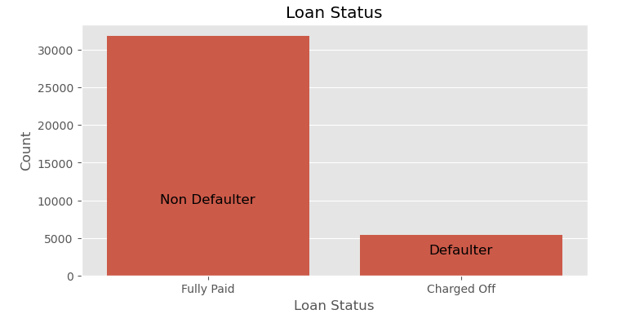
Loan status
Approximately 13% of total customers defaulted their loans

Slide 13
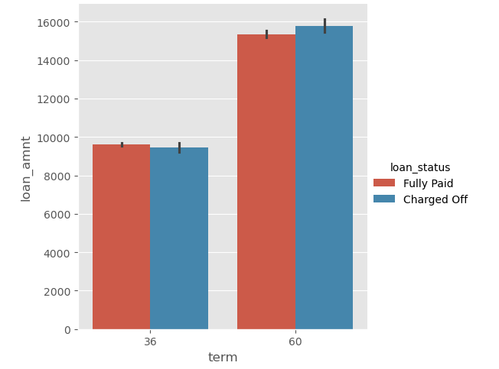
Term of loan
People who took loan for higher term tend to default more

Slide 14
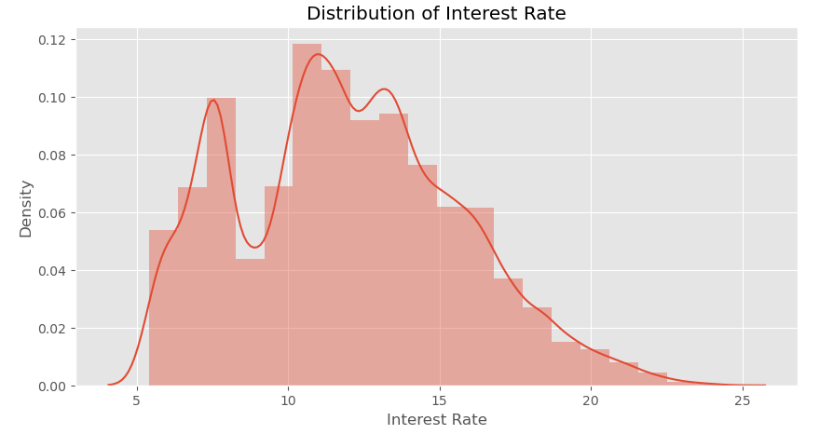
Distribution of interest rate
Most of the customers got interest rate between 10-14% and a considerable amount of customers also got around 8%

Slide 15
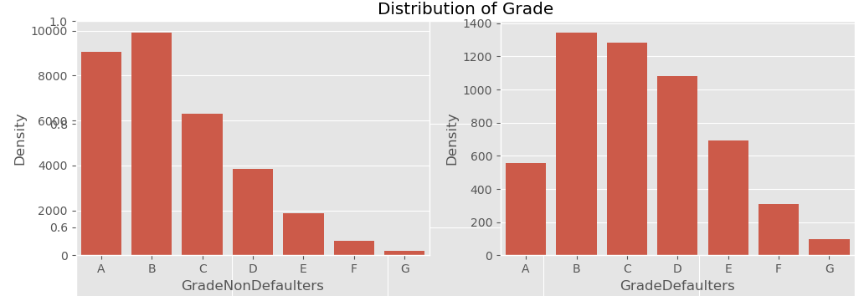
Distribution of Grade
People in Grade ‘A’ default very less compared to other grades

Slide 16
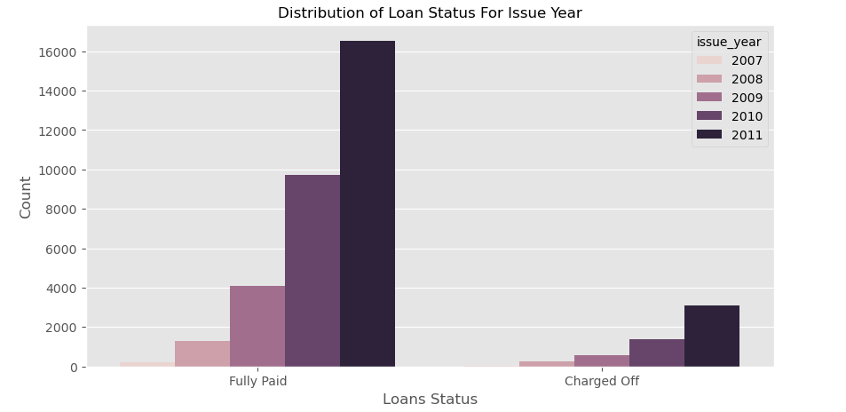
Distribution of Loan Status For Issue Year

Slide 17
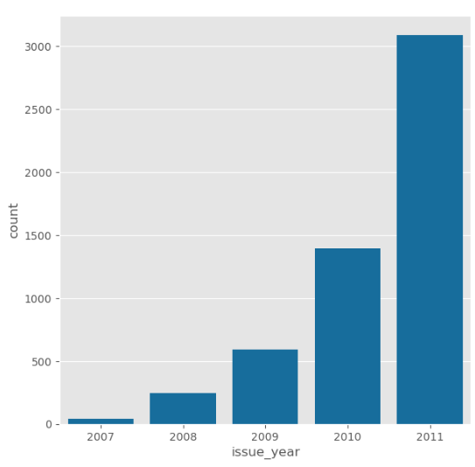
Distribution of defaulted loans across year of lending
Year 2011 had a huge surge of loans resulting in huge amount of defaults

Slide 18
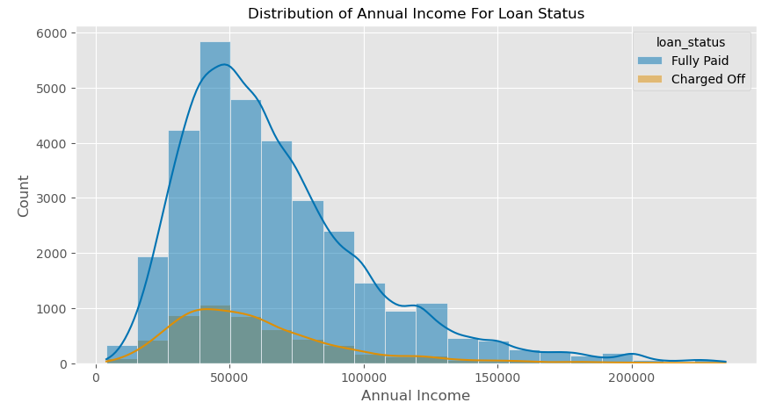
Distribution of Annual Income For Loan Status

Slide 19
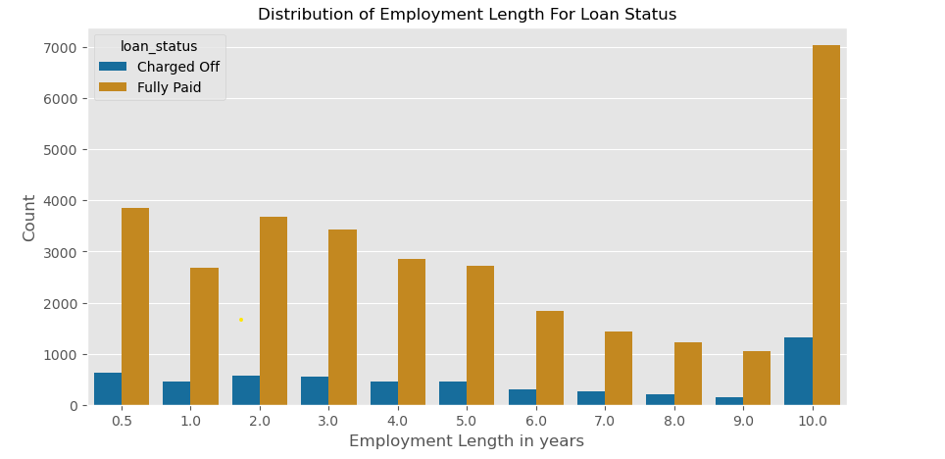
Distribution of Employment Length For Loan Status

Slide 20
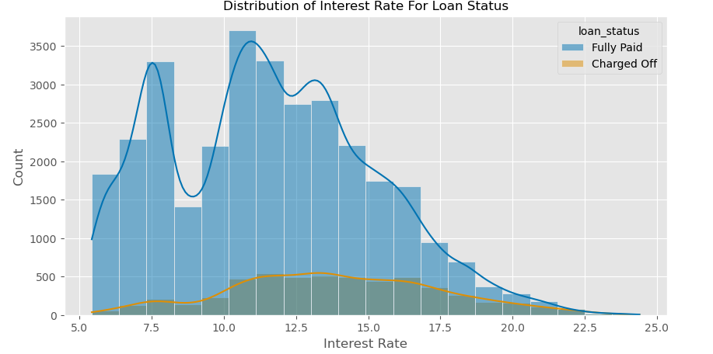
Distribution of Interest Rate For Loan Status

Slide 21
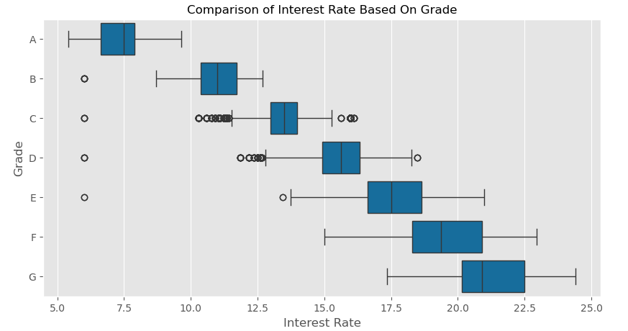
Comparison of Interest Rate Based On Grade
Higher the grade lower the rate of interest. People with good grades get lower interest rates.

Slide 22
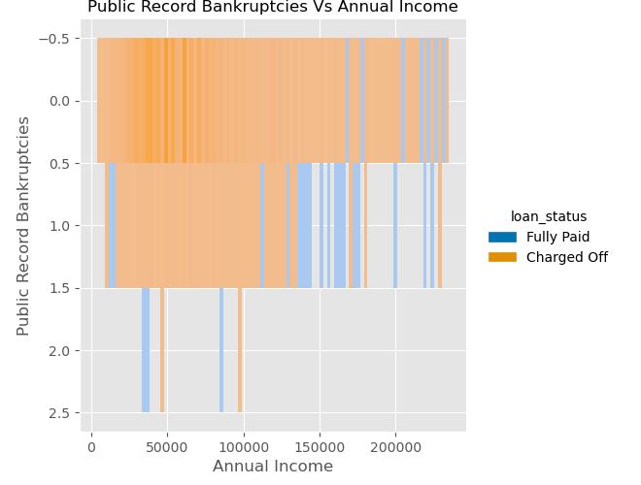
Public Record Bankruptcies Vs Annual Income
Customers who have public record of Bankruptcies tend to default more

Slide 23
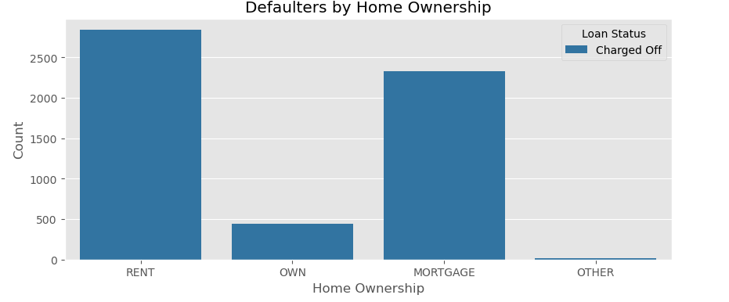
Defaulters by Home Ownership

Slide 24
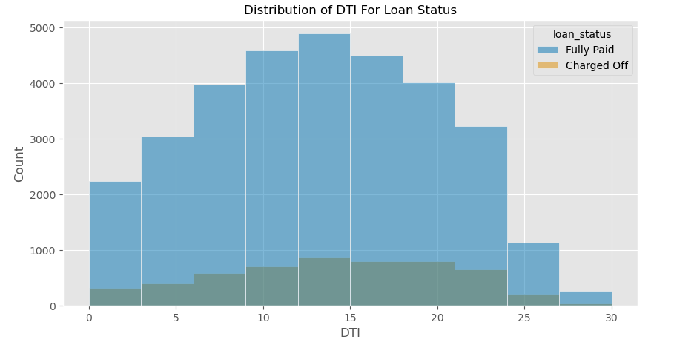
Distribution of DTI For Loan Status

Slide 25
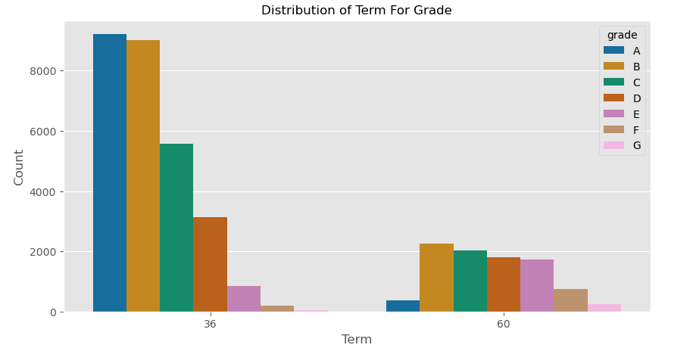
Distribution of Term For Grade
People with grade ‘A’ took loan for short term

Slide 26
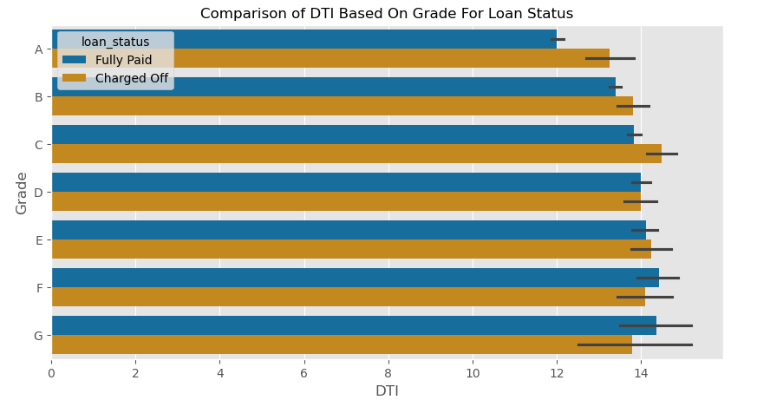
Comparison of DTI Based On Grade For Loan Status

Slide 27
Conclusion
Higher the grade lower the interest rate
2011 there is a unusual surge of loan applications and defaulters were also more
Approximately 13% of total customers defaulted
Approximately 80% of the loan applicants had income 100k or less
Customers who have public record of Bankruptcies tend to default more
People in Grade ‘A’ default very less compared to other grades, they also prefer short term loans

