Slide 1
Lending Club Case Study
Irfan Syed & Jereme Wilsander

Slide 2
Business Understanding
A consumer finance company which specializes in lending various types of loans to urban customers. When the company receives a loan application, the company has to make a decision for loan approval based on the applicant’s profile.
The data given in dataset loan contains information about past loan applicants and whether they ‘defaulted’ or not. The aim is to identify patterns which indicate if a person is likely to default, which may be used for taking actions such as denying the loan, reducing the amount of loan, lending (to risky applicants) at a higher interest rate, etc.

Slide 3
Business Objective
To understand the driving factors (or driver variables) behind loan default, i.e. the variables which are strong indicators of default. The company can utilise this knowledge for its portfolio and risk assessment.

Slide 4
Analysis Approach
Data Understanding
Check the dataset for the nature of Data
Data Cleaning
Remove unwanted data that might influence our analysis
Derived Variables
Derive useful information from existing data
Univariate Analysis
Analyze Individual variables to get insights
Bivariate Analysis
Analyze the relationship between 2 variables

Slide 5
Data Understanding
Load the given ‘loan.csv’ to python data frame and check the data
It has 39717 rows and 111 columns
Observations
We have quite a few columns that has ONLY NULL values
We have some columns that has only unique values
We have some columns calculated on customer behaviour and won’t be useful for our analysis
We have some columns whose data are got after the loan approval process
We have some columns that has free text or links that doesn’t help in our analysis

Slide 6
Data Cleaning
Following steps are performed as part of data cleaning
Drop invalid/unnecessary columns
Fix/Filter rows
Missing Values
Standardize Numbers
Standardize Text
Fix Invalid Values
Filter Data

Slide 7
Derived Variables
Derive month and year from issue_d column

Slide 8
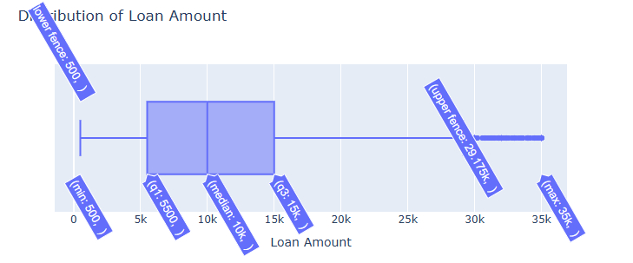
Distribution of Loan Amount

Slide 9
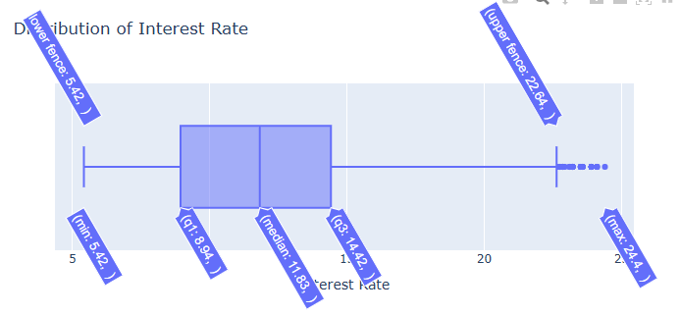
Distribution of Interest Rate

Slide 10
Distribution of Interest Rate

Slide 11
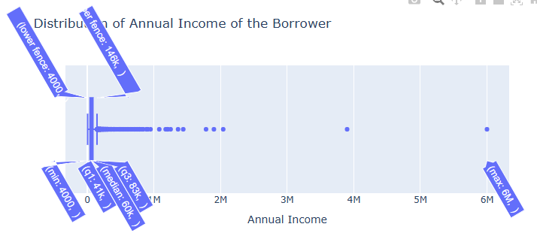
Distribution of Annual Income of the Borrower

Slide 12
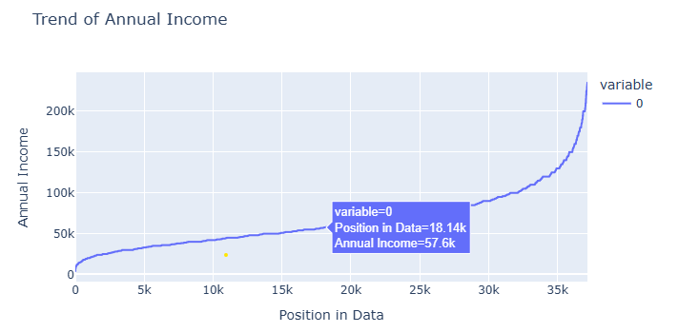
Trend of Annual Income

Slide 13
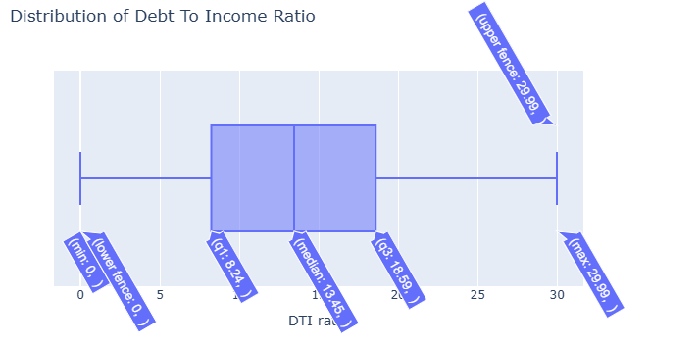
Distribution of Debt To Income Ratio

Slide 14
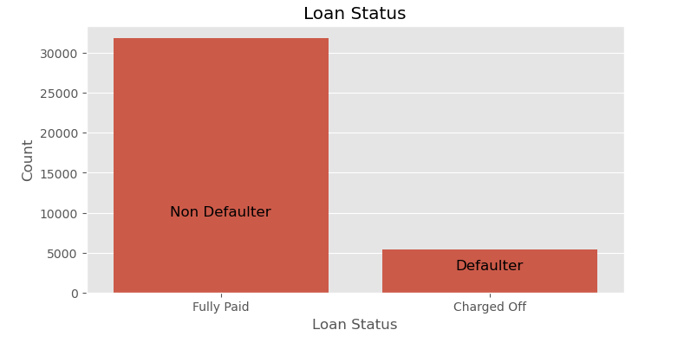
Loan status

Slide 15
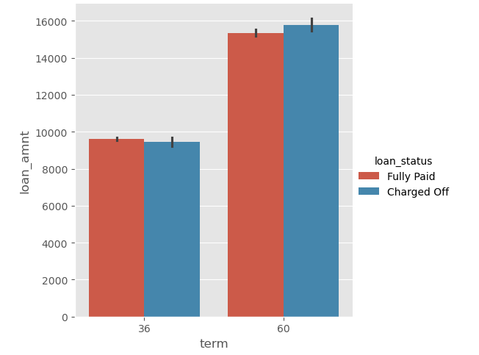
Term of loan

Slide 16
Term of loan

Slide 17
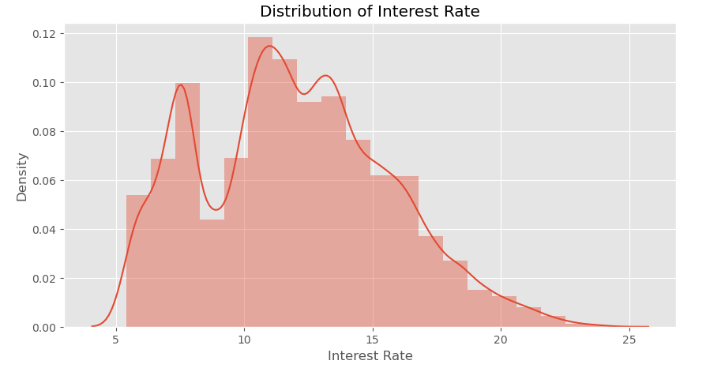
Distribution of interest rate

Slide 18
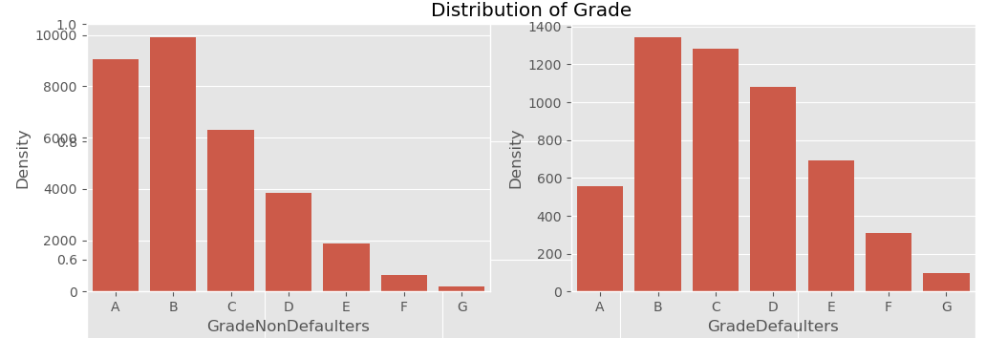
Distribution of Grade

Slide 19
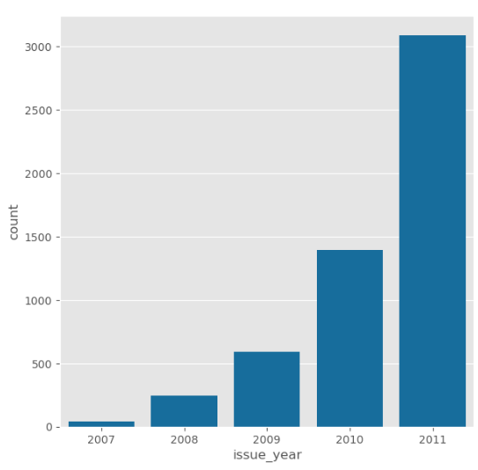
Distribution of loans across year of lending

Slide 20
Conclusion

