Slide 1

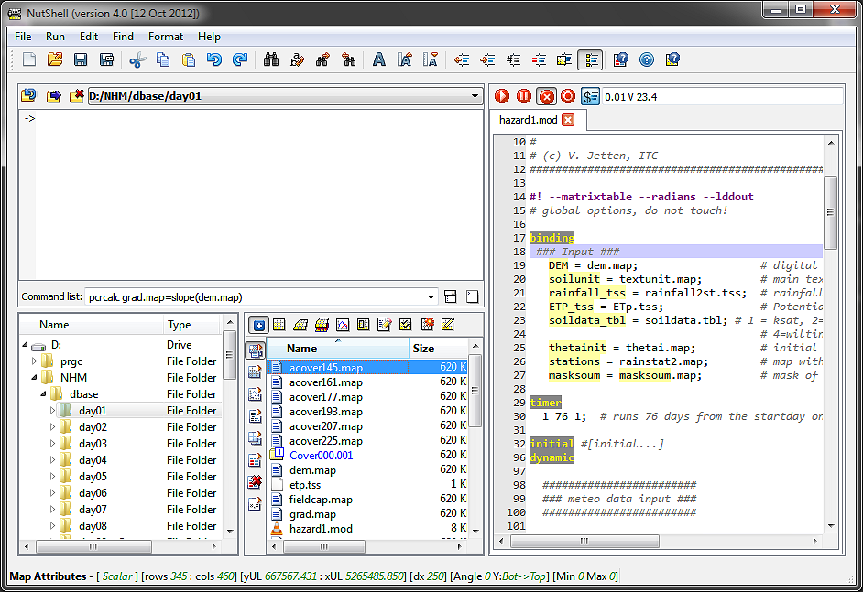
NutShell main functions
Go to/Set/Delete
Work Directories
Script edit options
(Alt-U/I/3/4)
Run/Pause/Stop
current script
Context sensitive
Help (Ctrl-F1)
Work Directories
are saved
Argument substitution
Runtime indication
Clear commands
Typed commands are saved
Aguila “+”: show maps in stack or parallel
Mark and display files directly from script
(F6, F4, dbl-click)
Current Work directory drag and drop files
Between dirs
Code folding
dbl-click on section header
Current map attributes
Show only
PCRaster relevant files
Show/Delete reported files of current script
Map series in blue
Can be deleted/moved/copied
Aguila / Legend / edit / map attributes / make new map / mapedit

