Slide 1

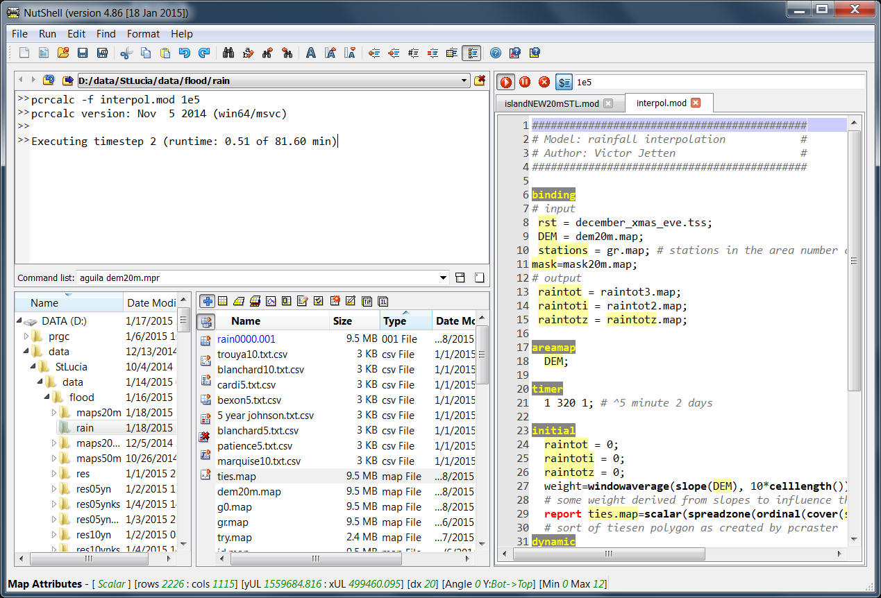
NutShell 5.1 main functions (1 Oct 2018)
Go to/Set/Delete
Work Directories
Script edit options
(Alt-U/I/3/4)
Run/Pause/Stop
current script
Online context sensitive
Help (Ctrl-F1)
List of Work Directories
Argument substitution
Runtime indication
Editor for PCRaster scripts & CMD files
Clear commands
List of typed commands
“+”: show maps stacked or in connected windows
Mark and display files directly from script
(F6, F4)
Code folding
double-click on section header
drag and drop files and map series
between folders
Ctrl-drag = copy
Current map attributes
Show PCRaster relevant files
Map series in blue
Can be deleted/moved/copied
Shortcuts to PCRaster
Programs, incl mapedit
Use GDAL to convert maps

