Slide 1

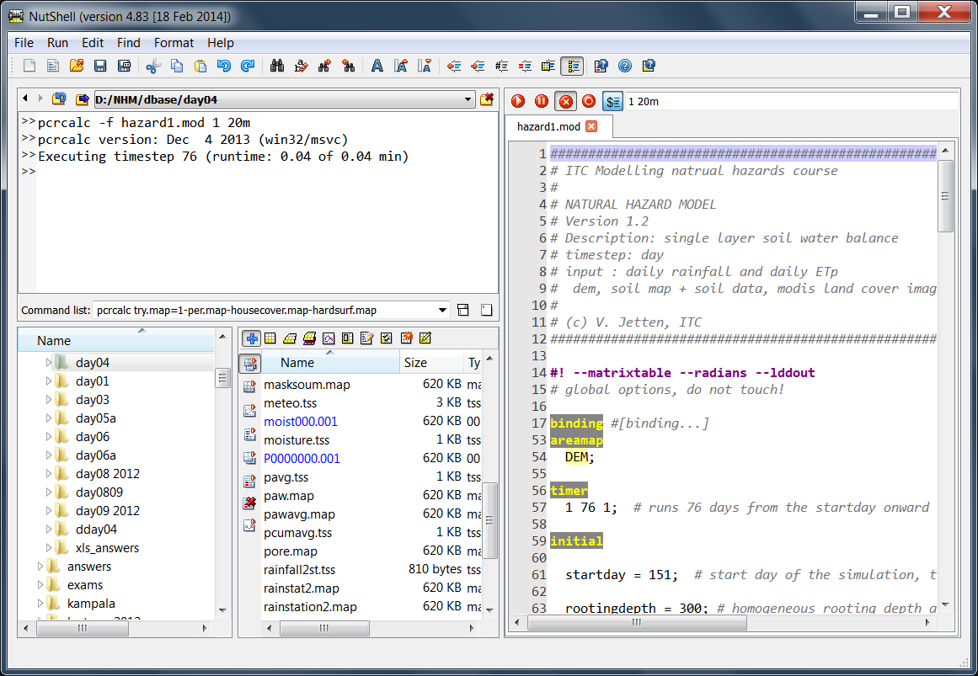
NutShell 4.8x main functions (22 Feb 2014)
Go to/Set/Delete
Work Directories
Script edit options
(Alt-U/I/3/4)
Run/Pause/Stop
current script
Online context sensitive
Help (Ctrl-F1)
List of Work Directories
Argument substitution
Runtime indication
Clear commands
List of typed commands
“+”: show maps stacked or in connected windows
Mark and display files directly from script
(F6, F4)
Code folding
dbl-click on section header
drag and drop files and map series
Between dirs
Ctrl-drag = copy
Current map attributes
Show only
PCRaster relevant files
Show/Delete reported files of current script
Map series in blue
Can be deleted/moved/copied
Aguila / Legend / map attributes / new map / mapedit

