Slide 1
RFID unit documentation
These notes are for the units which are attached to two of the TRAXSTER robots.
Special notes for building the standalone units:
The standalone RFID units have the same circuit diagram as the robot units, the only difference is that the robot units are designed to be stuck to the underside of the robot using some packing foam type material as a spacer whereas the standalone units are built into a small plastic box.
So the construction for the standalone units requires that 1 small holes are drilled in the box for the 1 pins of the RFID reader. 1 larger hole is drilled for the yellow LED.
The RFID unit and LED are then glued in place using Araldite glue.
The connections on the inside of the box are the same as they are on the robot units (see pictures) but obviously cannot be done until after the RFID unit is glued in place.
I recommend that the RFID reader and LED are placed on the LID of the box, as this makes it MUCH easier to assemble the circuit.
(See also the existing unit, before building the new ones)
The data pin MUST be on bit 0 of the IDC cable, because this has to go to a specific pin (bit 0 of port D).

Slide 2
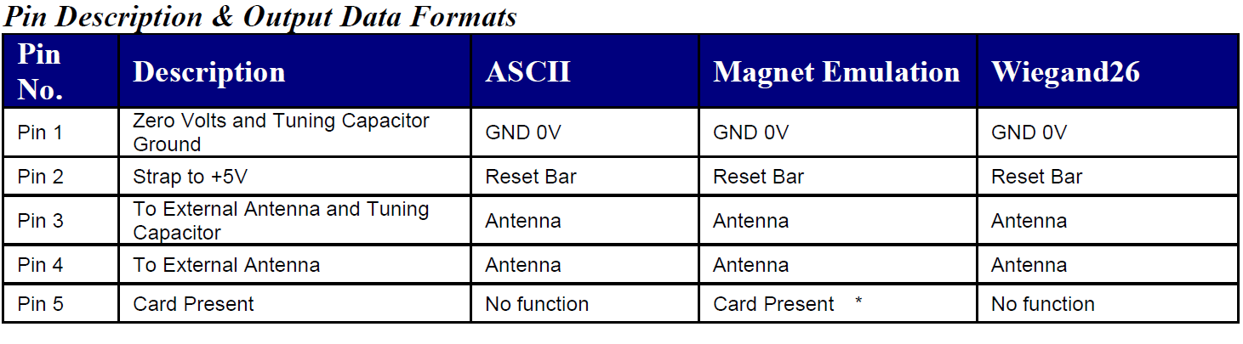
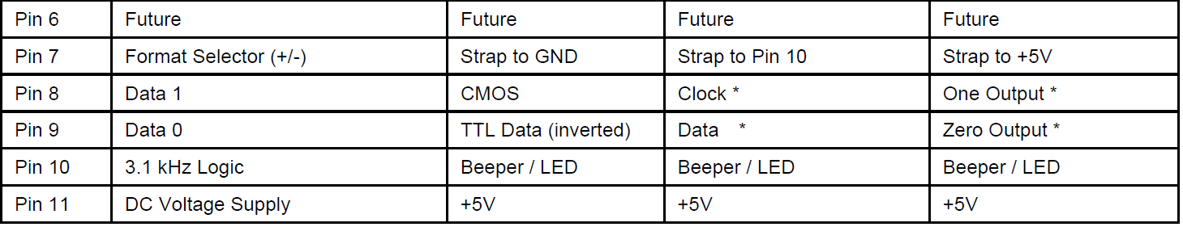
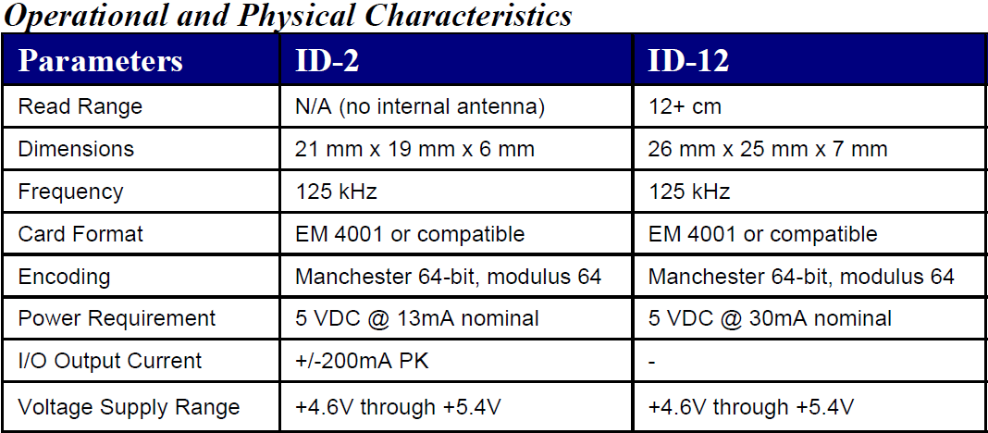
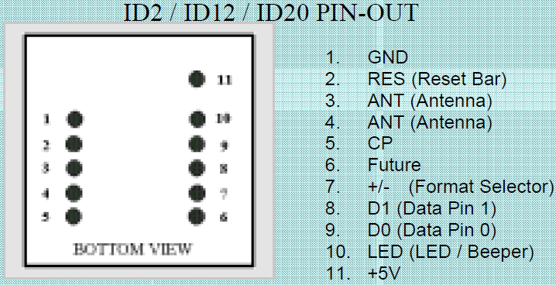
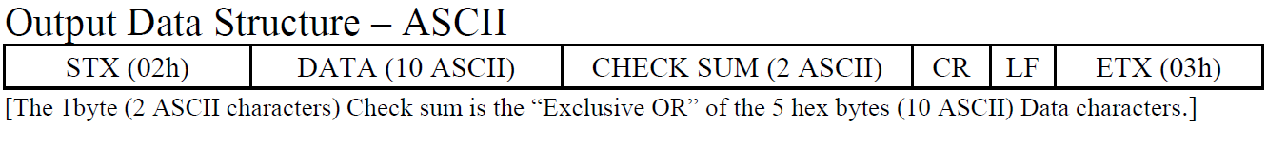
RFID Reader unit (ID-12) documentation
The ID-12 RFID reader supports 3 data formats and two output signal formats.
The Traxster robot configuration uses the ASCII data format and the TTL data (inverted) signal output.
The ID-12 is interfaced with a simple 3-wire connection at the microcontroller end (+Vcc, Gnd and Data).
X

Slide 3

RFID Circuit
The RFID reader device connects to the microcontroller via a single Data output pin. This connects to the microcontroller’s USART RXD input pin (PORT D bit 0).
The RFID reader has a ‘Card Detected’ signal output which is connected to a Yellow LED on the standalone RFID reader for lab use, but is not connected on the Traxster Robot (see dotted line on diagram below).
The RFID ‘circuit’ is connected directly across the pins of the RFID device, such that it is self-contained and connects to the sensor interface board by a single IDC10 cable
+5V logic
supply
Data signal connects to bit 0 (which on the sensor interface board connects to the RXD pin, PD0)
RFID
Connector
(cable part)
2 Reset-BAR
11 Vcc
Pin 0
9 D0
ID-12
RFID
READER
10 3.1KHz Logic
(Card detected)
0V
1 GND
7 F/S
1K Ω
Yellow
LED
Richard Anthony March 2010

Slide 4
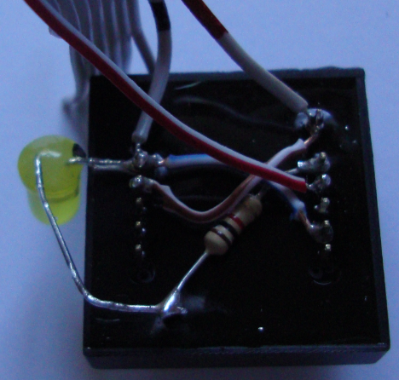
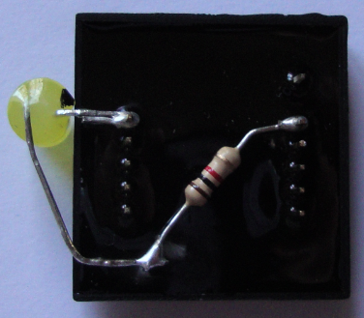
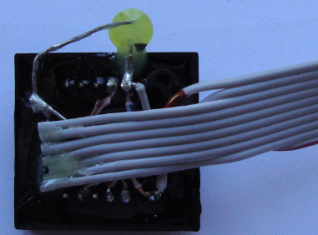
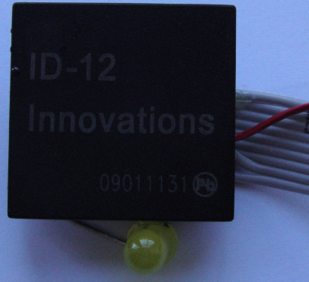
RFID Unit construction

