Slide 1

1
Introduction
2
Task Overview
SUPERMARKET DATA VISUALISATION WITH "R"
3
Item frequency plot
supervisor
Prof. Svetlana Meißner
4
Generate the basket rule and paracoode plot
Presented By
Vikas Jivani (28403)
5
Outcomes & Further business prediction
System Simulation, SS2021
6
Code link & Fiels

Slide 2


Introduction
Vikas Jivani
Programing with R
Information Engineering and Computer Science
Area of Interest: Data analysis and machine learning
Project: Data-analysis & visualization with R
Supermarket data visualization
R plot functionality & further prediction
Date: 19 June 2021

Slide 3

Task overview
Aim : Supermarket data visualizations and further prediction in “R”
Create Transaction data set from CSV
Create an Item Frequency Plot
Task
Generate rule and create the plot for most Frequent Item using paracord method
Generate rule and create the plot for most Frequent Item using paracord method

Slide 4
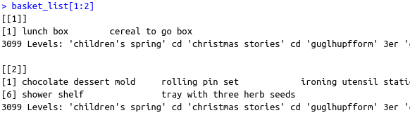
Create transaction data set from csv
Requirement & Installation
R version 3.6 -> For arulesViz library installation
Required library
library(arulesViz)
library(arules)
library(tidyverse)
Transaction data from csv
# Read CSV file from local computer and assign to the data variablr
> data <- read.csv( file ="/home/vikas/Documents/acadamic/system-simulation/data.csv",sep = ";")
# Create Group from basket id for data set
> group_data <- group_by(data,basket_id)
# Make a list of item base on grop set
> basket <- summarise(group_data,count = n(),basket_list = list(article_name))
# Filter data first 25000 basket list analysis
> basket_list <- basket$basket_list[1:25000]
# Convert list in to transaction
> retail_transaction <- as(basket_list,"transactions")

Slide 5
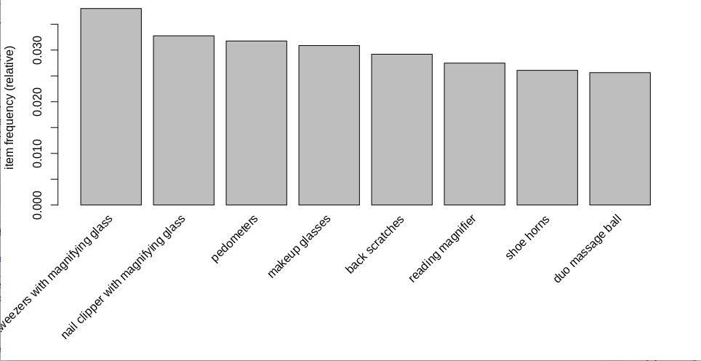
Item frequency plot overview
Transaction data overview
25000 transactions (rows) > (filter from 214,530 row)
2319 items (columns)
Top-8 most frequent item in shopping basket
support of item “Tweezers with magnifying glass” is more than 0.03
more then 3% chance of “Tweezers with magnifying glass” in shopping basket
Identify E-question :
- support = σ{item in set}/ {total Transaction}
Plot generation code
> itemFrequencyPlot(retail_transaction,topN = 8)

Slide 6
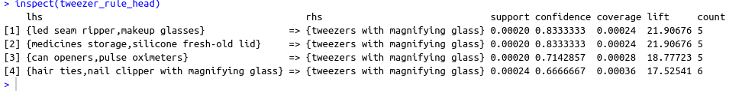
Generate rule & plot for a most frequent item using paracord method
Generate rule with support 0.0002 and confidence 0.66 minimum item is 2 and max 3 from create 54 rule
> basket_rule <- apriori(retail_transaction, parameter = list(support = 0.0002, conf = 0.66, minlen = 2, maxlen = 3))
#filter rule apply on tweezer with magnifing glass
> tweezer_rule <- subset(basket_rule, subset = rhs %in% "tweezers with magnifying glass")
> tweezer_rule_head <- head(sort(tweezer_rule ,by = "lift"),4)
> inspect(tweezer_rule_head)

Slide 7
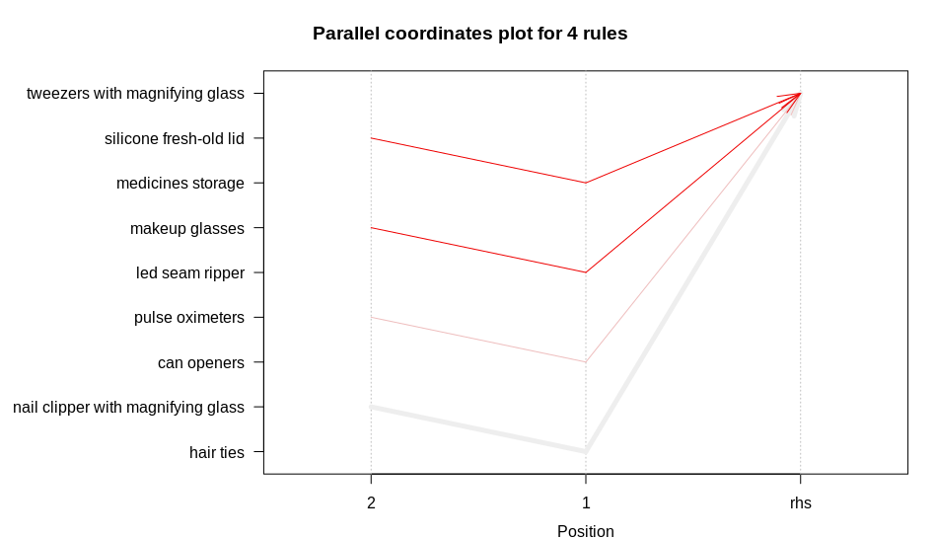
Plot of most frequent item with method paracoord
> plot(tweezer_rule_head,method="paracoord")

Slide 8
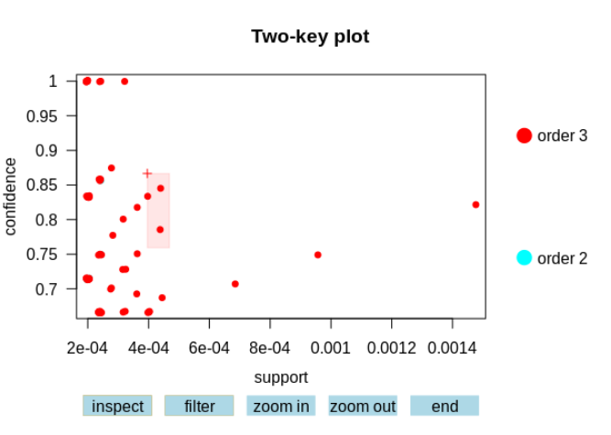

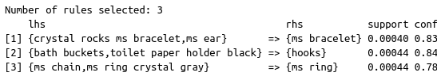
Generate rule for entire basket and create plot with two-key plot method
> plot(basket_rule,method = "two-key plot",interactive = TRUE)
NOTE : Selected data shows the inspect of item list from “Two-key plot” graph

Slide 9
Outcomes & Further Prediction
Outcomes
The item “tweezer with a magnifying glass” and “nail clipper with magnifying glass” both the most frequent items from the same category so these two product keep gathering in shop. For easy to customer.
Further Prediction
Also, identify which category of the item should keep together
Which item should close to selling due to very low frequency of buy.
How to arrange section of item with daily usage

Slide 10
Project and Code Link
The project code push on GitHub repository link has been given below
Code Link
GitHub: https://github.com/vji-axelor/simulation
Related Fiels
data.csv: Supermarket transaction data records
documents.pdf: The brief description about code and project
system-simulation.r : R code with comments
presentation.pdf : Presentation with pdf format
Simulation.pptx : Presentation with power-point format

Slide 11

Thank You...!
M-IE_1.01 System Simulation, SS2021

