Slide 1

Predict & Approach Risk variables for Cardiac patients
DSC530 FINAL PROJECT
AUTHOR: Venkat JAGADEESH JAMPANI
Date: JUN 04, 2022

Slide 2
Data Analysis
13 parameters in the Kaggle Heart failures clinical dataset
Effect of below parameters is analyzed:
Age of Patient
CPK Levels(creatine phosphokinase)
Ejection Fraction
Platelets
Serum Creatinine
Serum Sodium

Slide 3
Attributes Summary
Attribute Name | Details about Attribute | Scale/Measurement | Range Of Values
Age | Age of the patient | Years | [40,..., 95]
Anaemia | Decrease of red blood cells or hemoglobin | Boolean | 0, 1
High blood pressure | If a patient has hypertension | Boolean | 0, 1
Creatinine phosphokinase-(CPK) | Level of the CPK enzyme in the blood | mcg/L | [23,..., 7861]
Diabetes | If the patient has diabetes | Boolean | 0, 1
Ejection fraction | Percentage of blood leaving | Percentage | [14,..., 80]
 | the heart at each contraction
Sex | Woman or man | Binary | 0, 1
Platelets | Platelets in the blood | kiloplatelets/mL | [25.01,..., 850.00]
Serum creatinine | Level of creatinine in the blood | mg/dL | [0.50,..., 9.40]
Serum sodium | Level of sodium in the blood | mEq/L | [114,..., 148]
Smoking | If the patient smokes | Boolean | 0, 1
Time | Follow-up period | Days | [4,...,285]
(target) death event | If the patient died during the follow-up period | Boolean | 0, 1

Slide 4
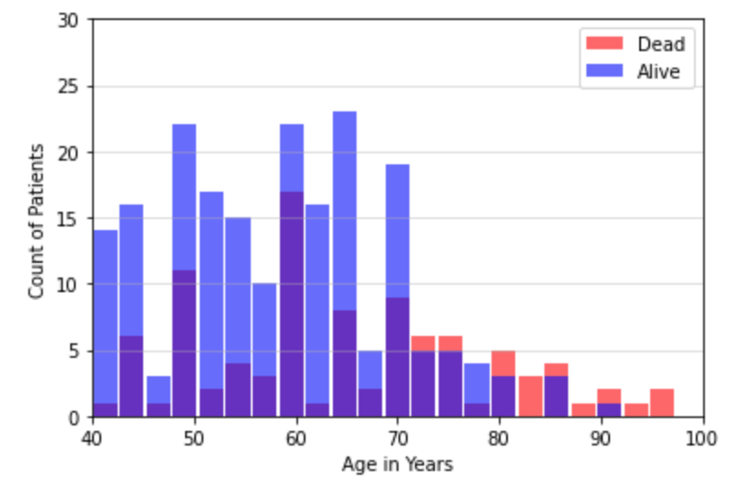
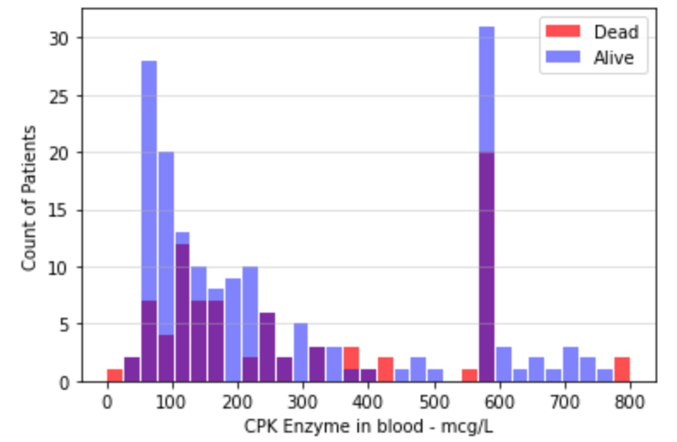
Histogram Plots

Slide 5
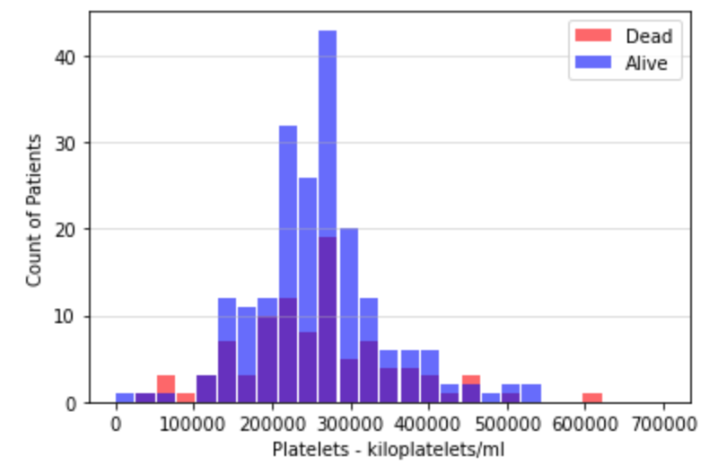
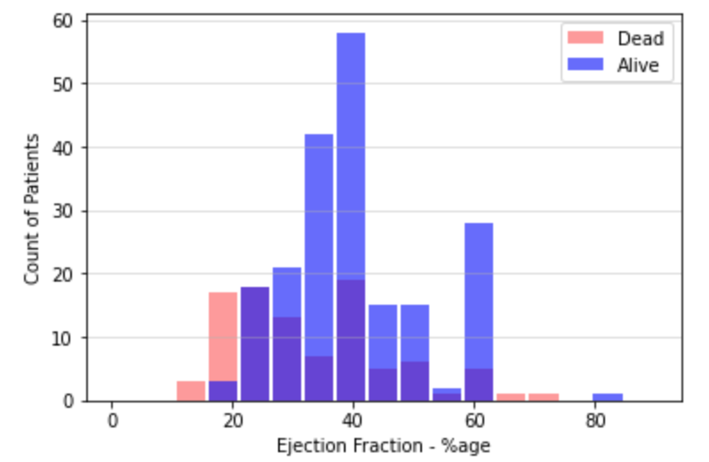
Histogram Plots

Slide 6
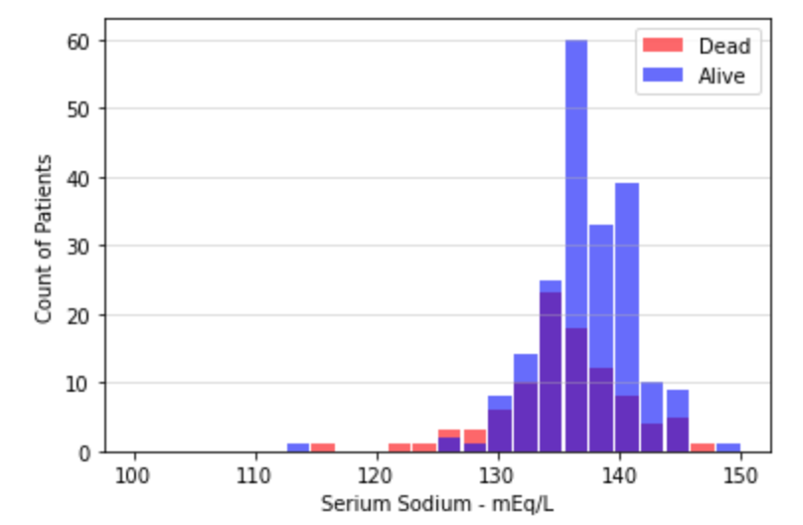
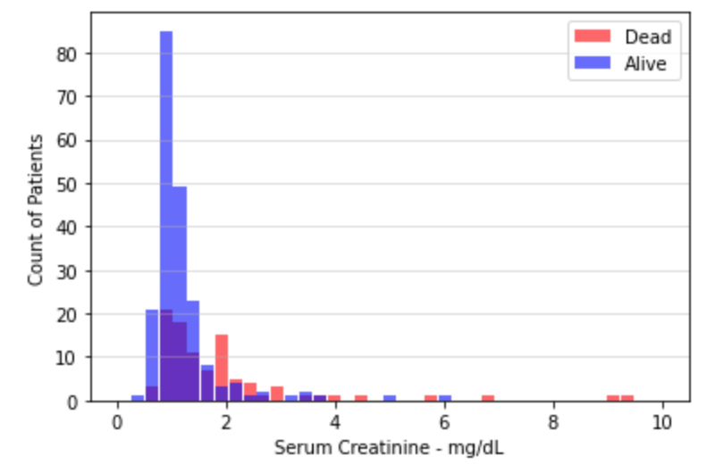
Histogram Plots

Slide 7

Histogram Analysis
From the histograms, we may be able to identify the pattern but its not clearly visible.
Age effects the mortality. With the increase in the age the mortality risk increases.
Lower Ejection fraction increases the risk.
Higher serum creatinine levels also increase the risk.
Lower serum sodium levels will increase the risk.
We also see some outliers from the histograms, for Platelet counts, serum creatinine, ejection fraction & serum sodium which suggest things otherwise. If they have much effect on the prediction model, then we may try to resample the data. We can't do much removals in this dataset as the sample size is small.

Slide 8
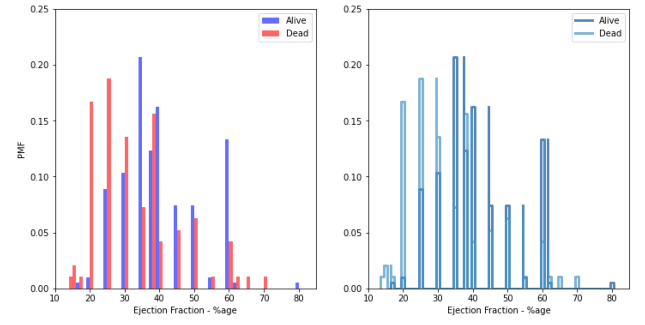
PMF: Ejection Fraction

Slide 9
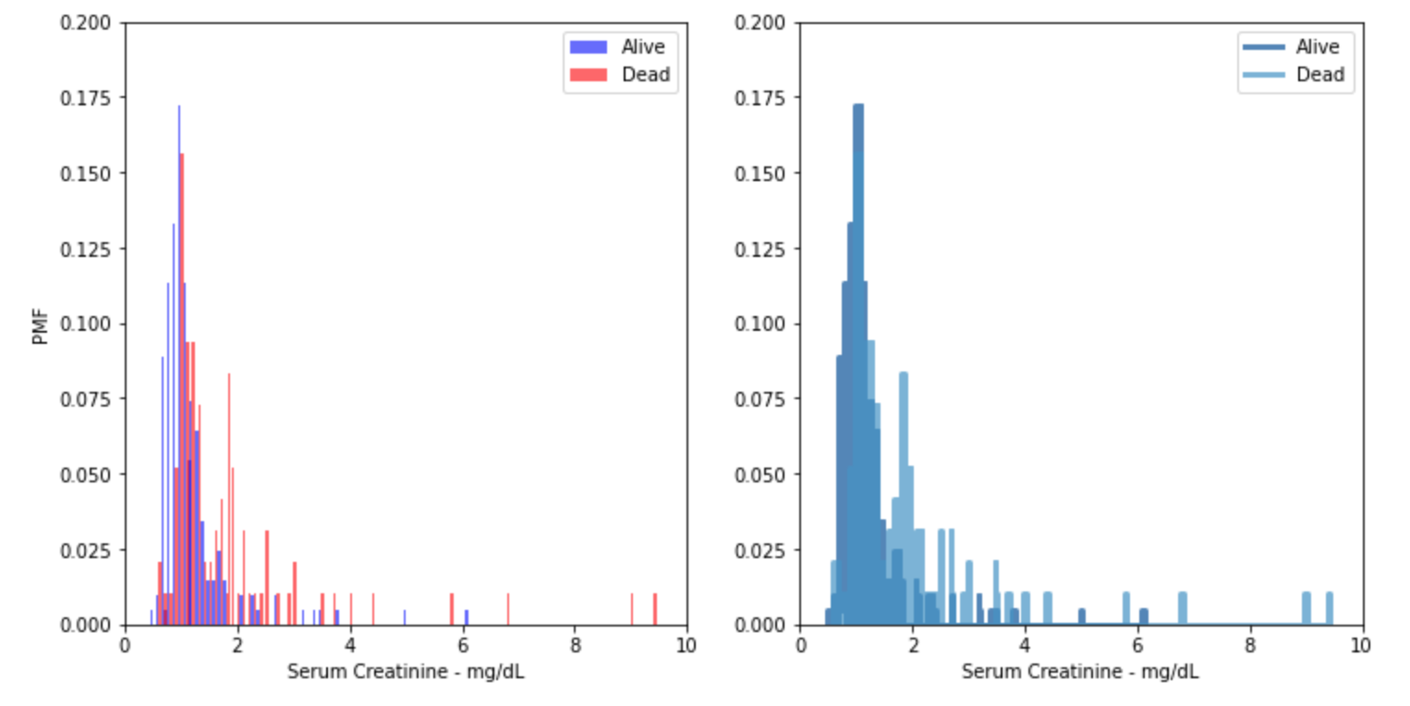
PMF: Serum Creatinine

Slide 10
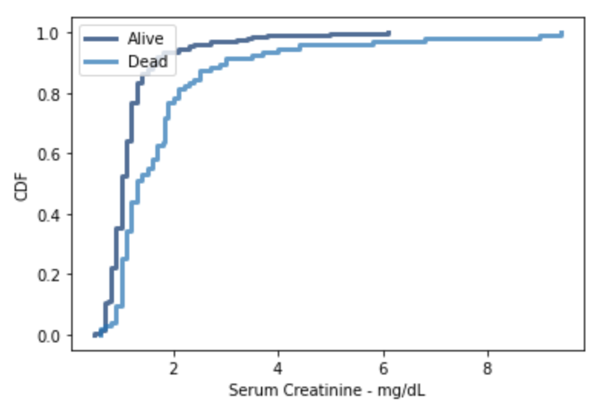
CDF: Serum Creatinine
From the CDF we observe that for both Alive and Dead Patients, the max of the population lies between 1 & 2
As per healthline.com: “In general, however, normal creatinine levels range from 0.9 to 1.3 mg/dL in men and 0.6 to 1.1 mg/dL in women who are 18 to 60 years old. Normal levels are roughly the same for people over 60. High serum creatinine levels in the blood indicate that the kidneys aren't functioning properly.”
Our data model also seems to reflect the same opinion.

Slide 11
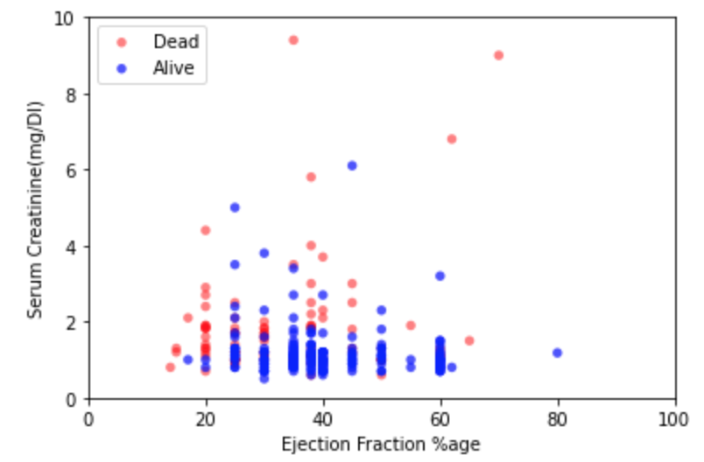
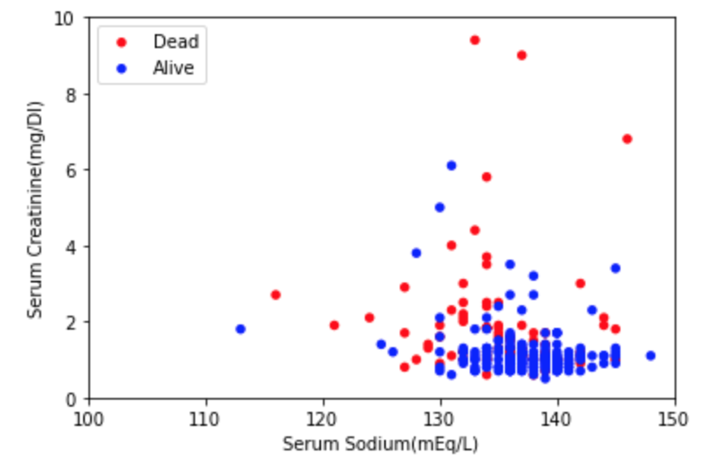
Scatter Plots
The Covariance and Correlation Coefficient values seems to have very weak relation between the variables(Ejection Fraction vs Serum Creatinine & Serum Creatinine vs Serum Sodium). The correlation coefficient values for both dead and alive data show weak correlation. The correlation coefficients in all the scenarios remained <22% approx.
Hence the parameters don't seem to be correlated

Slide 12
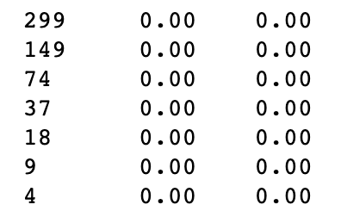
Hypothesis Test: Mean Difference
Ejection Fraction is lower for Dead vs Alive Patients.
Serum Creatinine is higher for Dead vs Alive Patients.
We ran the hypothesis testing using mean diff as the test statistic and results are shown with different sample sizes.
Conclusion:
The tests for test1, test2 are positive throughout. However this pattern may change if we could get large datasets. This is my assumption as 299 is pretty small number of patients that we are using for this hypothesis. Still based on our data, we may say our hypothesis is right.

Slide 13
References
https://www.healthline.com/health/creatinine-blood#results
https://www.mayoclinic.org/diseases-conditions/heart-disease/symptoms-causes/syc-20353118#:~:text=The%20term%20%22heart%20disease%22%20is,pain%20(angina)%20or%20stroke.
https://www.kaggle.com/andrewmvd/heart-failure-clinical-data
Discover Statistics Using R, Andy Field | Jeremy Miles | Zoe Field
R for Everyone, Jared P Lander
Think Stats, Allen B Downey

