Slide 1
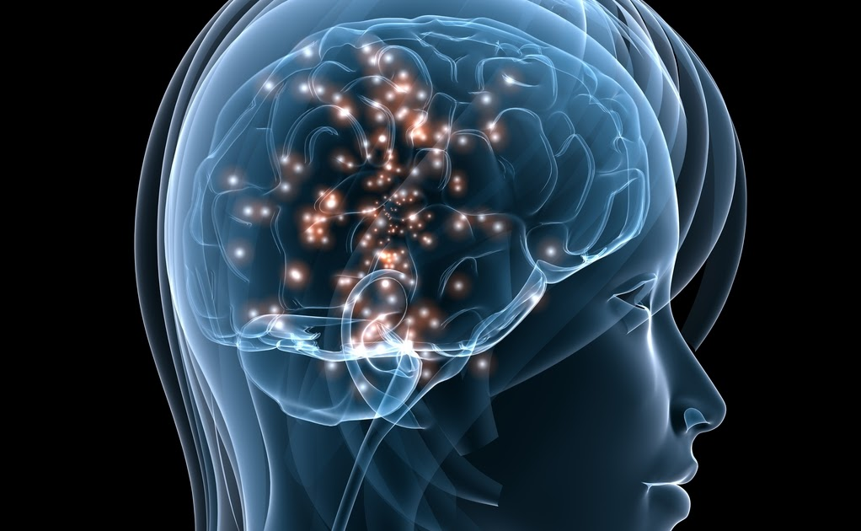

Brain Stroke - Prediction
Venkat Jagadeesh Jampani
Bellevue University
DSC-630
This Photo by Unknown author is licensed under CC BY-SA-NC.

Slide 2
Introduction
• Brain Stroke causes to the following reasons : 1. A blocked artery or leaking or bursting of a blood vessel (hemorrhagic stroke).
2. A temporary disruption of blood flow to the brain
• In the United States, every 40 secs someone has a stroke. Every 3.5 minutes, someone dies of a stroke.
• Every year, more than 795,000 people in the United States have a stroke. About 610,000 of these are first or new strokes.
• Stroke-related costs in the United States came to nearly $53 billion between 2017 and 2018.
• Stroke is a leading cause of serious long-term disability. Stroke reduces mobility in more than half of stroke survivors age 65 and older.

Slide 3
Facts – Brain Stroke
• Risk of having a first stroke is nearly twice as high for Blacks as for Whites, and Blacks have the highest rate of death due to stroke.
• Stroke risk increases with age, but strokes can—and do—occur at any age.
• In 2014, 38% of people hospitalized for stroke were less than 65 years old.³
• High blood pressure, high cholesterol, smoking, obesity, and diabetes are leading causes of stroke.
• Patients who arrive at the emergency room within 3 hours of their first symptoms often have less disability 3 months after a stroke than those who received delayed care.

Slide 4
Problem statement - Motivation
Objective of this project is to predict the certainty of a person to have this brain stroke based on various parameters such as age, gender, healthy habits, etc. so that this disease can be predicted before it becomes critical and be treated with normal measures and to save the lives.
From the existing vast pool of machine learning algorithms, we chose few methods to predict the stroke accurately.

Slide 5
Models – methods of prediction
•K- Nearest Neighbor (K-NN)
• Support Vector Machine (SVM)
• Logistic Regression
• Decision Tree
• Random Forest
• Gaussian NB
• Bernoulli NB
The mentioned predictive methods are used for prediction:

Slide 6
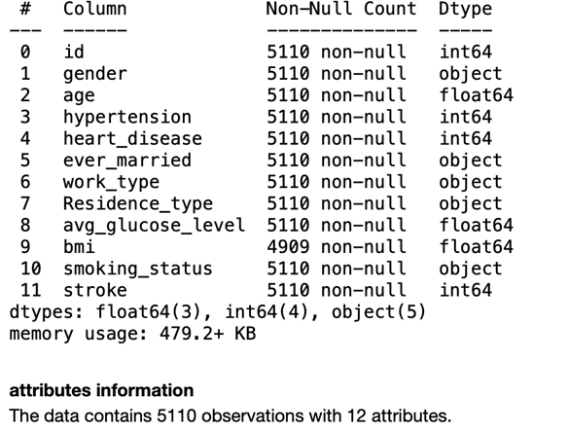
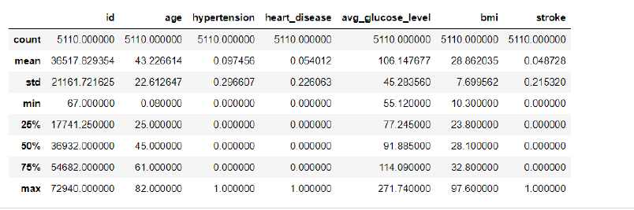
DATA SET
Data is sourced from kaggle.com

Slide 7
Brain Stroke – Risk factors
•Age
•Sex
•Race or Ethnicity
•High Blood Pressure/Hypertension
•High Cholesterol
•Heart Disease
•Diabetes
•Unhealthy diet/Physical inactivity
•Obesity
•Tobacco use
•Alcohol Use

Slide 8
Data Set - Features
Categorical FEATURES
Numerical FEATURES
Gender
Hypertension
Marital Status
Smoking status
Age
BMI
Average Glucose level

Slide 9
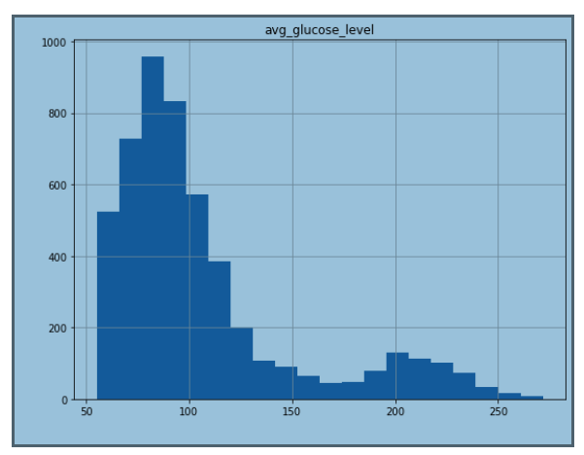
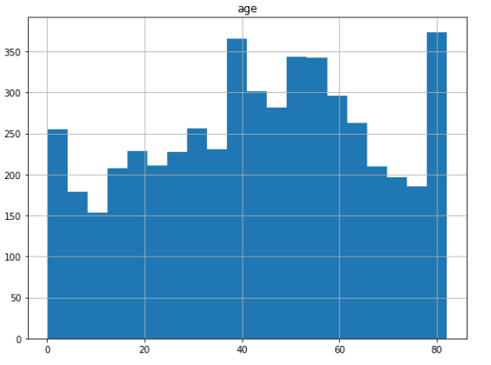
Understanding Data Distributions

Slide 10
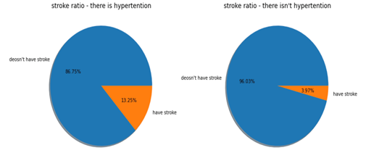
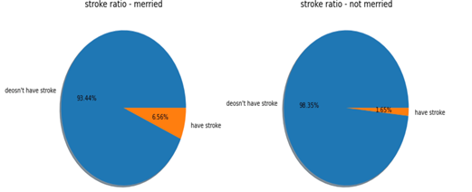
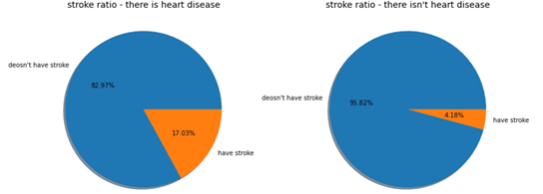
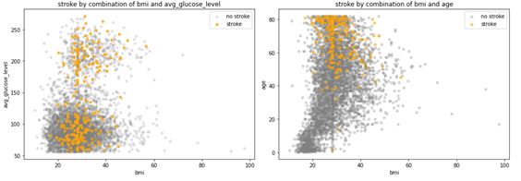
EDA- Visualizations

Slide 11
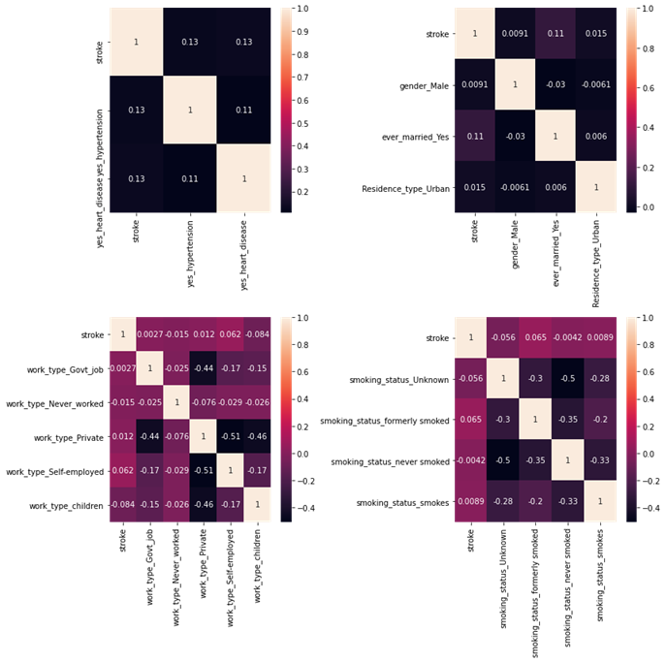
Heat Map for Correlation

Slide 12
Summary
Patterns and correlation conclusion:
Following attributes have main correlations with stroke (>0.10):
age
avg glucose level
hypertension
heart disease background
ever married
Stroke patterns:
The older a person is, the more likely to have a stroke.
Blood glucose level is dangerous at both edges (the safe zone is between 120 to 180 approximately.
Background of heart disease increases the risk of stroke by 13%.
Hypertension increases the risk of stroke by 10%.
1/2 of the stroke cases are around 30 BMI.
combination of BMI and AGE is a very powerful factor to predict stroke (high age, around 30 BMI).
In Dataset, 95% of data represents no stroke event and only 5% represents a stroke event. Part of the modeling, I will explore methods to smooth imbalance of data.

Slide 13
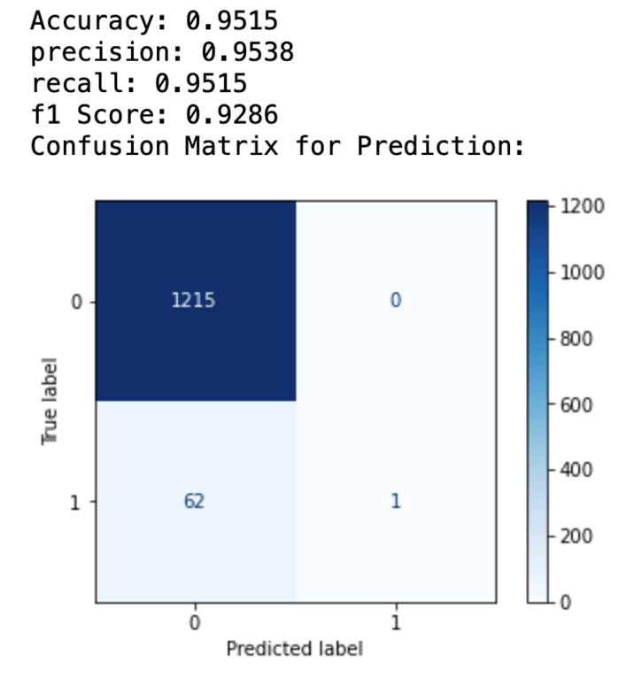
KNN - Before

Slide 14
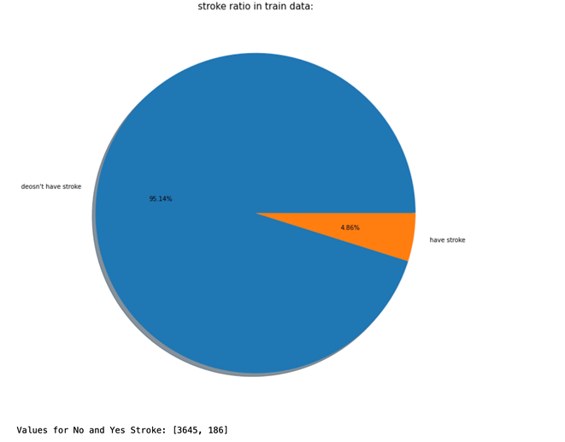
Class Re-balance -Before

Slide 15
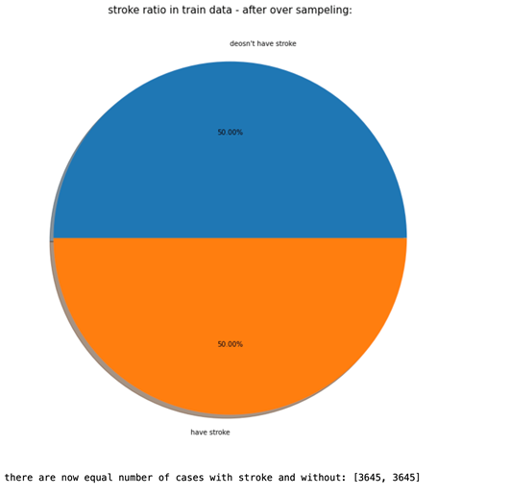
Train After SMOTE

Slide 16
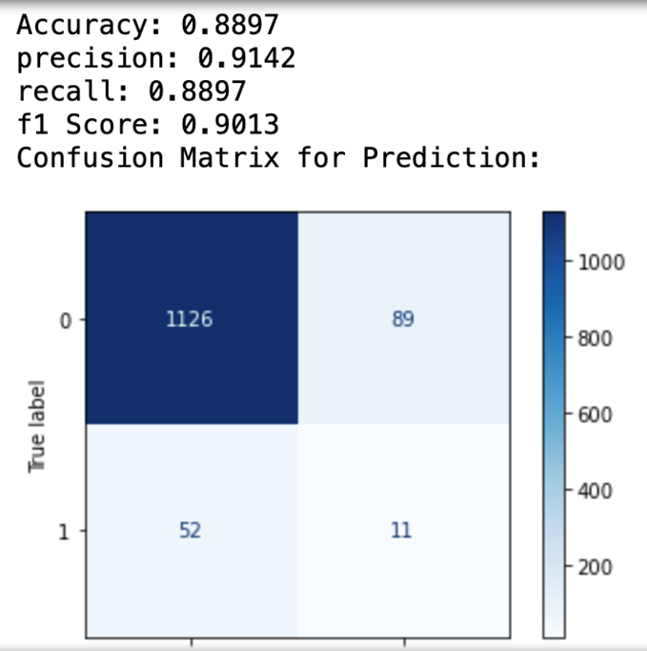
KNN - After

Slide 17
Conclusion
Input Data classification is key for model training.
KNN Classifier has best balance of Accuracy and predictions.
Should attempt multiple models for training to get balanced data.
Model Can be deployed but, should consider looking for more features and balanced train data set.

Slide 18
References
Chris Albon. (2018). Machine Learning with Python Cookbook Practical Solutions from Preprocessing to Deep Learning.
Stroke Prediction Dataset | Kaggle. https://www.kaggle.com/fedesoriano/stroke-prediction-dataset
Stroke background information by CDC from https://www.cdc.gov/stroke/about.htm
Raj, S. (2020). How to Evaluate the Performance of Your Machine Learning Model - KDnuggets. https://www.kdnuggets.com/2020/09/performance-machine-learning-model.html
scikit-learn. (2021). API Reference — scikit-learn 1.0.1 documentation. https://scikit-learn.org/stable/modules/classes.html#module-sklearn.metrics
SMOTE - https://machinelearningmastery.com/smote-oversampling-for-imbalanced-classification/
Siegel, E. (2013). Predictive analytics: The power to predict who will click, buy, lie, or die.John Wiley & Sons.

Slide 19

Thank you

