Slide 1
Big Data
Vijay Singh Kholiya
B.Tech CSE
11603123
K1642B50

Slide 2
Technology Learnt:
Hadoop
Hive
Pig
Sqoop
MapReduce
HBase

Slide 3
What’s Big Data ?
‘Big Data’ is similar to ‘small data’, but bigger in size, more complex data sets.
These data sets are so voluminous that traditional data processing software just can’t manage them.
But these massive volumes of data can be used to address business problems you wouldn’t have been able to tackle before.
an aim to solve new problems or old problems in a better way.

Slide 4
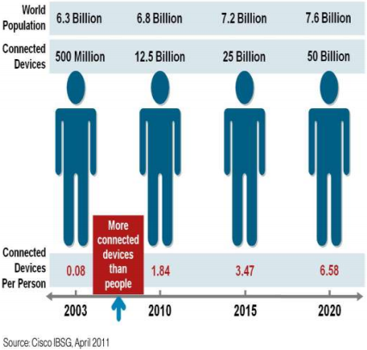
Why Big Data ?
FB generates 10TB daily
Twitter generates 7TB of data Daily
IBM claims 90% of today’s stored data was generated in just the last two years.

Slide 5
4 V’s by IBM
1. Volume
2. Velocity
3. Variety
4. Veracity

Slide 6
Types of Data
1. Structured data:
Data which is represented in a tabular format
E.g.: Databases
2. Semi-structured data:
Data which does not have a formal data model
E.g.: XML files
3. Unstructured data:
Data which does not have a pre-defined data model
E.g.: Text files

Slide 7
What is Hadoop ?
Hadoop is an open source, Java-based programming framework .
It supports the processing and storage of extremely large data sets in a distributed computing environment.
It is part of the Apache project sponsored by the Apache Software Foundation.
Hadoop splits files into large blocks and distributes them across nodes in a cluster.

Slide 8
Core Components of Hadoop
Hadoop Distributed File System (HDFS) – a distributed file-system that stores data on commodity machines, providing very high bandwidth across the cluster.
Hadoop MapReduce – an implementation of the MapReduce programming model for large scale data processing.

Slide 9
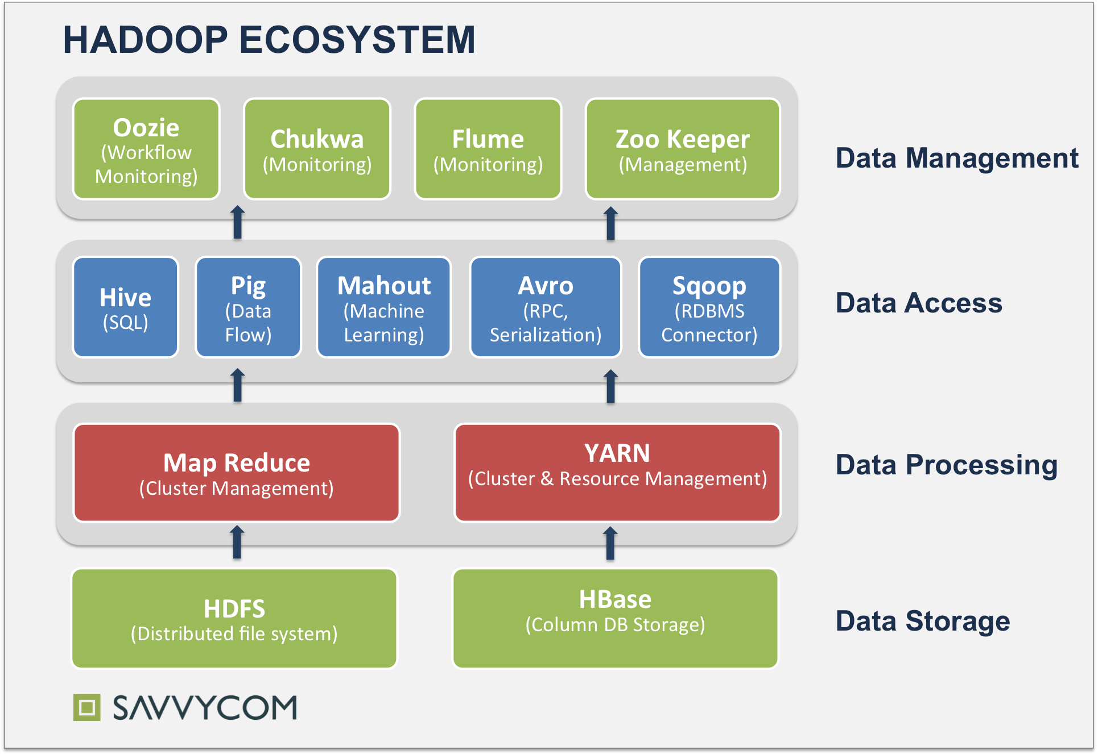
Hadoop Ecosystem

Slide 10
HDFS – Core Components
Hadoop File System was developed using distributed file system design.
It is run on commodity hardware.
Unlike other distributed systems, HDFS is highly fault tolerant and designed using low-cost hardware.
HDFS holds very large amount of data and provides easier access.
To store such huge data, the files are stored across multiple machines.

Slide 11
NameNode
NameNode can be considered as a master of the system. It maintains the file system tree and the metadata for all the files and directories present in the system.
It is the master daemon that maintains and manages the DataNodes (slave nodes)
It records the metadata of all the files stored in the cluster, e.g. The location of blocks stored, the size of the files, permissions, hierarchy, etc.

Slide 12
DataNode
Datanodes perform read-write operations on the file systems, as per client request.
They also perform operations such as block creation, deletion, and replication according to the instructions of the namenode.

Slide 13
Hive
Hive is a data warehouse infrastructure tool to process structured data in Hadoop(used for structure and semi structured data analysis and processing).
Initially Hive was developed by Facebook, later the Apache Software Foundation took it up and developed it further as an open source under the name Apache Hive.
Hive is not a relational database.

Slide 14
Features of Hive
It stores schema in a database and processed data into HDFS.
It provides SQL type language for querying called HiveQL or HQL.
It is familiar, fast, scalable, and extensible.

Slide 15
Pig
Pig is a high level scripting language that is used with Apache Hadoop.
Pig enables data workers to write complex data transformations without knowing Java.
Pig’s simple SQL-like scripting language is called Pig Latin, and appeals to developers already familiar with scripting languages and SQL.
Pig scripts are translated into a series of MapReduce jobs that are run on the Apache Hadoop cluster.

Slide 16
Features of Pig
Rich set of operators
Ease of Programming
Optimization opportunities
User Define Functions (UDF’s)
All types of data handling

Slide 17
Sqoop
Sqoop is a tool designed to transfer data between Hadoop and relational database servers.
It is used to import data from relational databases such as MySQL, Oracle to Hadoop HDFS, and export from Hadoop file system to relational databases.
Sqoop occupies a place in the Hadoop ecosystem to provide feasible interaction between relational database server and Hadoop’s HDFS.

Slide 18
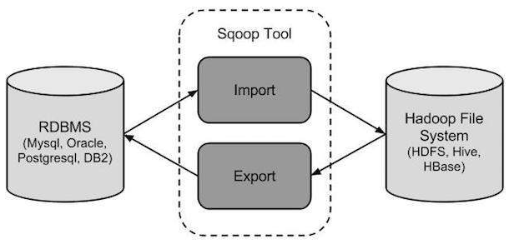
How Sqoop Works ?

Slide 19
MapReduce
MapReduce is a framework using which we can write applications to process huge amounts of data, in parallel, on large clusters of commodity hardware in a reliable manner.
The MapReduce algorithm contains two important tasks, namely Map and Reduce.
MapReduce is useful for batch processing on terabytes or petabytes of data stored in Apache Hadoop.

Slide 20
MapReduce Benefits
Simplicity: Programmers can write applications in any language such as Java, C++ or Python. Java is the most preferred language.
On the fly Scalability – We can add servers to increase processing power depending on our requirement and our MapReduce code remains untouched.
Speed: Parallel processing means that Hadoop can take problems that used to take days to solve and solve them in hours or minutes.
Handling failover: MapReduce takes care of failures. If a machine with one copy of the data is unavailable, another machine has a copy of the same key/value pair, which can be used to solve the same sub-task. The JobTracker keeps track of it all.

Slide 21
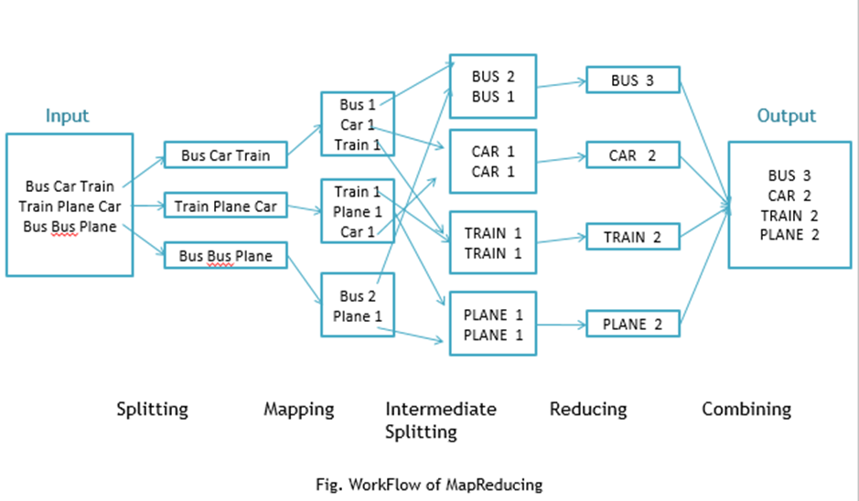
Workflow of MapReduce

Slide 22
HBase
HBase is a data model that is similar to Google’s big table designed to provide quick random access to huge amounts of structured data.
HBase is a distributed column-oriented database built on top of the Hadoop file system.
HBase internally uses Hash tables and provides random access, and it stores the data in indexed HDFS files for faster lookups.

Slide 23
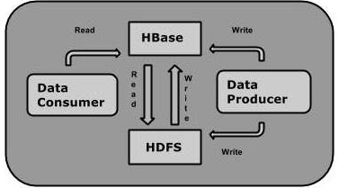
How it works ?
One can store the data in HDFS either directly or through HBase.
Data consumer reads/accesses the data in HDFS randomly using HBase.
HBase sits on top of the Hadoop File System and provides read and write access.

Slide 24
Thank You

