Slide 1

TERM PROJECT
IndiaClimate: An Interactive Platform for Historical Weather Data Analysis, Visualization, and Forecasting
Student Name :
Nitin Vijay N
Student ID :
23035010571
Email ID :
n.nitin@op.iitg.ac.in
Indian Institute of Technology Guwahati
Programme :
BSc. (Hons.) Data Science & AI
Course Code :
DA377
BSc. (Hons.) Data Science & Artificial Intelligence
Online Degree Programme
Course Name :
Term Project - I
Trimester :
VII

Slide 2
Problem Statement
0:30 – 1:30
What problem did we solve?
No integrated platform
Fragmented data sources
No forecasting layer
Tools are either global in scope, behind paywalls, or provide raw CSV downloads with no analysis — no unified open-source India platform existed.
IMD 115-year rainfall records and modern daily weather data existed in silos. No pipeline connected them for joint analysis.
No publicly available India-specific platform combined historical analysis with probabilistic 90-day city-level forecasting.
Why it matters
India's 1.4 billion people face agriculture risk, heat stress, and flood threats directly tied to weather variability. A reproducible, open-source platform that collects, cleans, analyses, visualizes, and forecasts Indian weather data is both scientifically valuable and practically impactful for students, researchers, and policymakers.

Slide 3
Tools & Dataset
1:30 – 2:30
Tech Stack
Datasets
Python 3.12
pandas + numpy
Open-Meteo Historical API
Core language for all phases
Data cleaning & processing
8 cities · 2010–2023 · Daily resolution
40,904 rows
Temp, precipitation, humidity, wind speed
SQLite
Streamlit + Plotly
IMD Subdivision Rainfall (data.gov.in)
Relational DB · 3 tables · 45k rows
Interactive web dashboard
36 subdivisions · 1901–2015 · Monthly
4,116 rows
115 years of data — drought/flood analysis
Folium
Prophet (Facebook)
5 geographic HTML maps
90-day ML forecasting
District Rainfall Normals (IMD)
641 districts · 35 states · Averages
641 rows
Baseline for anomaly detection
Matplotlib + Seaborn
scipy
28 static analysis charts
Pearson correlation · regression
Total: 45,661 records across 3 database tables

Slide 4
Code Walkthrough
2:30 – 5:00
9-Phase Pipeline
1
Data Collection
2
Data Cleaning
3
Database Design
fetch_openmeteo.py · retry logic · 8 cities API
clean_data.py · outlier cap · season labels
create_database.py · 3 tables · FK constraints
4
EDA
5
Statistical Analysis
6
Streamlit Dashboard
eda.py · 6 charts · temperature + monsoon
statistical_analysis.py · correlation · heatwave
app.py · 4 tabs · 11 Plotly charts · CSV export
7
Folium Maps
8
Forecasting
9
Report + GitHub
create_maps.py · 5 HTML maps · layer toggle
forecasting.py · 16 Prophet models · 90 days
IEEE report · github.com/vjnitin312/da377

Slide 5
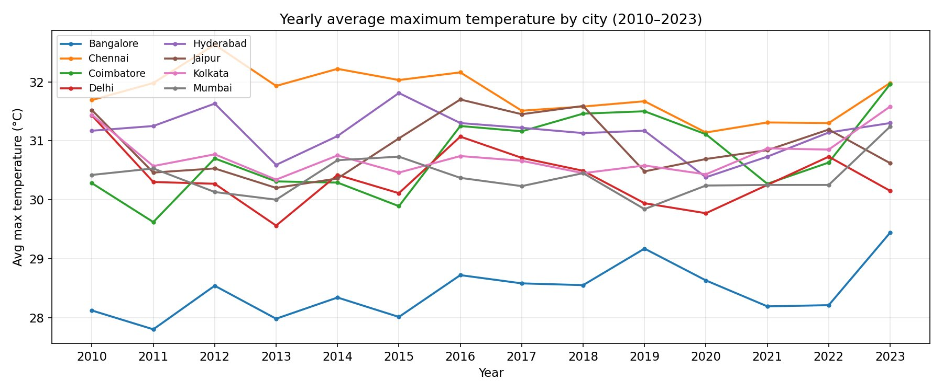
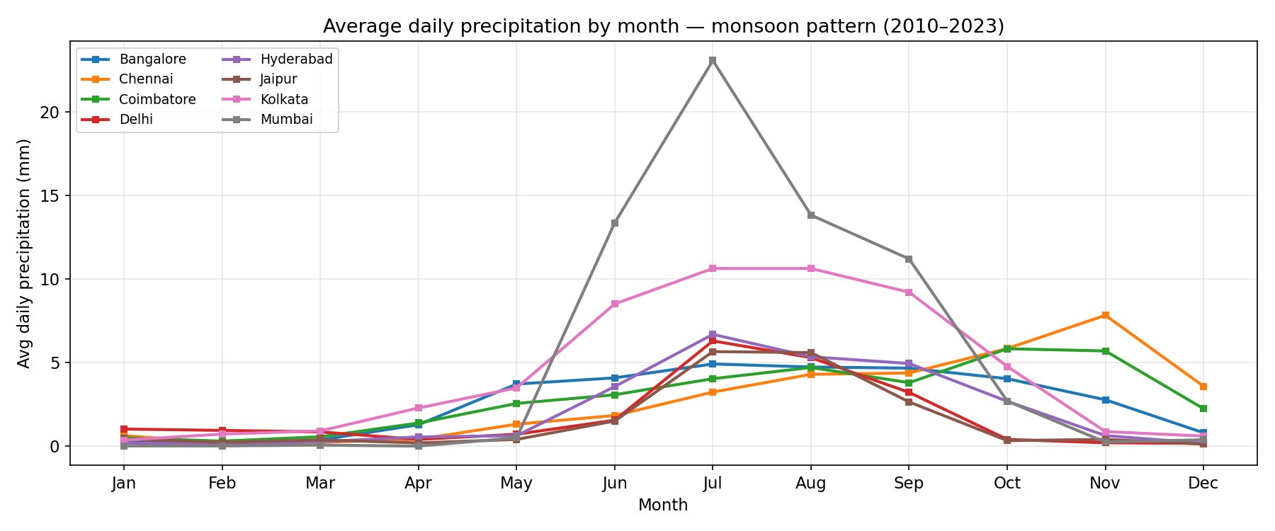
Results & Outputs — Temperature & Monsoon
5:00 – 7:30
31.79°C
28.45°C
40,904
14 years
Chennai · hottest city
Bangalore · coolest city
Daily records collected
2010 – 2023 coverage
Yearly Avg Max Temperature by City
Monthly Rainfall — Monsoon Pattern
Key insight: Mumbai peaks at 23 mm/day in July (Western Ghats orographic effect). Chennai & Coimbatore follow the Northeast Monsoon — onset August, peak November — opposite to all other cities.

Slide 6
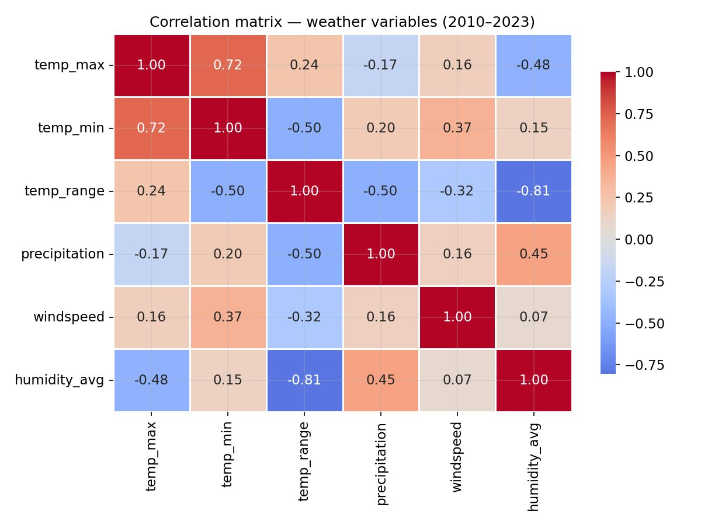
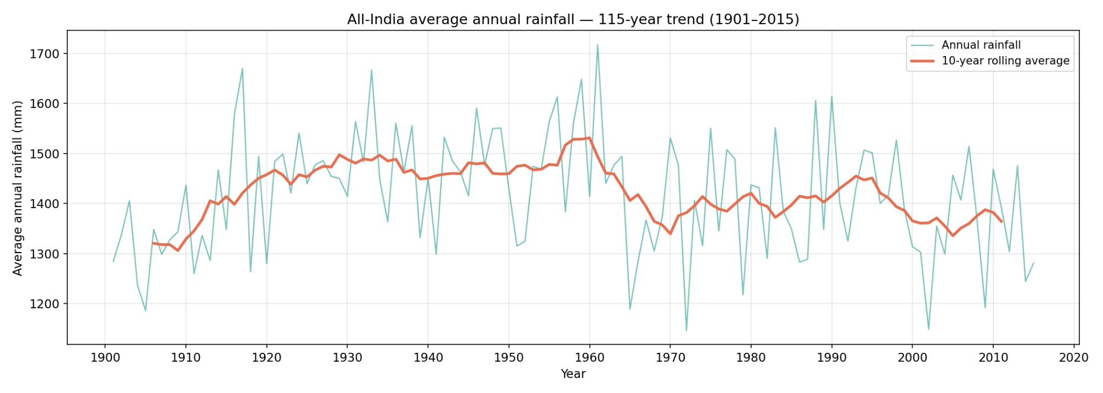
Results & Outputs — Statistical Analysis
5:00 – 7:30
Top correlations
Pearson Correlation Matrix
-0.81
temp_range ↔ humidity
Dominant signal: humid days shrink day–night temperature gap.
+0.72
temp_max ↔ temp_min
Shared regional atmospheric forcing across all 8 cities.
+0.45
precipitation ↔ humidity
Higher humidity precedes rainfall — physically expected.
115-Year All-India Rainfall Trend (1901–2015)

Slide 7
Live Demo — Streamlit Dashboard & Folium Maps
5:00 – 7:30
Streamlit Dashboard — localhost:8501
5 Interactive Folium Maps
Tab 1
Temperature
City Climate Markers
Yearly trends · seasonal breakdown · heatwave detector
Click any city → popup with full climate stats card
Temperature Bubble Map
Tab 2
Rainfall
Bubble size = avg temp · color = hot/warm/cool scale
Monsoon pattern · 115-year trend · decade bar chart
Rainfall Bubble Map
Climate Stats
Bubble size = avg daily rainfall · Mumbai dominates
Tab 3
Correlation heatmap · humidity scatter · extreme rain
Heatwave Risk Map
Dark tile layer · red circles sized by heatwave count
Tab 4
Raw Data
Combined Layer Map
Full table · live filters · CSV download button
Toggle temperature heatmap, rainfall bubbles, markers
Run: streamlit run app.py · Maps in: maps/01_city_climate_markers.html · github.com/vjnitin312/da377

Slide 8
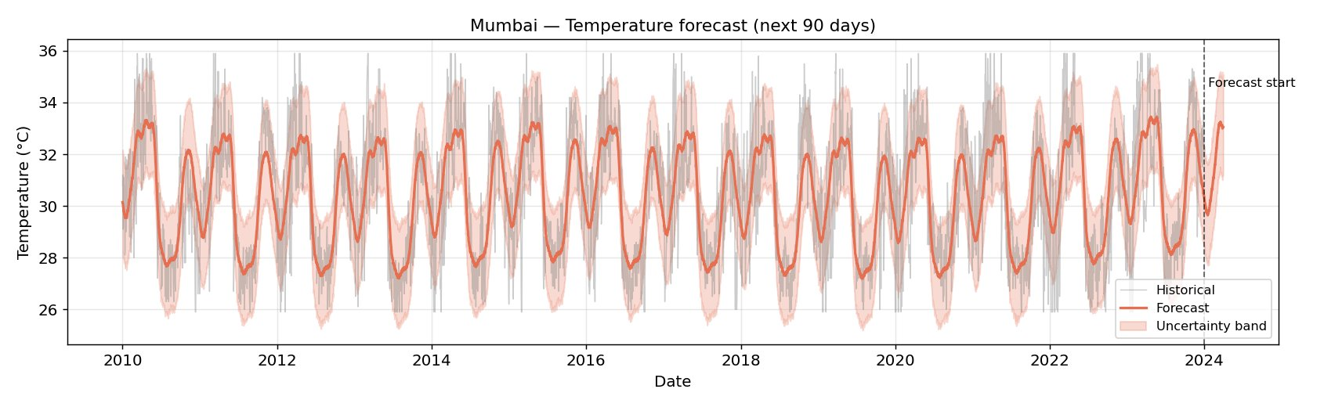
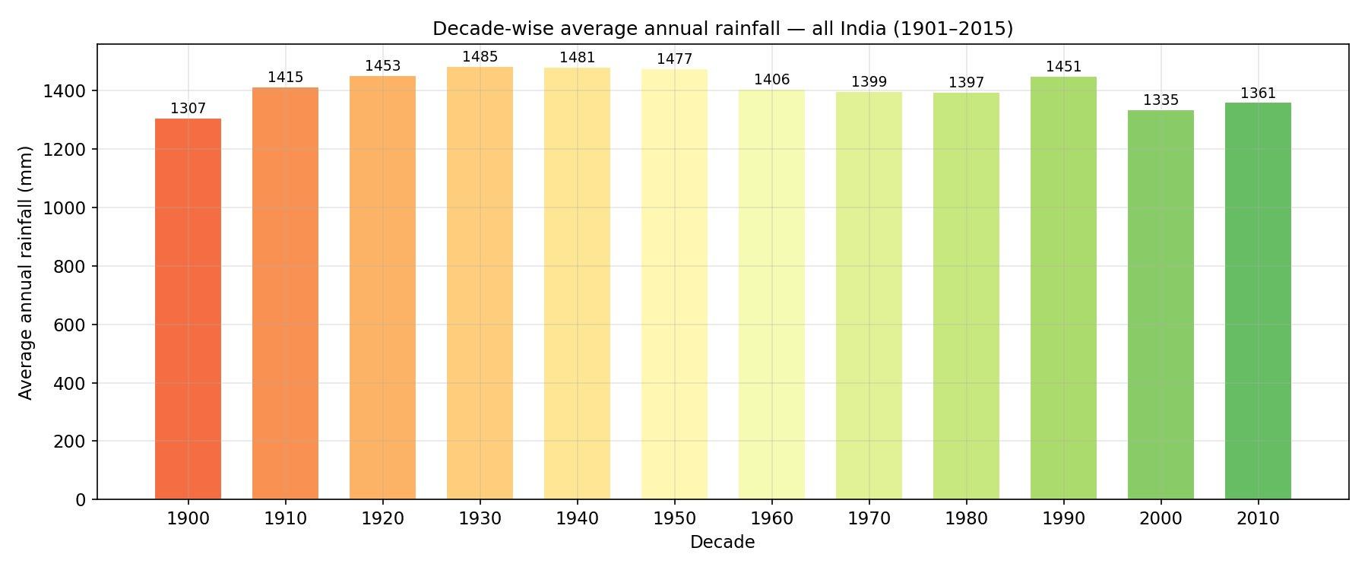
Evaluation Metrics — What the Numbers Mean
7:30 – 9:00
Prophet uncertainty bands · Heatwave thresholds · Monsoon onset index · Decade-wise rainfall
Mumbai — 90-Day Temperature Forecast
How to interpret
±2–4°C
Prophet Uncertainty Band
Continental cities (Delhi, Jaipur): tight band → reliable seasonal pattern. Coastal (Mumbai): wider ±4–6°C due to sea influence.
41.1°C
Heatwave Threshold (P₉₅)
is Delhi threshold. Bangalore: 34.1°C. Mumbai: 54 heatwave days in 2023 — highest single-year reading in 14 years.
Decade-wise All-India Rainfall
> 1.5×
Monsoon Onset Index
Monthly ÷ annual daily avg. Chennai onset: August (NE monsoon). All other cities: June–July (SW monsoon).
-0.31mm/yr
115-Year Regression Slope
p = 0.47 — not statistically significant individually. But decade table clearly shows 1930s peak (1,485mm) declining to 1,335mm in 2000s.

Slide 9
Wrap Up
Summary · Key Learnings · Future Scope
3 Scientific Conclusions
1
Humidity is the dominant modulator of diurnal temperature range across Indian cities (r = −0.81 with temp_range).
2
The dual monsoon system leaves a statistically detectable fingerprint — discoverable from raw data alone, without domain encoding.
3
India's wettest decade was the 1930s (1,485mm avg); a sustained post-1960 declining trend is visible in the rolling average.
Future Scope
→
Extend to all 641 districts
→
ENSO & IOD regressors in Prophet
using gridded ERA5 for spatial interpolation across India
to improve seasonal forecast skill beyond 30 days
→
Deploy on Streamlit Cloud
→
Post-2023 live data integration
public access — no local installation required
real-time updates from IMD station observations
github.com/vjnitin312/da377 · n.nitin@op.iitg.ac.in · Nitin Vijay N | 23035010571 | DA377 | Trimester VII

