Slide 1

TERM PROJECT
Phoneme Distribution Across Languages: Analysis, Geographic Patterns, and Clustering
Student Name :
Nitin Vijay N
Student ID :
23035010571
Email ID :
n.nitin@op.iitg.ac.in
Indian Institute of Technology Guwahati
Programme :
BSc. (Hons.) Data Science & AI
Course Code :
DA378
BSc. (Hons.) Data Science & Artificial Intelligence
Online Degree Programme
Course Name :
Term Project - II
Trimester :
IX
https://youtu.be/piv-lchv_U0

Slide 2
Problem Statement
0:30 – 1:30
What problem did we solve?
No large-scale empirical test
Scattered phoneme data
No geographic ML analysis
Greenberg (1963) proposed universals on just 30 languages. No computational pipeline had tested them at scale on 2,000+ languages with modern data.
PHOIBLE v2.0 aggregates 3,000+ inventories but no analysis pipeline existed to compute cross-linguistic frequencies, pairwise statistics, and geographic groupings.
No study had applied unsupervised K-Means Clustering to test whether phoneme data alone can recover the world’s geographic language regions.
Why it matters
Human speech sounds follow universal patterns shaped by biology and perception. A pipeline that analyses 2,176 languages, computes pairwise statistics, maps geographic patterns, and applies K-Means Clustering to phoneme data is scientifically significant and valuable for linguistics and AI.

Slide 3
Tools & Dataset
1:30 – 2:30
Tech Stack
Datasets
Python 3.12
pandas + numpy
PHOIBLE v2.0 (phoible.org)
Core language for all phases
Data cleaning & processing
2,176 languages · 177 families · 6 macroareas
76,327 rows (deduplicated)
2,721 unique phonemes across all inventories
scikit-learn
Streamlit + Plotly
CLDF PHOIBLE languages.csv
K-Means · Silhouette · Ward linkage
Interactive web dashboard
Glottolog geographic metadata
2,176 rows (one per language)
Macroarea, latitude, longitude, family name
Folium
Plotly
Tone map · Click map
Inventory map · Cluster map
Key derived tables
Co-occurrence matrix, Jaccard matrix
8 analysis tables
Phi coefficient matrix, Cluster assignments
Matplotlib + Seaborn
stats
27 static analysis charts
Pairwise statistics · Jaccard · Phi coefficient · P(B|A)
Total: 2,176 languages · 2,721 phonemes · 177 families

Slide 4
Code Walkthrough
2:30 – 5:00
Project Pipeline
1
Data Ingestion
2
Cleaning & Dedup
3
Frequency Analysis
01_download_data.py · PHOIBLE v2.0 · 23.4 MB from GitHub
03_clean_data.py · marginal removal · Glottocode merge · 2,176 languages
04_frequency_analysis.py · cross-linguistic f(p) · 2,721 phonemes ranked
4
Geographic & Family
5
Pairwise Statistics
6
Interpretation & Dashboard
06_geographic_analysis.py · 6 macroareas · 177 families · inventory stats
08_pairwise_statistics.py · Jaccard · Phi · P(B|A) · 5,253 pairs
10_interpretation_report.py + app.py · 6-tab Streamlit · Plotly + Folium
7
K-Means Clustering
8
Visualizations
9
IEEE Report
12_clustering.py · K=10 · silhouette · Ward linkage · 100% AU purity
05/07/09/11/13_visualize_*.py · 27 static + 12 interactive charts
4-page IEEE format · 8 references · all phases documented

Slide 5
Live Demo — Streamlit Dashboard & World Maps
5:00 – 7:30
Streamlit Dashboard — streamlit run dashboard/app.py
4 Interactive World Maps
Tab 1
Overview
Inventory Size Map (Plotly)
Top 10 phonemes · class pie · Zipfian histogram · frequency table
scatter_geo · each dot = 1 language · coloured & sized by total phonemes
Tab 2
Frequency Explorer
Adjustable top-N slider · per-class bars · rank-vs-frequency scatter
Tonal Languages Map (Folium)
Tab 3
Regional Analysis
Red = tonal / Blue = non-tonal · clickable popup per language · Africa dominates
Inventory by macroarea · tone/click bars · class stacked · box plots
Tab 4
Language Families
Click Languages Map (Folium)
Top 20 families · heatmap · bottom 10 · sortable table
16 click languages highlighted in red · 100% African restriction visible
Tab 5
World Maps
Inventory size · tonal languages · click languages
Cluster World Map (Plotly)
Tab 6
Clustering
10 cluster colours · Australian cluster = pink island · geographic coherence
Silhouette score vs K · cluster sizes · world map · cluster purity
Run: streamlit run dashboard/app.py

Slide 6
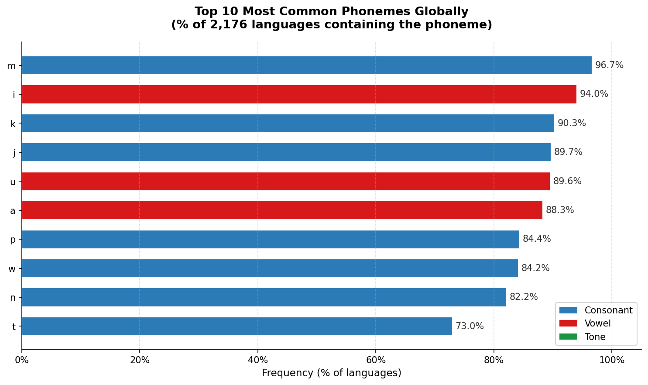
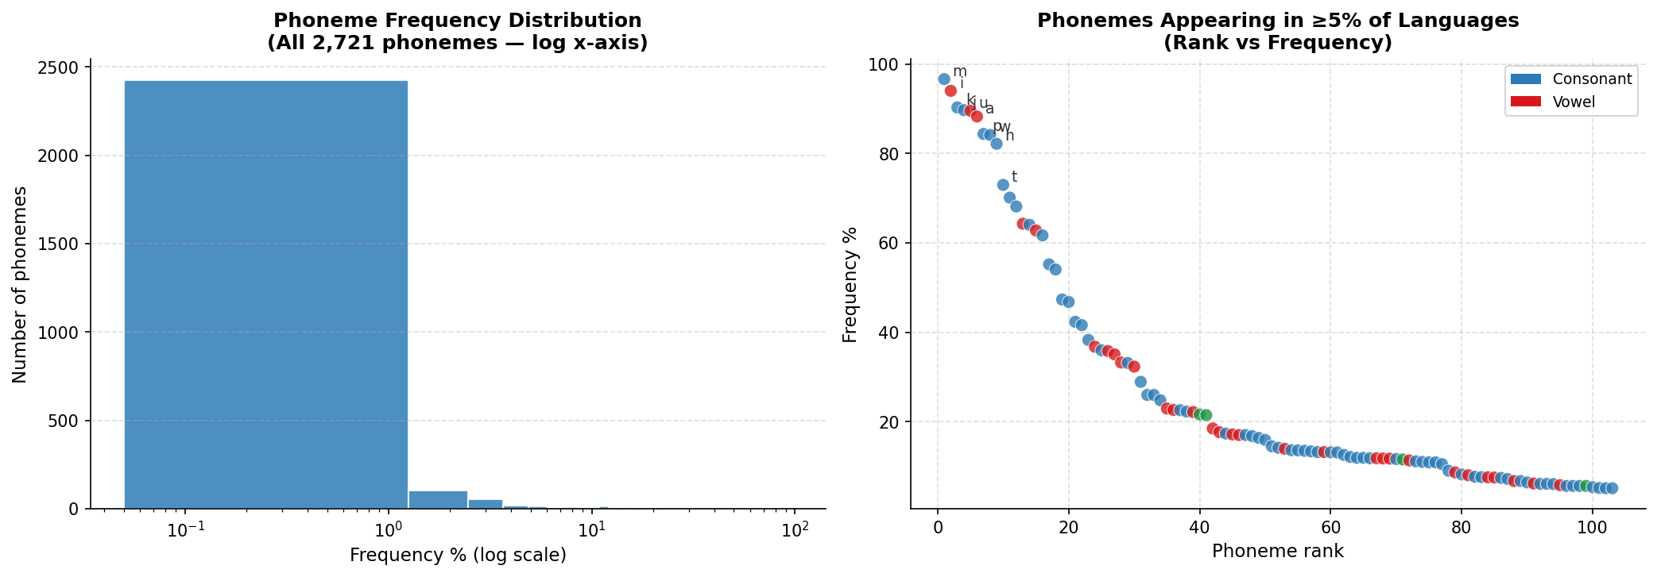
Results & Outputs — Frequency Analysis
5:00 – 7:30
96.7%
18
1,444
2,721
/m/ · most universal phoneme
phonemes in >50% of languages
phonemes in exactly ONE language
total unique phonemes found
Top 10 Phonemes Globally
Zipfian Distribution
Key insight: /m/ appears in 96.7% of 2,176 languages — the most universal sound. Only 18 phonemes exceed 50% frequency. 1,444 phonemes (53%) appear in exactly ONE language, confirming a Zipfian power-law. Consonants = 63.6%, Vowels = 34.4%, Tones = 2% of all 2,721 phonemes.

Slide 7
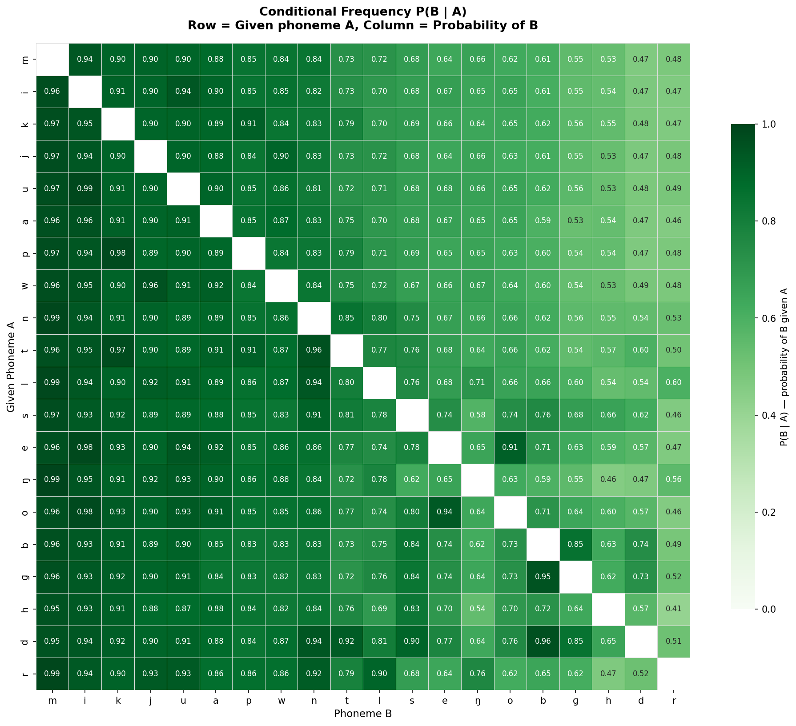
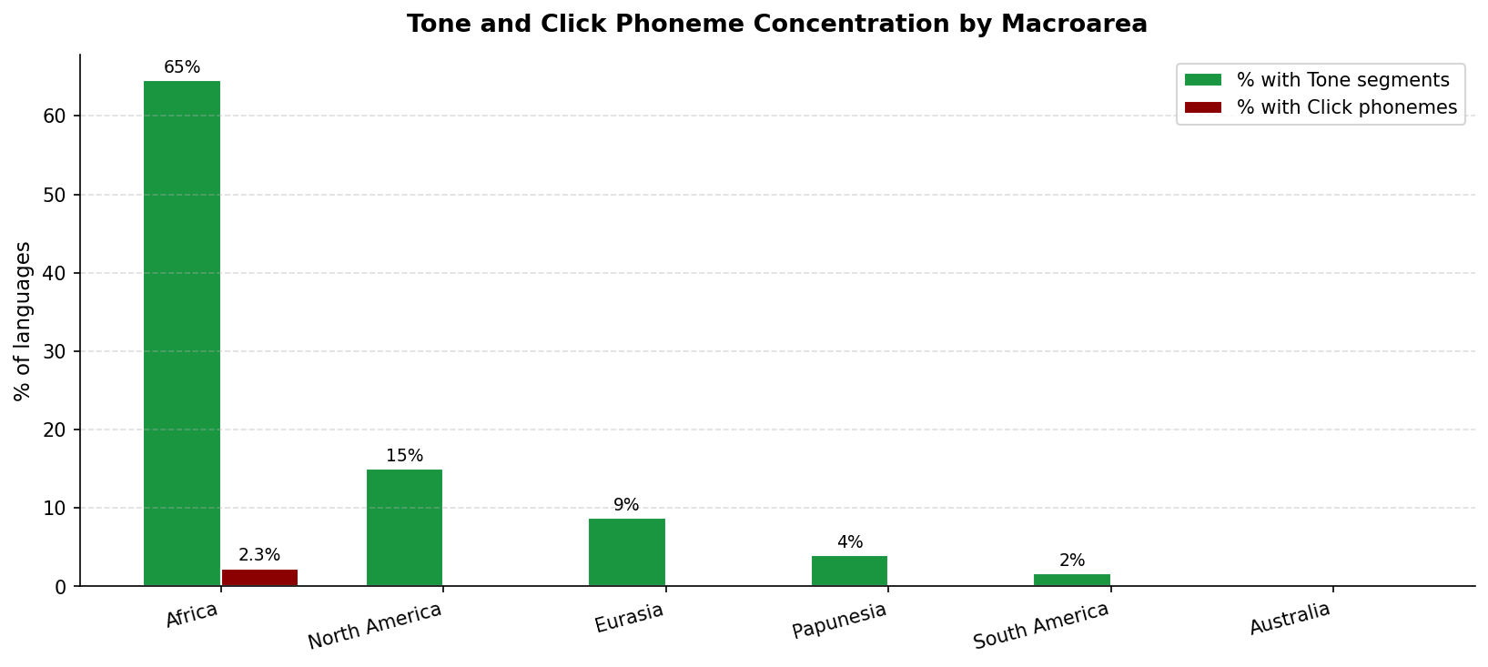
Results & Outputs — Geographic & Pairwise Analysis
5:00 – 7:30
139 phoneme pairs with P(B|A) ≥ 0.90 — empirical Greenbergian universals confirmed at 2,176-language scale
Key findings
64.6%
Africa tonal languages
64.6% of African languages are tonal. Australia: 0%. Sharpest areal contrast in the dataset.
100%
Clicks restricted to Africa only
Zero non-African languages have click phonemes across all 2,176 languages. Absolute geographic restriction.
J=0.960
Jaccard: high/low tone pair
J=0.960 — tonal languages always contrast ≥2 levels. Vowel pair /i/&/u/: J=0.932 (vowel dispersion).
Tone & Click Phonemes by Macro area

Slide 8
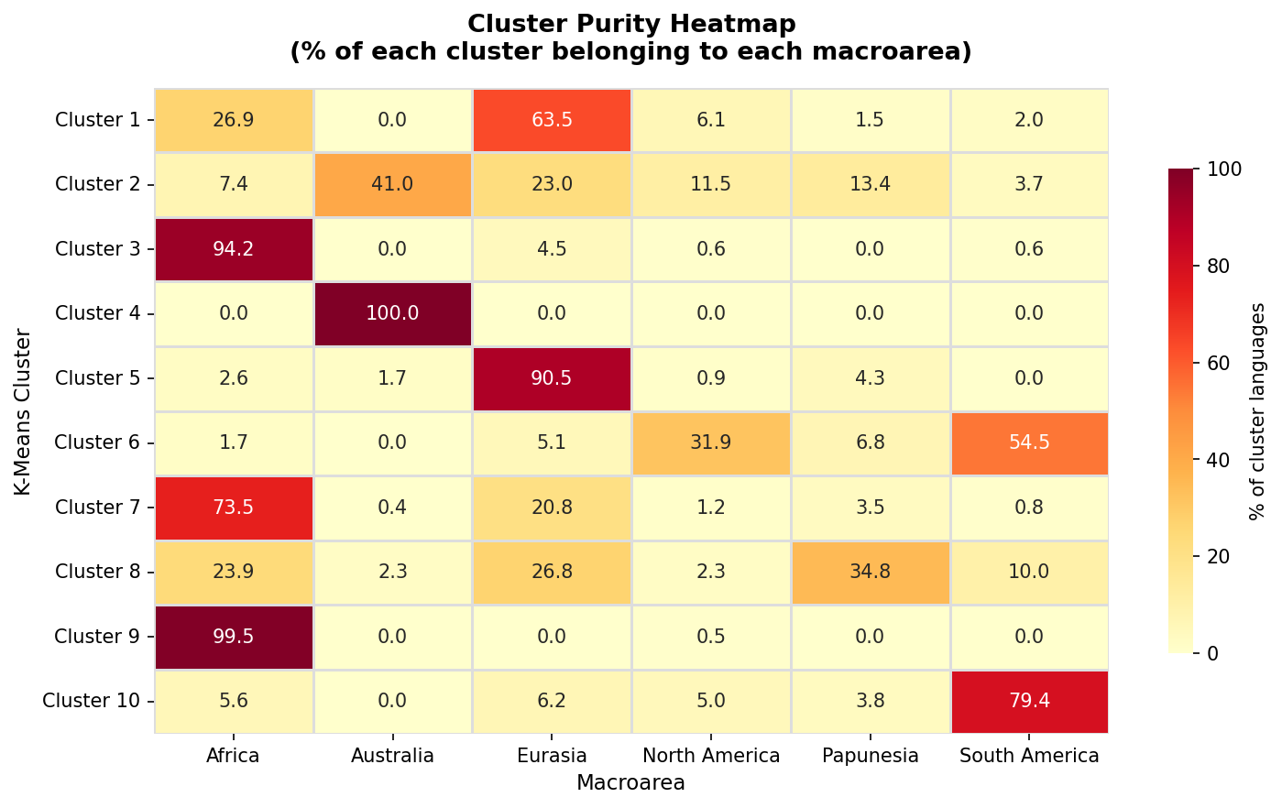
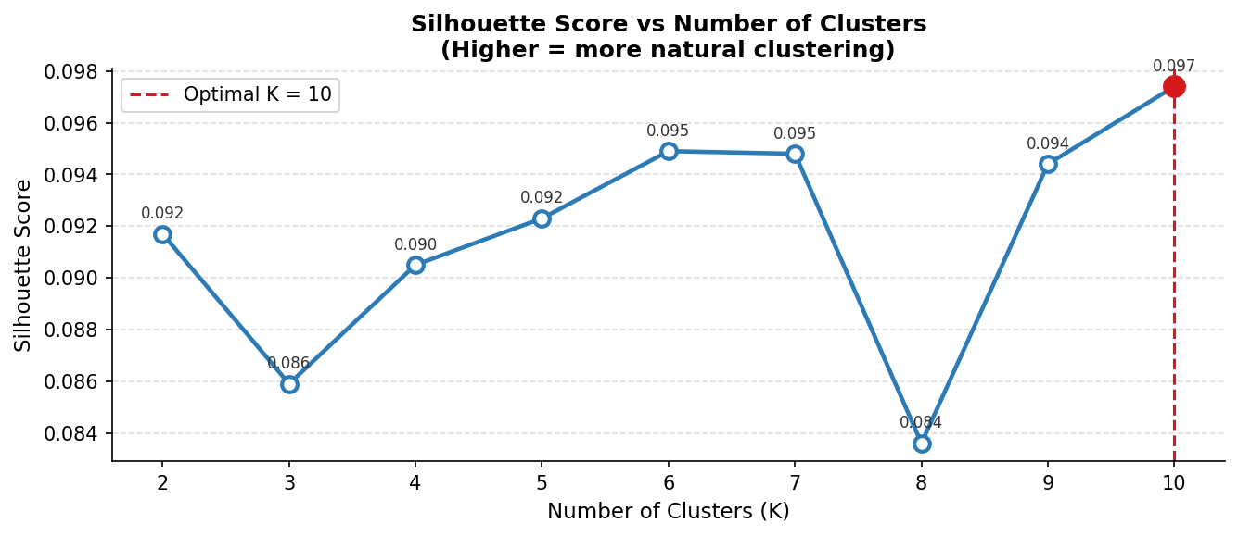
K-Means Clustering — What the Numbers Mean
7:30 – 9:00
Cluster Purity Heatmap
How to interpret
0.097
Silhouette Score at K=10
Modest but valid. All languages share the universal core (/m/,/i/,/k/) making vectors similar. Positive score confirms clusters are geographically real.
100%
cluster purity Threshold (P₉₅)
Cluster 3 = 100% Australian languages. All 237 Australian languages grouped into one cluster without any geographic label — strongest ML result.
Silhouette vs K
0.994
Strongest Implication
P(m | ng) = 0.994. Every language with velar nasal /ng/ also has bilabial /m/. Markedness hierarchy: complex sounds imply simpler ones, not vice versa.
-0.13 to +0.13
Phi Coefficient Range
Avoidance between clicks and tone contours (phi=-0.13) reflects geographic incompatibility — clicks in Africa, tones in East Asia — not direct phoneme repulsion.

Slide 9
Wrap Up
Summary · Key Learnings · Future Scope
3 Scientific Conclusions
1
18 phonemes appear in >50% of all 2,176 languages, forming a universal core shaped by articulatory economy and perceptual salience. The distribution is Zipfian.
2
Click phonemes are absolutely restricted to Africa (0 non-African languages). 64.6% of African languages are tonal vs 0% in Australia — sharpest areal contrast.
3
K-Means Clustering (K=10, silhouette=0.097) recovered geographic regions from phoneme data alone. Australian cluster = 100% purity. 139 implicational universals confirmed at scale.
Future Scope
→
Neural phoneme embeddings
→
Supervised classification
richer articulatory similarity beyond binary presence-absence vectors
predict macroarea from phoneme profile — quantify geographic predictability
→
Endangerment data integration
→
Expand to all PHOIBLE sources
test if smaller phoneme inventories correlate with language loss (Ethnologue)
include non-deduplicated sources for ensemble frequency estimates
n.nitin@op.iitg.ac.in · Nitin Vijay N | 23035010571 | DA378 | Trimester IX

