Slide 1

TERM PROJECT
AirWatch India: AQI Inspection and Prediction
Student Name :
Nitin Vijay N
Student ID :
23035010571
Email ID :
n.nitin@op.iitg.ac.in
Indian Institute of Technology Guwahati
Programme :
BSc. (Hons.) Data Science & AI
Course Code :
DA379
BSc. (Hons.) Data Science & Artificial Intelligence
Online Degree Programme
Course Name :
Term Project - I
Youtube Link:
https://youtu.be/y57es9DNrsM
Trimester :
IX

Slide 2
Problem Statement
0:30 – 1:30
What problem did we solve?
No integrated platform
Substantial missing data
No forecasting layer
Government portals publish raw CPCB pollutant CSVs with no cleaning, no forecasting, and no unified inspection tool for the public or researchers.
15.9% of AQI values were missing in the raw CPCB dataset, and existing tools simply drop those rows rather than recovering them.
No open-source India platform combined historical AQI inspection with machine-learning prediction and short-term forecasting in one place.
Why it matters
Air pollution is a leading health risk in India, with several cities regularly exceeding WHO guideline limits. A reproducible, open-source platform that cleans, analyses, predicts, and visualizes AQI data is both scientifically valuable and practically impactful for citizens, public health officials, and researchers.

Slide 3
Tools & Dataset
1:30 – 2:30
Tech Stack
Datasets
Python 3.12
pandas + numpy
Air Quality Data in India (CPCB)
Core language for all phases
Data cleaning & feature engineering
26 cities · 2015-2020 · Daily resolution
29,531 rows
PM2.5, PM10, NO2, SO2, CO, O3 + 5 more
scikit-learn
Streamlit + Plotly
Stations Metadata (CPCB)
Random Forest, Decision Tree, Logistic/Linear Regression
Interactive web dashboard
230 stations · City-State mapping
230 rows
Used to attach State to each city
Folium
statsmodels
2 geographic HTML maps
Holt-Winters 6-month forecasting
City Coordinates (compiled)
26 cities · Lat/Long reference
26 rows
Used for Folium geo-visualization
Matplotlib + Seaborn
sklearn.metrics
13 static analysis charts
R2, MAE, RMSE, Accuracy, F1, Confusion Matrix
Total: 29,530 cleaned records, 0 missing values

Slide 4
Code Walkthrough
2:30 – 5:00
9-Phase Pipeline
1
Data Cleaning
2
EDA
3
Feature Engineering
phase1_cleaning.py · CPCB AQI recomputation · imputation
phase2_eda.py · 7 charts · correlation + seasonality
phase3_feature_engineering.py · lag & rolling AQI
4
Geo-Visualization
5
Time-Series Forecasting
6
ML Prediction
phase4_geo_visualization.py · Folium · 26 cities
phase5_time_series.py · Holt-Winters · 10 cities
phase6_ml_modeling.py · Random Forest, Decision Tree, Logistic Regression
7
Model Evaluation
8
Streamlit Dashboard
9
Report + GitHub
R2, MAE, RMSE, Accuracy, F1, Confusion Matrix
app.py · 4 tabs · live filters · predictions
IEEE report · github.com/vjnitin312/da379

Slide 5
Live Demo — Streamlit Dashboard & Folium Map
5:00 – 7:30
Streamlit Dashboard — localhost:8501
2 Folium Maps Generated
Tab 1
Overview
India AQI Map (main)
National KPIs · AQI trend · category distribution
Click any city → popup with Avg/Max AQI details
Legend & Color Coding
Tab 2
City Inspection
6 CPCB categories, Good (green) to Severe (purple)
Per-city AQI trend · seasonal pattern · pollutants
Top 10 Cities Map
Predict AQI
Static map for the 10 most polluted cities
Tab 3
Live pollutant inputs · gauge chart · comparison
Marker Sizing
Circle radius scales with avg AQI value too
Tab 4
Map View
Embedded in Dashboard
All 26 cities · embedded Folium map · stats table
Map View tab renders it live via components.html
Run: streamlit run dashboard/app.py · Maps in: outputs/maps/ · github.com/vjnitin312/da379

Slide 6
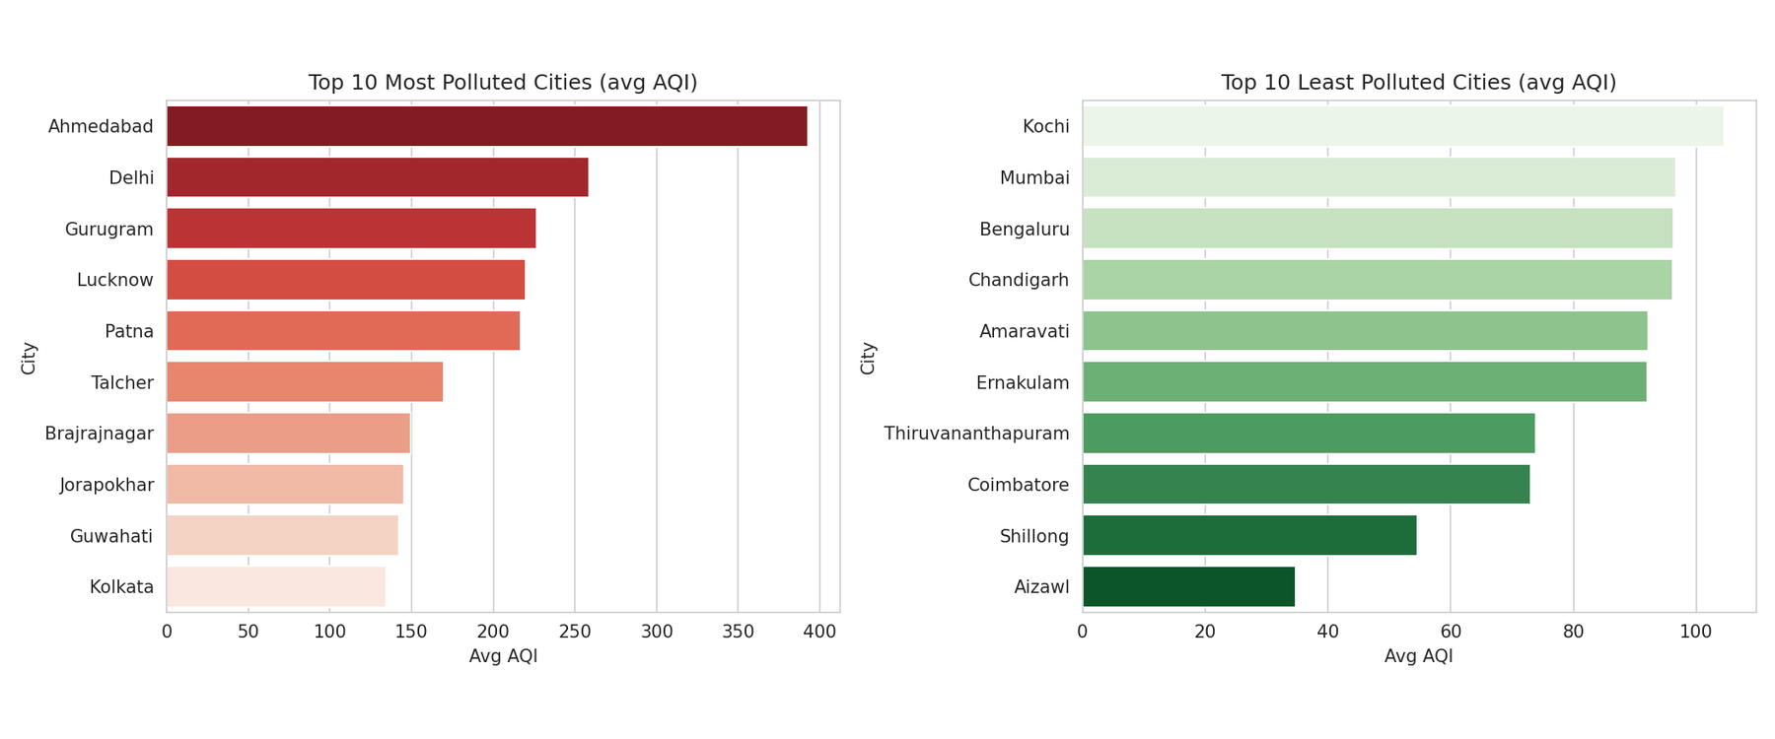
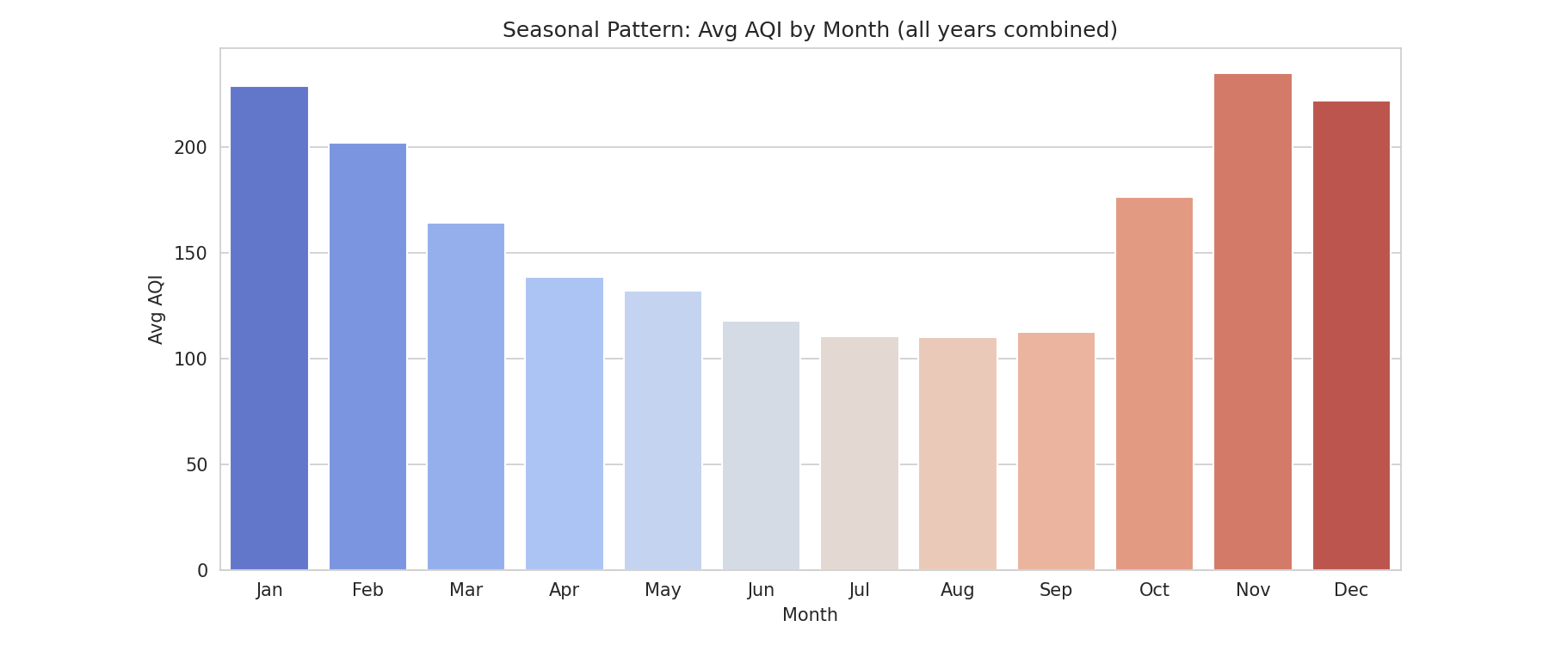
Results & Outputs — Overview
5:00 – 7:30
392.6
34.8
29,530
5.5 years
Ahmedabad · most polluted
Aizawl · least polluted
Daily records collected
2015 – 2020 coverage
Top & Bottom 10 Cities by Avg AQI
Seasonal Pattern — Avg AQI by Month
Key insight: November peaks at 234.9 AQI due to winter temperature inversion trapping pollutants near the surface. August is lowest at 110.0 AQI due to monsoon rains washing pollutants from the air.

Slide 7
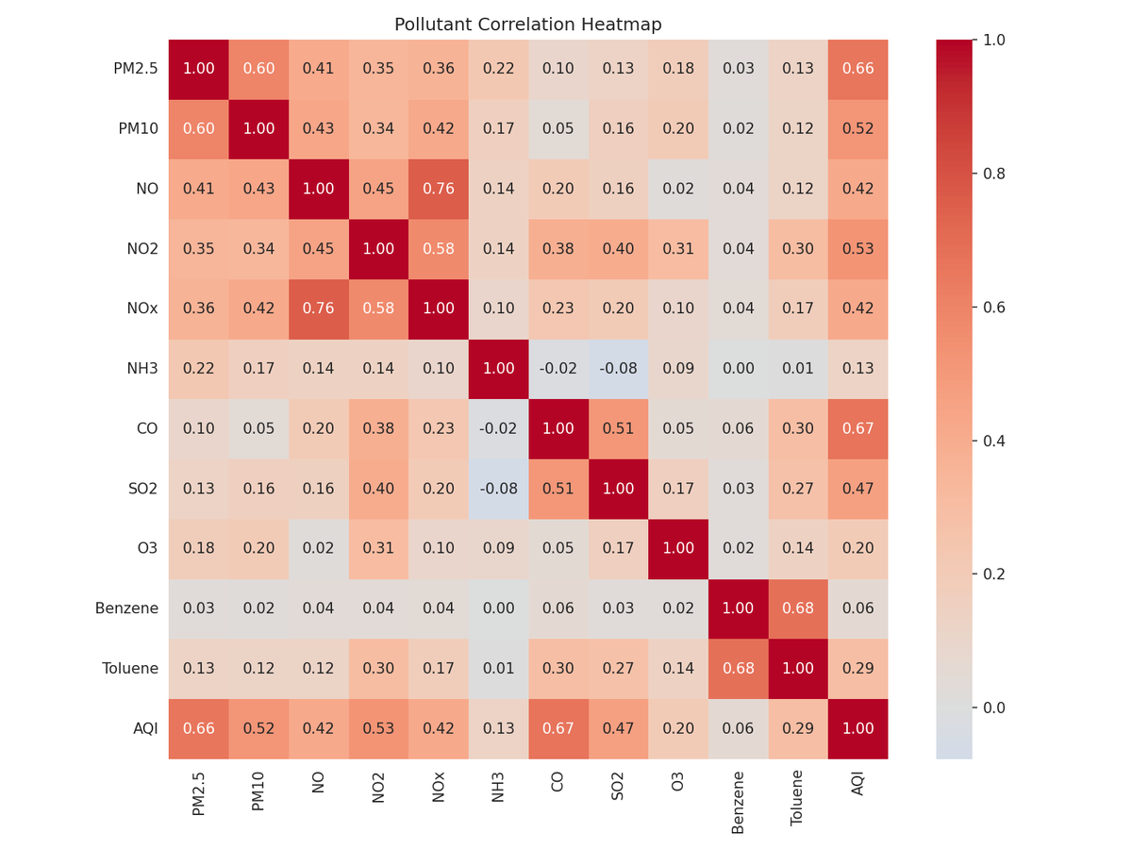
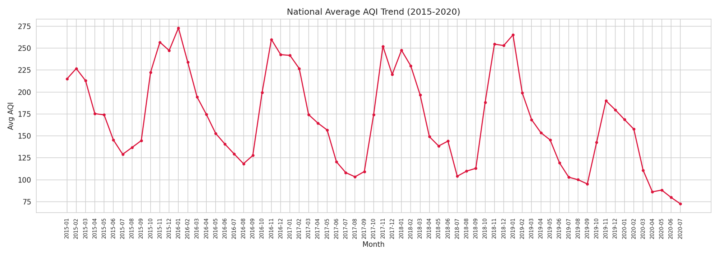
Results & Outputs — Statistical Analysis
5:00 – 7:30
Top correlations
Pearson Correlation Matrix
+0.67
CO ↔ AQI
Strongest correlate: combustion-related CO tracks AQI closely.
+0.66
PM2.5 ↔ AQI
Fine particulates are a primary driver of poor air quality.
+0.53
NO2 ↔ AQI
Vehicular/industrial emissions tracer, third-strongest signal.
National Average AQI Trend (2015–2020)

Slide 8
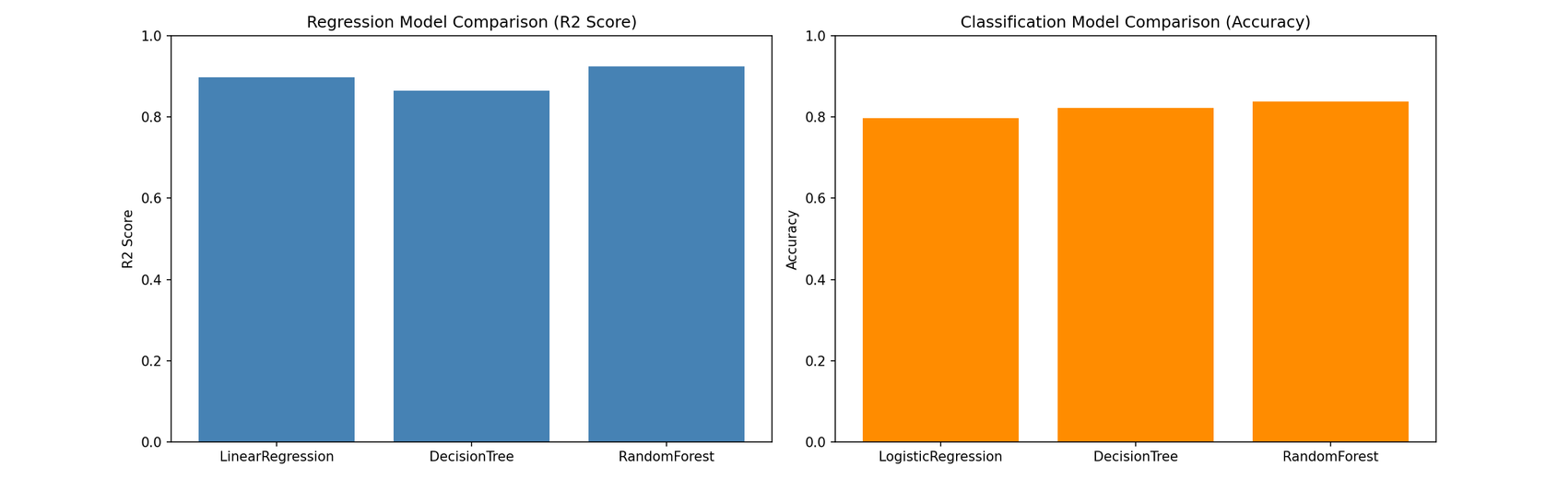
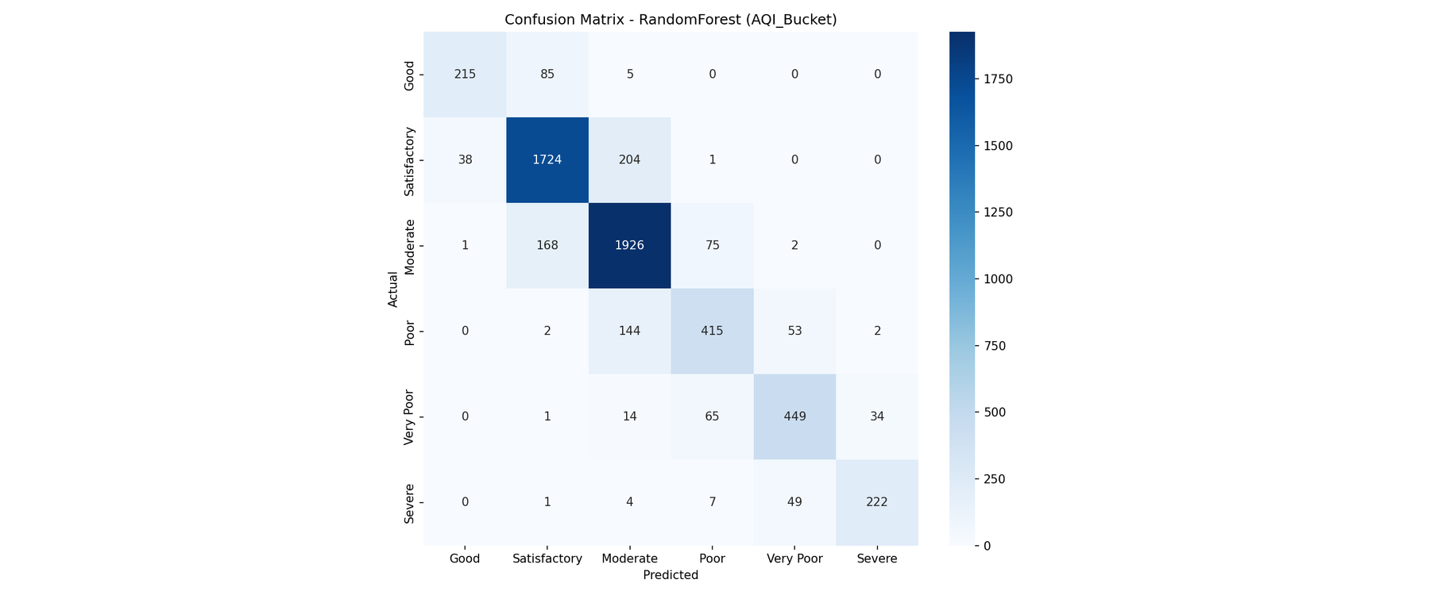
Evaluation Metrics — What the Numbers Mean
7:30 – 9:00
R2 & MAE · Accuracy & F1 · Confusion matrix · Holt-Winters forecast
Model Comparison — Regression & Classification
How to interpret
0.925
Random Forest R2 Score
Best of 3 regression models. Linear Regression scored 0.897, Decision Tree scored 0.865 — ensemble averaging wins.
16.33
Mean Absolute Error (MAE)
Predictions off by ~16 AQI points on average. RMSE is higher (35.37), meaning a few large misses pull the squared error up.
Confusion Matrix — AQI Category (Random Forest)
83.8%
Classification Accuracy (F1 0.837)
Random Forest correctly bucketed 5 of 6 test rows into Good–Severe (vs. 79.7% for Logistic Regression).
6 months
Holt-Winters Forecast Horizon
Ahmedabad November forecast: 366.3 AQI, correctly capturing the winter peak. Only cities with >=24 months history are decomposed.

Slide 9
Wrap Up
Summary · Key Learnings · Future Scope
3 Scientific Conclusions
1
Combustion-related pollutants (CO, PM2.5) are the dominant drivers of AQI, not secondary pollutants like ozone.
2
A strong, recurring winter pollution peak driven by temperature inversion is detectable nationwide across all 5 years.
3
Ensemble tree-based models (Random Forest) substantially outperform linear baselines for both regression and classification.
Future Scope
→
Real-time CPCB station APIs
→
Meteorological covariates
for live inspection beyond the 2015-2020 window
temperature, wind, humidity as exogenous regressors
→
Deploy on Streamlit Cloud
→
Station-level spatial modelling
public access — no local installation required
finer-grained resolution within large metro areas
github.com/vjnitin312/da379 · n.nitin@op.iitg.ac.in · Nitin Vijay N | 23035010571 | DA379 | Trimester 9

