Slide 1
Army Combat Fitness Test Tier System Analysis
Valerie M. Jones
IST 707 Data Analytics
June 2021

Slide 2
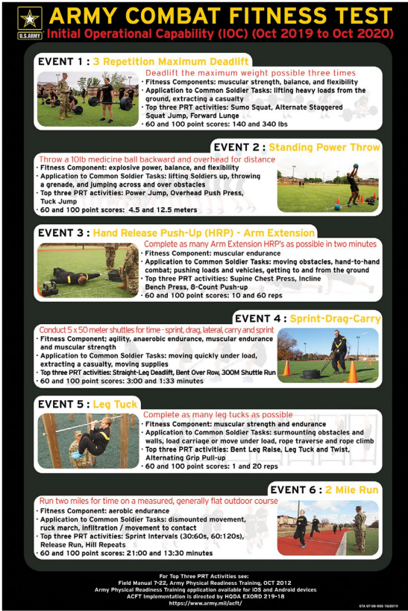
Introduction
As of October 1, 2020, The United States Army implemented the Army Combat Fitness Test (ACFT) as the physical fitness test of record for all Soldiers in the Active Army, Army Reserve, and Army National Guard.
The Army conducted a Baseline Soldier Physical Readiness Requirements Study (BSPRRS) to identify which fitness events most predict performance on tests of commonly performed physically demanding military tasks.
The 6 events of the ACFT include:
140-200lbs deadlift
10lbs Standing Power Throw
Hand-Release-Push-Up
Sprint-Drag-Carry
Leg tuck or 2min plank*
Cardio event: 2mi run, (alternate: 5000m row, 1500m bike, 1000m swim).
Currently the senate is conducting a study on the current Army Combat Fitness Test to see if it is feasible to have this version of the physical fitness test as the test of record for all army components. The Army is currently collecting performance data to assess whether the current evaluation requirements can accurately assess fitness across all Soldiers.
*Effective 1 APR 2021
Notes:
Research question / Motivation
Target Domain:
Real-estate Investment
Target Audience:
Individual Property Management Firms and or Sol Proprietors who buy and rent single family homes as an investment

Slide 3
Problem Statement
Concerns have been raised that this new 6 event test is discriminatory against certain military occupational specialties that are not regularly exposed to the physical demands of this new test, gender and soldiers who have physical limitations that would not exclude them from deploying but limit their ability to complete the required events.
Effective 1 April 2021 the Army transitioned to the ACFT 3.0, as part of the constant improvements to the ACFT. This updated ACFT establishes a tiered system based upon performance by gender. (HQDA EXORD 144-21)
Once a soldier has both achieved a score greater than 360 points (baseline passing) and exceeded the statistical average score for their gender, the soldier will be proportionally tiered based on their relative position above the average score. (HQDA EXORD 144-21)
The purpose of this project is to attempt to predict the number of Soldiers entering the four tiers established in ACFT 3.0 using various data mining techniques.
Notes:
Notes: 1) You must have at least two different vis types that support each method. 2) Each method above will have its own subsection(s) in the Analysis and in the Results. 3) Place the visualizations where they belong in the your project – not at the end.

Slide 4
About the Data
Constraints:
Cannot use actual ACFT data in accordance with provisions of Headquarters Department Of the Army, Executive Order 144-21 Army Physical Fitness Training (APFT) and Testing For FY21-22
Historical Army Physical Fitness Test results from the Defense Training Management System (DTMS) will be utilized to create the tier system using the Push-Up event, Sit-Up event and 2mi run as indicators of top tier performance.
Due to use of rStudio cloud, PII had to be omitted prior to importing data into rStudio
Pre-processing:
A unique identifier will be created to mitigate against duplication errors
All PII will be omitted
Soldiers currently on physical limitation profiles, exempt from certain events will be omitted
Sample of 300 Soldiers (random sample of 75 from the 4 Companies of the battalion)
2mi Run time will be converted to decimal value to determine average
Analysis Methods Used:
Scatter and Dot plots for distribution
Association Rule Mining
K-means clustering
Knn Model
Decision trees
Known Outliers:
Soldiers not completing all events due to failure of one event
Soldier failing event out of score range

Slide 5
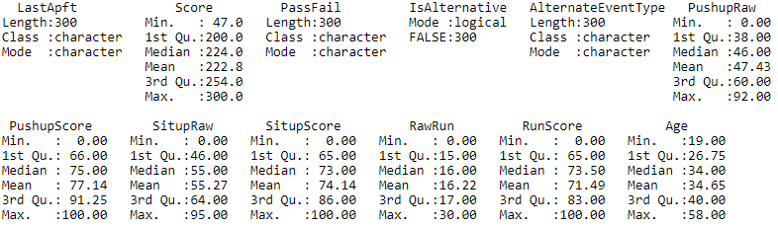
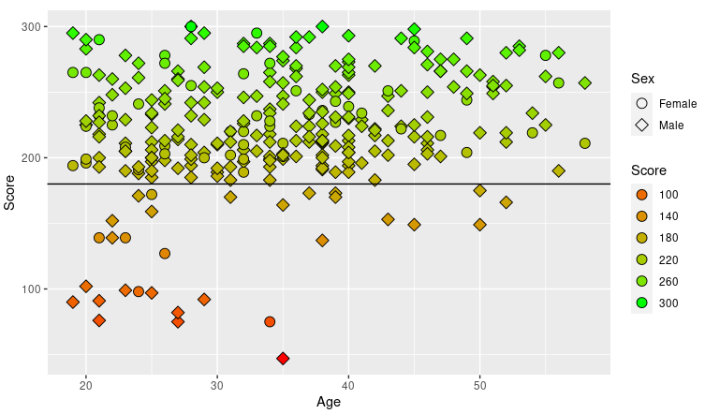
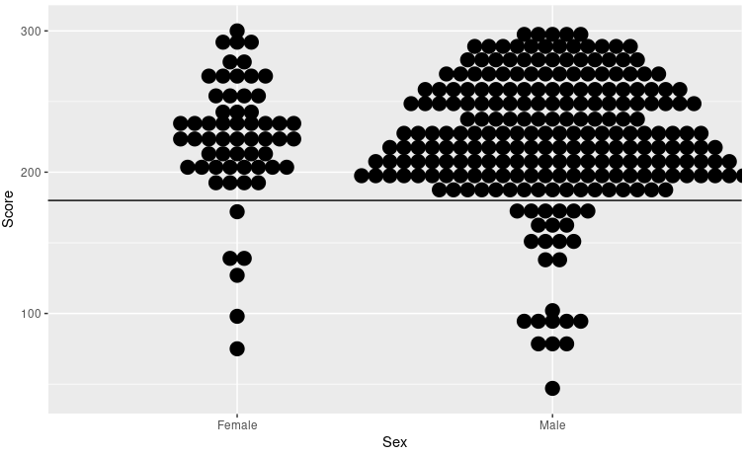
Score Distribution: Age and Gender
Summary Statistics of Data
Mean Total Score: 223
Mean Age: 35
Mean Score of Males: 224
Mean Age: 35
Mean Score Females: 222
Mean Age: 32
APFT Score Distribution Scatter Plot
Age
APFT Score Distribution Scatter Plot
Gender
Reference line indicates minimum passing score of 180
Notes:
Notes: 1) You must have at least two different vis types that support each method. 2) Each method above will have its own subsection(s) in the Analysis and in the Results. 3) Place the visualizations where they belong in the your project – not at the end.

Slide 6
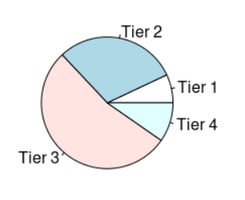
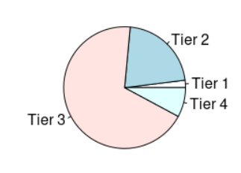
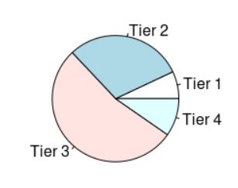
Tier Criteria
Tier 1:
Soldiers who score 90% or above in all three events
Tier 2:
Soldiers who score between 240-280 out of 300 total points but score less than 90% in one or more events
Tier 3:
Soldiers who score 239 and below
Tier 4:
Soldier fails test
Tier Pie Chart
Females
Males
Notes:
Notes: 1) You must have at least two different vis types that support each method. 2) Each method above will have its own subsection(s) in the Analysis and in the Results. 3) Place the visualizations where they belong in the your project – not at the end.

Slide 7
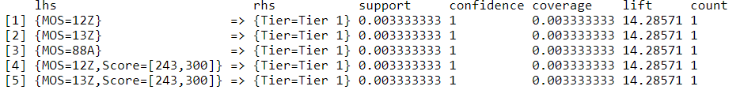
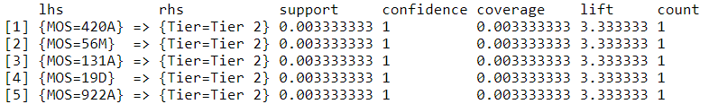
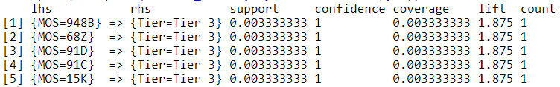
Predictive Models Association Rule Mining
? What if it could the tier assigned to each soldier could be predicted by Military Occupational Specialty
Tier 1
Tier 2
Tier 3
Tier 4 Soldiers were primarily (09B) initial entry soldiers still in basic training
Notes:
Notes: 1) You must have at least two different vis types that support each method. 2) Each method above will have its own subsection(s) in the Analysis and in the Results. 3) Place the visualizations where they belong in the your project – not at the end.

Slide 8
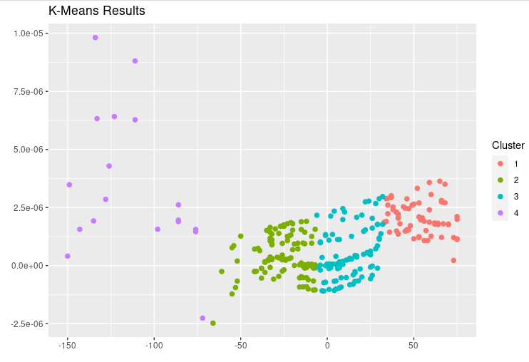
K-means clustering
The resulting clusters from this model are evenly distributed in comparison to the tiers in with respect to intra-cluster distance and in terms of inter-cluster distance. This model is a strong predictor for the assignment of tiers.
Most Effective
Notes:
Notes: 1) You must have at least two different vis types that support each method. 2) Each method above will have its own subsection(s) in the Analysis and in the Results. 3) Place the visualizations where they belong in the your project – not at the end.

Slide 9
Naïve Bayes and K-NN Models
Naives Bayes
Unfortunately this model was not as successful as the k-means result as it was only able to accurately identify the male training data 40 percent of the time with the training data and returned a null value with the female test data.
k Nearest Neighbor (kNN) Model
This model was significantly less accurate than the k-means clustering Model, but still had very strong prediction results. It achieved a 15% accuracy when predicting the male training data tiers and a 19% accuracy when predicting the female test data tiers.
Notes:
Notes: 1) You must have at least two different vis types that support each method. 2) Each method above will have its own subsection(s) in the Analysis and in the Results. 3) Place the visualizations where they belong in the your project – not at the end.

Slide 10
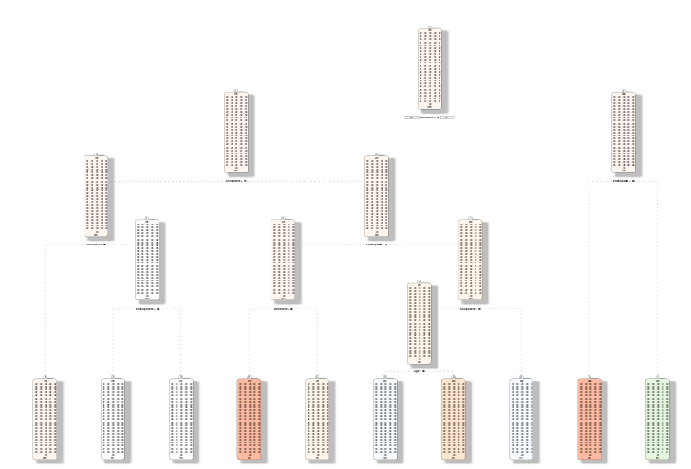
Decision Tree
This model used 14 nodes to decide the most important scores in determining the tiers. This model was only able to correctly predict the train data tiers with a 2 percent accuracy and the test data tiers with 5 percent accuracy.

Slide 11
Conclusion
The purpose of this project is to attempt to predict the number of Soldiers entering the three tiers established in ACFT 3.0 using various data mining techniques.
Due to multiple variables with significant values, only the K-means clustering method provided decent accuracy in classifying the individual tiers. The Naïve Bayes model also had a moderately high accuracy rate for predicting the tiers. But this only applied to the training data.
In order to effectively predict tiers, more subsets of the data would need to be created and stronger parameters to limit the population of each model. Normalization would be able to occur to provide more comprehensive confusion matrices and higher accuracy rates.

Slide 12
References
Baseline Soldier Physical Readiness Requirements Study, University of Iowa, 1 April 2020
Headquarters Department Of the Army, Executive Order 144-21 Army Physical Fitness Training (APFT) and Testing For FY21-22. (HQDA EXORD 144-21)
U.S. Army Public Health Command, Public Health Report, Development of a New Army Standardized Physical Readiness Test January 2012 through December 2013, June 2015
National Defense Authorization Act for Fiscal Year 2021
Field Manual 7-22 (Holistic Health and Fitness), 1 October 2020
20-09 - Army Combat Fitness Test (Version 2), United States Army, Combined Arms Center, 18 February 2020.

