Slide 1
Towards Wide Adoption of Deeply Embedded DSLs
Vojin Jovanovic, Amir Shaikhha, Sandro Stucki, Vladimir Nikolaev

Slide 2
External DSLs
External DSLs (SQL, Matlab, Pig, etc.)
Custom compiler and tool-chain
Very user friendly but:
People do not like new languages
Hard to develop (man decades)

Slide 3
Embedded DSLs
Shallow Embedding
Values in the host language represent values in the embedded language
Deep Embedding
Values in the host language symbolically represent values in the embedded language
Direct Embedding
Shallow embedding “on the nose”. Host language values are exact embedded language values

Slide 4
Vector DSL (Direct Embedding)
object Vector {
def fromSeq[T: Numeric](seq: Seq[T]): Vector[T] =
new Vector(seq)
def fill[T: Numeric](v: T, size: Int): Vector[T] =
fromSeq(Seq.fill(size)(v))
def range(start: Int, end: Int): Vector[Int] =
fromSeq(Seq.range(start, end))
}
class Vector[T: Numeric](val data: Seq[T]) {
def map[S: Numeric](f: T => S): Vector[S] =
Vector.fromSeq(data.map(x => f(x)))
def +(that: Vector[T]): Vector[T] =
Vector.fromSeq(data.zip(that.data).map(x => x._1 + x._2))
}

Slide 5
Vector DSL Deep Embedding
object Vector {
def fill[T:Numeric:TypeTag]
(value: Rep[T], size: Rep[Int])
(implicit sc: SourceContext): Rep[Vector[T]] =
vector_fill(value, size)
def range(start: Rep[Int], end: Rep[Int])
(implicit sc: SourceContext): Rep[Vector[Int]]=
vector_range(start, end)
}
implicit class VectorRep[T:Numeric:TypeTag](v: Rep[Vector[T]]) {
def +(that: Rep[Vector[T]])(implicit sc: SourceContext):Rep[Vector[T]] =
vector_plus(v, that)
def map[S:Numeric:TypeTag](f: Rep[T] => Rep[S])
(implicit sc: SourceContext): Rep[Vector[S]] =
vector_map(v, f)
}

Slide 6
Deep Embedding Summary
Property | Deep Embedding | Direct Embedding
Idiomatic Interface | X | ✓
Idiomatic Type Errors | X | ✓
Idiomatic Documentation | X | ✓
Seamless Debugging | X | ✓
Domain Error Reporting | ✓ | X
Restricting the Embedded Language | ✓ | X
Fast Compilation | X | ✓
No run-time overheads | X | ✓
Domain Specific Optimizaitons | ✓ | X

Slide 7
Idea: Complement Embeddings
Won’t work
Intrinsic differences in the interface
Language intrinsics accept primitive types
Types always show up (ascription methods)
Deep embedding is usually in a different domain

Slide 8

Translation (the only way)
Virtualization
DSL Intrinsification
Constants ([[1]] = lift[Int](1))
Free Variables
[[[x]] = hole[x.type](typeTag[x.type], uniqueId)]
Operations [[vect.Vector.range]] = this.Vector.range

Slide 9
Alternative Type Translations
Generic Polymorphic Embedding
^{τ(T,argument) = T}
^{τ(T,other) = Rep[T]}
LMS (Automatic Inlining)
^{τ(T} ^{⇒ U,argument) = error}
^{τ(T} ⇒ U,other) = τ(T,other) ⇒ τ(U,other)
^{τ(T,argument) = T}
τ(T , other) = Rep[T ]
Dynamic
τ(T,other) = Dynamic
^{τ(T,argument) = T}

Slide 10
Restricting the Language
What does this do?
new VectorDSL { // deep embedding
try Vector.fill(-1, 100)
catch { case _ => println("Error!") }
}
After Translation
new VectorDSL { // deep embedding
__try(
Vector.fill(-1, 100),
{ case _ => println("Error!") }
)
}

Slide 11
Reflective Evaluation
Execute code that is acquired by reflection
def evalPow(expr: Double): Double = macro _evalPow
def _evalPow(c: Context)(expr: c.Expr[Double]): c.Expr[Double] = {
import c.universe._
expr.tree match {
case q"math.pow(${b: Literal},${e: Literal})" =>
c.Expr(q"${c.eval[Double](expr)}")
case _ => expr
}
}

Slide 12
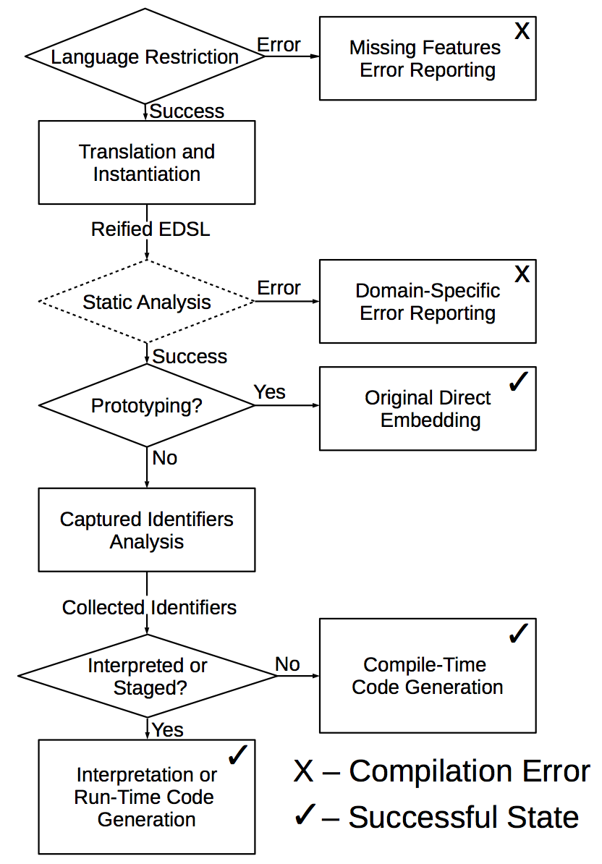
Work Flow

Slide 13
Domain-Specific Error Reporting
DSL authors analyze errors in the domain of the embedded language
Analyze a very simple IR
Report errors at host language compile-time

Slide 14


Dual Embeddings are Hard to Maintain
(Theory) Just reuse the translation to make direct-to-deep deep and generate the Scala source
(Practice)

Slide 15
Applicability to Other Langauges
Languages based on polymorphic lambda calculus of rank 1 advanced enough to embed DSLs (Haskell, C#, SML, etc.)
Requirements
Reflection capable of type and code introspection and transformation (Scala)

Slide 16
Summary
Property | DSL Embedding
Idiomatic Interface | ✓
Idiomatic Type Errors | ✓
Idiomatic Documentation | ✓
Seamless Debugging | ✓
Domain Error Reporting | ✓
Restricting the Embedded Language | ✓
Fast Compilation | ✓
No run-time overheads | ✓
Domain Specific Optimizations | ✓

Slide 17
User Perspective
DSL user
Same as the external DSL with the syntax of the host language
DSL author
Implement the direct embedding
Implement optimizations and error reporting
Completely shielded from the host language

Slide 18
TODO
Erik Meier: “DSLs always start as cute little puppies but end up as hairy beasts”
Staging is rarely used
Why not invert the types
Now[T] instead of Rep[T]
Configurable JIT compilation of DSLs
Composing different DSLs
Deep EDSLs should not exist in the first place

