Slide 1

Jet: An embedded DSL for Distributed Data Parallel Computing
Stefan Ackermann (ETH Zürich), Vojin Jovanovic, Tiark Rompf, Martin Odersky (EPFL)
Programming Methods Laboratory
Notes:
Thank you for comming.

Slide 2
Motivation
MapReduce simplified big data processing
Low level programming model
Complex pipelines, low level code
Joins are hard to write
Hand written relational optimizations
Hard to write and maintain
Notes:
MapReduce has greatly simplified big data processing.
MapReduce greatly alleviates problems arising in distributed processing; machine faliures and communication.
It provides a low level programming model which allows us to write highly optimal and general code.
Over time users started writing complex pipelines of MapReduce jobs which were hard to maintain. Simple algorithms like are not trivial in.
Native MapReduce does not support relational optimizations.

Slide 3
Motivation
Dryad/LINQ and Flume Java frameworks
High level interface
Language integration
Limited knowledge about program structure
Relational optimizations hard
Suboptimal code
Performance penalty

Slide 4
Motivation
Hive QL and Pig Latin
Allow relational optimizations
High level declarative language
Strict programming model
No iterative algorithms
No language integration
Generality through UDFs
Not general
Notes:
Additionally these approaches are hard to extend with user constructs that allow relational optimizations.

Slide 5
Challenge
How to provide a language
Declarative, high level interface
General (loops, conditionals, classes)
Language integration
Relational optimizations
Extensible

Slide 6
Solution: Jet
Word count
val wc = jet {
DColl("hdfs://" + input)
.flatMap(_.split("\\s"))
.map(x => (x, 1))
.groupByKey()
.reduce(_ + _)
}
println(“The occurs “ + wc.get(“the"))
UDF
def gcd(a: Rep[Int], b: Rep[Int]): Rep[Int] =
if (b == 0) then a
else gcd(b, a % b)
Notes:
TODO

Slide 7
Jet Overview
Jet program
Language Embedding
High Level IR
Relational Optimizations
Optimized High Level IR
Lowering
Extensible
Low Level IR
Compiler Optimizations
Optimized Low Level IR
Scala Code Generation
Hadoop (Crunch)
Spark [NSDI ‘12]

Slide 8
Outline
Language Embedding
Optimizations
Evaluation
Future Work and Conclusions

Slide 9
Language Virtualization
Feature of Scala that translates language constructs to function calls
if (c) then t else e => __ifThenElse(c, t, e)
while (c) body => __while(c, body)
new User("john", "doe") =>
new Struct("name" -> "john", "last" -> , "doe")

Slide 10
Lightweight Modular Staging
Framework for embedded DSLs [GPCE ‘10]
"hdfs://"
input
val wc = jet {
DColl("hdfs://" + input)
+
DColl
.map(x => (x, 1))
in1
in2
.groupByKey()
Map(…)
.reduce(_ + _)
}
+
GroupByKey
Function2
Reduce

Slide 11
Outline
Language Integration
Optimizations
Projection Insertion
Code Motion
Fusion
Regular Expressions
Evaluation
Future Work and Conclusions

Slide 12
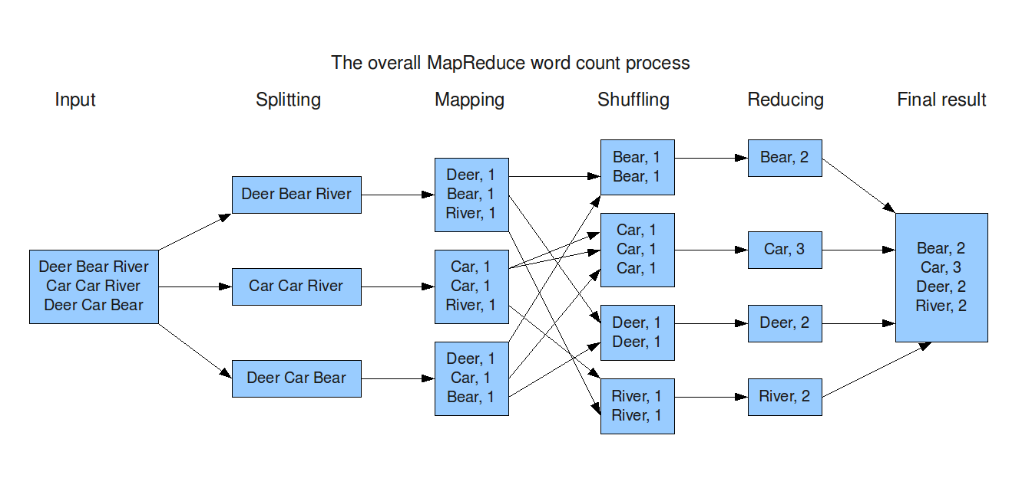
Relational optimizations
Less Data

Slide 13
Column Pruning - Projection Insertion
Reduce IO, CPU time, Memory usage
Column pruning over user functions and user defined classes of finite nesting
First step: apply field access analysis for UFs
def lastName (user: Rep[User]) = {
if (user.gender == “F” && user.maritalStatus)
user.maidenName
else
user.lastName
}

Slide 14
Field Analysis
String
String
map
(parse)
map
(parse)
(Long, LogEvent)
{long, logevent.date}
{long, user.name}
(Long, User)
join
{logevent.date, user.name}
(Long, (LogEvent, User))
map
{string}
String
Notes:
Next: Effect of this on generated code.

Slide 15
Projection Insertion
String
String
map
(parse, project)
map
(parse)
map
(parse, project)
map
(parse)
(Long, LogEvent)
(Long, User)
map
(project)
map
(project)
(Long, LogEvent)
{long, logevent.date}
{long, user.name}
(Long, User)
join
{logevent.date, user.name}
(Long, (LogEvent, User))
map
{string}
String
Notes:
Next: Effect of this on generated code.

Slide 16
Compiler Optimizations
Reduce CPU Time
Reduce CPU Time

Slide 17
Optimizations: Code Motion
Constant expressions out of functions and loops
in.filter(s: String => s.matches("wiki"))
becomes
val pattern = Pattern.compile("wiki")
in.filter(s: String =>
pattern.matcher(s).matches()
)
Notes:
This is precious. Whatever you can extract from a hot loop gives you a high speedup.

Slide 18
Optimizations: Code Motion
Unused values inside conditionals
val date = parse(“31.08.2012"))
if (today) println(“VLDB “ + date)
becomes
if (today) {
val date = parse(“31.08.2012"))
println(“VLDB “ + date)
}
Notes:
This is precious. Whatever you can extract from a hot loop gives you a high speedup.

Slide 19
Optimizations: Loop Fusion
String
map
(parse)
LogEvent
flatMap
(parse, filter, tuple)
filter
LogEvent
map
(tuple)
(Long, LogEvent)

Slide 20
Projection Insertion with Fusion
String
String
map
(parse, project)
map
(parse)
map
(parse, project)
map
(parse)
(Long, LogEvent)
(Long, User)
map
(project)
map
(project)
(Long, LogEvent)
{long, logevent.date}
{long, user.name}
(Long, User)
join
{logevent.date, user.name}
(Long, (LogEvent, User))
map
{string}
String
Notes:
Next: Effect of this on generated code.

Slide 21
Optimizations: Regular Expressions
matches / split / replaceAll
Regex Pattern
create
RegexFrontend
Java Regex
Automaton
Fast Splitter
Notes:
RegexFrontend is created once, used like the Pattern class in Java Regex.

Slide 22
Optimizations: Mapper of TPCH Q12
String
map (parse)
LineItem
filter
LineItem
filter
(3 more filters)
LineItem
map (tuple)
(Long, LineItem)

Slide 23
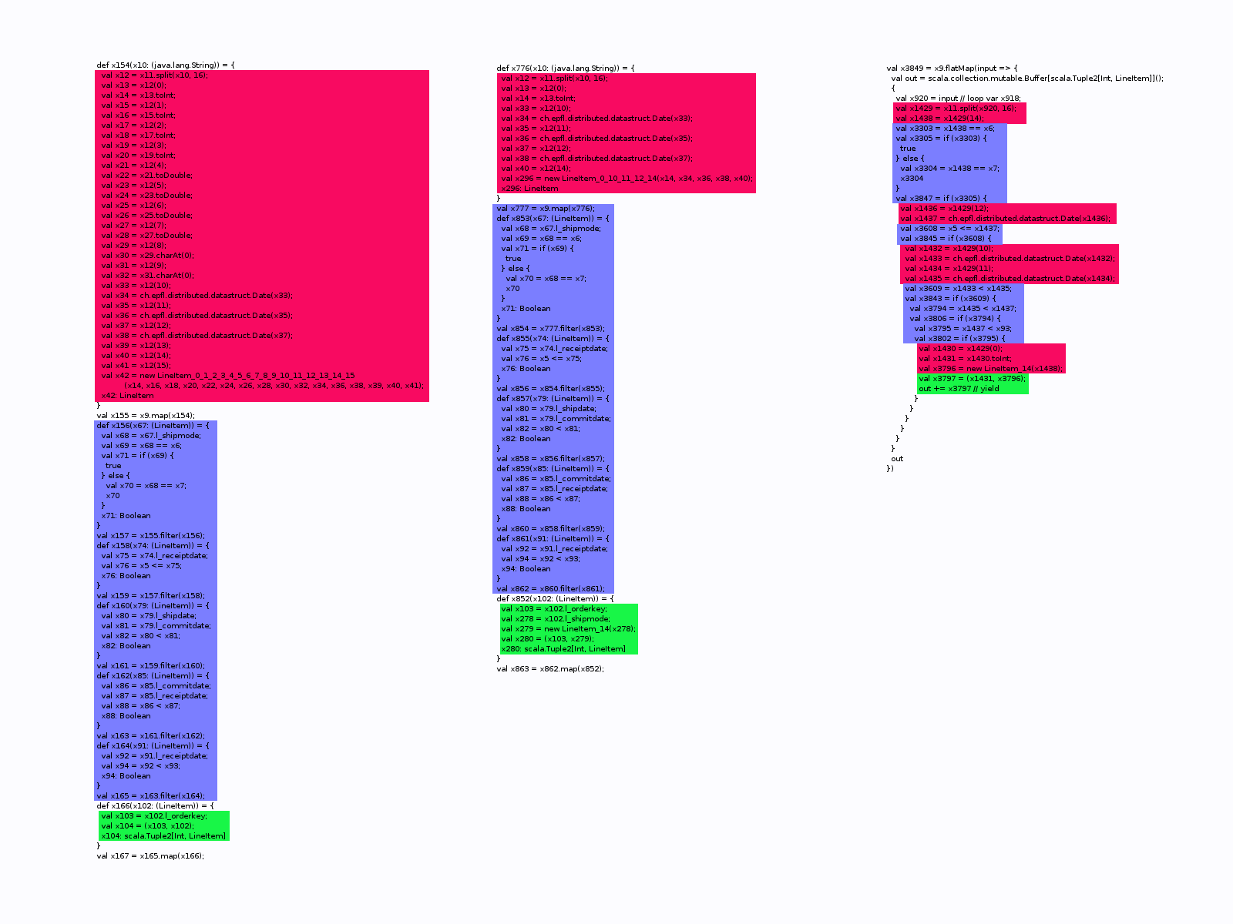
Optimizations: Mapper of TPCH Q12
Unoptimized
With Projection
With Loop Fusion
Parsing
Filtering
Creating Tuple
Fields: 16 / 16 5 / 16 1 – 5 / 1

Slide 24
Outline
Language Integration
Optimizations
Evaluation
Word Count
TPCH Q12
Extensibility
Future Work and Conclusions

Slide 25
Results: Setup
Amazon EC2 Cloud
21 EC2 m1.large nodes (1 master, 20 slaves)
7.5 Gb Ram
2 Cores
2 Hard disks
1 Gbit network connection
Cloudera distribution cd3u4
Latest Spark version

Slide 26
Results: Word Count with Parsing
Prior parsing with 5 regular expressions
Input: 124 Gb Wikipedia articles
Notes:
Tests the speed of the mapper mostly, as the data involved in the reduce phase is very small

Slide 27
Results: TPCH Q12
Input: dbgen with scaling factor 200 (~ 200Gb)

Slide 28
Comparison with Pig
Notes:
Crunch vs Pig important.
Spark vs Hadoop not directly comparable. Spark does not distribute the jar etc.

Slide 29
Results: Extensibility
Crunch backend: One week of effort
Code generation around 400 lines of code
Vector extension for k-means
Less than a day effort
~ 200 lines of code
Notes:
Effort for crunch includes benchmarking, getting to know crunch, adding new serialization type, and implementation.

Slide 30
Future Work
Complete relational optimizations
Cost based join reordering
Predicate pushdown
Use indexes
Integrate with other DSLs
Regular Expressions DSL
XML Parsing DSL

Slide 31
Conclusion
Compiler optimizations are relevant in MapReduce environment
Developed Jet
Declarative, high level interface
General (loops, conditionals, classes)
Language integration
Relational optimizations
Extensible
Thank you!
Notes:
Thanks for the attention.
Questions?

Slide 32
Backup

Slide 33
Background: LMS
Framework for writing DSL’s
Basis for Jet
Deeply embedded in Scala
Modular / Extensible
Effects tracking
Code generation for multiple languages (C, CUDA, Scala)

Slide 34
Background: LMS Optimizations
Inline
Removes method calls
Loop Fusion (vertical & horizontal)
Code Motion
Dead Code Elimination
Structs

Slide 35
Background: Structs in LMS
Assume: No subtyping
With inlining
Idea:
Work with Fields directly
Object
Fields:
Map[String, (Type, Value)]
Methods:
Map[Signature, Method]

Slide 36
Background: Field Read Shortcut
val complex = new Complex(re = 1, im = -1)
val re = complex.re
becomes
val re = 1
No object required => No object created

Slide 37
Background: Decomposition
if copied
for each field
def map1(in: Complex) = {
val cond = in.im > 0.0
val reOut = if (cond) {
in.re
} else {
-1.0 * in.re
}
val imOut = if (cond) {
in.im
} else {
-1.0 * in.im
}
val out = new Complex(reOut, imOut)
out: Complex
}
complex.map{ c =>
if (c.im > 0)
c
else
Complex(-1*c.re, -1*c.im)
}
Constructor Invocation last

Slide 38
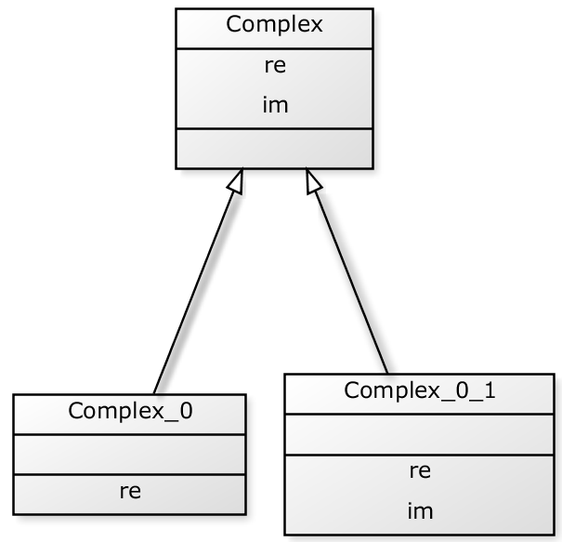
Projection Insertion: Classes
Notes:
http://yuml.me/diagram/scruffy/class/draw
[Customer]<>-orders*>[Order]
[Order]++-0..*>[LineItem]
[Order]-[note:Aggregate root.]
[Complex|re;im|]^-[Complex_0_1||re;im], [Complex]^-[Complex_0||re]
Needed others to
Use plain, huge. Make screencapture of it (background is otherwise black?). Crop to size.

Slide 39
Projection Insertion
def map1(in: Complex) = {
val cond = in.im > 0.0
val reOut = if (cond) {
in.re
} else {
-1.0 * in.re
}
val imOut = if (cond) {
in.im
} else {
-1.0 * in.im
}
val out = new Complex_0_1(reOut, imOut)
out: Complex
}
We know: Only field «re» is needed afterwards.
def project(in: Complex) = {
Complex_0(in.re)
}
Notes:
Mention that I call this a narrower

Slide 40
Projection Insertion: Step 1
def map1(in: Complex) = {
val cond = in.im > 0.0
val reOut = if (cond) {
in.re
} else {
-1.0 * in.re
}
val imOut = if (cond) {
in.im
} else {
-1.0 * in.im
}
val out = new Complex_0_1(reOut, imOut)
out: Complex
}
def project(in: Complex) = {
Complex_0(in.re)
}
def map1(in: Complex) = {
val cond = in.im > 0.0
val reOut = if (cond) {
in.re
} else {
-1.0 * in.re
}
val imOut = if (cond) {
in.im
} else {
-1.0 * in.im
}
val out = new Complex_0_1(reOut, imOut)
Complex_0(out.re)
}
Loop Fusion

Slide 41
Projection Insertion: Step 2
def map1(in: Complex) = {
val cond = in.im > 0.0
val reOut = if (cond) {
in.re
} else {
-1.0 * in.re
}
val imOut = if (cond) {
in.im
} else {
-1.0 * in.im
}
val out = new Complex_0_1(reOut, imOut)
Complex_0(out.re)
}
def map1(in: Complex) = {
val cond = in.im > 0.0
val reOut = if (cond) {
in.re
} else {
-1.0 * in.re
}
val imOut = if (cond) {
in.im
} else {
-1.0 * in.im
}
val out = new Complex_0_1(reOut, imOut)
Complex_0(reOut)
}
Field Read Shortcut

Slide 42
Projection Insertion: Step 3
def map1(in: Complex) = {
val cond = in.im > 0.0
val reOut = if (cond) {
in.re
} else {
-1.0 * in.re
}
val imOut = if (cond) {
in.im
} else {
-1.0 * in.im
}
val out = new Complex_0_1(reOut, imOut)
Complex_0(reOut)
}
def map1(in: Complex) = {
val cond = in.im > 0.0
val reOut = if (cond) {
in.re
} else {
-1.0 * in.re
}
val imOut = if (cond) {
in.im
} else {
-1.0 * in.im
}
Complex_0(reOut)
}
Dead Code Elimination

Slide 43
Projection Insertion: Step 4
def map1(in: Complex) = {
val cond = in.im > 0.0
val reOut = if (cond) {
in.re
} else {
-1.0 * in.re
}
val imOut = if (cond) {
in.im
} else {
-1.0 * in.im
}
Complex_0(reOut)
}
def map1(in: Complex) = {
val cond = in.im > 0.0
val reOut = if (cond) {
in.re
} else {
-1.0 * in.re
}
Complex_0(reOut)
}
Dead Code Elimination

Slide 44
Projection Insertion: Analysis
def project(in: Complex) = {
Complex_0(in.re)
}
How do we know which fields to keep?
Notes:
Mention that I call this a narrower

