Slide 1

Introduction to Scala
Vojin Jovanovic, EPFL
Twitter: @vojjov

Slide 2
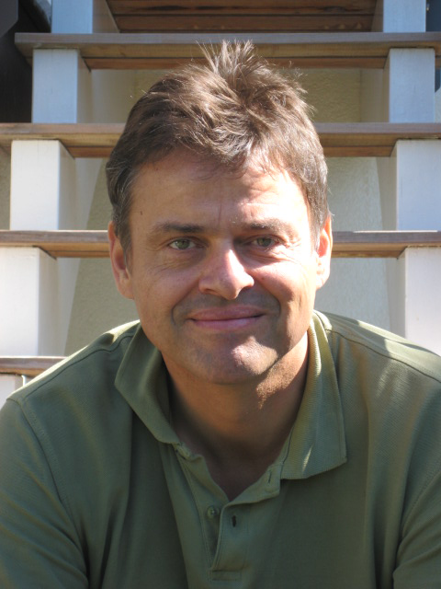

2003
Statically Typed
Lightweight
Java Interop.
OO + Functional

Slide 3

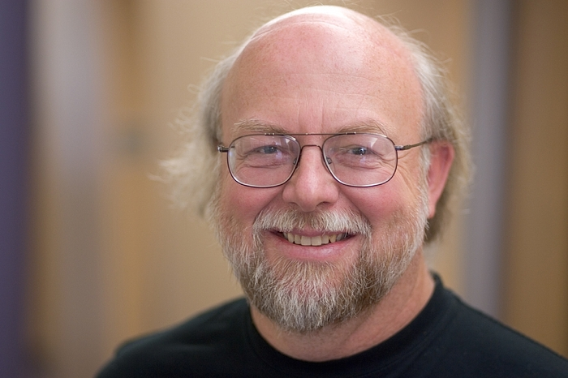
“If I were to pick a language to use today other than Java, it would be Scala.”
James Gosling (creator of Java)

Slide 4
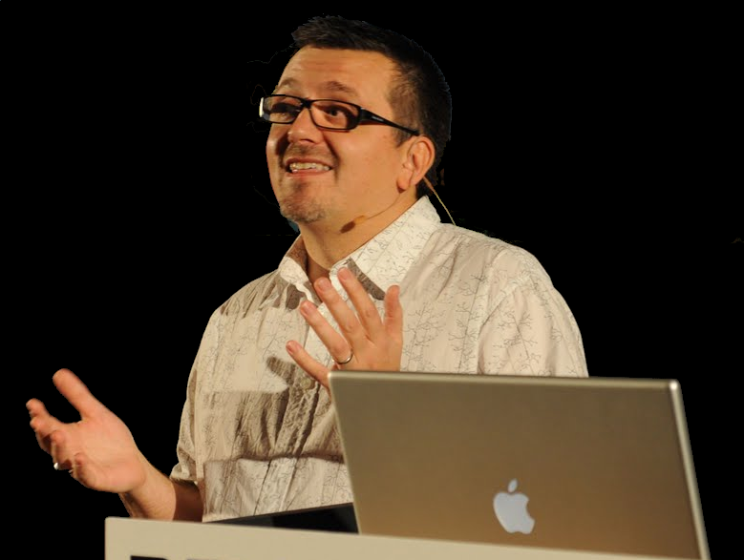

“I can honestly say if someone had shown me the Programming Scala book by Martin Odersky, Lex Spoon & Bill Venners back in 2003 I'd probably have never created Groovy.“
James Strachan, creator of Groovy

Slide 5








Who Uses Scala?

Slide 6

Scala is Lightweight

Slide 7
println("Zdravo svete!")

Slide 8
REPL
scala> println("Zdravo svete!")
Zdravo svete!

Slide 9
Compiled Hello World
object MyApp extends App { println("Zdravo svete!") }

Slide 10
Declaring Methods
object MyApp { def main(args: Array[String]) = { println("Zdravo svete!") } }

Slide 11
Declaring Variables
object MyApp { def main(args: Array[String]) { var user: String = args(0) println(s“Zdravo $user")
} }

Slide 12
Declaring Values
object MyApp { def main(args: Array[String]) { val user: String = args(0) println(s“Zdravo $user")
} }

Slide 13
Local Type Inference
object MyApp { def main(args: Array[String]) { val user = args(0) println(s"Zdravo $user")
} }

Slide 14
Local Type Inference
class StringArrayFactory { def create: Array[String] = { val array: Array[String] = Array[String]("1", "2", "3") array } }

Slide 15
Local Type Inference
class StringArrayFactory { def create = { val array = Array("1", "2", "3") array } }

Slide 16
Declaring Classes
// Java public class Person { private String name; private int age; public Person(String name, int age) { this.name = name; this.age = age; } public String getName() { return name; } public int getAge() { return age; } public void setName(String name) { this.name = name; } public void setAge(int age) { this.age = age; } }
// Scala class Person( var name: String, var age: Int )

Slide 17
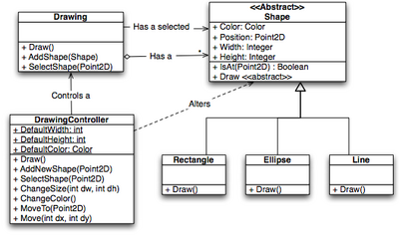
Scala is Object Oriented

Slide 18
Everything is an Object
Any
AnyVal
AnyRef
Boolean
Char
String
Int

Slide 19
Object Creation
object BigInt { // companion def apply(s: String): BigInt = new BigInt(s) def apply(i: Int): BigInt = new BigInt(i.toString) } class BigInt(val s: String) new BigInt("42") BigInt("42") BigInt(42)

Slide 20
Traits (are like interfaces)
trait Iterator[T] { def next(): T def hasNext: Boolean }

Slide 21
Traits (with implementations)
trait Iterator[T] { def next(): T def hasNext: Boolean
def print() { while (hasNext) println(next()) } }

Slide 22
Multiple Inheritance
trait Animal

Slide 23
Multiple Inheritance
trait Animal trait Human extends Animal { def think() { println(“hm...”) } }

Slide 24
Multiple Inheritance
trait Animal trait Human extends Animal { def think() { println(“hm...”) } } trait Horse extends Animal { def gallop() = System.createEgg() }

Slide 25
Inheritance – Mix-in Composition
trait Animal trait Mammal extends Animal { def think() { println(“hm...”) } } trait Bird extends Animal { def layEgg() = System.createEgg() } class Centaur extends Human with Horse

Slide 26
Dynamic Mix-in Composition
trait Lazy { def layInTheSun() {} } class Cat(name: String) extends Mammal new Cat("Garfield") with Lazy

Slide 27
Module Systems (aka Cake)
trait Logging { def log(msg: String) } trait AnimalPersistance { self => DAO def getByName(msg: String): Animal } trait AnimalService { self: Logging with AnimalPersistance => def animalByName(m: String) { log(s"Loading animal $m") getByName(m) } }

Slide 28
Module Instantiation
trait ConsoleLogging extends Logging { def log(msg: String) = println(msg) }
trait DBAnimalManager extends H2DAO
class DBAnimalService extends DBAnimalManager with ConsoleLogging
// Instantiate Module
new DBAnimalService

Slide 29

Functional Programming

Slide 30
First Class Functions
(x: Int) => x + 1

Slide 31
Functions are Objects
val inc: Int => Int = (x: Int) => x + 1
inc(1)
 2

Slide 32
Higher-Order Parameters
val inc: Int => Int = (x: Int) => x + 1
List(1, 2, 3).map(inc)  List(2, 3, 4)

Slide 33
Syntactic Sugar
List[Int](1, 2, 3).map((x: Int) => x + 1) // more type inference List(1, 2, 3).map(x => x + 1) // or even shorter List(1, 2, 3).map(_ + 1)

Slide 34
Closures (functions that capture the environment)
var step = 1 val inc = x => x + step
inc(5)  6
step = 2 inc(5)  7

Slide 35
Curried Functions
object FunctionFactory { def adder(x: Int)(y: Int) = x + y }
val inc: Int => Int = adder(1)
// or val ident = adder(0)_
inc(0) == ident(1)
 6

Slide 36
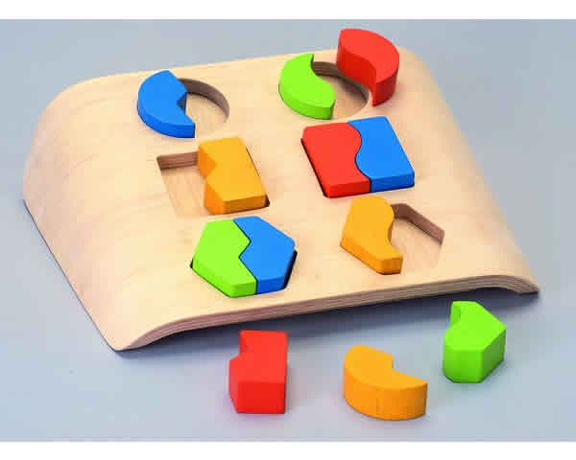
Pattern Matching

Slide 37
Pattern Matching (is concise)
// Java button.addMouseListener(new MouseAdapter() { public void mousePressed(MouseEvent e) {} public void mouseReleased(MouseEvent e) {} public void mouseEntered(MouseEvent e) {} public void mouseEntered(MouseEvent e) { System.out.println("I see it !"); } public void mouseExited(MouseEvent e) { System.out.println("Lost it."); } public void mouseClicked(MouseEvent e) { System.out.println("Poked !"); }}
// Scala reactions += { case m: MouseEntered => println("I see it!") case m: MouseExited => println("Lost it.") case m: MouseClicked => println("Poked!") }

Slide 38
Pattern Matching
trait Tree case class Leaf(v: Int) extends Tree case class Node(l: Tree, r: Tree) extends Tree def foreach(t: Tree, f: Int => Unit): Unit = t match { case Node(l, r) => foreach(l, f) foreach(r, f) case Leaf(v) => f(v)
case _ => sys.error("Another node type :/") }

Slide 39
Algebraic Data Types
Composite type formed by combining other types
sealed trait Tree case class Leaf(v: Int) extends Tree case class Node(l: Tree, r: Tree) extends Tree

Slide 40
Pattern Matching (is exhaustive)
def foreach(t: Tree, f: Int => Unit): Unit = t match { case Node(l, Leaf(v)) => foreach(l, f) f(v) case Node(Leaf(v), r) => foreach(r, f) f(v) }
<console>:14: warning: match may not be exhaustive.
It would fail on the following input:
Node(Node(_, _), Node(_, _))

Slide 41
Pattern Matching (is extensive)
def matchingAnything(a: Any): Any = a match { case 11 => “eleven” case s: String => “’%s’”.format(s) case <tag>{t}</tag> => t case Array(1, 2, 3) => “1, 2, 3” case head :: tail => tail case _ => null }

Slide 42

Lazy Evaluation in Scala

Slide 43
Lazy Values (compute on demand)
class Student(id: Int) { lazy val publications = fetchPublications(id) }

Slide 44
Call-by-Name Parameters
Call-by-value computes the message every time.
def log(msg: String) =
if (debugEnabled) println(msg)
log(veryExpensiveMessage())

Slide 45
Call-by-Name Parameters
Call-by-name computes the message when debugging is enabled.
def log(msg: => String) =
if (debugEnabled) println(msg)
log(veryExpensiveMessage())

Slide 46
Expressiveness of Scala
def qsort[T <% Ordered[T]](list: List[T]): List[T] =
list match { case Nil => Nil case p :: xs => val (lesser, greater) = xs partition (_ <= p) qsort(lesser) ++ List(p) ++ qsort(greater) }

Slide 47
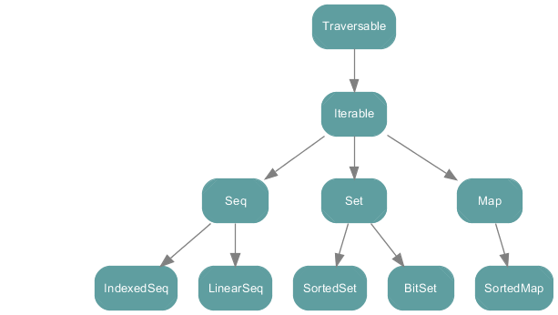
Collections

Slide 48
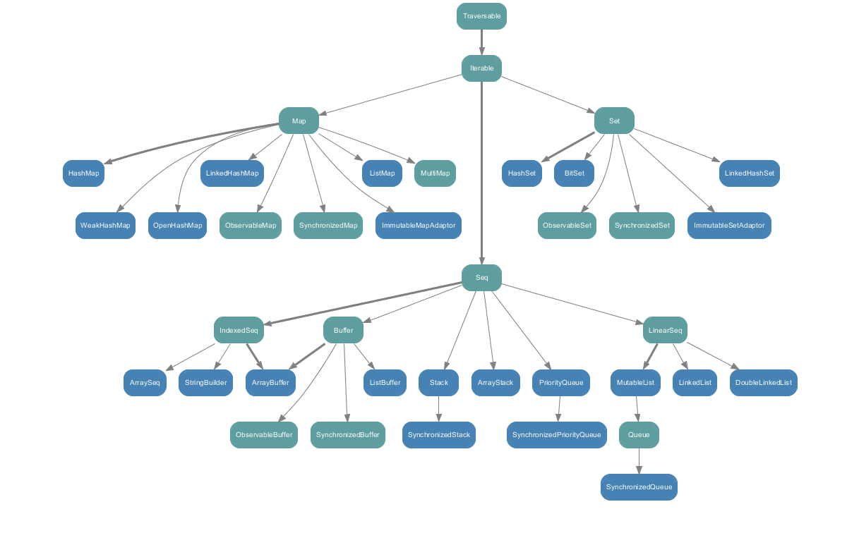
Mutable Collections

Slide 49
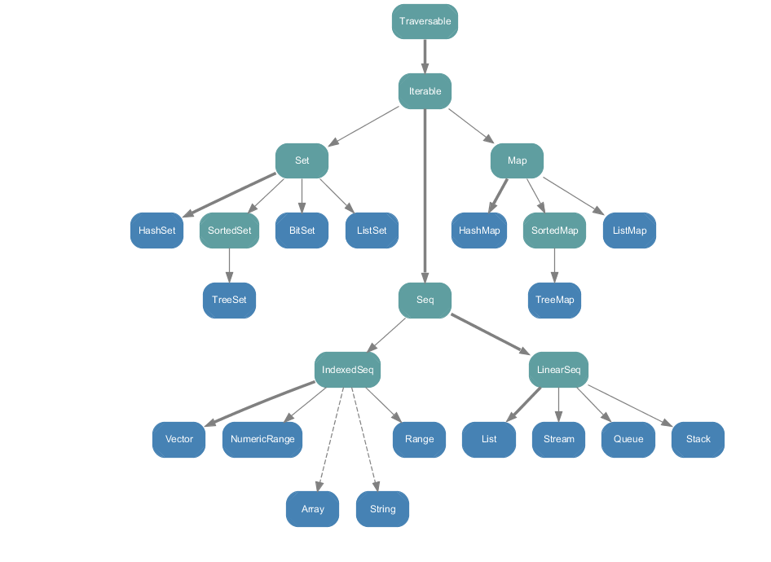
Immutable Collections

Slide 50
for Comprehensions
Traverse anything
for (x <- List(1, 2, 3)) println(x) List(1, 2, 3).foreach(x => println(x)) for (x <- 0 until 10) println(x) (0 until 10).foreach(x => println(x)) Range(0, 10, 1).foreach(x => println(x))

Slide 51
for Comprehensions (mapping)
for (x <- List(1, 2, 3)) yield x + 1 List(1, 2, 3).map(x => x + 1) for (x <- List(1, 2); y <- List(1, 2)) yield x + y List(1, 2).flatMap(x => List(1, 2).map(y => x + y) )

Slide 52
Scala has Support
Build tools Interactive build in SBT
Ant
Maven
SBT
> compile
...
> ~compile
...
> test
...
> package

Slide 53
IDEs supporting Scala
Eclipse
Netbeans
IntelliJ IDEA
Sublime Text
ENSIME
JEdit

Slide 54
Testing Tools - ScalaTest
"A list" should { "be a double reverse of itself" in { val ls = List(1, 2, 3, 4, 5, 6) ls.reverse.reverse should equal (ls) } }

Slide 55
Active Community
Social Media
http://stackoverflow.com/questions/tagged/scala
http://www.quora.com/If-Im-interested-in-Scala-then-who-should-I-follow-on-Twitter
Mailing Lists
http://groups.google.com/group/scala-user
http://groups.google.com/group/scala-internals

Slide 56
References
Learn Scala
http://scala-lang.org
coursera.org/course/progfun/

Slide 57


