Slide 1



Delite: Framework for Parallel Embedded DSLs
Vojin Jovanovic, EPFL
Twitter: @vojjov

Slide 2
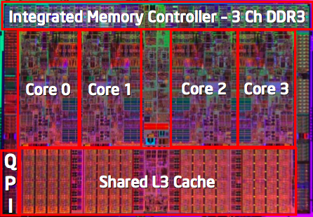

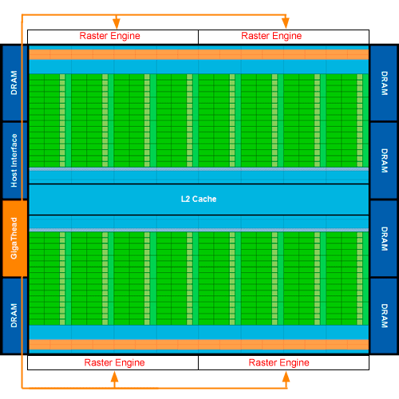
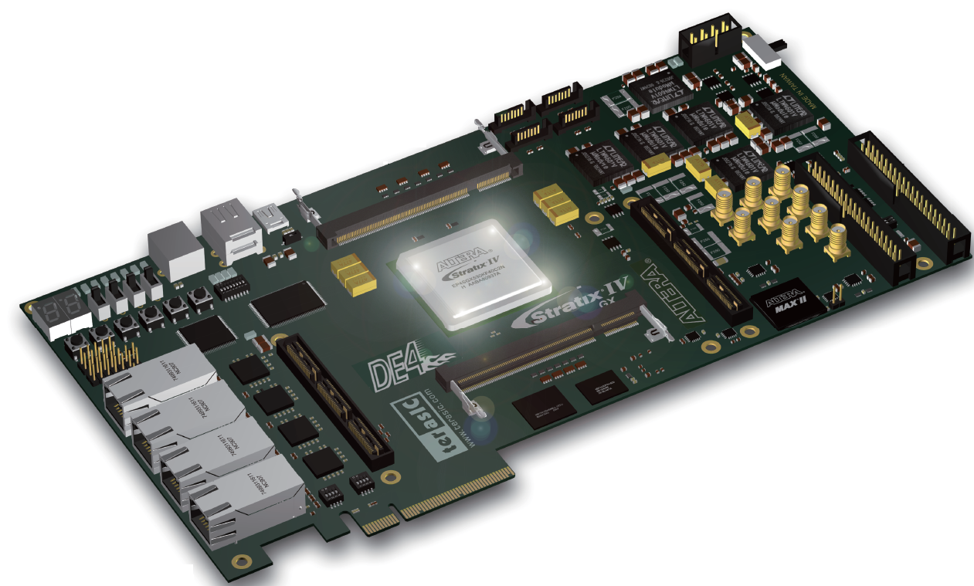
Programmability Gap
Pthreads
OpenMP
Sun
T2
CUDA
OpenCL
Nvidia
Fermi
Verilog
VHDL
Altera
FPGA
MPI
PGAS
Cray
Jaguar

Slide 3

Programmability Gap
Applications
Pthreads
OpenMP
Sun
T2
Scientific
Engineering
DSLs
Virtual Worlds
CUDA
OpenCL
Nvidia
Fermi
Personal Robotics
Verilog
VHDL
Altera
FPGA
Data
Informatics
MPI
PGAS
Cray
Jaguar
Too many different programming models

Slide 4
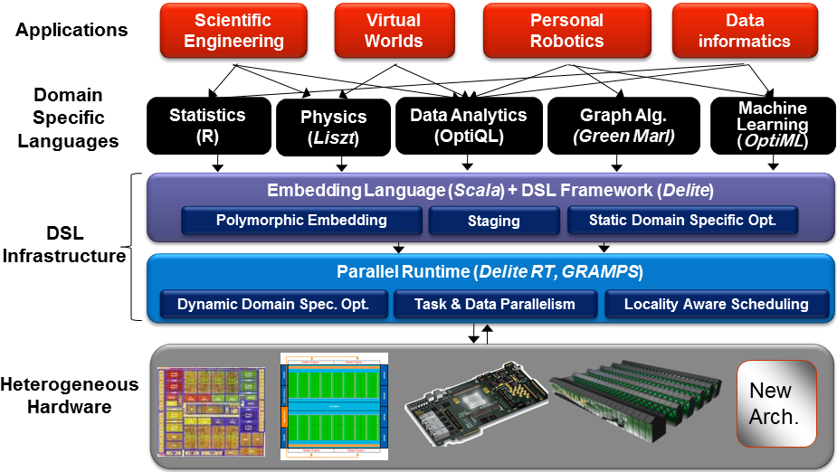
Delite Architecture

Slide 5
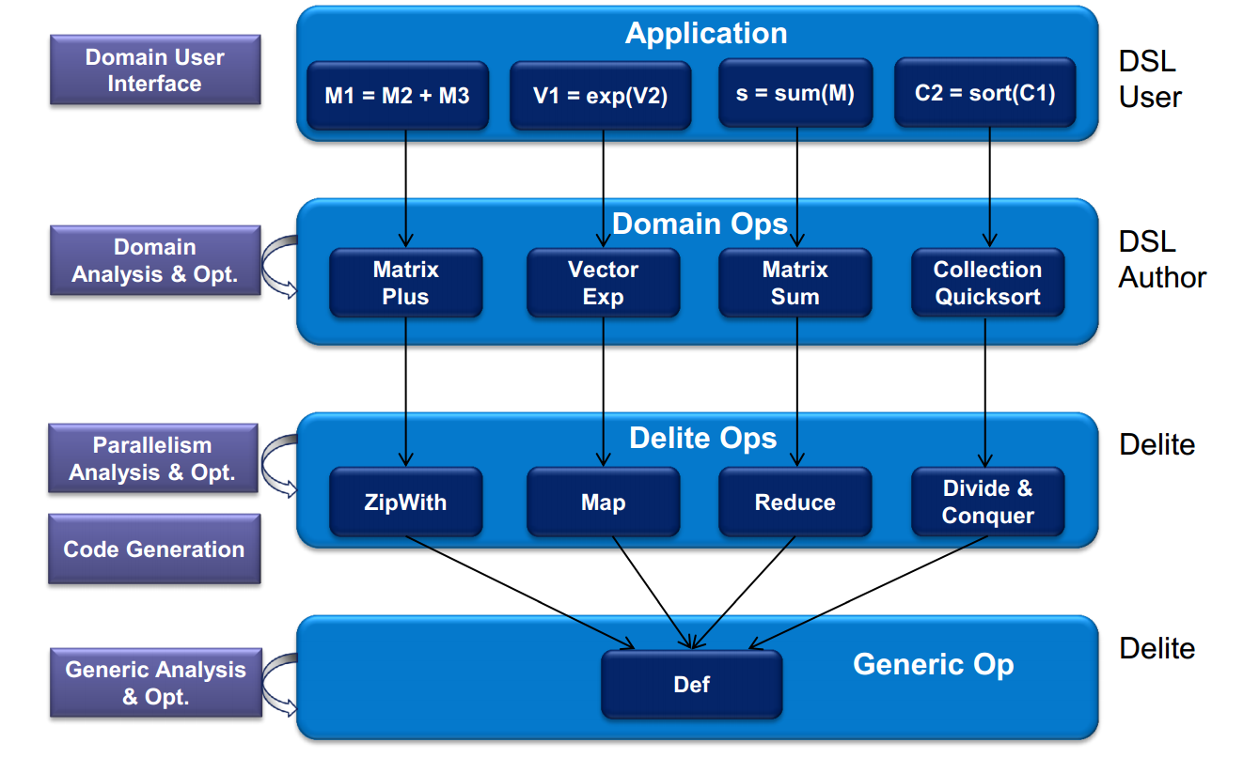
Delite Abstraction Layers

Slide 6
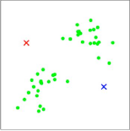
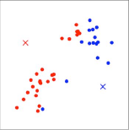
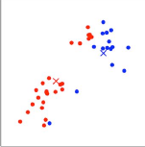
OptiML: Machine Learning
untilconverged(mu, tol){ mu =>
// calculate distances to current centroids
val c = (0::m){i =>
val allDistances = mu mapRows { centroid =>
dist(x(i), centroid)
}
allDistances.minIndex
}
// move each cluster centroid to the
// mean of the points assigned to it
val newMu = (0::k,*){ i =>
val (weightedpoints, points) = sum(0,m) { j =>
if (c(i) == j) (x(i),1)
}
val d = if (points == 0) 1 else points
weightedpoints / d
}
newMu
}

Slide 7
OptiML: K-Means
1.6
1.9
3.6
5.1
10.6

Slide 8
OptiQL: In Memory Querying
// lineItems: Iterable[LineItem]
// Similar to Q1 of the TPCH benchmark
val q = lineItems.Where(_.shdat <= Date(‘‘1998-12-01’’)).
GroupBy(l => (l.l_linestatus)).
Select(g => new Result {
val lineStatus = g.key
val sumQty = g.Sum(_.l_quantity)
val sumDiscountedPrice =
g.Sum(r => r.l_extendedprice*(1.0-r.l_discount))
val avgPrice = g.Average(_.l_extendedprice)
val countOrder = g.Count
}) OrderBy(_.returnFlag) ThenBy(_.lineStatus)
60x faster than the naïve implementations

Slide 9
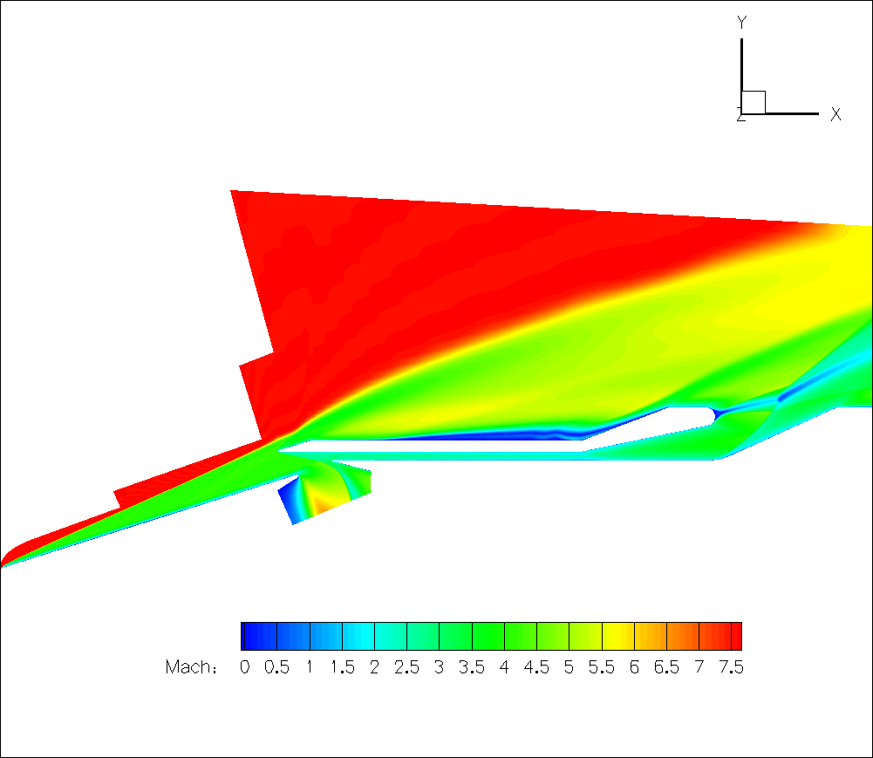
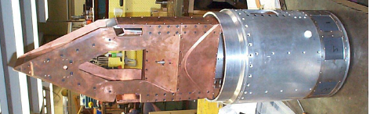
Fluid Dynamics
Example—PSAAP’s simulation of fluid flow in a hypersonic scramjet
Combustion
Turbulence
Fuel injection
Transition
Thermal
Turbulence

Slide 10
PSAAP’S Code Ported to Liszt
Full scramjet simulation [Pecnik et al.]
~2,000 lines of Liszt code
Ported from ~40,000 lines of MPI/C++ code
Two Versions
Euler—inviscid only
Navier-Stokes (NS)—viscous + inviscid

Slide 11
Listzt Performs as Well as C++
Single-core Performance
8-core Intel Nehalem E5520 2.26Ghz, 8GB RAM
All performance results use double precision

Slide 12
Liszt Scales On Large Clusters
Speedup
~20 million cells/mesh
Knee at 20k cells/core at 1024 cores (SA vs. Volume)
Liszt optimized away a message in Euler code
256 boards, 2 Nehalem X5650 processors/board , 4 cores/processor, OpenMPI
Notes:
Show graphs first without comparison to C++

Slide 13
Liszt Runs on GPUs
NS speedups from 7x to 28x in literature
[Corrigan et al., Kampolis et al., Giles et al.]

Slide 14
And Many Others
OptiCVX – convex optimization
OptiGraph – graph processing
OptiLA – linear algebra
OptiSDR- software defined radio

Slide 15
References
Learn Delite
http://github.com/stanford-ppl/Delite

Slide 16
Questions?
Also at:
@vojjov
vojin.jovanovic@epfl.ch

