Slide 1



High-performance DSLs Embedded in Scala

Slide 2
Is SQL a Good DSL?
select c.name, c.email from Candidate c, AppliesToJob atj, Jobs j where c.company = 'Oracle' and c.id = atj.cId and
atj.jId = j.id and j.company = 'Microsoft'
X Expressive
Fast

Slide 3
Good DSLs
Expressive
Fast

Slide 4
Why is SQL Expressive?
Language crafted for the domain
The whole language and tool chain built for the domain
Very large effort is required
Parser
Type Checker
IDE Support (IntelliJ, Eclipse, NetBeans …)
Build tool integration

Slide 5
Good DSLs (TODO image)
Expressive
Ad-hoc compiler and tool chain
Fast
Easy to develop

Slide 6
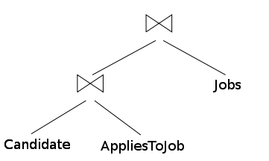
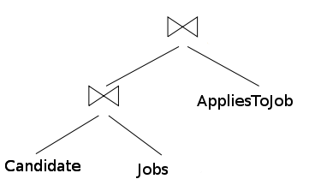
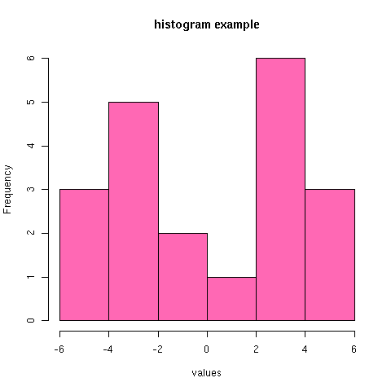
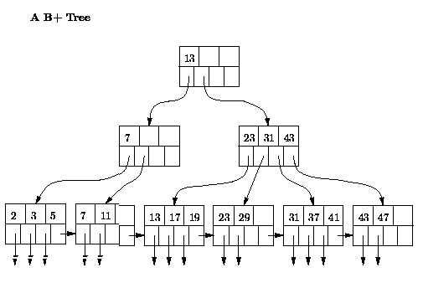
Good Performance of SQL
Compiler has domain knowledge
Compiled at run-time (access to data)
=

Slide 7
Good DSLs (TODO image)
Expressive
Flexible syntax (ad-hoc compiler and tool chain)
Fast
Domain Knowledge
Compiled at run-time
Easy to Construct

Slide 8
Using External DSLs
Programs in separate files
Programs as strings

Slide 9
DSL Programs as Strings
val pstmt = con.prepareStatement(s""" select (c.name, c.email) from Candidate c, AppliesTo ato, Jobs j where c.company = ? and c.id = ato.cid and
ato.jobId = j.id and j.company = ? """) pstmt.setString(1, company) pstmt.setString(2, jobCompany)

Slide 10
Using External DSLs
Requires additional tool support
Compile-time type checking
Boilerplate
Lack of modularity
Mismatch between DSLs and the host language

Slide 11
A QL Embedded in Java
create.select(Candidate.name,Candidate.phone) .from(Candidate) .join(AppliesToJobs) .join(Jobs) .where(Candidate.company.eq(fromCompany)) .and(Jobs.company.eq(toCompany))) .and(Candidate.id.eq(AppliesToJobs.cid)) .and(AppliesToJobs.jid.eq(Jobs.id));
X Not very concise
The dot notation
Table names repeated several times
No operators (e.g. `eq` used for `=`)

Slide 12
Why Couldn’t we Write?
from(Candidates,
AppliesToJobs,
Jobs)((c, atj, j) => where(
c.company == fromCompany && c.id == atj.cid &&
atj.jid == j.id && j.company == toCompany) compute(c.name, c.email))

Slide 13
Good DSLs (TODO image)
Expressive
Flexible syntax (ad-hoc compiler and tool chain)
Fast
Domain Knowledge
Compiled at run-time
Easy to Construct

Slide 14
Outline
Scala for Embedded DSLs
Lightweight Modular Staging
High-Performance DSLs
stay tuned…

Slide 15
Scala for Embedded DSLs
Flexible Method Invocation
User Defined Implicit Conversions
Macros
Virtualization
Abstract Type Members
Mix-In Composition

Slide 16
Symbolic Method Names
import java.math.BigInteger
class BigInt(val v: BigInteger) {
def +(that: BigInt): BigInt =
BigInt(v.add(that.v))
def +(that: Int): BigInt =
this.+(BigInt(that)) }
val v = BigInt(23) v.+(19)

Slide 17
Infix Methods
Dot and parenthesis can be omitted
val v = BigInt(23) v + 19 + 10 + 1
Methods are treated as left associative
val v = BigInt(23) (((v + 19) + 10) + 1)
Except Methods that end in a column (:)
val v = BigInt(23) 1 +: 10 +: 19 +: v == v + 19 + 10 + 1
Notes:
TODO what about multiparameter methods. What does the style guide say?

Slide 18
Unary Methods
object BigInt { ... }
class BigInt(val v: BigInteger) {
// ... def unary_-: BigInt = BigInt(0) – this
// ...
}
-(-BigInt(23) + -19)

Slide 19
Postfix Methods
class BigInt(val v: BigInteger) {
// ... def !: BigInt =
if ((BigInteger.ONE compareTo this.v) == 1) BigInt(1) else this * (this - 1).!
// ...
} BigInt(5)! // use with caution
BigInt(5).!

Slide 20
Putting it Together
val v = BigInt(23) + 19 -BigInt(3).! + BigInt(4).! * BigInt(2).! == v
Are we there yet?
val v = 23 + 19 -3.! + 4.! * 2.! == v

Slide 21
Implicit Conversions
Fixing type errors by changing terms
Known construct from C, C++, C#, and Java:
Scala implicits - user defined and prioritized
Boolean b = true; Boolean b = Boolean.TRUE;
boolean unb = b; boolean unb = b.readBoolean();

Slide 22
User Defined Implicit Conversions
Type of a term is wrong => find a fix
implicit def toBigI(i: Int) = BigInt(i)
val v = 3.!
val v = toBigI(3).!
val v: BigInt = 3
val v: BigInt = toBigI(3)

Slide 23
Putting it Together (again)
val v = 23 + 19 -3.! + 4.! * 2.! == v
Are we there yet?
val v = BigInt(23) + 19 42 == v

Slide 24
And now… Macros (gorilla)
Compile-time meta programming
Simple compiler plugins with a stable API
Completely transparent to users
def fix_==(c: Any, msg: Any): Unit =
macro fix_==Impl

Slide 25
Macro Workflow

Slide 26
What does this macro do?
def fix_==Impl(block: Tree): Tree = new Transformer { override def transform(t: Tree) =
t match { case q"$lhs == $rhs " => q”””this.__== (
${transform(lhs)},
${transform(rhs)}
)”””
case tree => super.transform(tree) }
}.transform(block))

Slide 27
What does this macro do?
def virtualize(block: Tree): Tree = new Transformer { override def transform(t: Tree) =
t match { case q"if($c) $t else $e" => q”””this.__ifThenElse(
${transform(c)},
${transform(t)},
${transform(e)}
)”””
case tree => super.transform(tree) }
}.transform(block))

Slide 28
Language Virtualization
def __ifThenElse[T](c: Boolean,
t: => T,
e: => T): T = { println(s"if ($c) $t else $e")
if (c) t else e
} def __==[T, U](lhs: T, rhs: U): Boolean = {
println(s"$lhs == $rhs")
lhs == rhs
}
virtualize {
if (true == false) "wrong" else "correct"
}

Slide 29
Language Virtualization
def __ifThenElse[T](c: Boolean,
t: => T,
e: => T): T = { println(s"if ($c) $t else $e")
if (c) t else e
} def __==[T, U](lhs: T, rhs: U): Boolean = {
println(s"$lhs == $rhs")
lhs == rhs
}
__ifThenElse(__==(true,false),“wrong“,“correct“)

Slide 30
Finally!
42 == -3.! + 4.! * 2.!
What about performance?
__==(42, toBigI(-3).! + toBigI(4).! * toBigI(2).!)
What should be executed?
true

Slide 31
Good DSLs (TODO image)
Concise
Flexible syntax (ad-hoc compiler and tool chain)
Fast
Domain Knowledge
Compiled at run-time
Easy to Construct

Slide 32
Abstract Type Members
Abstraction over types
trait Graph {
type Node
def foreach(x: Node => Unit)
}

Slide 33
Abstract Type Members
trait SimpleNode {
def pred: List[SimpleNode]
}
class DirectedGraph extends Graph {
type Node <: SimpleNode
def foreach(x: Node => Unit) = …
}

Slide 34
Good DSLs (TODO image)
Concise
Flexible syntax (ad-hoc compiler and tool chain)
Fast
Domain Knowledge
Compiled at run-time
Easy to Construct

Slide 35
Mix-in Composition
Form of multiple inheritance
Interfaces with implementations
trait TraversableLike[+A, +Repr] {
def foreach[U](f: A => U): Unit
// + > 50 methods based on foreach
}

Slide 36
Mix-in Composition
Iterable trait signature
DirectedGraph with Iterable

Slide 37
Let’s Build a DSLs

Slide 38
Lightweight Modular Staging
Framework for embedding DSLs
Makes it easy to develop new EDSLs

Slide 39
LMS Design
Start with our Graph and change the Node to Rep[T]
Compiler has an IR and it is a graph right?

Slide 40
Interface as a Trait
Object for creating a List
Println for printing

Slide 41
IR Construction

Slide 42
LMS Optimizations
Loop Fusion
Code Motion
Decomposition of Structure

Slide 43
Optimizations in Practice

Slide 44
Macros to the Rescue

Slide 45
Jet: Big Data on Hadoop/Spark
Abstracts over Hadoop and Spark

Slide 46
Jet: TPCH Q12
Input: dbgen with scaling factor 200 (~ 200Gb)

Slide 47
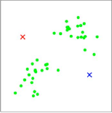
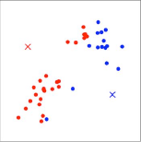
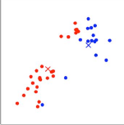
OptiML: Machine Learning
untilconverged(mu, tol){ mu =>
// calculate distances to current centroids
val c = (0::m){i =>
val allDistances = mu mapRows { centroid =>
dist(x(i), centroid)
}
allDistances.minIndex
}
// move each cluster centroid to the
// mean of the points assigned to it
val newMu = (0::k,*){ i =>
val (weightedpoints, points) = sum(0,m) { j =>
if (c(i) == j) (x(i),1)
}
val d = if (points == 0) 1 else points
weightedpoints / d
}
newMu
}

Slide 48
OptiML: K-Means
1.6
1.9
3.6
5.1
10.6

Slide 49
Examples: Liszt
val Position = FieldWithLabel[Vertex,Double3](“position”)
val Temperature = FieldWithLabel[Vertex,Double](“init_temp”)
val Flux = FieldWithConst[Vertex,Double](0.0)
val JacobiStep = FieldWithConst[Vertex,Double](0.0)
var i = 0
while (i < 1000) {
val all_edges = edges(mesh)
for (e <- all_edges) {
val v1 = head(e)
val v2 = tail(e)
val dP = Position(v1) - Position(v2)
val dT = Temperature(v1) - Temperature(v2)
val step = 1.0/(length(dP))
Flux(v1) += dT*step
Flux(v2) -= dT*step
JacobiStep(v1) += step
JacobiStep(v2) += step
}
for (p <- vertices(mesh)) {
Temperature(p) += 0.01*Flux(p)/JacobiStep(p)
}
for (p <- vertices(mesh)) {
Flux(p) = 0.0; JacobiStep(p) = 0.0;
}
i += 1
}

