Slide 1



High-Performance DSLs Embedded in Scala
Vojin Jovanovic, EPFL
Twitter: @vojjov

Slide 2
Is SQL a Good DSL?
select (c.name, c.email) from Candidate c, AppliesToJobs atj, Jobs j where c.company = 'Oracle' and c.id = atj.cId and
atj.jId = j.id and j.company = 'Microsoft'
✓Expressive
✓ Fast

Slide 3
A Good DSLs
✓ Expressive
✓ Fast

Slide 4
Why is SQL Expressive?
✓Language crafted for a single domain
X Very large effort is required
Parser
Type Checker
IDE Support (IntelliJ, Eclipse, NetBeans …)
Build tool integration

Slide 5
A Good DSLs
✓ Expressive
Syntax Crafted for the Domain
✓ Fast
✓ Easy to develop

Slide 6
Is SQL SQL a Good DSLs?
✓ Expressive
Syntax Crafted for the Domain
✓ Fast
X Easy to develop

Slide 7
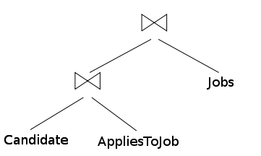
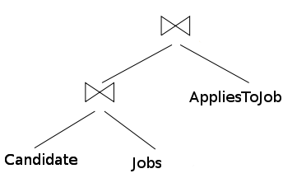
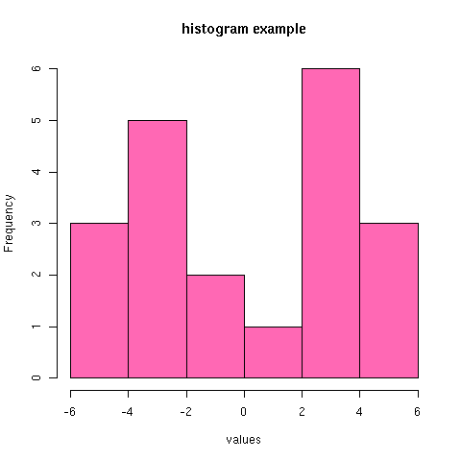
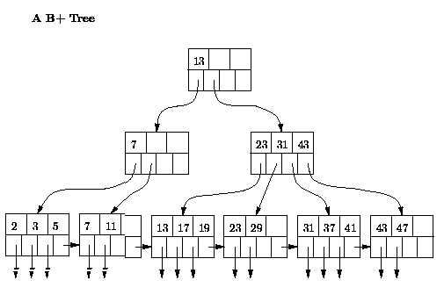
Good Performance of SQL
SQL compiler has domain knowledge
Compiled at run-time (access to data)
=

Slide 8
A Good DSL
✓ Expressive
Syntax Crafted for the Domain
✓ Fast
Domain knowledge
Run-time compilation
✓ Easy to develop

Slide 9
Using External DSLs
DSL programs in separate files
DSL programs as strings

Slide 10
DSL Programs as Strings
val pstmt = con.prepareStatement(s""" select (c.name, c.email) from Candidate c, AppliesToJobs atj, Jobs j where c.company = ? and c.id = atj.cid and
atj.jobId = j.id and j.company = ? """) pstmt.setString(1, fromCompany) pstmt.setString(2, toCompany)

Slide 11
Using External DSLs
Requires additional tool support
Run-time type checking
Boilerplate
Lack of composability
Mismatch of DSLs and the host language

Slide 12
Is SQL a Good DSLs?
✓ Expressive
Syntax Crafted for the Domain
✓ Fast
Domain knowledge
Run-time compilation
X Easy to develop

Slide 13
A QL Embedded in Java
create.select(Candidate.name,Candidate.phone) .from(Candidate) .join(AppliesToJobs) .join(Jobs) .where(Candidate.company.eq(fromCompany)) .and(Jobs.company.eq(toCompany)) .and(Candidate.id.eq(AppliesToJobs.jid)) .and(AppliesToJobs.jid.eq(Jobs.id));
X Not very concise
The dot notation
Table names repeated several times
No operators (e.g. `eq` used for `=`)

Slide 14
QL Embedded in Java
X Expressive
Syntax Constrained by the host language
✓ Fast
Domain knowledge
Run-time compilation
✓ Easy to develop

Slide 15
Why Couldn’t we Write?
from(Candidates,
AppliesToJobs,
Jobs)((c, atj, j) => where(
c.company == fromCompany && c.id == atj.cId &&
atj.jId == j.id && j.company == toCompany) compute(c.name, c.email))

Slide 16
A Good DSLs
✓ Expressive
Syntax Crafted for the Domain
✓ Fast
Domain knowledge
Run-time compilation
✓ Easy to develop

Slide 17
Outline
Scala for Embedded DSLs
Lightweight Modular Staging (LMS)
High-Performance DSLs
stay tuned…

Slide 18
Scala for Embedded DSLs
Syntactic Sugar
Flexible Method Invocation Syntax
User Defined Implicit Conversions
Macros
Language Virtualization
Abstract Type Members
Mix-In Composition

Slide 19
Syntactic Sugar
import java.math.BigInteger
class BigInt(val v: BigInteger) {
// ...
}
object BigInt { def apply(v: BigInteger): BigInt =
new BigInt(v)
def apply(v: Int): BigInt = BigInt(new BigInteger(v.toString))
}
val v = BigInt(23) v.add(BigInt(19))

Slide 20
Symbolic Method Names
import java.math.BigInteger
class BigInt(val v: BigInteger) {
def +(that: BigInt): BigInt =
BigInt(v.add(that.v))
def +(that: Int): BigInt =
this.+(BigInt(that)) }
val v = BigInt(23) v.+(19)

Slide 21
Infix Methods
The dot and parenthesis can be omitted
val v = BigInt(23) v + 19 + 10 + 1
Methods are treated as left associative
val v = BigInt(23) (((v + 19) + 10) + 1)
Except methods that end in a column (:)
val v = BigInt(23) 1 +: 10 +: 19 +: v == v + 19 + 10 + 1
Notes:
TODO what about multiparameter methods. What does the style guide say?

Slide 22
Unary Methods
class BigInt(val v: BigInteger) {
// ... def unary_-: BigInt = BigInt(0) – this
// ...
}
-(-BigInt(23) + -19)

Slide 23
Postfix Methods
class BigInt(val v: BigInteger) {
// ... def !: BigInt =
if ((BigInteger.ONE compareTo this.v) == 1) BigInt(1) else this * (this - 1).!
// ...
} BigInt(5)! // use with caution
BigInt(5).!

Slide 24
Putting it Together
val v = BigInt(23) + 19 -(BigInt(3).!) + BigInt(4).! * BigInt(2).! == v
Are we there yet?
val v = 23 + 19 -(3.!) + 4.! * 2.! == v

Slide 25
Implicit Conversions
Fixing type errors by changing terms
Known construct from C++, C#, and Java:
Boolean b = true; Boolean b = Boolean.TRUE;
boolean unb = b; boolean unb = b.readBoolean();

Slide 26

Scala Implicit Conversions
If a term type is wrong, search for a fix
implicit def toBigI(i: Int) = BigInt(i)
val v = 3.!
val v = toBigI(3).!
val v: BigInt = 3
val v: BigInt = toBigI(3)

Slide 27
Putting it Together (again)
val v = 23 + 19 -(3.!) + 4.! * 2.! == v
Are we there yet?
42 == -(3.!) + 4.! * 2.!

Slide 28


Macros
Compile-time meta-programming
Completely transparent to the users
def fix_==[T](block: => T): T =
macro fix_==Impl

Slide 29

Regular Workflow
…
foo{“Bar” == 1}
…
Type Checker
…
foo{“Bar” == 1} // typed
…

Slide 30
Macro Workflow
…
fix_=={“Bar” == 1}
…
Type Checker
fix_==Impl(Tree({“Bar” == 1}))
…
__==(“Bar”, 1) // typed
…

Slide 31
What Does This Macro do?
def fix_==Impl(block: Tree): Tree = new Transformer { override def transform(t: Tree) =
t match { case q"$lhs == $rhs" => q"""this.__== (
${transform(lhs)},
${transform(rhs)}
)"""
case tree => super.transform(tree) }
}.transform(block))

Slide 32
What Does This Macro do?
def virtualize(block: Tree): Tree = new Transformer { override def transform(t: Tree) =
t match {
case q"$lhs == $rhs " => … case q"if($c) $t else $e" => q"""this.__ifThenElse(
${transform(c)},
${transform(t)},
${transform(e)}
)""" // ... }
}.transform(block))

Slide 33
Language Virtualization
def __ifThenElse[T](c: Boolean,
t: => T,
e: => T): T = { println(s"if ($c) $t else $e")
if (c) t else e
} def __==[T, U](lhs: T, rhs: U): Boolean = {
println(s"$lhs == $rhs")
lhs == rhs
}
virtualize {
if (true == false) "wrong" else "correct"
}

Slide 34
Language Virtualization
def __ifThenElse[T](c: Boolean,
t: => T,
e: => T): T = { println(s"if ($c) $t else $e")
if (c) t else e
} def __==[T, U](lhs: T, rhs: U): Boolean = {
println(s"$lhs == $rhs")
lhs == rhs
}
__ifThenElse(__==(true,false),“wrong“,“correct“)

Slide 35
Finally!
42 == -(3.!) + 4.! * 2.!
What about performance?
__==(42, -toBigI(3).! + toBigI(4).! * toBigI(2).!)
What should be executed?
true

Slide 36
A Good DSLs
✓ Expressive
Syntax Crafted for the Domain
Fast
Domain knowledge
Run-time compilation
Easy to develop

Slide 37
Abstract Type Members
Abstraction over types
Can be refined with inheritance
trait Graph {
type Node
def foreach(x: Node => Unit): Unit
}

Slide 38
Abstract Type Members
trait SimpleNode {
def succ: List[SimpleNode]
}
trait DirectedGraph extends Graph {
type Node = SimpleNode
val root: List[SimpleNode]
def foreach(x: Node => Unit): Unit = …
}

Slide 39

Abstract Type Members
trait Base {
type Rep[T]
}
trait Expressions extends Base {
type Rep[T] = Exp[T]
trait Exp[T] {
def symbols: List[Exp[_]]
}
}

Slide 40
Abstract Type Members
trait Expressions extends Base {
type Rep[T] = Exp[T]
trait Exp[T] {
def symbols: List[Exp[_]]
}
case class BigIntPlus(
lhs: Rep[BigInt],
rhs: Rep[BigInt]
) extends Exp[BigInt]
def +(lhs: Rep[BigInt],
rhs: Rep[BigInt]): Rep[BigInt] =
BigIntPlus(lhs, rhs)
}

Slide 41
A Good DSLs
✓ Expressive
Syntax Crafted for the Domain
✓ Fast
Domain knowledge
Run-time compilation
Easy to develop

Slide 42
Mix-in Composition
Form of multiple inheritance
Interfaces with implementations
trait Traversable[A] {
def foreach(f: A => Unit): Unit
// + > 50 methods based on foreach
}

Slide 43
Mix-in Composition
trait VeryRichGraph extends DirectedGraph
with Traversable[SimpleNode]

Slide 44
Let’s Build a DSLs
✓ Expressive
Syntax Crafted for the Domain
✓ Fast
Domain knowledge
Run-time compilation
✓ Easy to develop

Slide 45
Lightweight Modular Staging (LMS)
Framework for embedding DSLs
Easy to develop high-performance DSLs
Uses all of the previous techniques

Slide 46
LMS: DSL Interface
trait Base { type Rep[+T] }
trait BigIntOps extends IntOps with Base {
object BigInt { def apply(v: Rep[Int]): Rep[BigInt] =
// delegate to a method }
trait BigIntTrait {
def +(that: Rep[BigInt]): Rep[BigInt] def +(that: Rep[Int]): Rep[BigInt]
}
implicit repBI(bi: Rep[BigInt]): BigIntTrait
implicit liftInt(i: Int): Rep[Int]
}

Slide 47
LMS: DSL Interface
new BigIntOps {
val v = BigInt(23) v + 19
}
Will this work?
<error> BigIntOps: is abstract and can not be instantiated since methods:
.
.
.
are not defined

Slide 48
LMS: Expressions
trait Expressions extends Base {
type Rep[T] = Exp[T]
trait Exp[T] {// DSL compiler stuff}
}

Slide 49
LMS: Expressions
trait BigIntExp extends Expressions {
case class BigIntPlus(l: Rep[BigInt],
r: Rep[BigInt]) extends Exp[BigInt]
class BigIntCls(val bi: Rep[BigInt])
extends BigIntTrait {
def +(that: Rep[BigInt]): Rep[BigInt] =
BigIntPlus(bi, that)
// and all other ops }
implicit repBI(bi: Rep[BigInt]): BigIntTrait=
new BigIntCls(bi)
// all other implicits
}

Slide 50
LMS: IR Construction
Const(1)
fooDSL {
if (true)
1 == 1
else
1.!
}
Const(1)
Const(1)
Const(true)
==
Fact
IfThenElse

Slide 51
The Question
def __ifThenElse[T](c: Boolean,
t: => T,
e: => T): T = if (c) t else e
def __ifThenElse[T](c: Rep[Boolean],
t: => Rep[T],
e: => Rep[T]): Rep[T] = IfThenElse(c, t, e)
// same for ==
// functions are not virtualized
def powRep(b: Rep[Int], exp: Rep[Int]) =
if (exp == 0) 1 else b * powRep(exp – 1)
def powNoRep(b: Rep[Int], exp: Int) =
if (exp == 0) 1 else b * powNoRep(exp – 1)

Slide 52
What does the following return?
def powRep(b: Rep[Int], exp: Rep[Int]) =
if (exp == 0) 1 else b * powRep(exp – 1)
def powNoRep(b: Rep[Int], exp: Int) =
if (exp == 0) 1 else b * powNoRep(exp – 1)
powRep(x, 10)
StackOverflow
powNoRep(x, 10)
x*x*x*x*x*x*x*x*x*x
??????????

Slide 53
We Stop Here
new BigIntOps extends BigIntExp with Optimizer
with CodeGenerator {
42 == -(3.!) + 4.! * 2.!
}
bigIntDSL {
42 == -(3.!) + 4.! * 2.!
}

Slide 54
LMS Optimizations
Loop Fusion
Code Motion
Decomposition of Structures

Slide 55
Optimizations: TPCH Q12
String
map (parse)
LineItem
filter
LineItem
filter
(3 more filters)
LineItem
map (tuple)
(Long, LineItem)

Slide 56
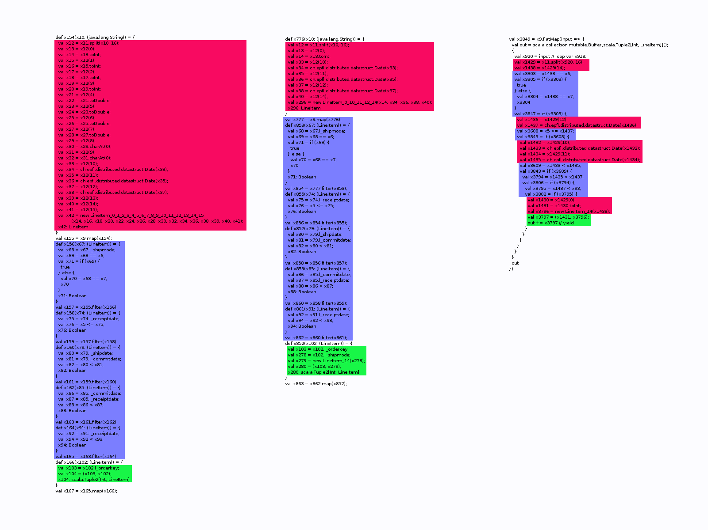
Optimizations: TPCH Q12
Unoptimized
With Projection
With Loop Fusion
Parsing
Filtering
Tuple Creation
Fields: 16 / 16 5 / 16 1 – 5 / 1

Slide 57
A Good DSLs
✓ Expressive
Syntax Crafted for the Domain
✓ Fast
Domain knowledge
Run-time compilation
? Easy to develop

Slide 58
trait MyNewDSL extends AllComplexStuff
with WholeScalaLibrary {
// please fill in what’s missing and
// would you like to generate
// C++, CUDA, or Scala?
}

Slide 59
A Good DSLs
✓ Expressive
Syntax Crafted for the Domain
✓ Fast
Domain knowledge
Run-time compilation
✓ Easy to develop

Slide 60
Jet: Big Data on Hadoop/Spark
val filteredLineitems = lineitems .filter(x => x.l_shipmode.matches(shipModes)) .filter(x => date <= x.l_receiptdate) .filter(x => x.l_shipdate < x.l_commitdate) .filter(x => x.l_commitdate < x.l_receiptdate) .filter(x => x.l_receiptdate < date +(1, 0, 0)) // perform the join val orderTuples = orders.map(x => (x.o_orderkey, x)) val lineItemTuples = filteredLineitems.map(x => (x.l_orderkey, x)) val joined = lineItemTuples.join(orderTuples, getArgs(4).toInt) // prepare for aggregation joined.map { x => val prio = x._2._2.o_orderpriority; val isHigh = prio.matches("1-URGENT") || prio.matches("2-HIGH") val count = if (isHigh) 1 else 0 val part2: Rep[(Int, Int)] = (count, 1 - count) (x._2._1.l_shipmode, part2) }.groupByKey(1).reduce((x, y) => (x._1 + y._1, x._2 + y._2)) .map { x => "shipmode " + x._1 + ": high " + x._2._1 + ", low " + x._2._2 }.save(getArgs(1))

Slide 61
Jet: TPCH Q12
Input: dbgen with scaling factor 200 (~ 200Gb)

Slide 62
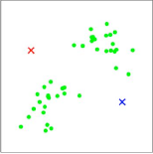
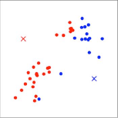
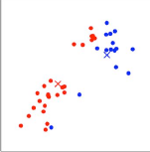
OptiML: Machine Learning
untilconverged(mu, tol){ mu =>
// calculate distances to current centroids
val c = (0::m){i =>
val allDistances = mu mapRows { centroid =>
dist(x(i), centroid)
}
allDistances.minIndex
}
// move each cluster centroid to the
// mean of the points assigned to it
val newMu = (0::k,*){ i =>
val (weightedpoints, points) = sum(0,m) { j =>
if (c(i) == j) (x(i),1)
}
val d = if (points == 0) 1 else points
weightedpoints / d
}
newMu
}

Slide 63
OptiML: K-Means
1.6
1.9
3.6
5.1
10.6

Slide 64
OptiQL: In Memory Querying
// lineItems: Iterable[LineItem]
// Similar to Q1 of the TPCH benchmark
val q = lineItems.Where(_.shdat <= Date(‘‘1998-12-01’’)).
GroupBy(l => (l.l_linestatus)).
Select(g => new Result {
val lineStatus = g.key
val sumQty = g.Sum(_.l_quantity)
val sumDiscountedPrice =
g.Sum(r => r.l_extendedprice*(1.0-r.l_discount))
val avgPrice = g.Average(_.l_extendedprice)
val countOrder = g.Count
}) OrderBy(_.returnFlag) ThenBy(_.lineStatus)
60x faster than the naïve implementations

Slide 65
When do DSLs Make Sense?
Well Defined and Restricted Domain
Need for productivity and performance
Data Analytics
Incremental View Maintenance
Statistics and Machine Learning
Graph Processing
Scientific Computing

Slide 66
Warning
Do not do anything similar at your workplace!
Making an embedded DSL is not that easy as it may seem in this presentation.

Slide 67
References
Learn Scala
http://scala-lang.org
coursera.org/course/progfun/
Learn LMS
http://scala-lms.github.com
http://github.com/stanford-ppl/Delite

Slide 68
Questions?
Also at:
@vojjov
vojin.jovanovic@epfl.ch

