Slide 1
Network Security Project
UDP Port Scan & SSH Brute Force Attack
By Vedant Patel
Notes:
Script: "Hello everyone, and thank you for being here. Today, I’ll be walking you through a cybersecurity project that focuses on two commonly used network attacks: a UDP Port Scan and an SSH Brute Force Attack. These attack techniques are often used by ethical hackers and penetration testers to assess vulnerabilities in systems — and unfortunately, also by malicious actors to gain unauthorized access. By understanding how these attacks work, we can better secure our systems and networks."

Slide 2
UDP Port Scan
Used: sudo nmap -sU -p- 192.168.2.242
Scans all 65,535 UDP ports
UDP is stealthy (no handshake), harder to detect
Notes:
"I started with a UDP Port Scan using a tool called Nmap — one of the most widely used network scanning tools out there. The target machine had an IP address of 192.168.2.242, and the command I used was:
sudo nmap -sU -p- 192.168.2.242
This command scans all 65,535 UDP ports on the target, helping detect services like DNS, SNMP, or VPNs that run over the UDP protocol. Unlike TCP scans, UDP scans don’t establish a connection, which makes them stealthy but also slower and less reliable. Often, open ports don’t respond at all, while closed ports reply with ICMP errors — so interpreting the results takes a bit of experience."

Slide 3
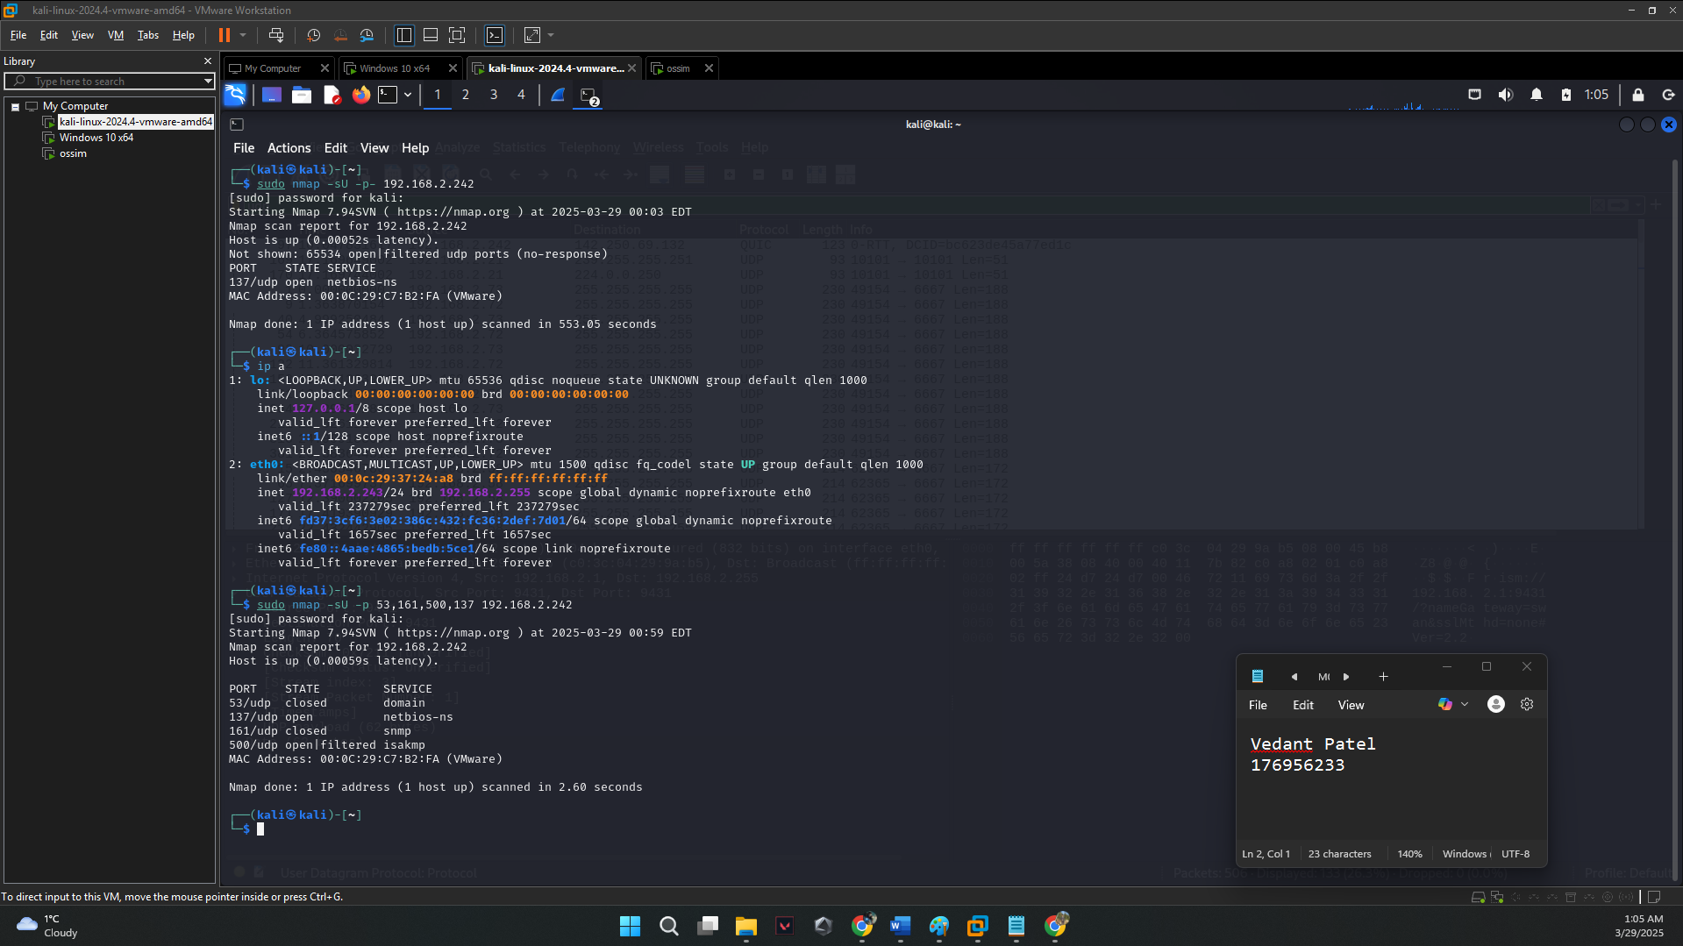
Command Output
Notes:
Here is the output of that command

Slide 4
Capturing UDP Packets
Wireshark filter used: udp
Open ports often show no response
Closed ports return ICMP 'port unreachable'
Notes:
"To analyze the network traffic in real-time during the scan, I used Wireshark, a packet analyzer. By applying a filter udp, I could see the exact packets being sent and received.
Since UDP is connectionless, there’s no handshake like in TCP. That’s why packet responses differ — for example, an open port might show no response, while a closed one returns an ICMP 'port unreachable' message. This uncertainty is what makes UDP scans harder to detect — but also harder to interpret."

Slide 5
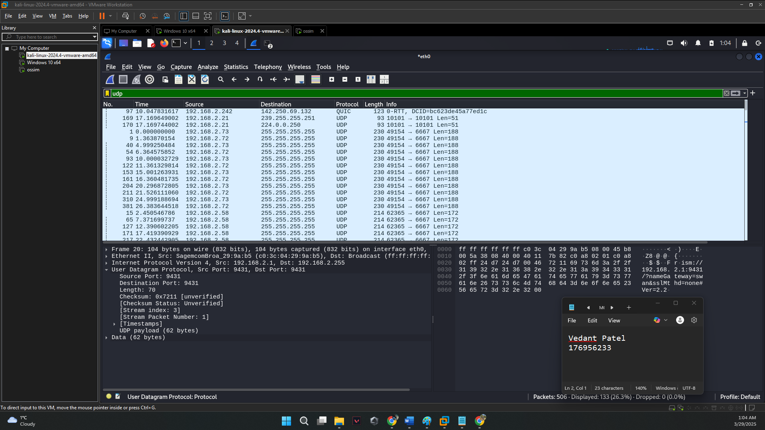
Wireshark Packets
Notes:
Here is the screenshot of wireshark packets caught

Slide 6
UDP Vulnerabilities
No connection handshake – stealthy
Firewalls/IDS often miss UDP scans
Service enumeration possible on open ports
Notes:
Script: "There are several reasons why UDP is a favorite target for attackers:
First, the lack of a handshake means scans can go undetected by traditional security tools like firewalls and intrusion detection systems.
Second, many legacy systems and devices still use outdated or insecure UDP services, making them easy to exploit.
And third, attackers can use this information for further attacks like DDoS amplification, or as entry points for lateral movement in the network."

Slide 7
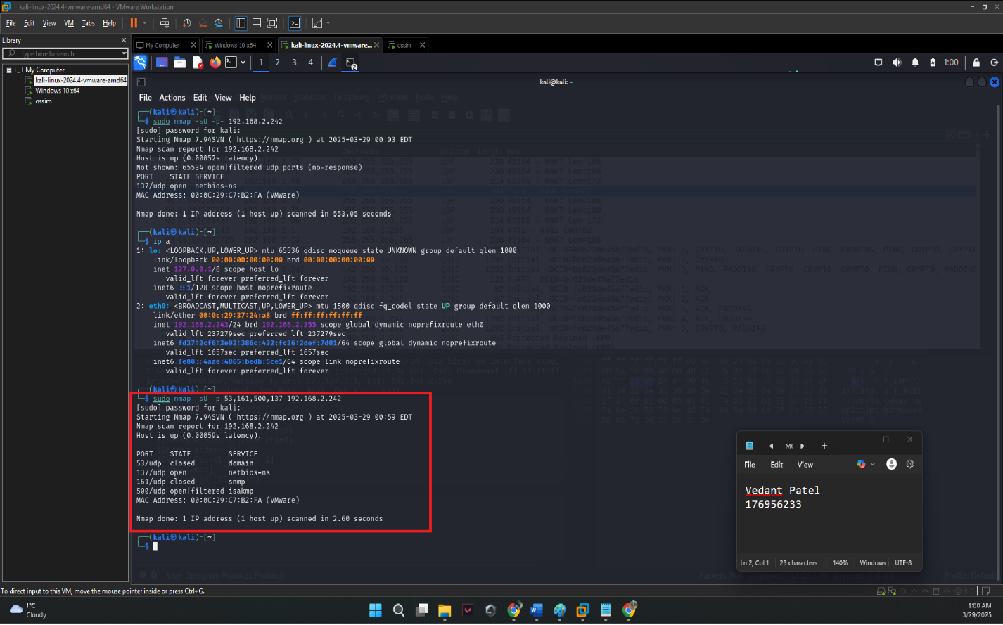
Vulnerability 1

Slide 8
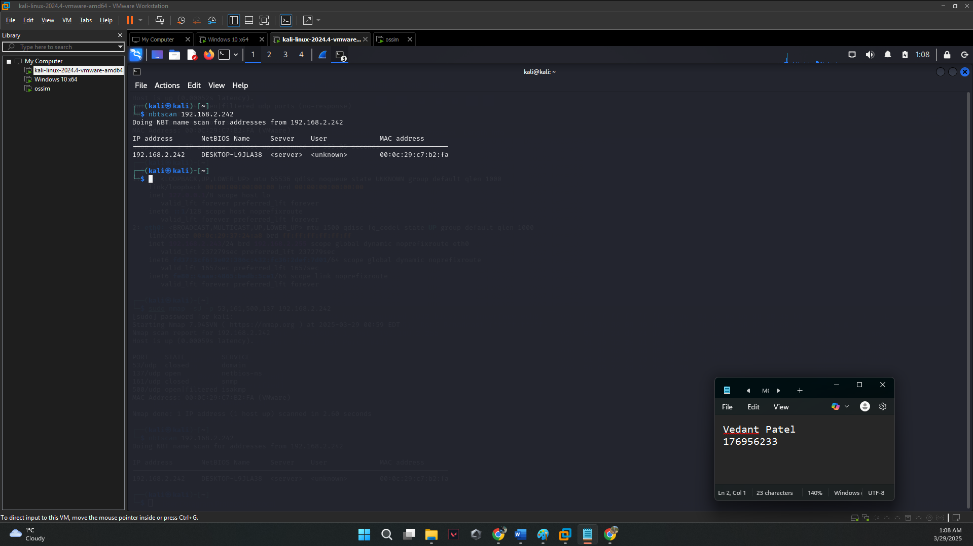
Vulnerability 2

Slide 9
UDP Exploitation
Command: sudo nmap -sU -p 53,161,500 192.168.2.242
Ports: DNS (53), SNMP (161), VPN/IKE (500)
Used nbtscan to reveal NetBIOS info
Notes:
"After identifying open UDP ports, I targeted a few specific ones with:
bash
CopyEdit
sudo nmap -sU -p 53,161,500 192.168.2.242
These ports correspond to DNS (53), SNMP (161), and IPSec VPN (500). If these services are exposed and unpatched, they can be used to extract sensitive info or launch further attacks.
I also used:
bash
CopyEdit
nbtscan 192.168.2.242
This helped me gather NetBIOS info like the hostname and workgroup — which can be useful for planning attacks on file shares or figuring out the network topology."

Slide 10
UDP Scan Mitigations
Disable
Disable unused UDP services
Use
Use stateful firewalls
Monitor/log
Monitor/log unusual UDP traffic
Notes:
"So how do we defend against this?
Disable unused UDP services — if you don’t need it, don’t run it.
Use a stateful firewall that can track UDP session behavior, even though it's harder than with TCP.
Most importantly, monitor UDP traffic continuously. Set up alerts for unusual spikes or patterns in your logs. Even if an attacker gets through once, catching them early is key."

Slide 11
SSH Brute Force Attack
Confirmed system is live: sudo nmap -sn 192.168.2.242
Verified SSH: sudo nmap -p 22 192.168.2.242
Notes:
"Next, I focused on a more direct form of attack — an SSH brute force attack on port 22. This is where an attacker tries hundreds or thousands of login combinations to find the right credentials.
I first made sure the target was live using:
bash
CopyEdit
sudo nmap -sn 192.168.2.242
Then, I checked that SSH was open using:
bash
CopyEdit
sudo nmap -p 22 192.168.2.242
Once confirmed, I moved on to the brute force phase."

Slide 12
Hydra Password Cracking
Command: hydra -L users.txt -P rockyou.txt ssh://192.168.2.242 -V
Uses username + password lists
Successful login found: administrator : password
Notes:
"To perform the actual brute force attack, I used a tool called Hydra — it's powerful and supports many protocols.
bash
CopyEdit
hydra -L users.txt -P rockyou.txt ssh://192.168.2.242 -V
This command used a list of usernames and the famous rockyou.txt password list to try different combinations rapidly.
Eventually, it found valid credentials: administrator : password. Yes — just ‘password’. This shows how risky weak passwords are — it took less than a minute to break in using commonly available tools."

Slide 13
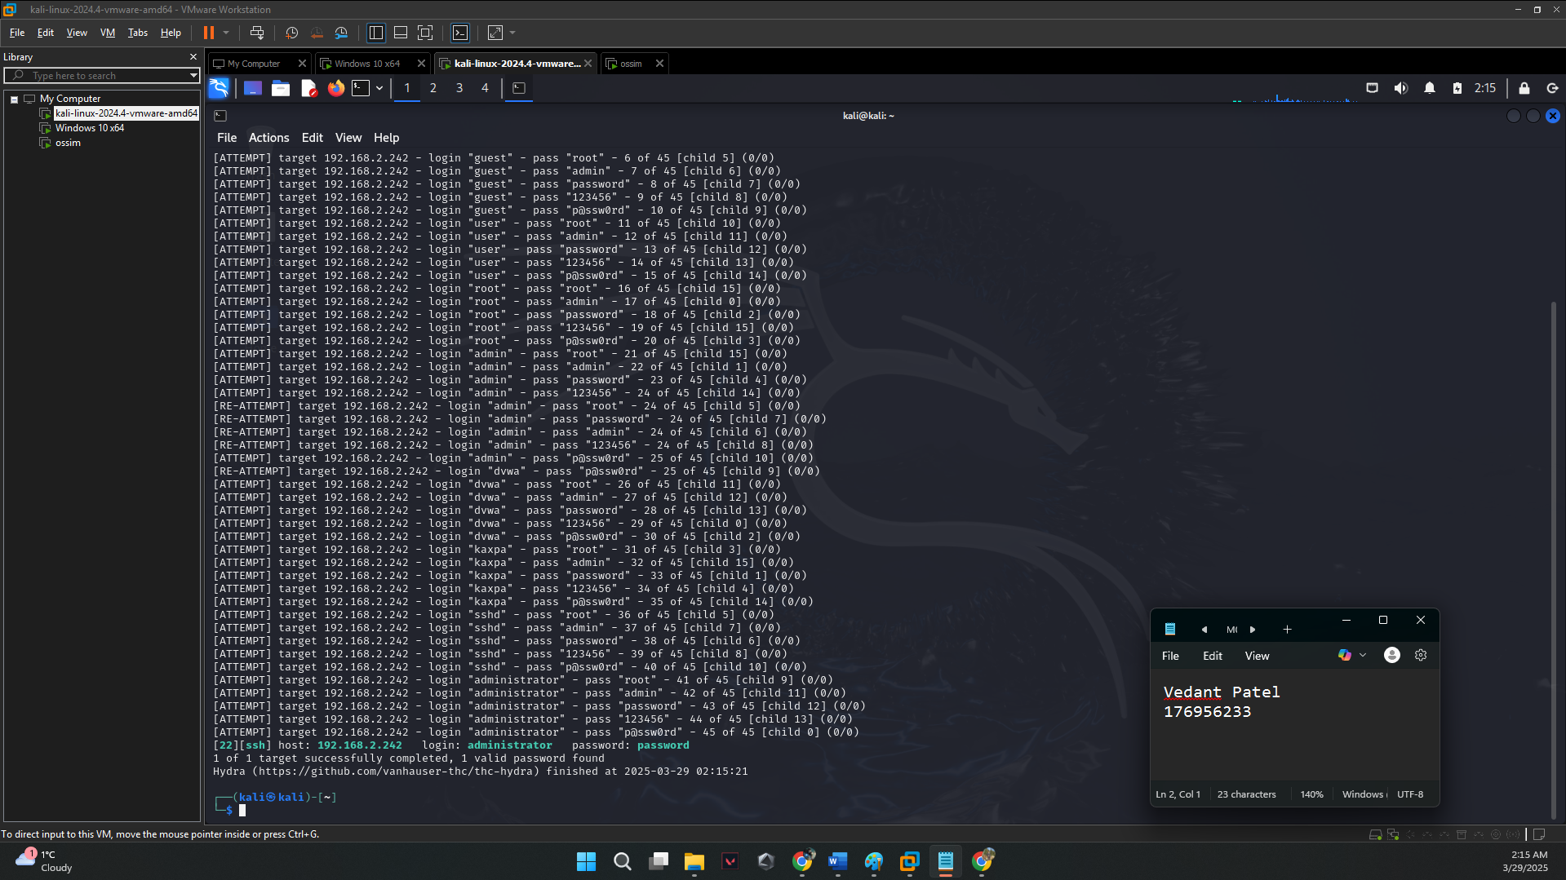
Password found

Slide 14
Brute Force Mitigations
Use strong, complex passwords
1
Enable account lockout
2
Use SSH keys or enable MFA
3
Notes:
Script: "To protect against this kind of attack:
Always use complex, unique passwords that aren’t found in public wordlists.
Enable account lockout after a few failed attempts to prevent continuous brute force attempts.
Turn on Multi-Factor Authentication (MFA) where possible.
And for added security, switch from password-based login to SSH key-based authentication, which is much harder to brute force."

Slide 15
Conclusion
UDP and SSH brute force are serious threats
Mitigation: proper configs, password policies, monitoring
Thank you!
Notes:
Script: "In summary, both UDP Port Scanning and SSH Brute Force Attacks highlight different types of weaknesses — one at the network service level, and the other at the authentication level.
UDP scans may fly under the radar but can reveal critical open ports.
SSH brute force attacks are loud and obvious, but they still succeed if systems use weak credentials.
Ultimately, prevention is better than detection. That means hardening your systems, monitoring your network, and following best practices like MFA and least-privilege access.
Thank you all for listening, and stay safe out there in the cyber world!

