Slide 1
Developing Desktop Applications with Electron
©2019 - A gitfetchvictor production…

Slide 2


Victor J. Pudelski
V. P. of Solutions @ TSC, LLC
Founder/Developer @ Next Link Software, LLC
Developer ~20 yrs
Worked mostly in ECM (boring stuff)
First saw Electron @ CodeMash ~2016
Written production code in Electron (written a lot more not in prod)

Slide 3
Agenda
What is Electron?
Creating an Application
Features
Packaging | Code Signing | Updating

Slide 4
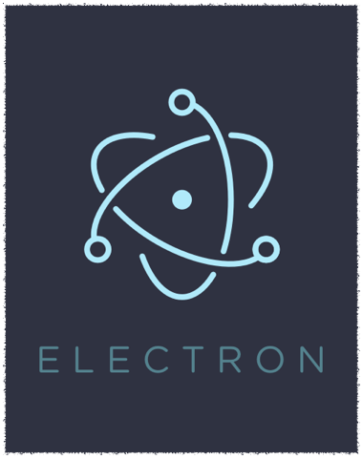
Electron
formerly Atom Shell
initial release 7/2015
dev started 2013
think NodeJS but on Desktop
Takes advantage of Chromium Browser

Slide 5
Chromium?!?
You mean Chrome, right?
Yes, kinda.. Chrome but open source
Chrome is web, web is HTML/CSS/JS
I can develop desktop applications in HTML/CSS/JS?!?

Slide 7
Others think so too…

Slide 8
But Why is this awesome?
Skills are needed for other types of apps and they are so many resources
You decide how fancy you want to be… Angular, React, etc…
CROSS-PLATFORM!!! -> Linux, Mac, Windows

Slide 9
How Do I Get Started?…
Setup Development Environment
Pick your favorite editor
CODE!!!

Slide 10
Development Environment
Install Nodejs
https://nodejs.org/en/download/
verify the install
npm -v
node -v

Slide 11
Code Editors
Atom
Visual Studio Code
Visual Studio
Brackets
Insert your favorite editor here…

Slide 12
Visual Studio Code
Terminal Window is in the editor
It’s free
I get a kick out of using Microsoft product to code on other platforms

Slide 13
Oh and the Best Part…
These Steps Apply to All Platforms…
Linux, Mac, Windows

Slide 14
Let’s Code!
Hello World, Electron sytle…

Slide 15
We Have An Application!
Are you creating SPA or Multipage app?
What Frameworks are you going to use?
What packages will be used?
How to deploy the application?
How to update the application?

Slide 16
Simplified Dev Cycle
Design it… Develop it… Deploy it… Update Apps in Field…

Slide 17
Live Reloads
instead of always stopping and starting
npm install --save-dev electron-reload
reloads browser as updates occur
Note: When deploying app comment out live reload code

Slide 18
Debug via Console
Console.log will work in Electron
Main process goes to terminal running application
renderer process goes to browser window console

Slide 19
I like the DevTools, I want the DevTools, I just don’t want them displayed by default?

Slide 20
Hiding DevTools
KeyBoard Shortcuts…
modify main.js and put some listeners for certain events…
Let’s make DevTools CmdOrCtrl+D

Slide 21
// Open the DevTools.
globalShortcut.register('CmdOrCtrl+D', () => {
win.webContents.openDevTools()
})
registering the key
event handler when key pressed

Slide 22
Let’s talk Deployment
npm install --save-dev electron-builder
modify package.json
voila! dmg and .app created!

Slide 23
Code Signing
Windows - Certificate Authority
Mac - Apple Developer Program
KeyChain Access
Use Self-Signed Certificate for Development

Slide 24
Publishing
GitHub, Amazon, WebSite, …
Idea is making releases available for updating

Slide 25
Auto Update
App can check for updates
You can determine when to check for updates
At Startup -> App.ready
Menu Option
Continuously on some interval

Slide 26
Updating
Normal Development lifecycle
When Ready Publish to location being checked
Voila! If coded right, user will be prompted or automatically updated

Slide 27
Quick Review
What is Electron?
Creating an Application
Live Reload
Keyboard Shortcuts
Packaging | Code Signing | Updating

Slide 28
Packages Used
electron
electron-builder
electron-reload
electron-log
electron-updater

Slide 29
Helpful Links
https://nodejs.org/
https://electronjs.org/
https://code.visualstudio.com/
https://docs.npmjs.com/files/package-lock.json

Slide 30
THANK YOU!
QUESTIONS?
Victor J. Pudelski
vpudelski@nextlinksoftware.com
@vjpudelski on twitter
www.gitfetchvictor.com

