Slide 1



AWS Gen AI Bootcamp-July 2024
Final Project Presentation
Team Name: AWSome Champs
Project Title: Using Amazon Bedrock & Rekognition - Unleashing the Power of Image Comprehension
Team members: Vijayaraghavan Vashudevan, Abinaya Devi SV, Sumbul Naqvi, Sunil Kumar

Slide 2
Table of content
Problem Statement
Architecture Diagram
Real-time use cases
Comparison with real-time benefits
References
AWS Gen AI Bootcamp- AWS UG Dehradun

Slide 3
Problem Statement
To extract labels/concepts from real-life images using Amazon Rekognition, then leveraging Amazon Bedrock large language models(LLMs) to convert those labels into descriptive captions or paragraphs and Amazon Polly to convert them into audio.
AWS Gen AI Bootcamp- AWS UG Dehradun

Slide 4
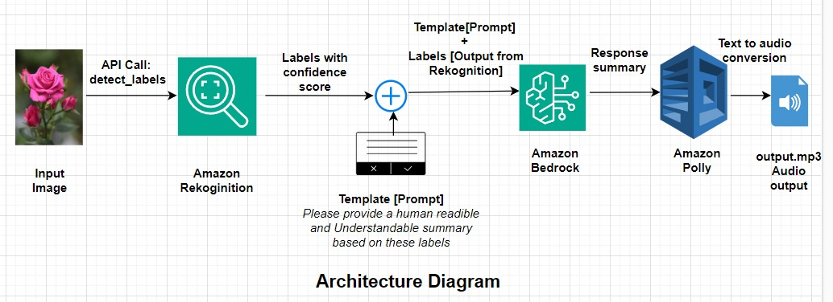
Architecture Diagram
AWS Gen AI Bootcamp- AWS UG Dehradun

Slide 5
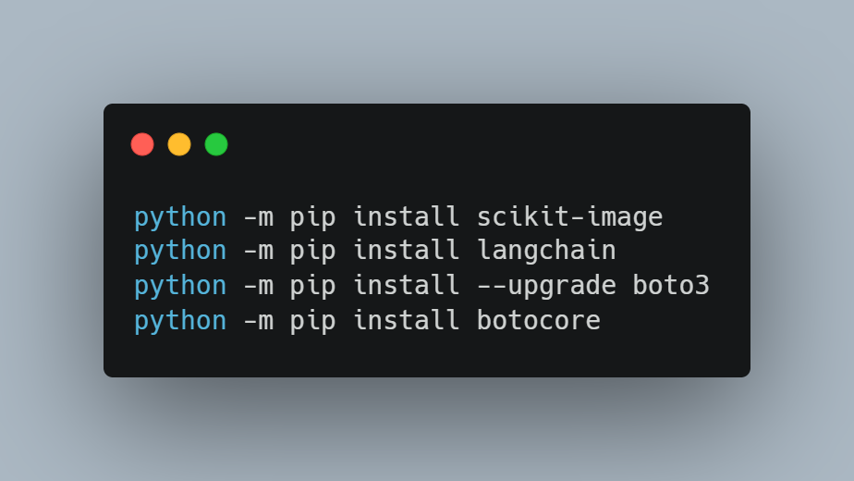
Code Walkthrough
Pre-requisite libraries required:
AWS Gen AI Bootcamp- AWS UG Dehradun

Slide 6
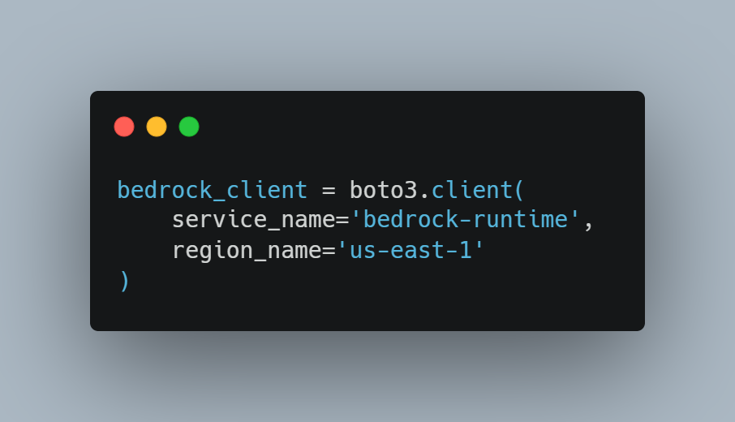
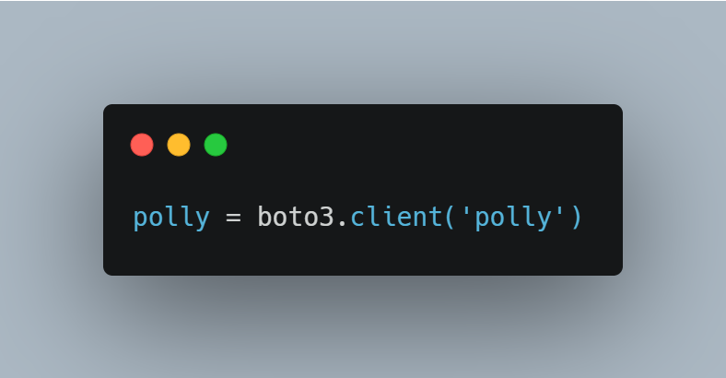
Initialization of Amazon Bedrock and Amazon Polly services:
Amazon Bedrock:
Amazon Polly:
AWS Gen AI Bootcamp- AWS UG Dehradun

Slide 7
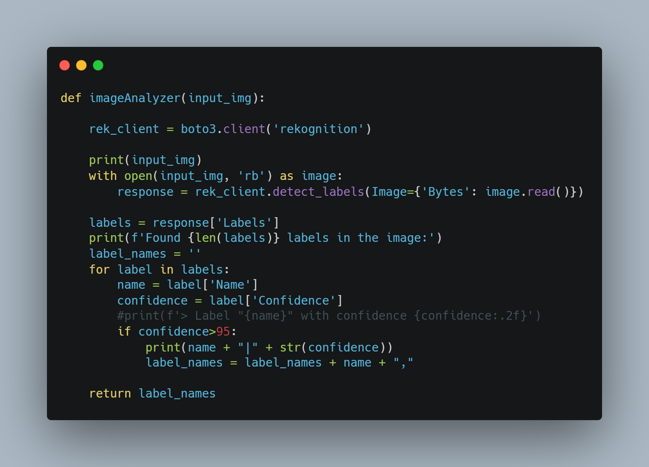
Image Analyzer in Amazon Rekognition:
AWS Gen AI Bootcamp- AWS UG Dehradun

Slide 8
Image Analyzer in Amazon Rekognition:
AWS Gen AI Bootcamp- AWS UG Dehradun

Slide 9
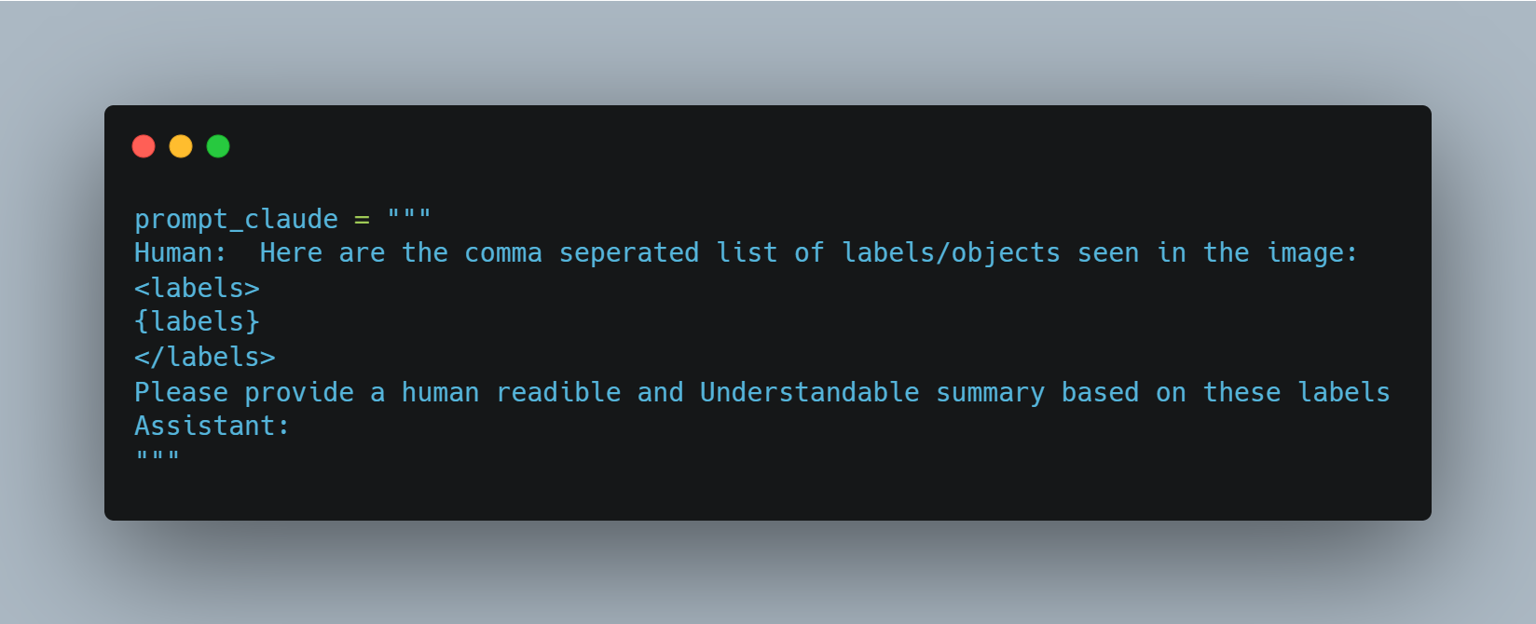
Invoking the generative models using prompt template:
Prompt Template:
AWS Gen AI Bootcamp- AWS UG Dehradun

Slide 10
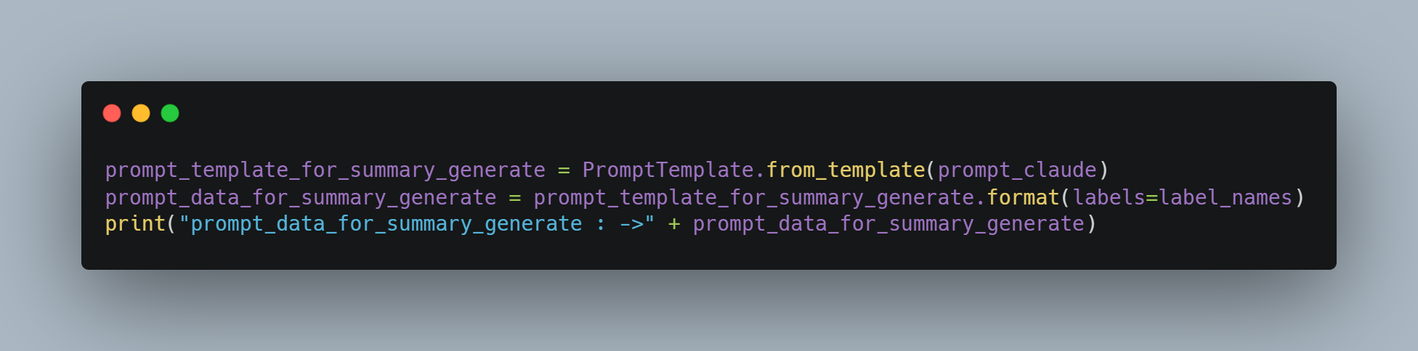
Invoking the generative models using prompt template:
AWS Gen AI Bootcamp- AWS UG Dehradun

Slide 11
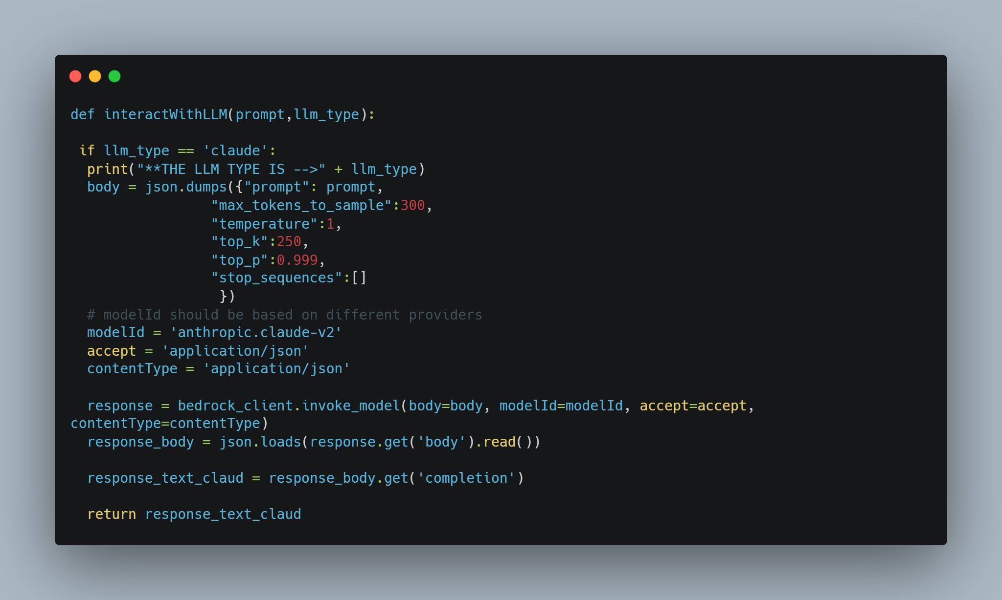
Invoking the LLM based on user prompt and LLM Model type:
AWS Gen AI Bootcamp- AWS UG Dehradun

Slide 12
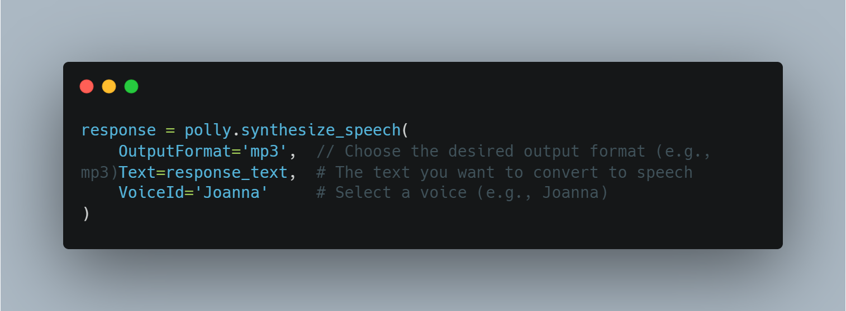
Use the Amazon Polly to convert generated response to speech:
AWS Gen AI Bootcamp- AWS UG Dehradun

Slide 13
Real-time use cases
Image captioning
Scene summarization
Metadata generation
Search improvement

Slide 14
Comparison with real-time benefits

Slide 15
Thank You !

